Slide 1
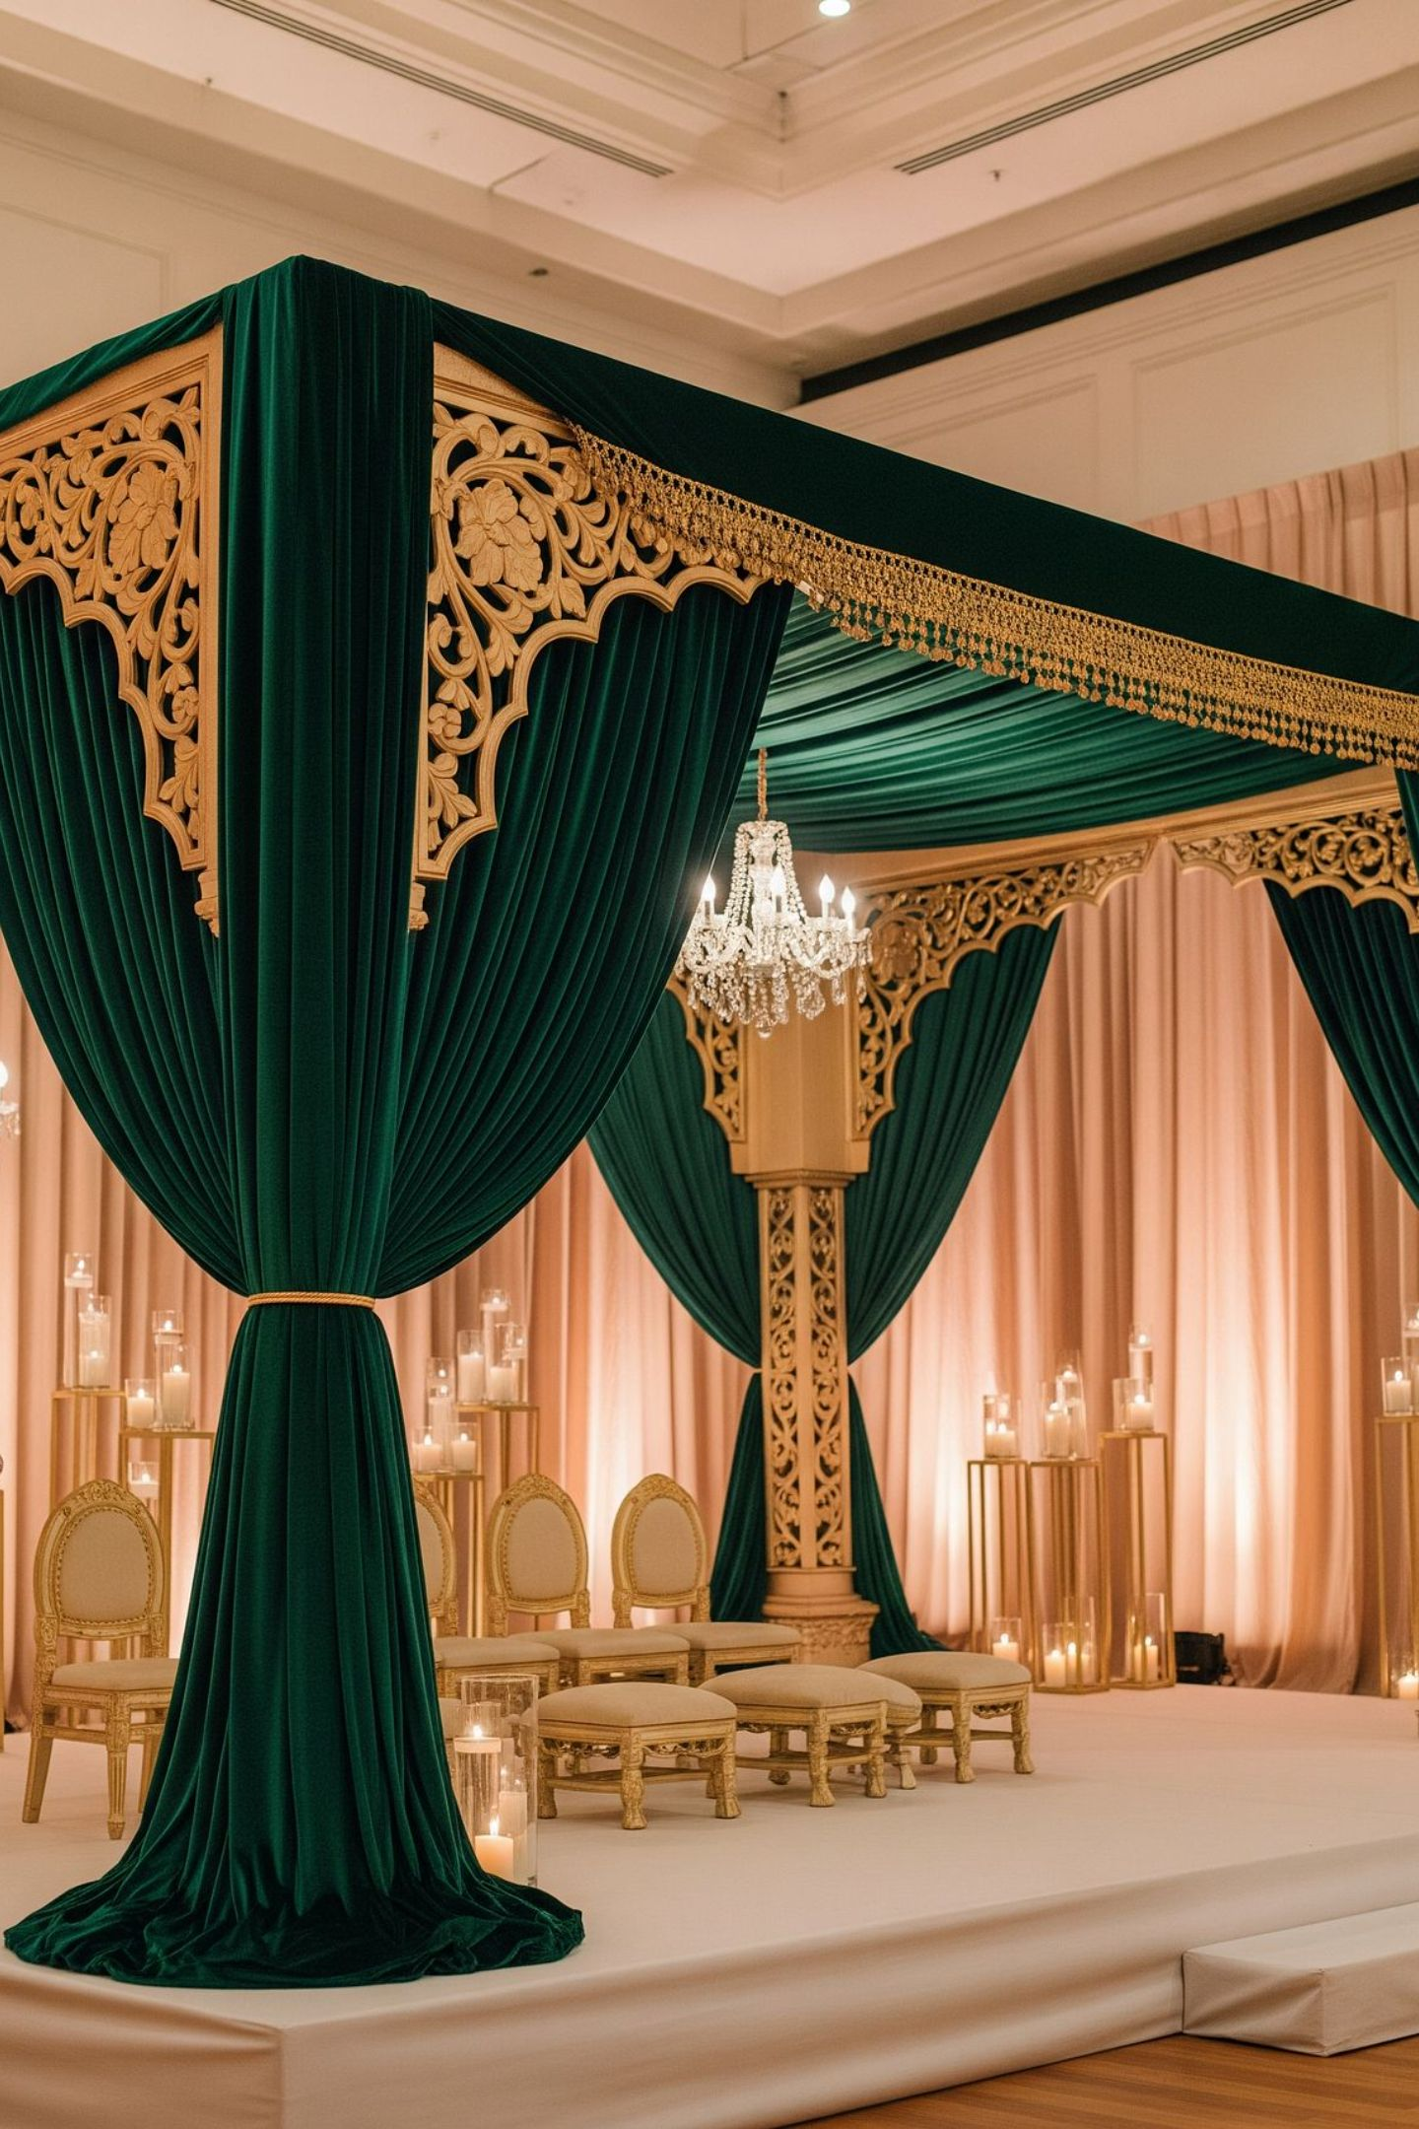
J.VARDHAN LUXE EVENTS
Wedding & Celebration Experience Profile
Floral Styling | Mandaps | Lighting | Event Production
Working brand only. Legacy connection: Mali Mukesh Wedding Planning & Decoration.

Slide 2
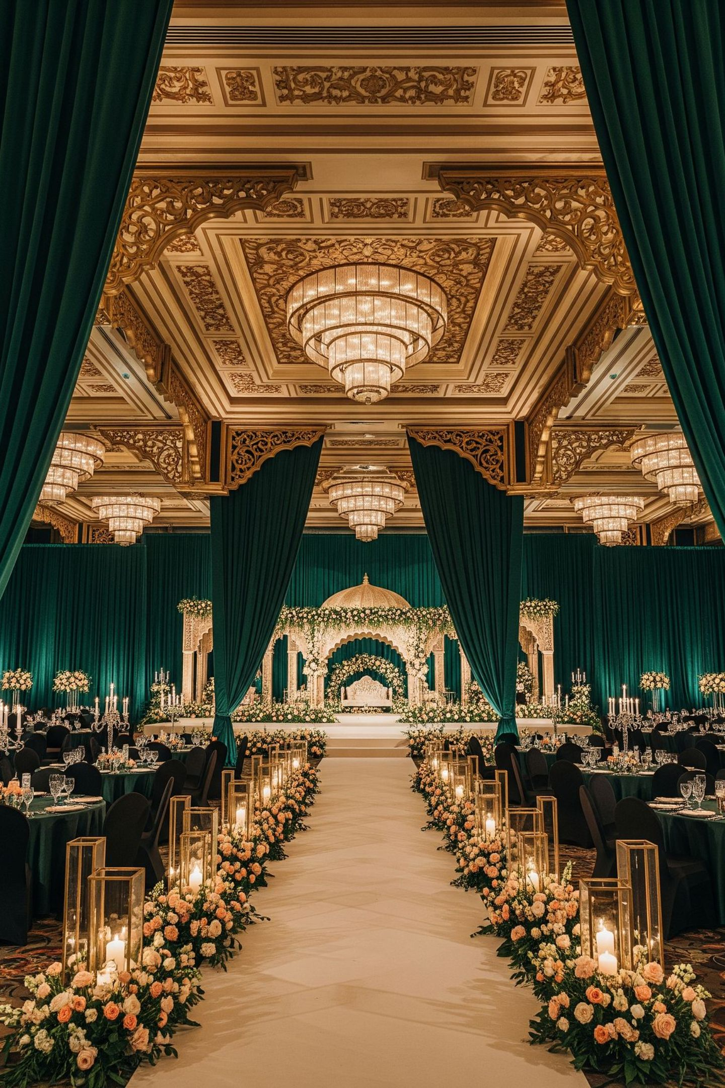
A celebration should feel designed, not assembled.
Families do not want scattered vendors and last-minute improvisation.
They want a clear creative direction, a calm planning process, and a venue that feels transformed without losing control.
This deck introduces the J.Vardhan experience for couples, families, and serious celebration enquiries.
2

Slide 3
The feeling we design for
Warm Arrival
Calm Ritual Flow
A welcome that sets the tone from the first step.
Ceremony spaces that move families with ease and intention.
Fresh Floral Presence
Elegant Mandap Focus
Blooms that feel alive, not overdressed.
The ceremony stage as the visual heart of the day.
Cinematic Evening Light
Beautiful Guest Spaces
Lighting that feels intentional, not loud.
Spaces that photograph naturally and move guests with grace.
3

Slide 4
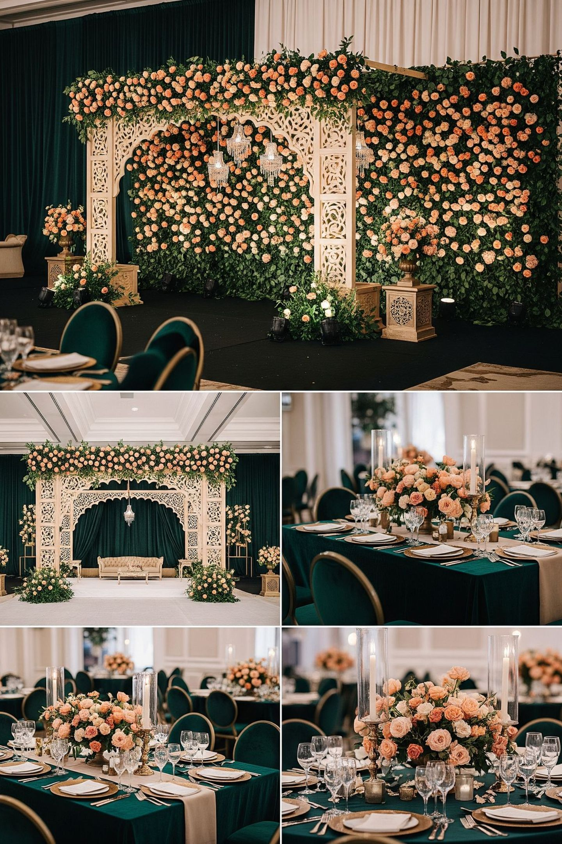

What we help plan
Mandaps & Ceremony Stages
Floral Styling
Walls, garlands, pathways, centerpieces and table styling.
Designed around sightlines, rituals, and photography.
Lighting & Stage Backdrops
Entrance Gates & Welcome Moments
Lighting, stage backdrops and guest-flow details.
First impressions that guide and delight.
Venue-Specific Decor Planning
All Celebration Functions
Haldi, mehendi, garba, sangeet, reception and family events.
Every plan is built around the property, not against it.
4

Slide 5
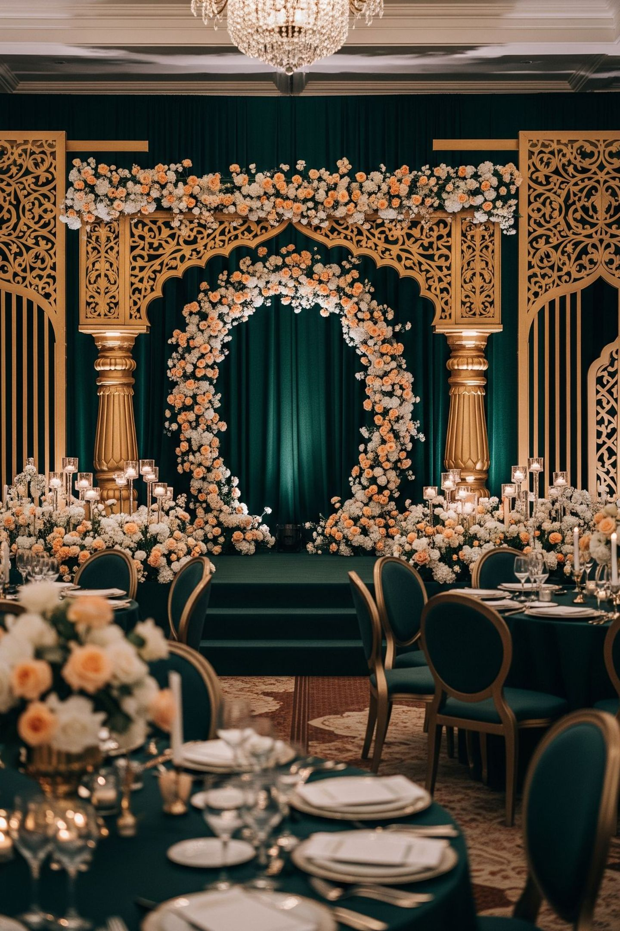
DECOR WORLD 1
Emerald Royal
The Palette
Best suited for
Deep green grounds
Gold architectural accents
Marigold, mogra and ivory floral moments
Evening receptions, premium hotel venues and formal family gatherings.
Emerald Royal is the signature direction — commanding, warm, and unmistakably considered. It rewards large venues and evening light.
5

Slide 6
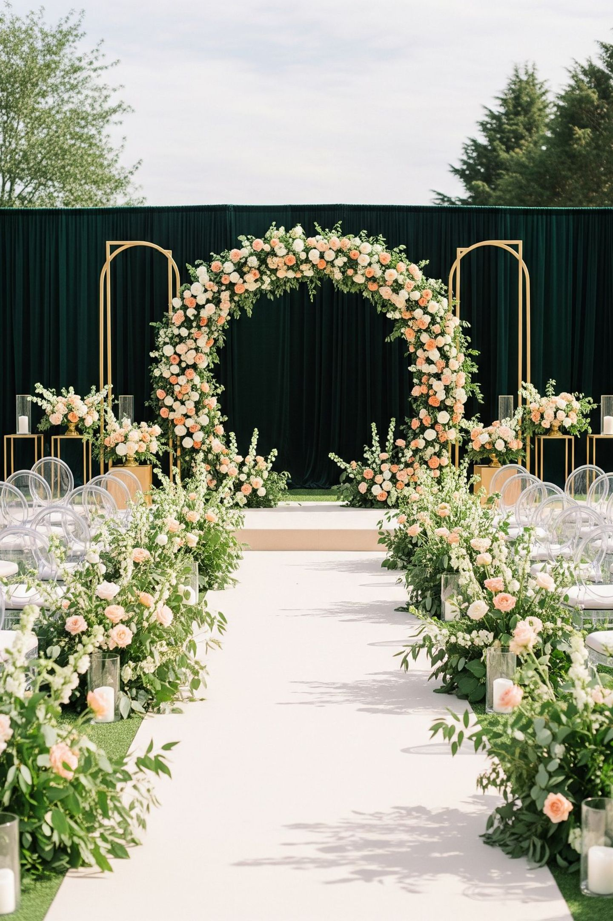
DECOR WORLD 2
Garden Ivory
The Palette
Best suited for
Ivory florals
Fresh greens
Soft gold rules
Daylight pheras, haldi, garden pathways, farmhouse weddings and understated luxury.
Garden Ivory breathes. It is the direction for families who want beauty that feels effortless and natural in open, sunlit spaces.
6

Slide 7
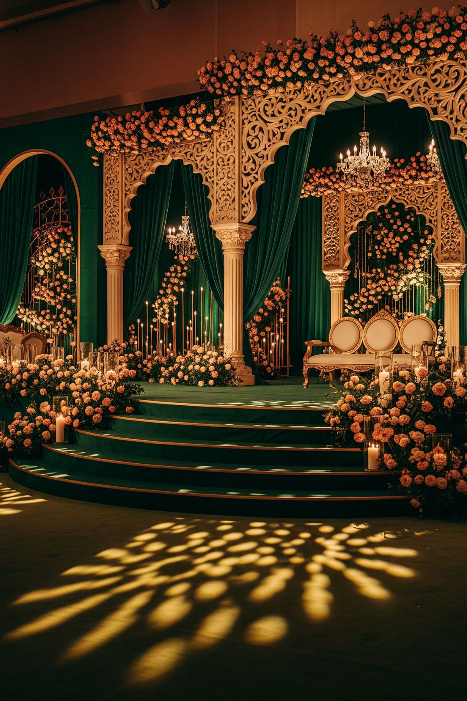
DECOR WORLD 3
Dusk Gold
The Palette
Best suited for
Deep emerald shadows
Warm gold lighting
Layered florals and calm stage focus
Receptions, sangeet evenings and high-impact guest arrival moments.
Dusk Gold is the direction for evenings that should feel cinematic. The room deepens, the stage glows, and every photograph carries weight.
7

Slide 8
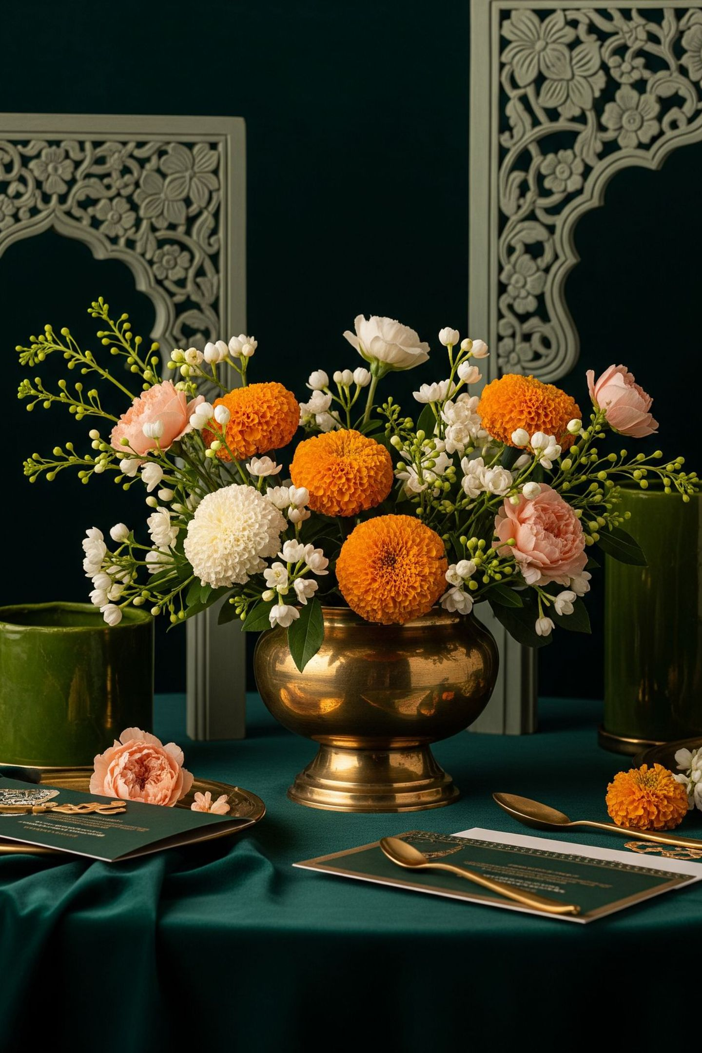

The flower story
[VERIFY: direct farm access or flower farm ownership] [VERIFY: flower varieties and seasonality] [VERIFY: storage, freshness, sourcing, and backup suppliers]
Safe public wording until proof is supplied:
Floral planning is treated as a core design layer, not an afterthought.
Every function has a floral brief. Blooms are chosen for the light, the palette, the ritual, and the photography. Freshness and placement are planned, not improvised.
8

Slide 9
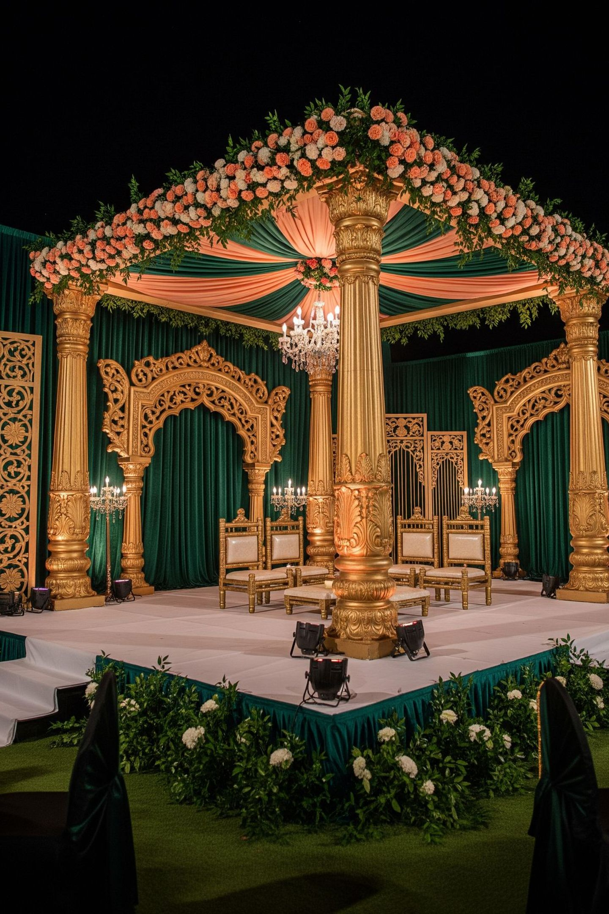

The mandap as the heart
The mandap sets the visual memory of the ceremony.
We design around sightlines, family movement, rituals, photography angles and venue restrictions.
The goal is not decoration everywhere. The goal is focus where it matters.
A mandap that commands the room does not need to compete with everything around it. Restraint is the luxury.
Sightlines
Every seat should have a clear view of the ceremony.
Family Movement
Ritual flow is mapped before setup begins.
Photography Angles
The stage is lit and framed for the camera.
9

Slide 10
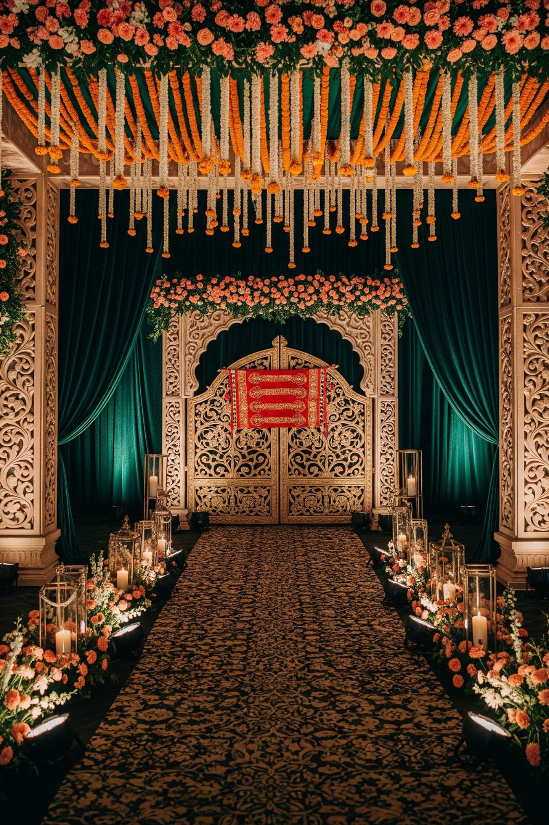




Entrances and pathways
The first guest impression starts before the stage.
Arrival gates, toran-style details, floral pathways, directional moments and lighting cues should all feel connected.
Arrival Gates
Framed, floral, and scaled to the venue entry.
Toran & Floral Details
Traditional welcome moments with a considered hand.
Lighting Cues
Directional light that guides guests naturally.
Photography-Ready
The entrance should welcome, guide and photograph well.
10

Slide 11
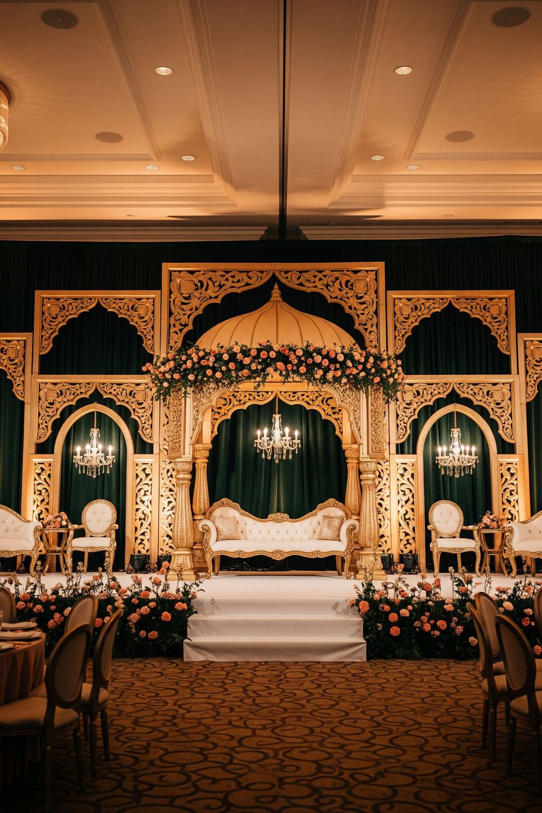
Reception and lighting
Evening decor needs discipline.
Lighting should shape the room, protect skin tones, support photography and make the stage feel intentional.
The reception stage is the final visual statement of the celebration. It should feel earned — a room that has been shaped by intention, not filled by volume.
Lighting is not a technical afterthought. It is the last layer of the design.
Gold should glow.
Emerald should deepen.
Nothing harsh. Nothing random. Nothing overfilled.
11

Slide 12
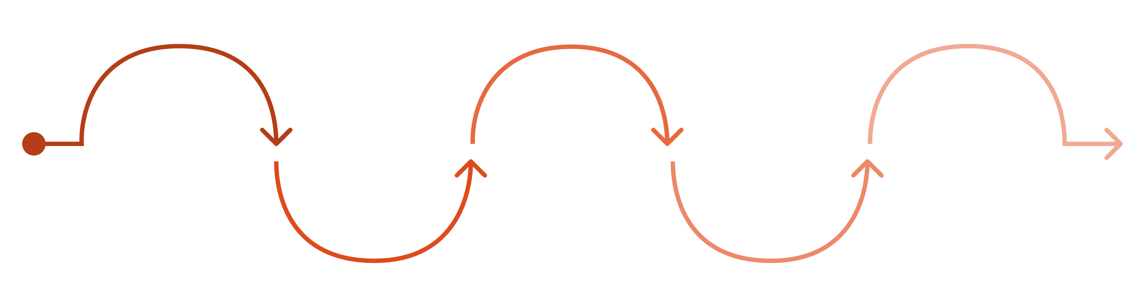
The planning path
Understand
Define
Create
Align
Review
Family, venue, rituals, dates
Decor world, priority spaces, budget
Visual references and site scope
Load-in, setup, approvals, permissions
Post-event debrief and learnings
Each step is designed to reduce uncertainty and give the family a clear view of what is being built, when, and why. The planning path is the product.
12

Slide 13
What the family gets
01
02
One clear decor direction
One planning contact
A single creative brief that guides every decision.
No handoffs, no confusion, no chasing multiple vendors.
03
04
One scope document
One setup timeline
Everything agreed, written, and referenced.
Load-in, approvals, and execution mapped in advance.
05
06
One venue-sensitive execution plan
One calmer path to the celebration day
Built around the property, not imposed upon it.
The family arrives as guests, not coordinators.
13

Slide 14
Venue-sensitive execution
Beautiful decor only works when it respects the property.
Site rules, entry routes, setup windows, surface protection, power access and guest movement must be planned before the event week.
This is especially important for resorts, hotels, banquet halls, farmhouses and party plots.
Site Rules
Entry Routes
Understood and respected before a single item is loaded in.
Mapped for efficient, damage-free setup.
Setup Windows
Surface Protection
Timed to the venue's schedule, not ours.
Every floor, wall, and fixture treated with care.
Power Access
Guest Movement
Load requirements confirmed and approved in advance.
Flow planned so decor never obstructs the experience.
14

Slide 15
Portfolio proof
[VERIFIED COPY HERE: event type, role, scope, location permission status]
[VERIFIED COPY HERE: client or venue name only if permission is confirmed]
Use only approved and verified event images.
No celebrity, private-family or venue claim should be published without permission.
Every image in this portfolio has been cleared for use. Every claim is one we can stand behind.
15

Slide 16
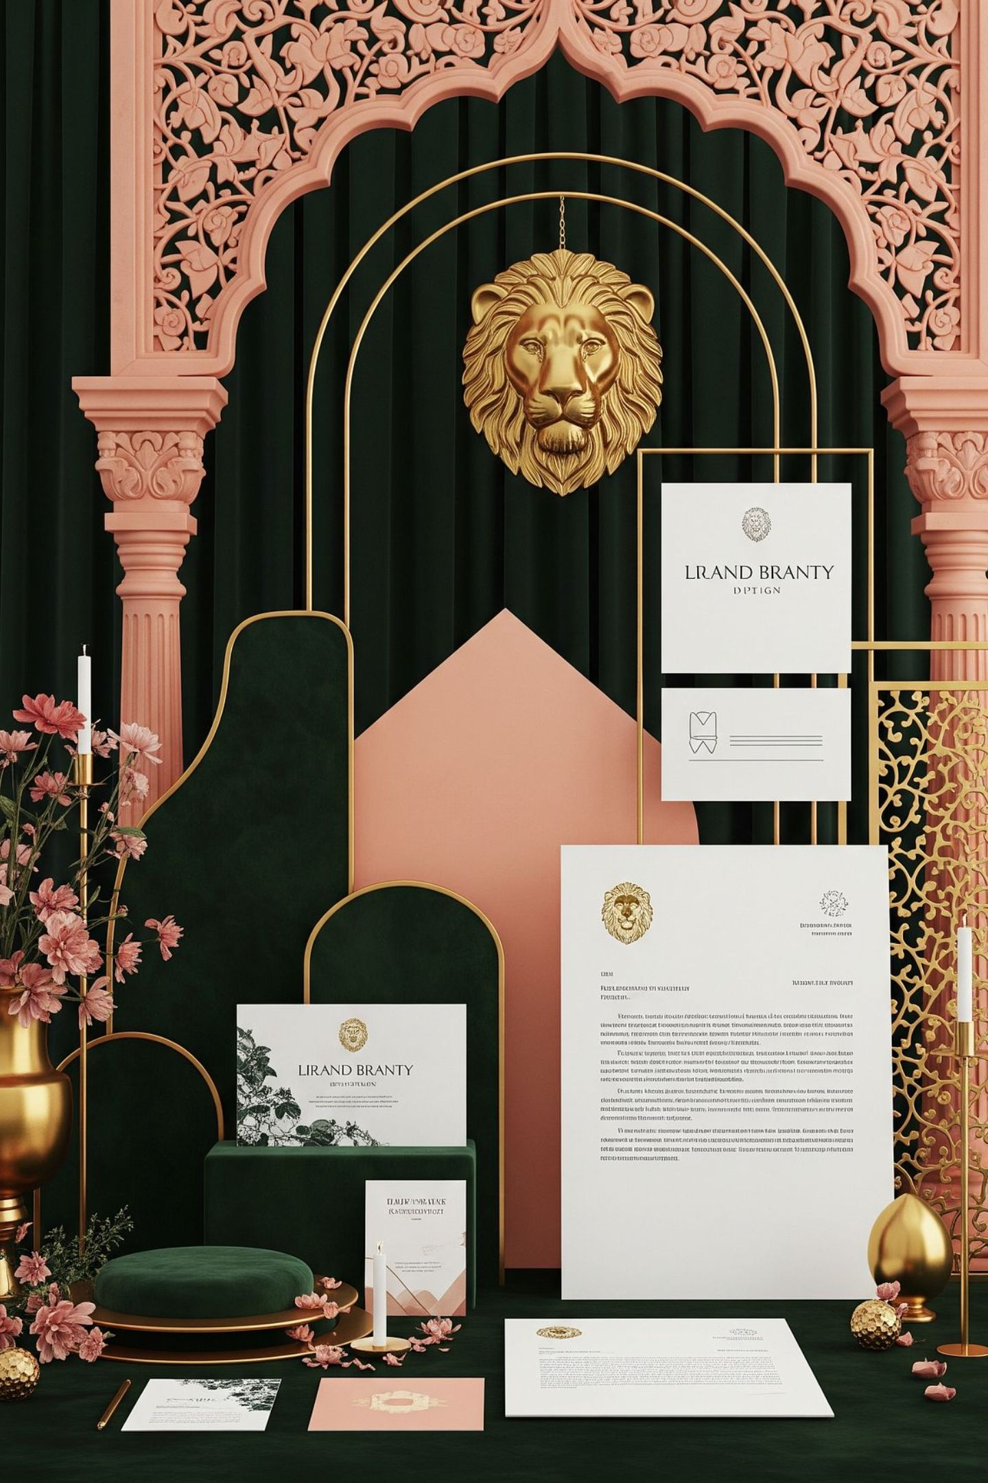
Brand identity
Use the uploaded logo sample board image if provided.
The Lion Mark
What comes next
The lion mark is still a concept system. It carries the right feeling — quiet authority, natural confidence, considered craft.
Final logo needs vector redraw
Trademark check
Small-size tests
Signage tests
Embroidery tests
The identity should work at every scale — from a digital deck to a brass nameplate at a venue entrance.
16

Slide 17






What we need from you
Event Dates
Venue
All functions and the primary ceremony date.
Confirmed or shortlisted venues.
Priority Functions
Family Customs
Which events matter most to the family.
Ritual needs and cultural considerations.
Photo & Video Permissions
Decision-Maker
What may be shared and what must remain private.
The single point of contact for approvals.
17

Slide 18
Begin with a decor consultation
Share your venue and event dates.
Choose the first priority function.
We will return with a celebration-specific visual direction and execution plan.
Step 1
Step 2
Step 3
Share your venue and event dates with us.
Choose the first priority function to focus on.
Receive a celebration-specific visual direction and execution plan.
Contact: [PHONE / WHATSAPP / EMAIL HERE]
18

Slide 19
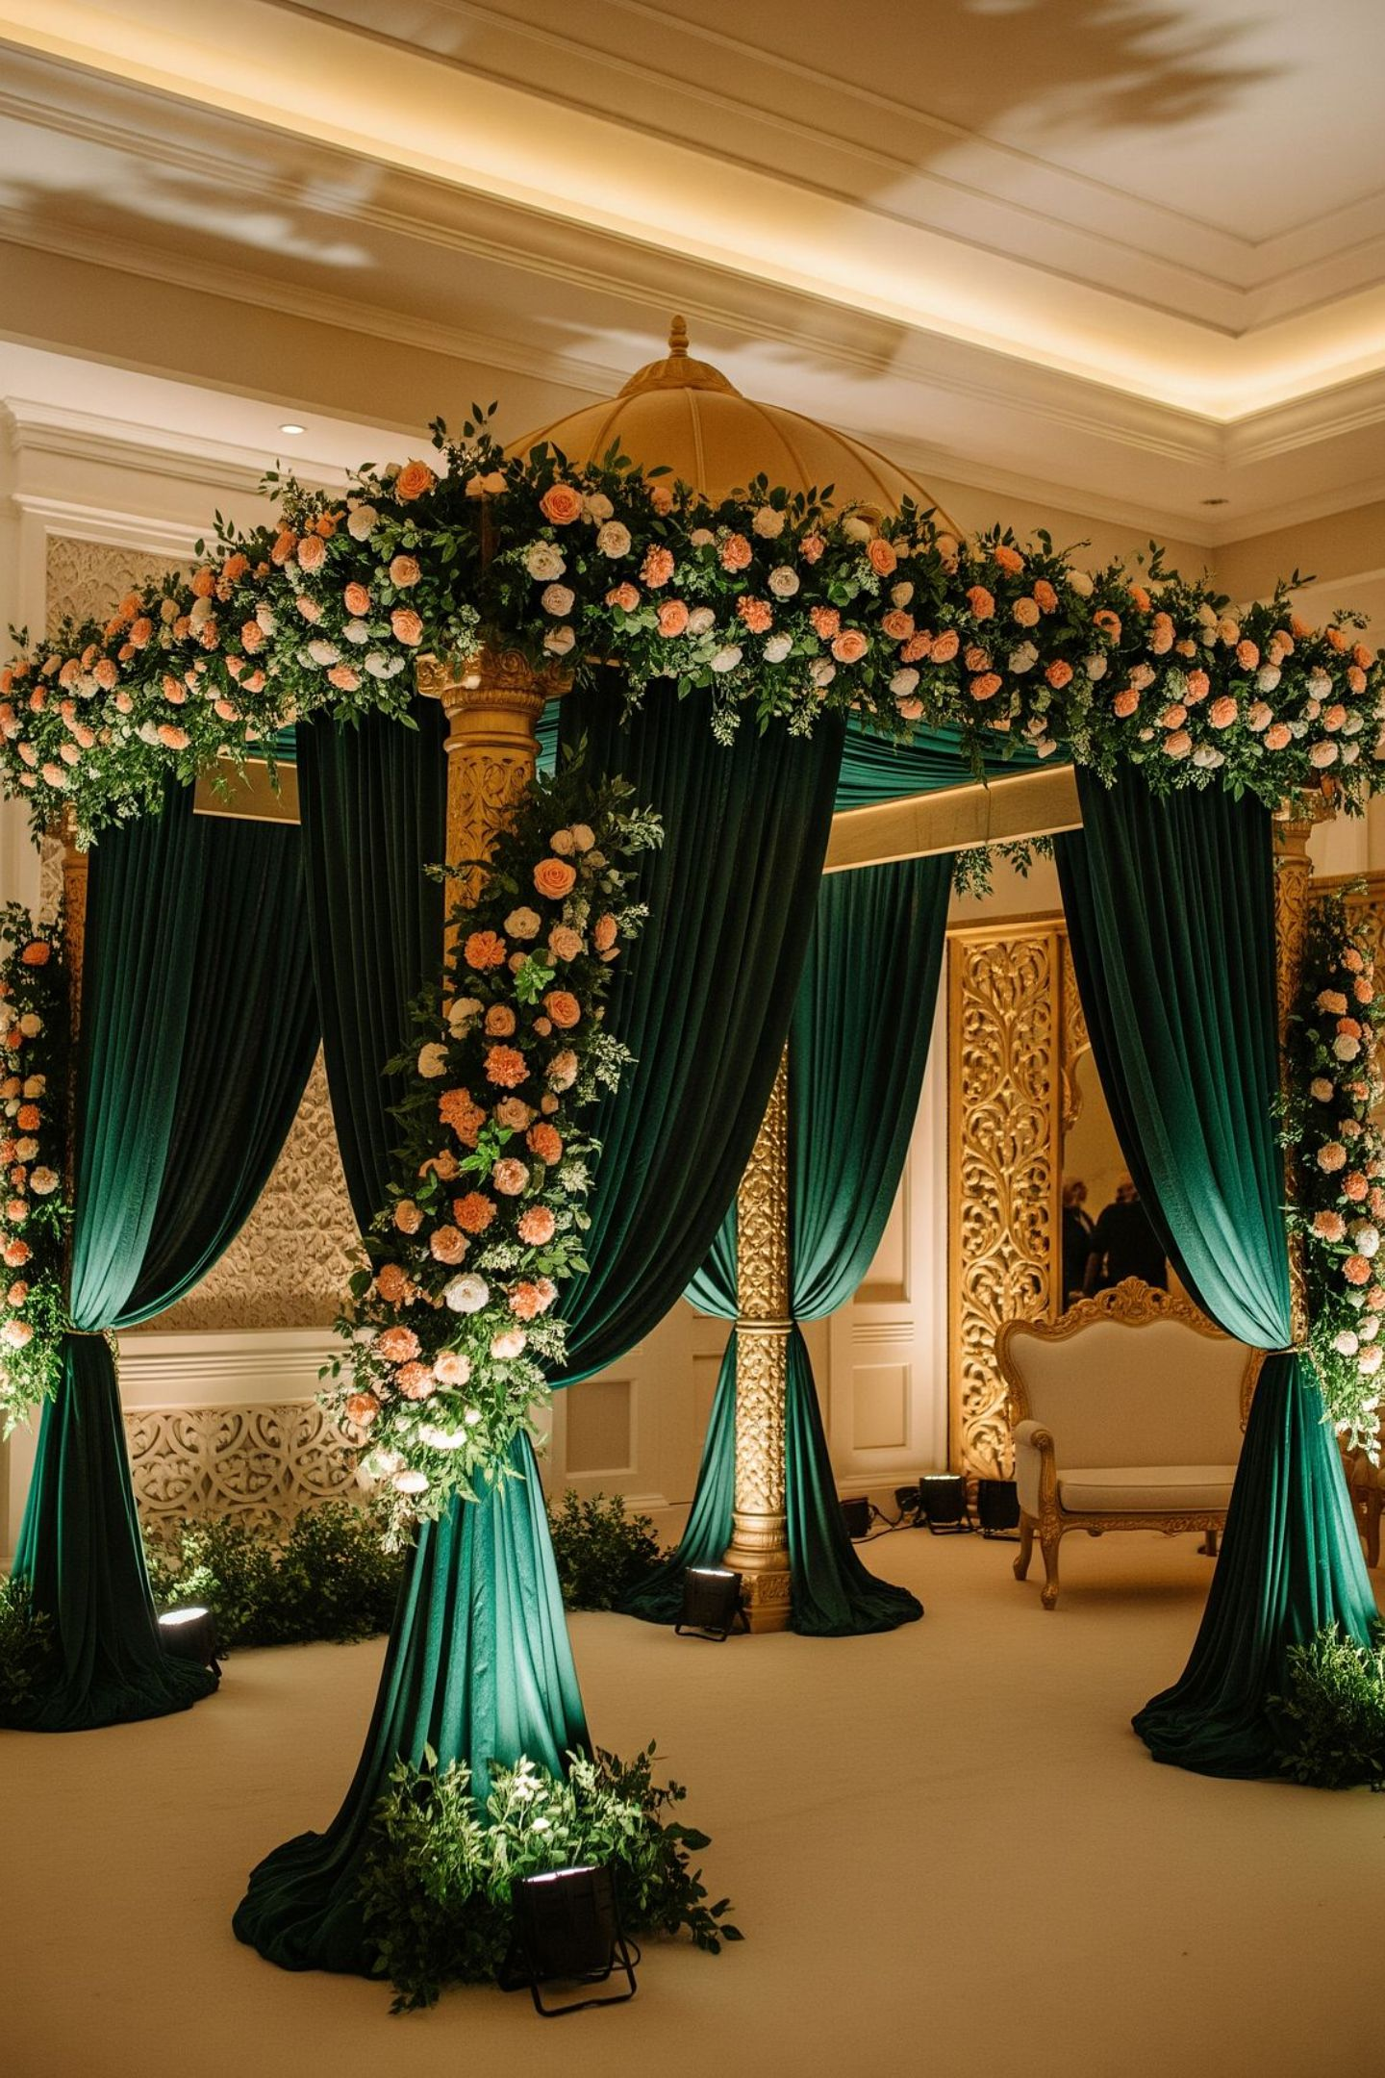
J.VARDHAN LUXE EVENTS
Celebrations built with calm, craft and visual memory.
[PHONE / WHATSAPP / EMAIL HERE]
19

