Slide 1
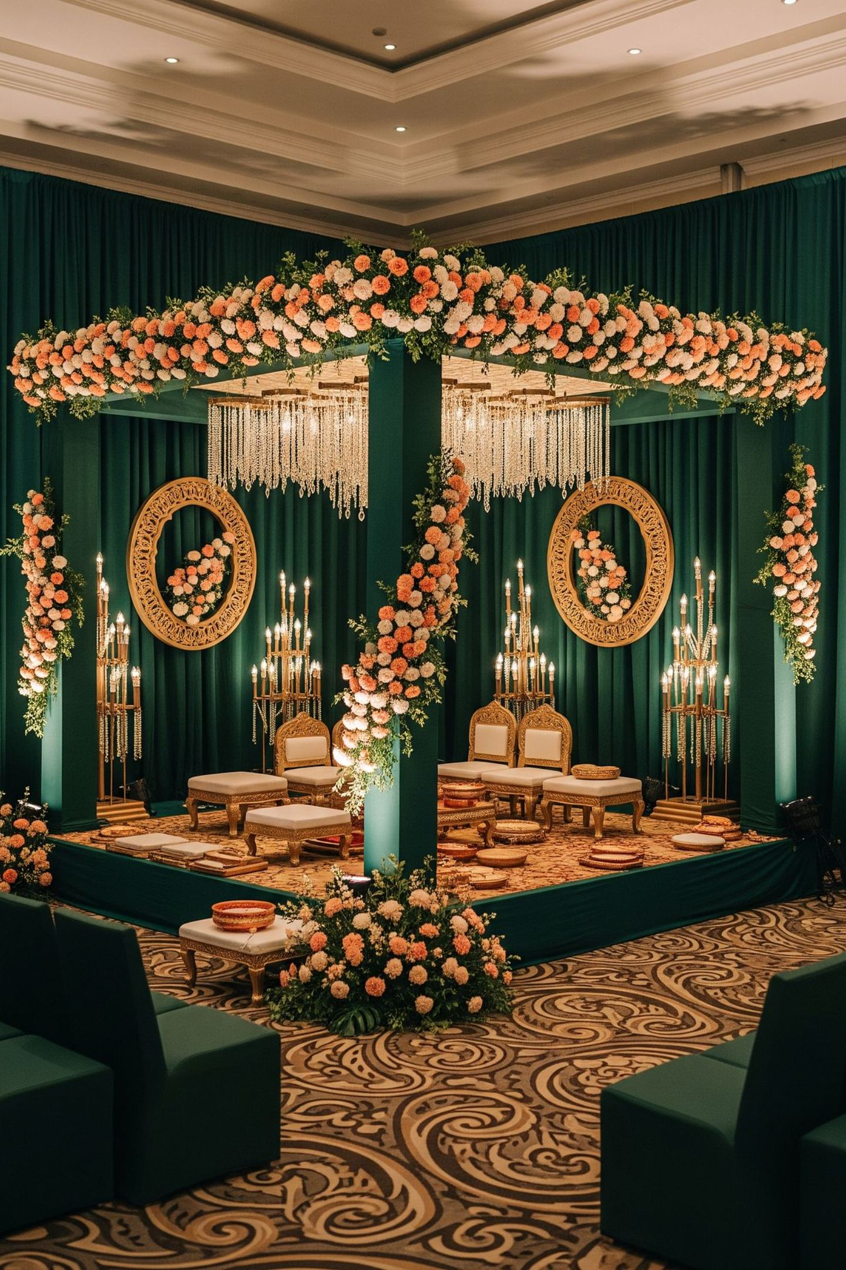
J.VARDHAN LUXE EVENTS
VENUE PARTNERSHIP PROFILE
Wedding Design · Floral Styling · Mandap & Event Production
Promised. Planned. Delivered.

Slide 2
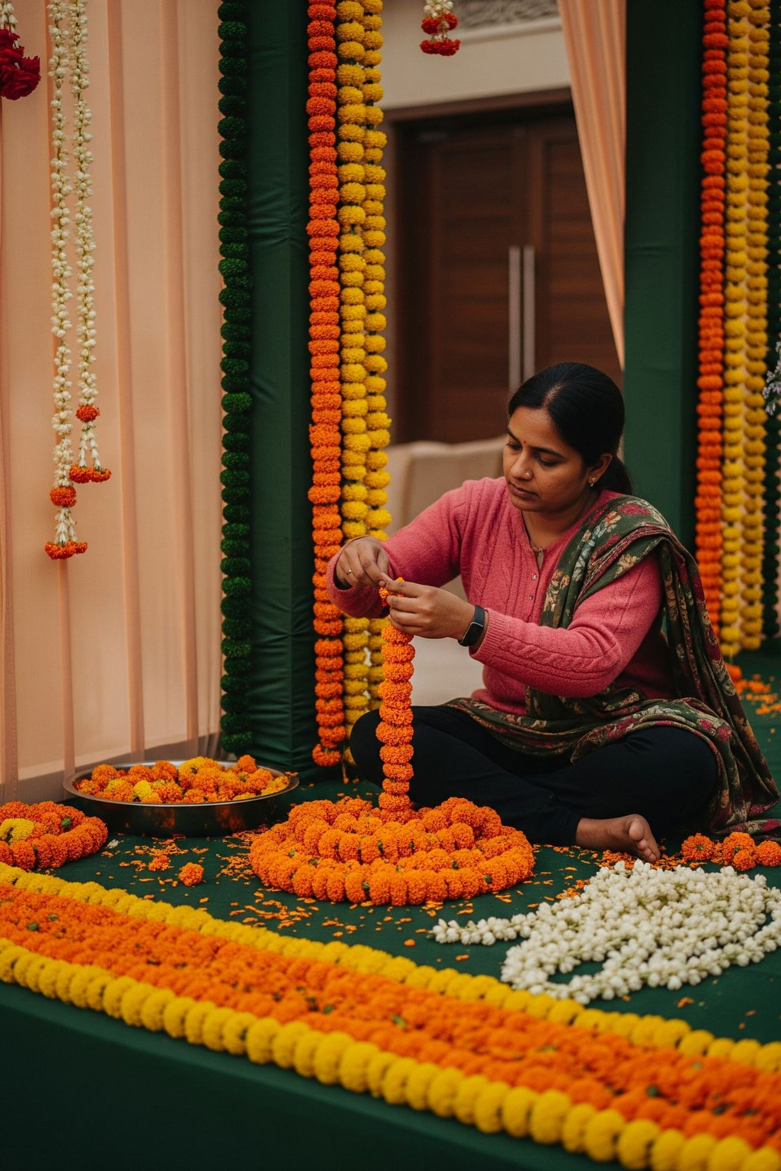
ABOUT US
Who We Are
A family-run house of floral design, mandap craft, lighting and end-to-end event production from Gujarat.
We design, build and deliver celebrations with our own team — from first flower to last light.
One house. Every detail.
2

Slide 3
THE CHALLENGE
The Problem Venues Know Well
Friction
Risk
Control
Outside decorators create friction.
Property damage risk sits with your team.
Unmanaged crews wander your property.
Timing
Stress
Late setups block the next booking.
Your banquet staff absorbs the stress.
3

Slide 4
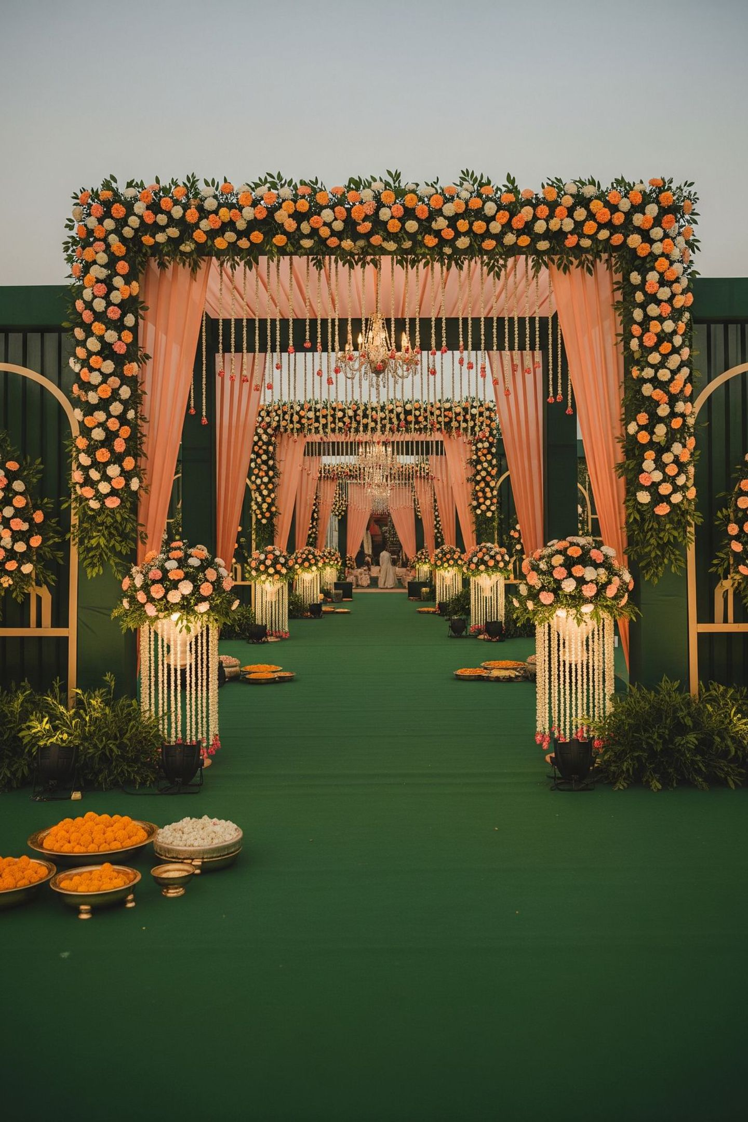
OUR ANSWER
One Integrated Production Partner
We arrive prepared. We work inside your rules.
Our crew is disciplined, supervised and accountable.
We hand the space back on time — and clean.
4

Slide 5
SERVICES
What We Deliver
Floral Design & Installations
Mandaps, Stages & Gateways
Bespoke arrangements and large-scale floral installations crafted by our own team.
Custom-built mandaps, ceremonial stages and entrance gateways designed for each event.
Ambient & Event Lighting
Planning & Coordination
Atmospheric lighting that transforms your property from ceremony to celebration.
End-to-end on-ground coordination under one roof, one point of contact.
5

Slide 6
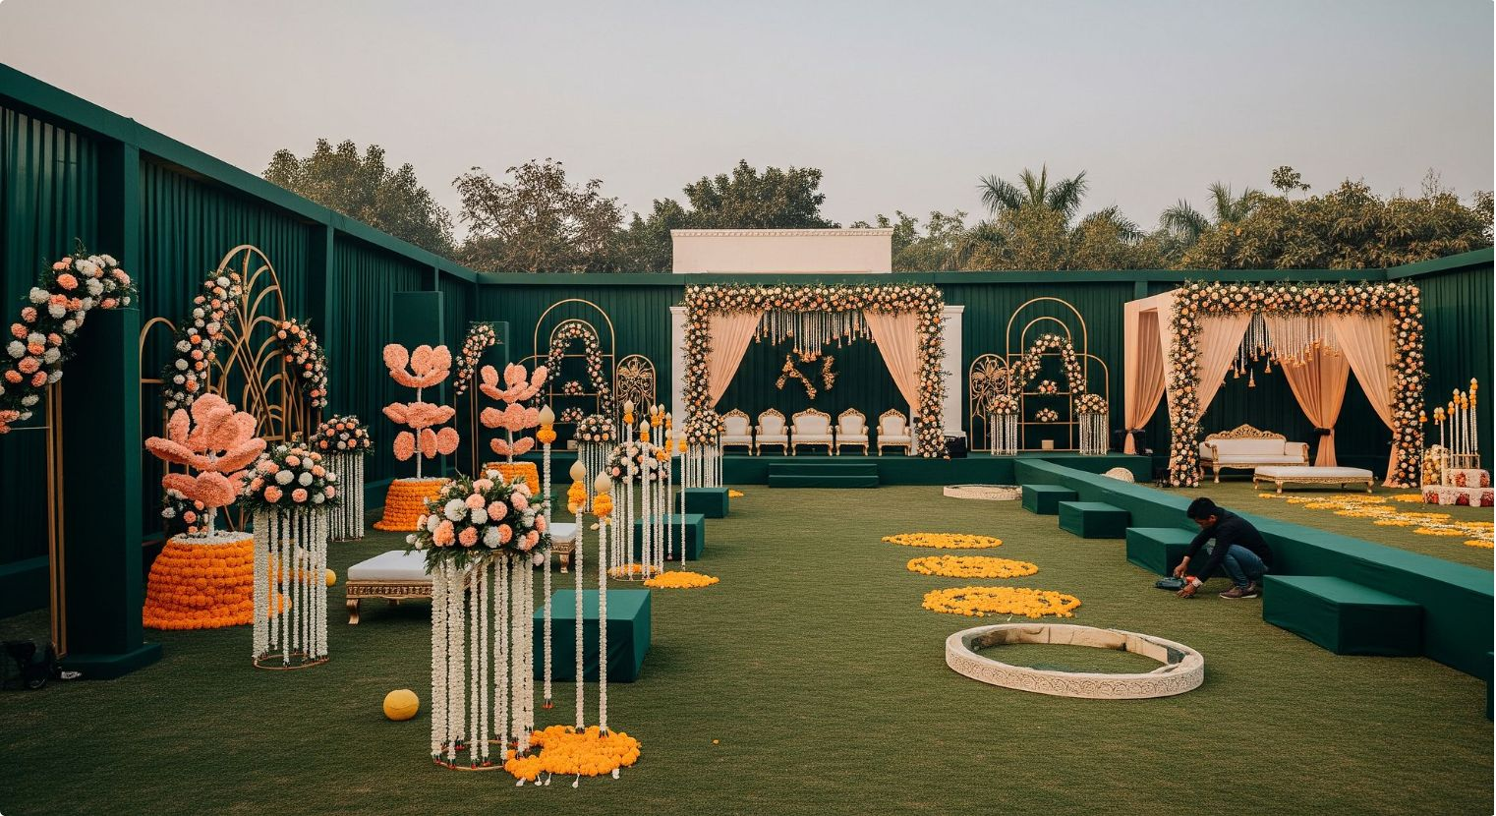
PROPERTY CARE
Our Responsibility to Your Property
Venue Rules First. Always.
Your property's policies govern every decision we make on-site.
Non-Invasive Methods
Setup techniques that protect floors, lawns and fixtures throughout.
Agreed Windows in Writing
Setup and dismantle schedules confirmed in advance, in writing.
Named Supervisor On-Site
A single accountable contact your team can always reach.
Clean, Complete Handover
Every event ends with a full, tidy handover of your space.
6

Slide 7
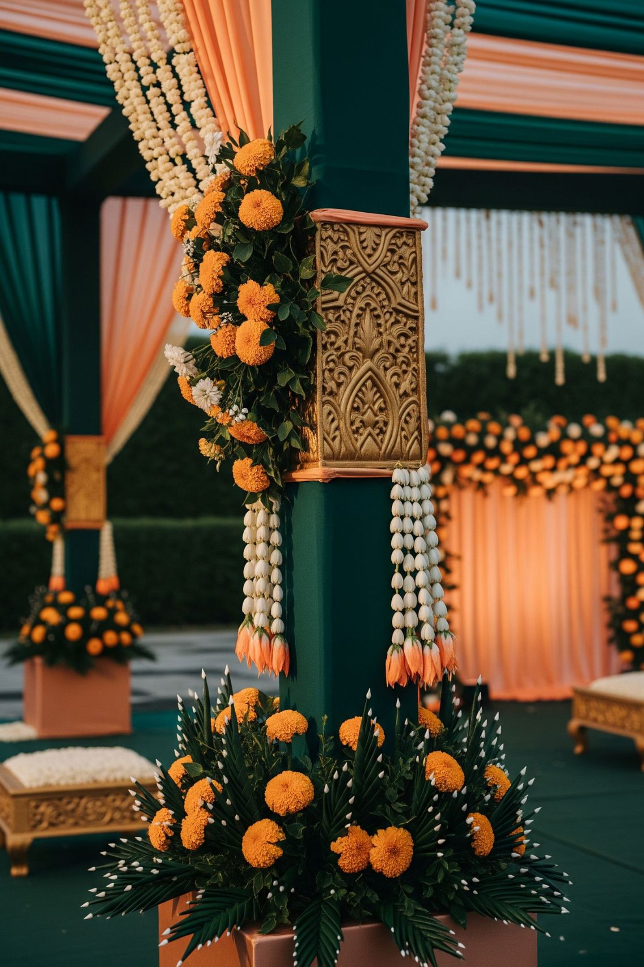
CRAFTSMANSHIP
The Quality We Bring
Every element designed, built and finished by our own hands.
Consistency your venue can promise its clients.
7

Slide 8

PROCESS
How a Partnership Works
Site Visit
Design Proposal
Written Agreement
Disciplined Execution
Review Together
A clear, structured process from first conversation to final handover — so your team always knows what to expect.
8

Slide 9
VENUE BENEFITS
What Your Venue Gains
Celebration-Ready Spaces
Packaged Decor Offers
Transformed spaces that convert enquiries into confirmed bookings.
Branded decor packages presented under your venue's name.
Professional Photography
Fewer Vendor Headaches
High-quality images of your transformed property, ready for your marketing.
One accountable partner means less coordination burden for your banquet team.
9

Slide 10
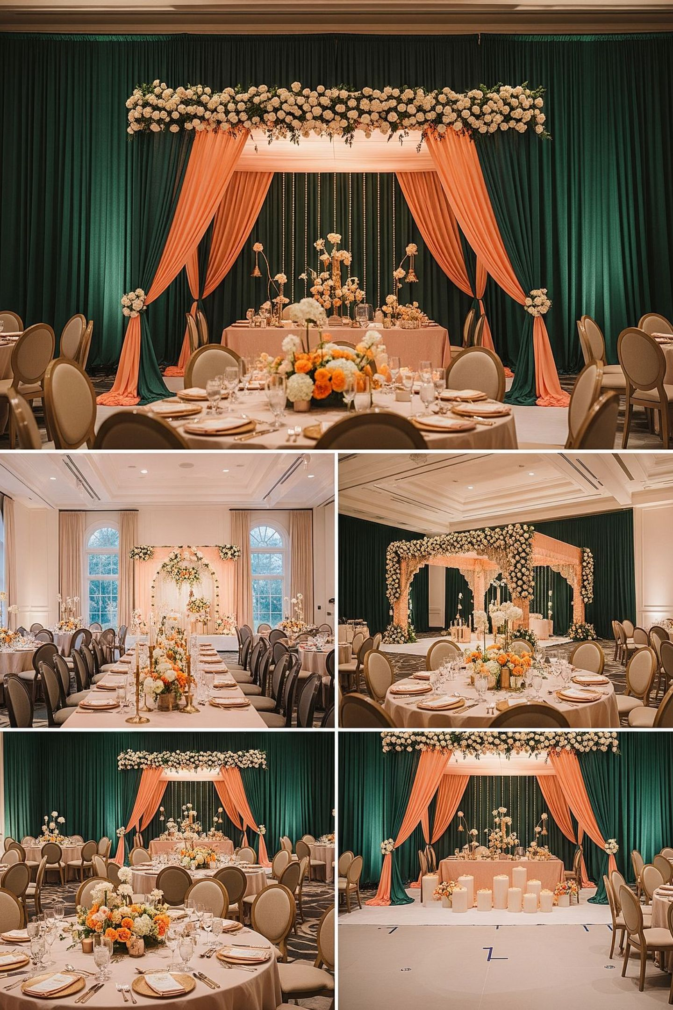
PARTNERSHIP MODELS
How We Can Work Together
Preferred Decor Partner
A formal preferred-partner arrangement with your venue.
Approved Vendor Listing
Listed as an approved vendor for clients booking your property.
Co-Branded Wedding Packages
Joint packages presented under both our names to prospective clients.
Seasonal Decor Partnership
Collaborative arrangements for peak wedding and festive seasons.
10

Slide 11
GETTING STARTED
Start Small. Prove Everything.
A low-risk pilot: partner with us for the first three events.
Judge the discipline. Judge the quality.
Then decide the long-term model.
Event One
Event Two
We demonstrate our process and discipline.
You assess quality, crew conduct and handover.
Event Three
Together, we decide the long-term model.
11

Slide 12
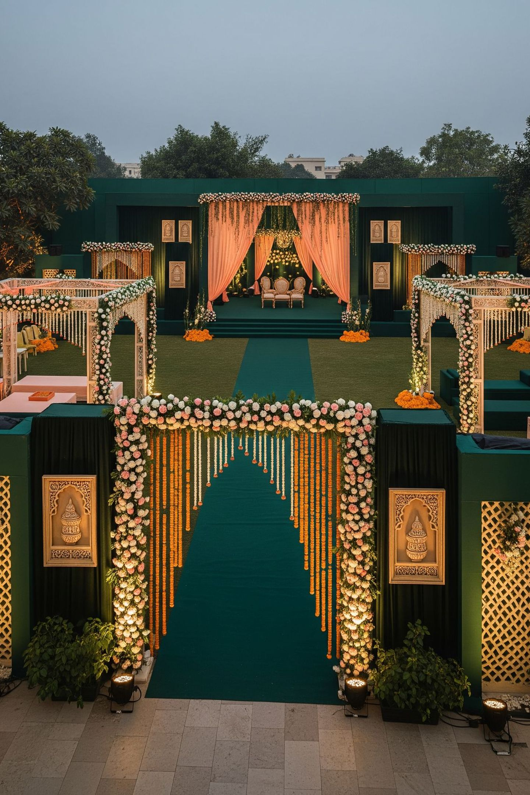
CONTACT
Let's Walk Your Property Together
We would rather show you than tell you.
Invite us for a site visit.
WhatsApp
Phone
[number pending]
[number pending]
Location
Gujarat, India.
12

Slide 13
A note of transparency
This profile is an introduction, not a contract or offer.
All scopes, timelines, responsibilities and commercial terms are confirmed in a written agreement before any event.
Images are representative of our design direction; a venue-specific proposal follows a site visit.
We work within each property's rules, safety requirements and vendor policies at all times.
13

