Slide 1
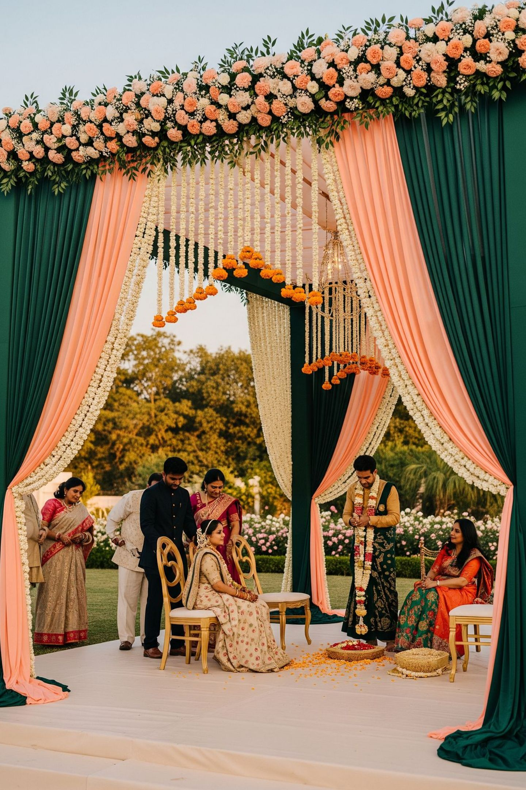
J.VARDHAN
LUXE EVENTS
WEDDINGS & CELEBRATIONS · GUJARAT, INDIA
Your celebration, built like an heirloom.

Slide 2
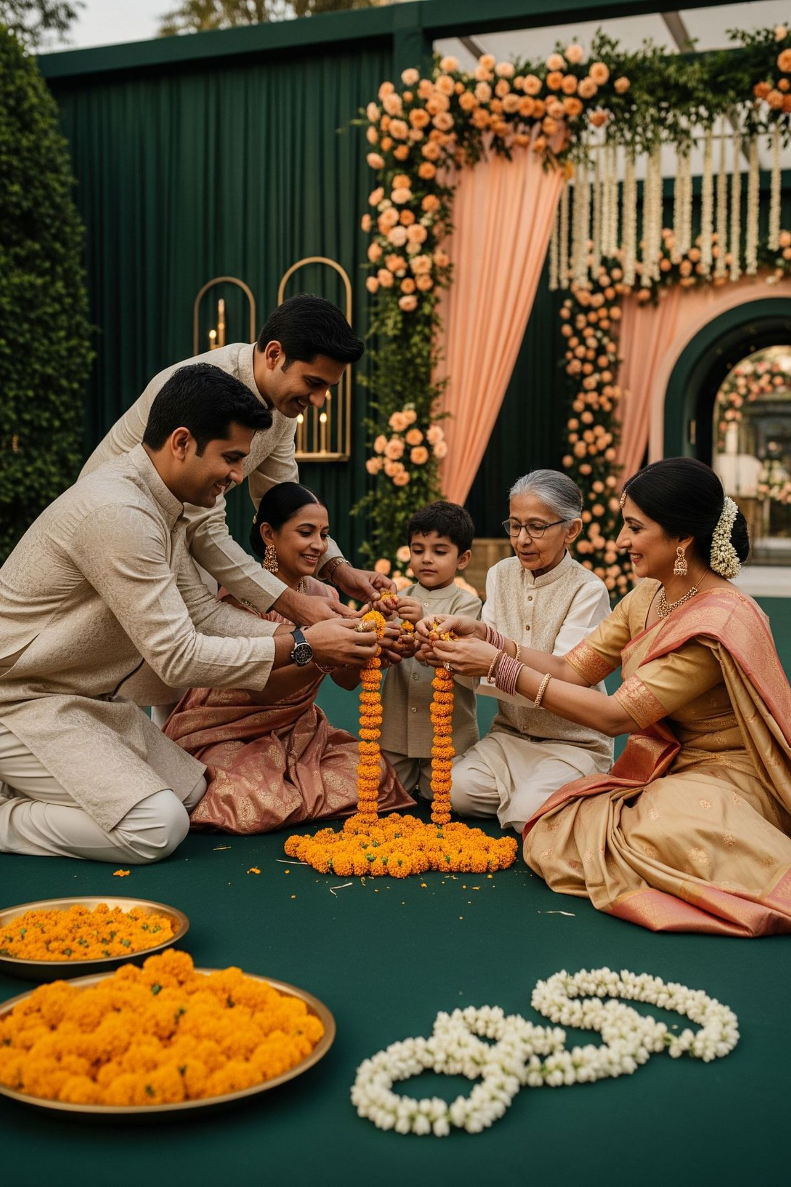
OUR STORY
One family, caring for yours
We are a family house of flowers and celebrations from Gujarat.
We design, grow, build and light weddings with our own hands and our own team.
2

Slide 3
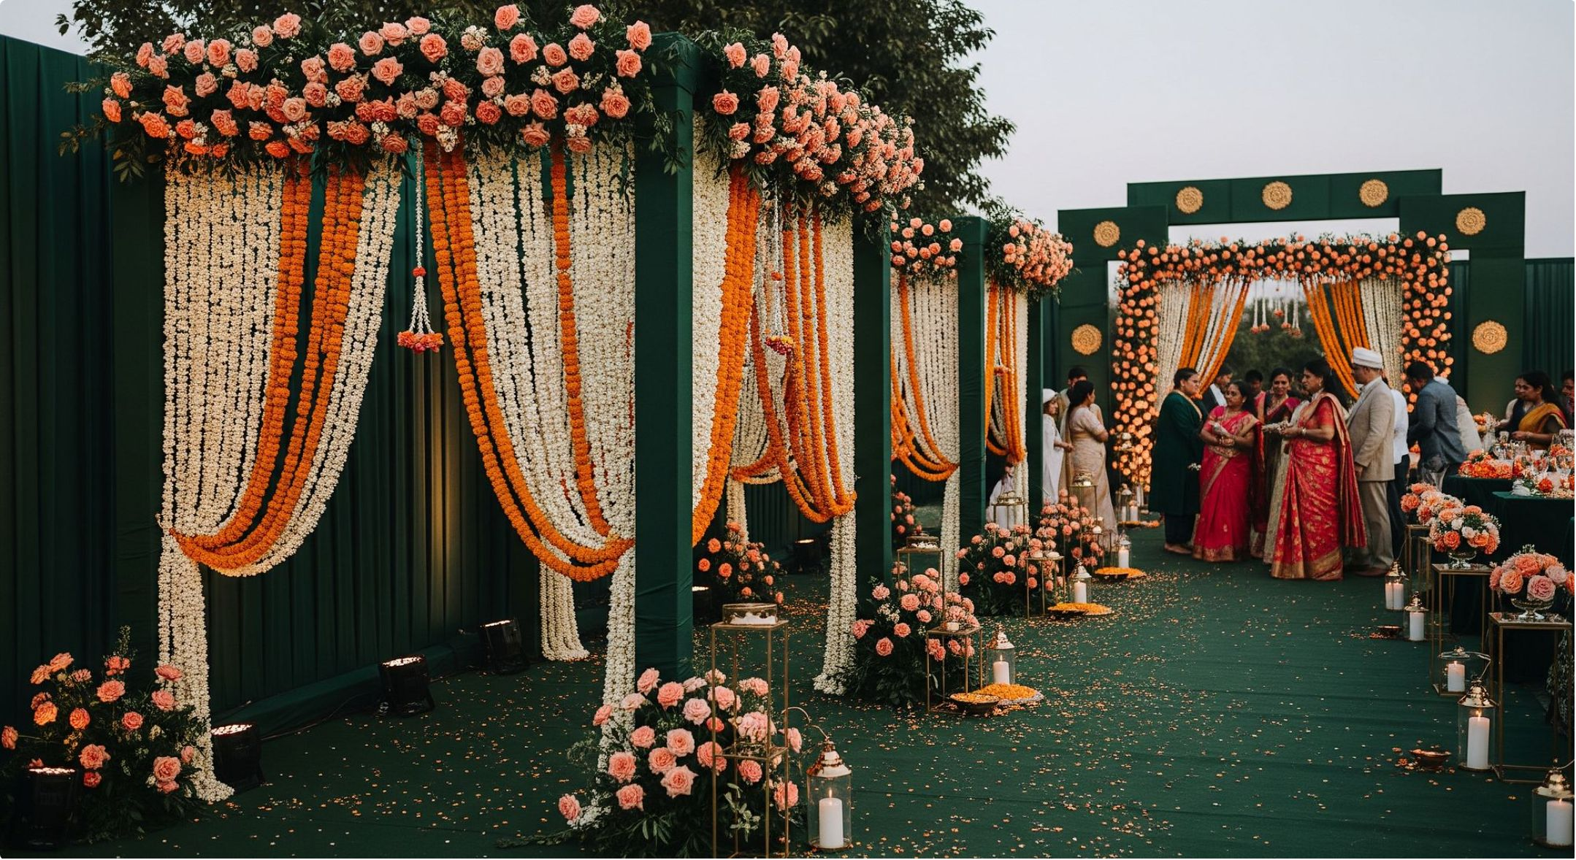
FLORALS
Our flowers
Fresh floral design — garlands, mandap florals, installations, pathway petals.
Composed for your functions, your rituals and your colours.
3

Slide 4
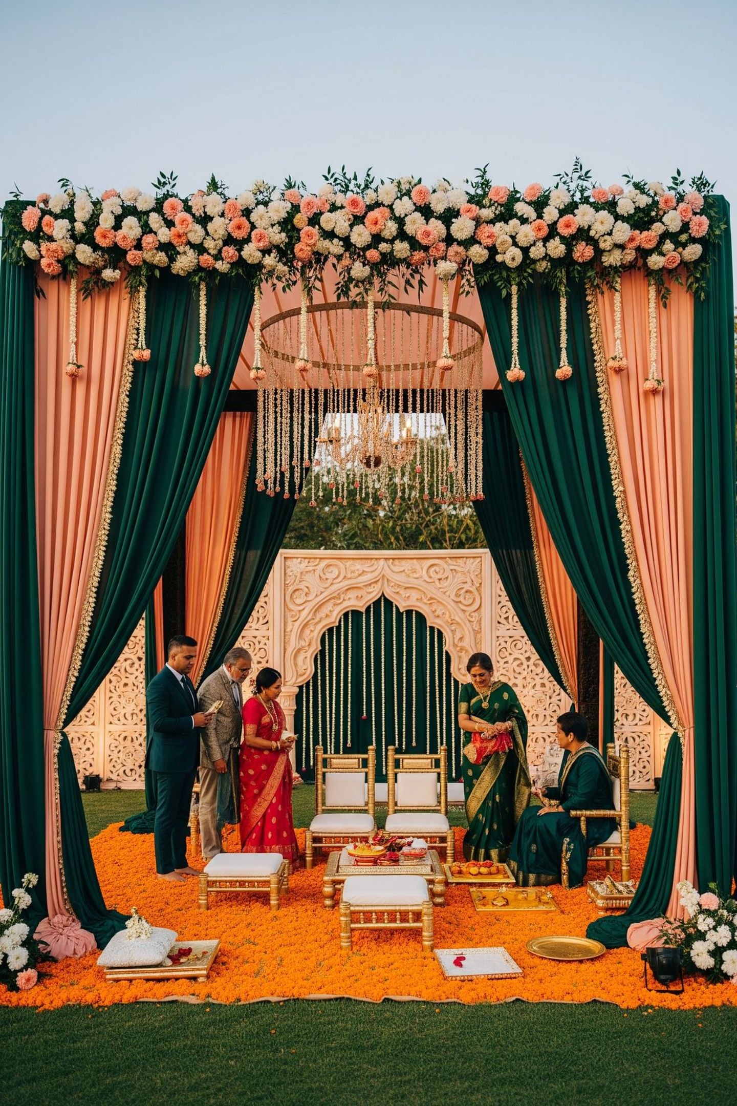
MANDAPS
The heart of the wedding.
Custom-designed mandaps built for your traditions, your venue and your taste.
4

Slide 5
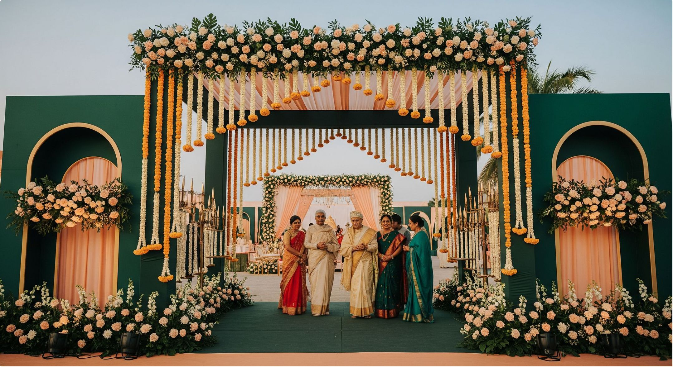
ENTRANCES & PATHWAYS
The first moment your guests feel the celebration.
Gateways, torans and walkways that welcome.
5

Slide 6
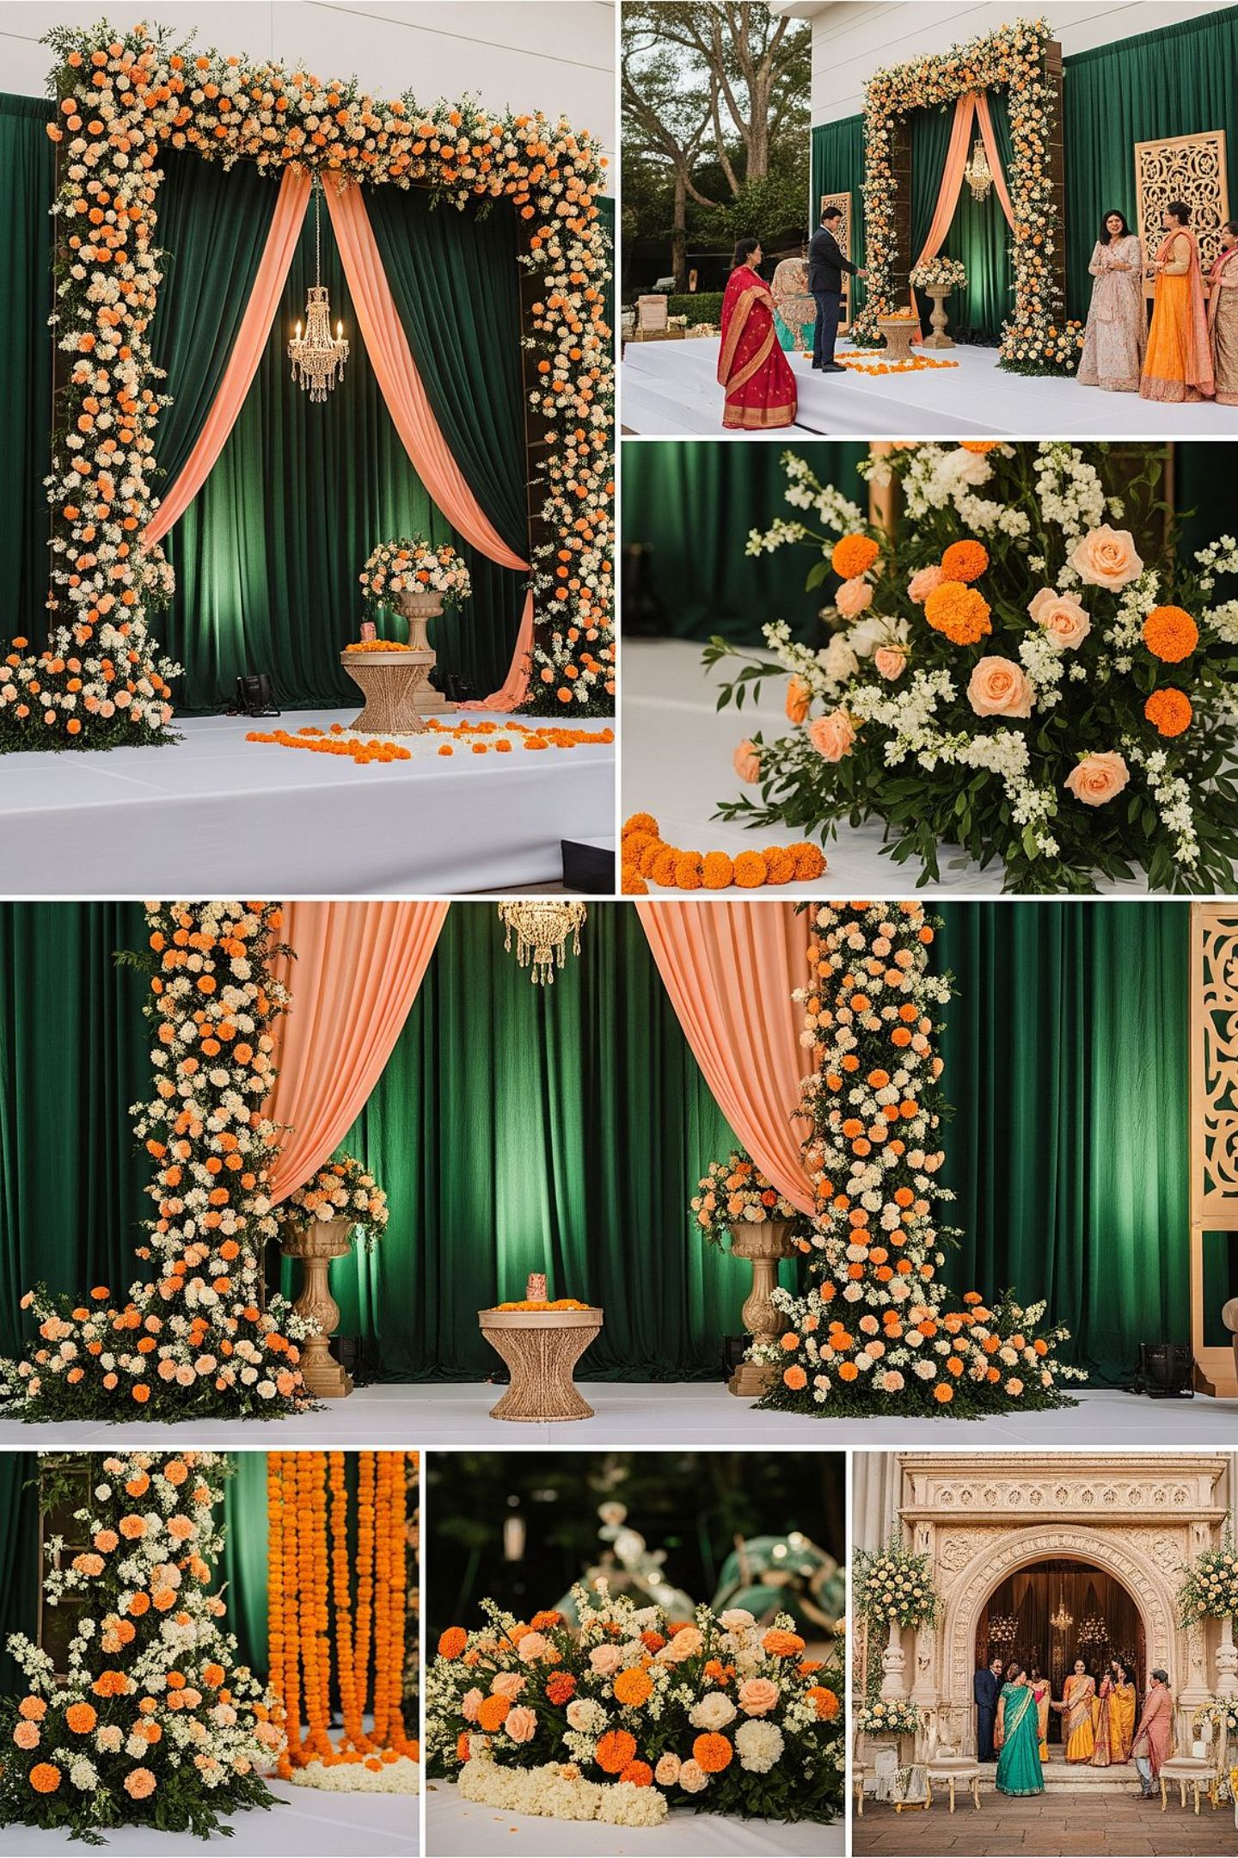
STAGES & RECEPTIONS
Stages and receptions
Backdrops and stages designed for the photographs your family will keep forever.
6

Slide 7
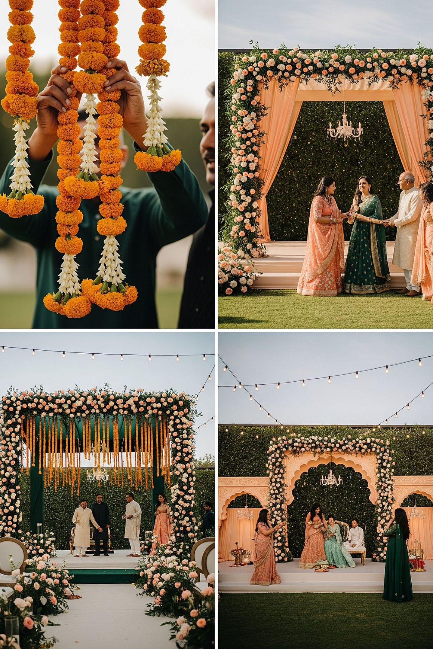
LIGHTING
When the sun sets
The celebration changes costume.
Ambient, warm, unforgettable lighting for your evening functions.
7

Slide 8
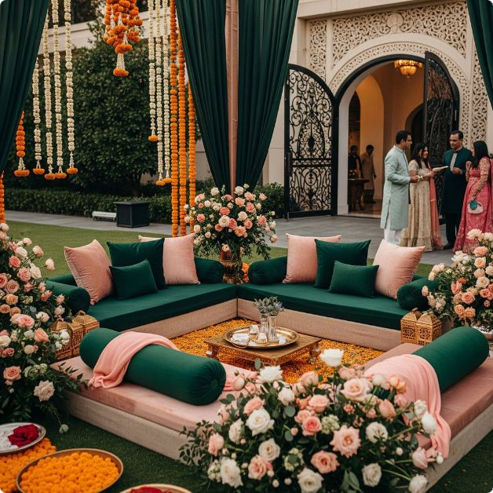
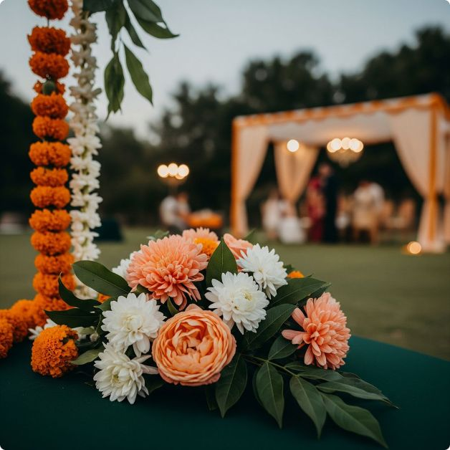
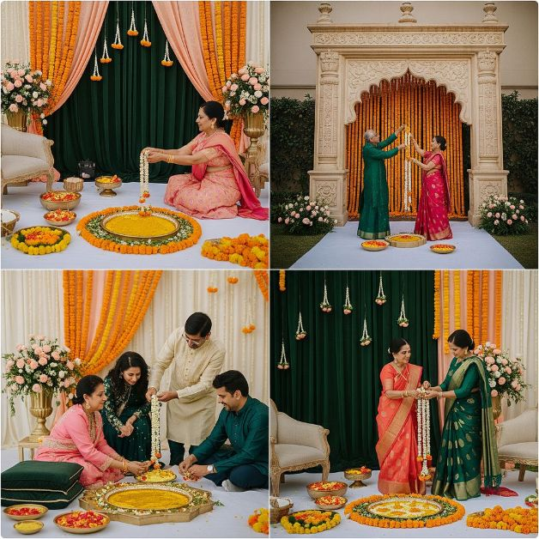
THE DETAILS
The small things guests remember
Seating corners & photo moments
The fragrance of fresh mogra
Tuned to each function
A scent that stays with your family long after the celebration ends.
Details composed for haldi, mehndi, pheras and reception — each one distinct.
Intimate spaces designed for your guests to pause, gather and remember.
8

Slide 9
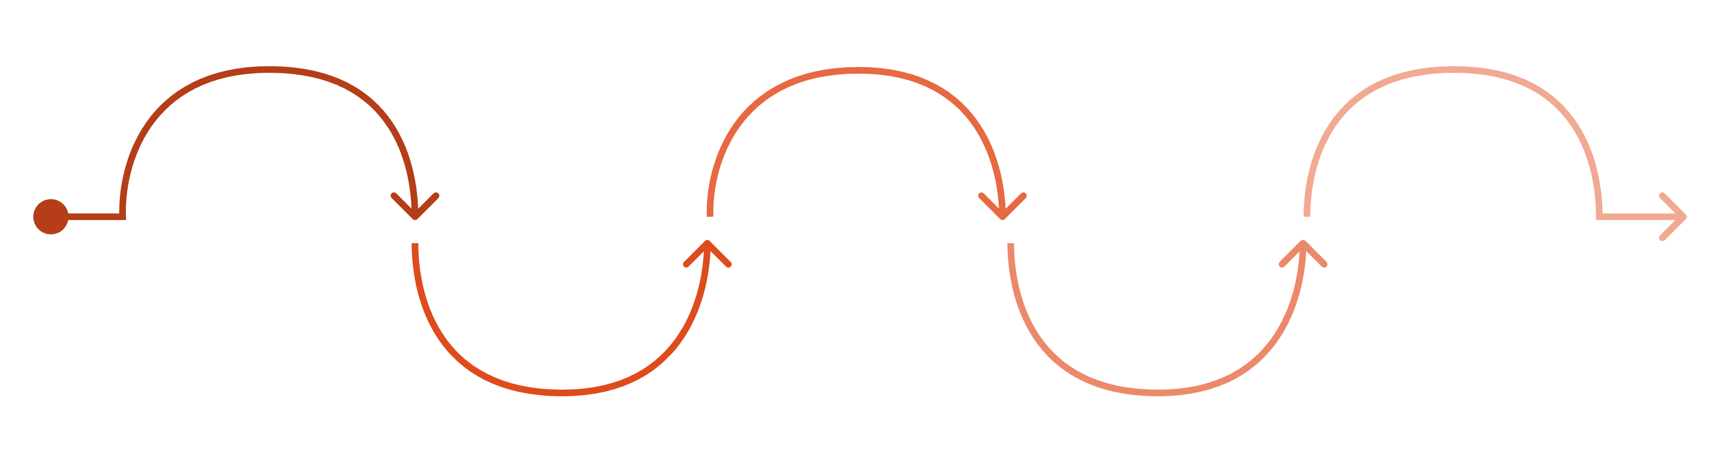
THE PROCESS
How planning works
We meet
We design
You receive
We build
You celebrate
We listen to your needs
Create your moodboard
Written proposal and plan
Manage every detail for you
Enjoy the day with family
A clear, unhurried process — so your family can look forward to the day, not manage it.
9

Slide 10
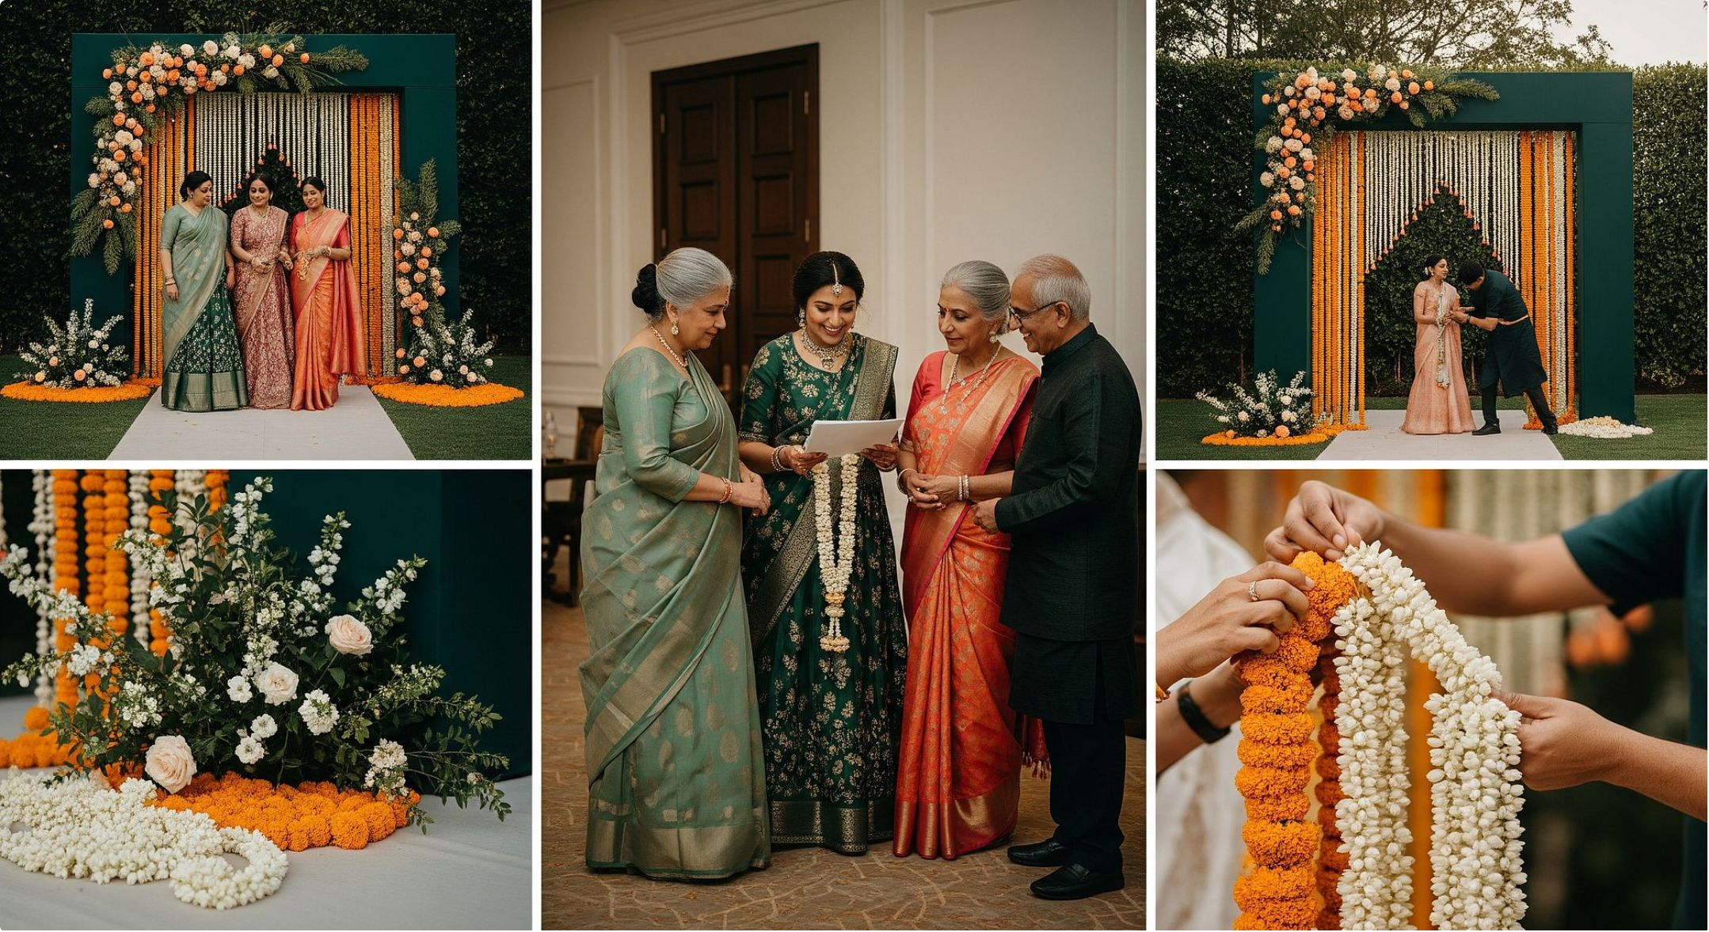
OUR PHILOSOPHY
Made for your story
Every wedding is designed fresh — for your family, your rituals, your budget conversation.
Nothing off the shelf.
10

Slide 11
OUR RESPONSIBILITY
Our responsibility
Your family enjoys. We carry the stress.
Disciplined crews and safe structures.
Full coordination with your venue and its rules.
Setup complete before your first guest arrives.
One person your family can always call.
11

Slide 12
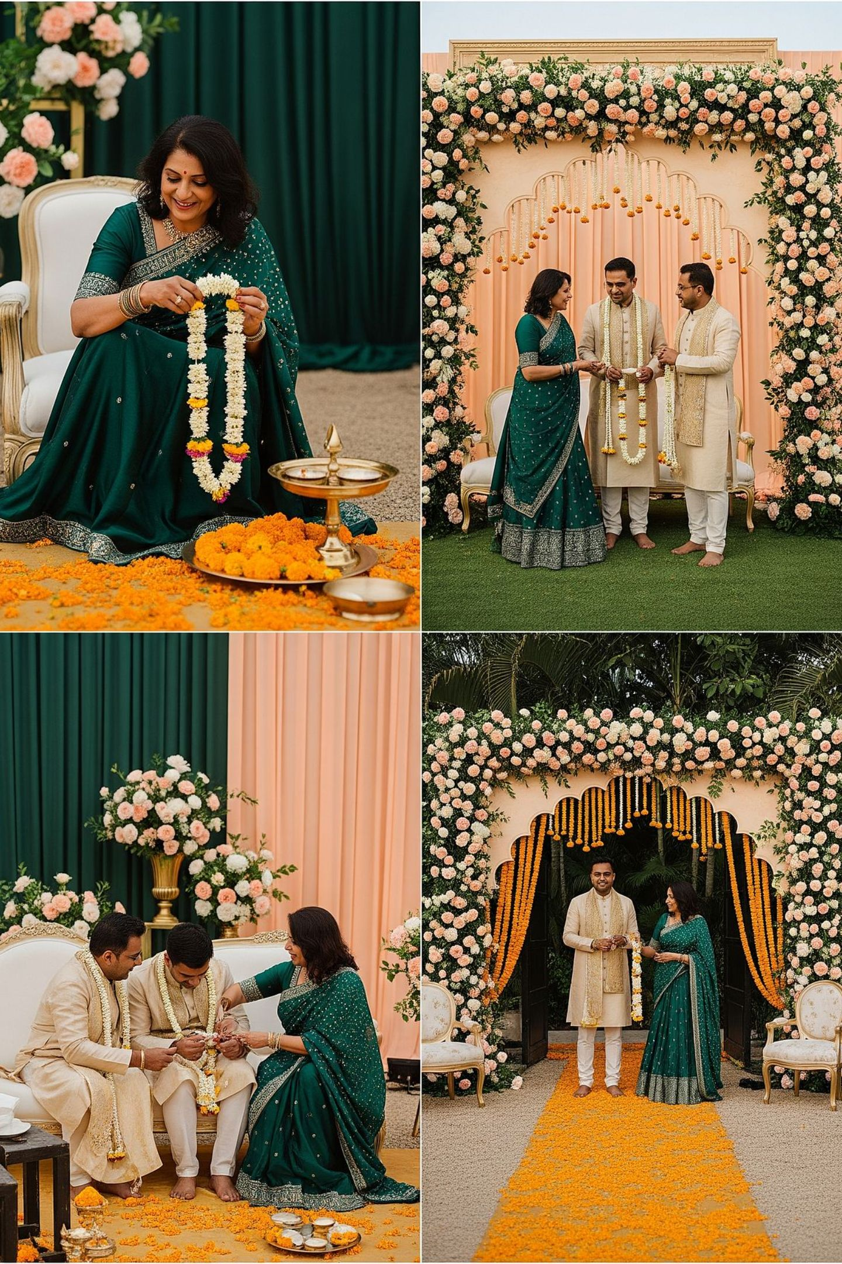
OUR WORK
Moments we have built
Weddings. Receptions. Haldi mornings. Evening celebrations.
Each one designed once, for one family.
12

Slide 13
WHAT WE OFFER
What comes with us
Design & Flowers
Structures & Lighting
One Team, Start to Finish
Fresh florals, moodboards and full creative direction for every function.
Mandaps, stages, entrances and ambient lighting — built by our own team.
Setup, on-day management and dismantling — handled completely by us.
13

Slide 14
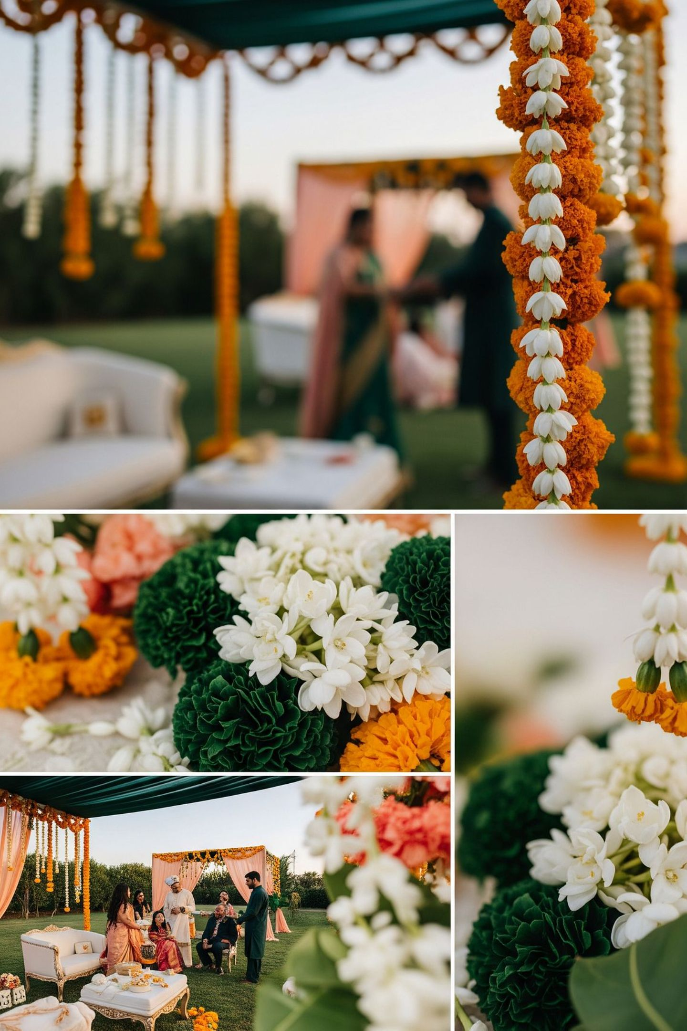
GET IN TOUCH
Begin your story
Tell us your dates. We'll bring the flowers.
WhatsApp
Phone
[number pending]
[number pending]
Location
Gujarat, India
14

Slide 15
A note from our family
This presentation introduces our work and design style.
Images are representative; every wedding we create is designed uniquely for each family.
Final designs, inclusions and pricing are always confirmed in a written proposal after a personal consultation.
We coordinate fully with your chosen venue and respect its guidelines at every step.
15

