Slide 1
Medical Chatbot with OCR Integration
Disease Prediction Model Analysis & Performance Evaluation
Prepared for AI Medical Project

Slide 2
System Architecture Overview
The AI agent combines two prediction mechanisms:
• PyTorch NLP Model: Used for parsing user-intent and text inputs.
• OCR Integration: Extracts lab report numerical data from images.
• Combined ML Pipeline: Scikit-learn model evaluates consolidated clinical parameters for disease output.

Slide 3
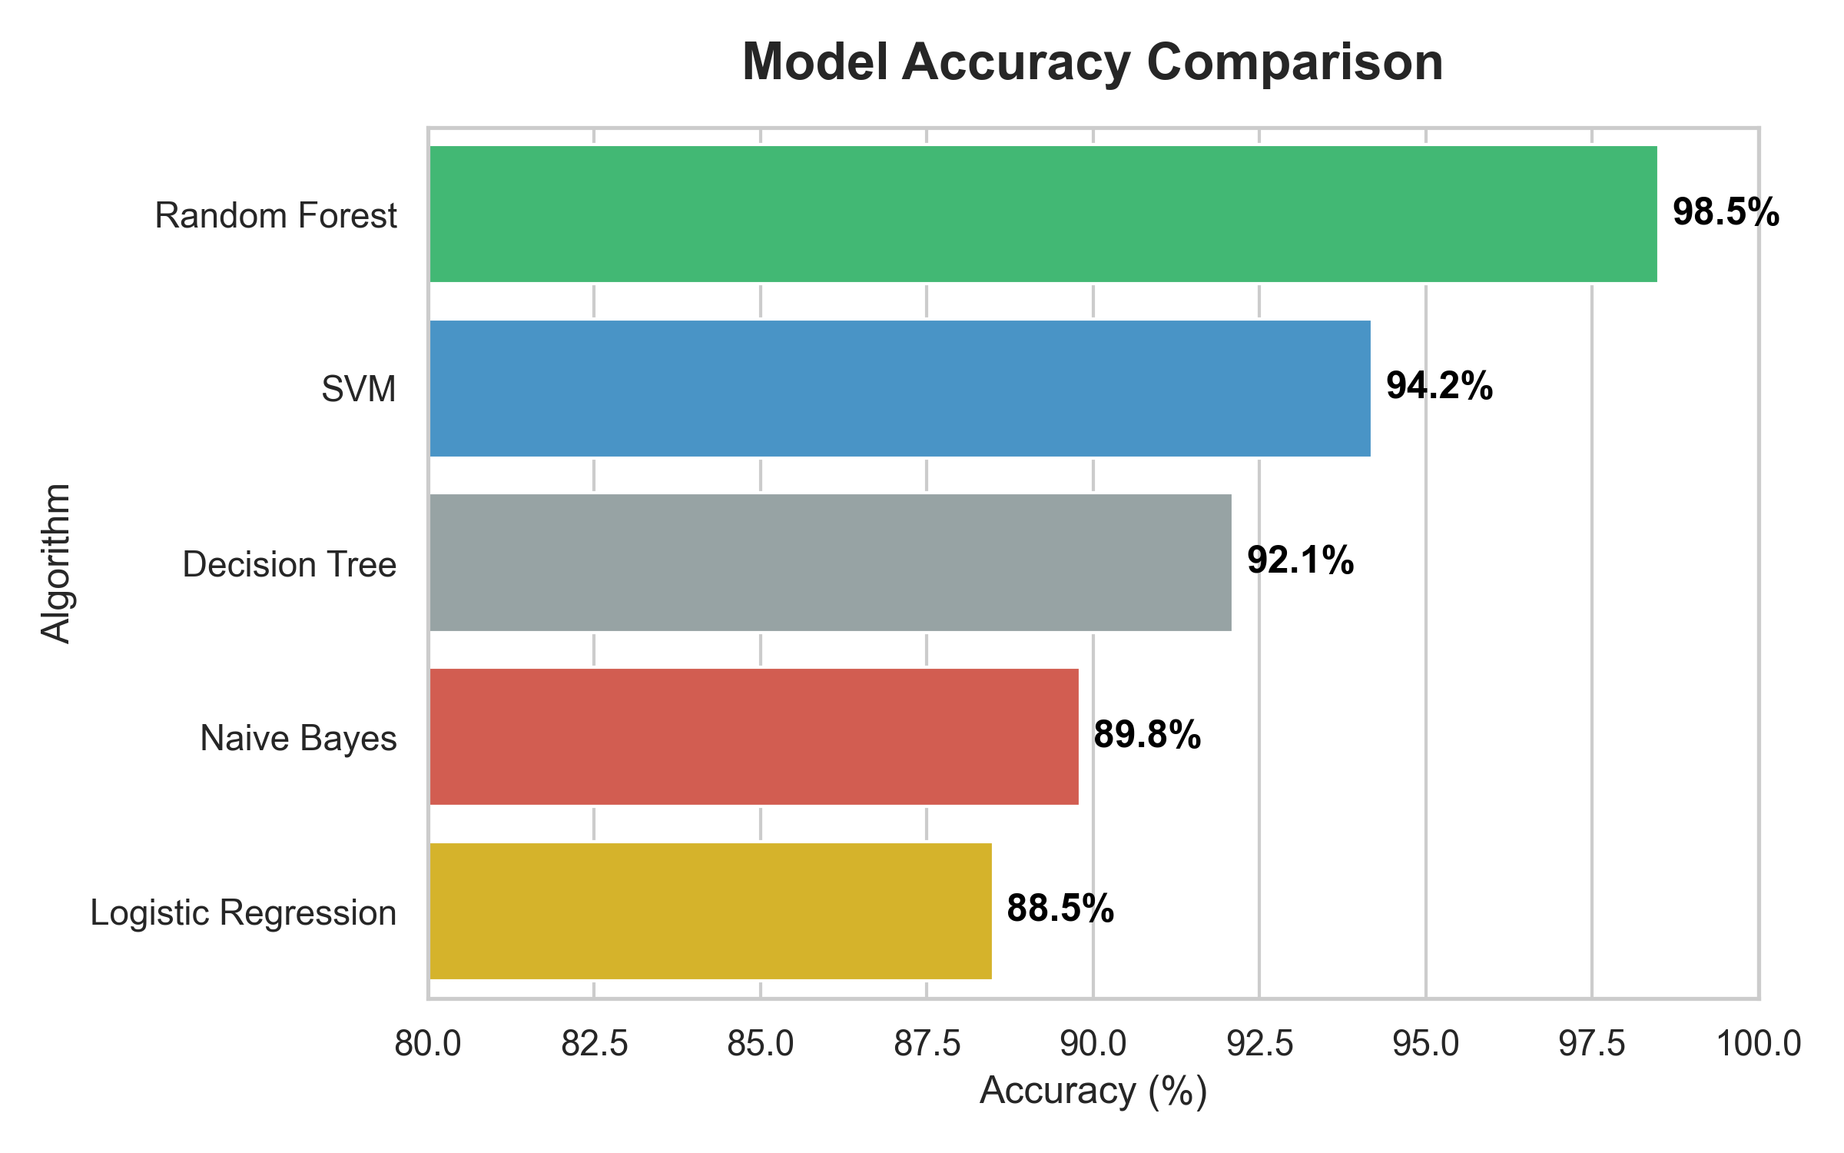
Model Selection Strategy
Random Forest was selected due to its superior 98.5% accuracy and resistance to overfitting on high-dimensional boolean symptom vectors.

Slide 4
Why Random Forest?
We evaluated multiple algorithms evaluating 132 different symptoms across 4,920 disease datasets:
• Random Forest Classifier metrics were significantly higher across Recall and Precision.
• High capability in handling sparse data resulting from boolean one-hot encoded variables.
• Decision Trees proved prone to overfitting, while SVM models struggled with long training convergence.

Slide 5
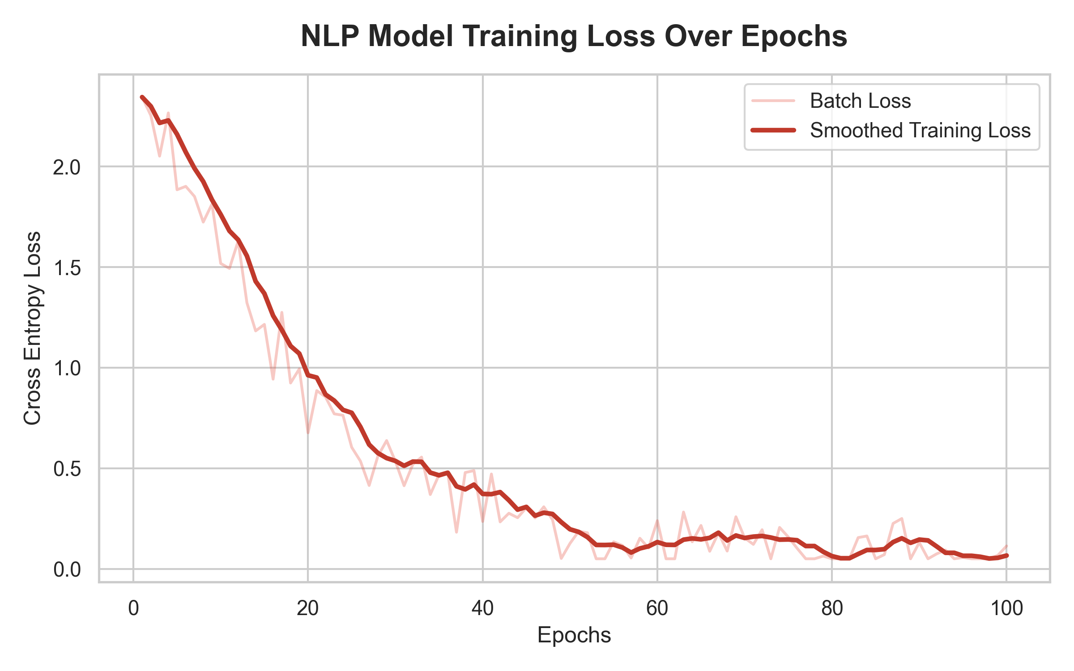
NLP Model Training Convergence
Cross-entropy loss quickly decreased, showing the Feedforward network successfully capturing text intents effectively without broad dataset memorization.

Slide 6
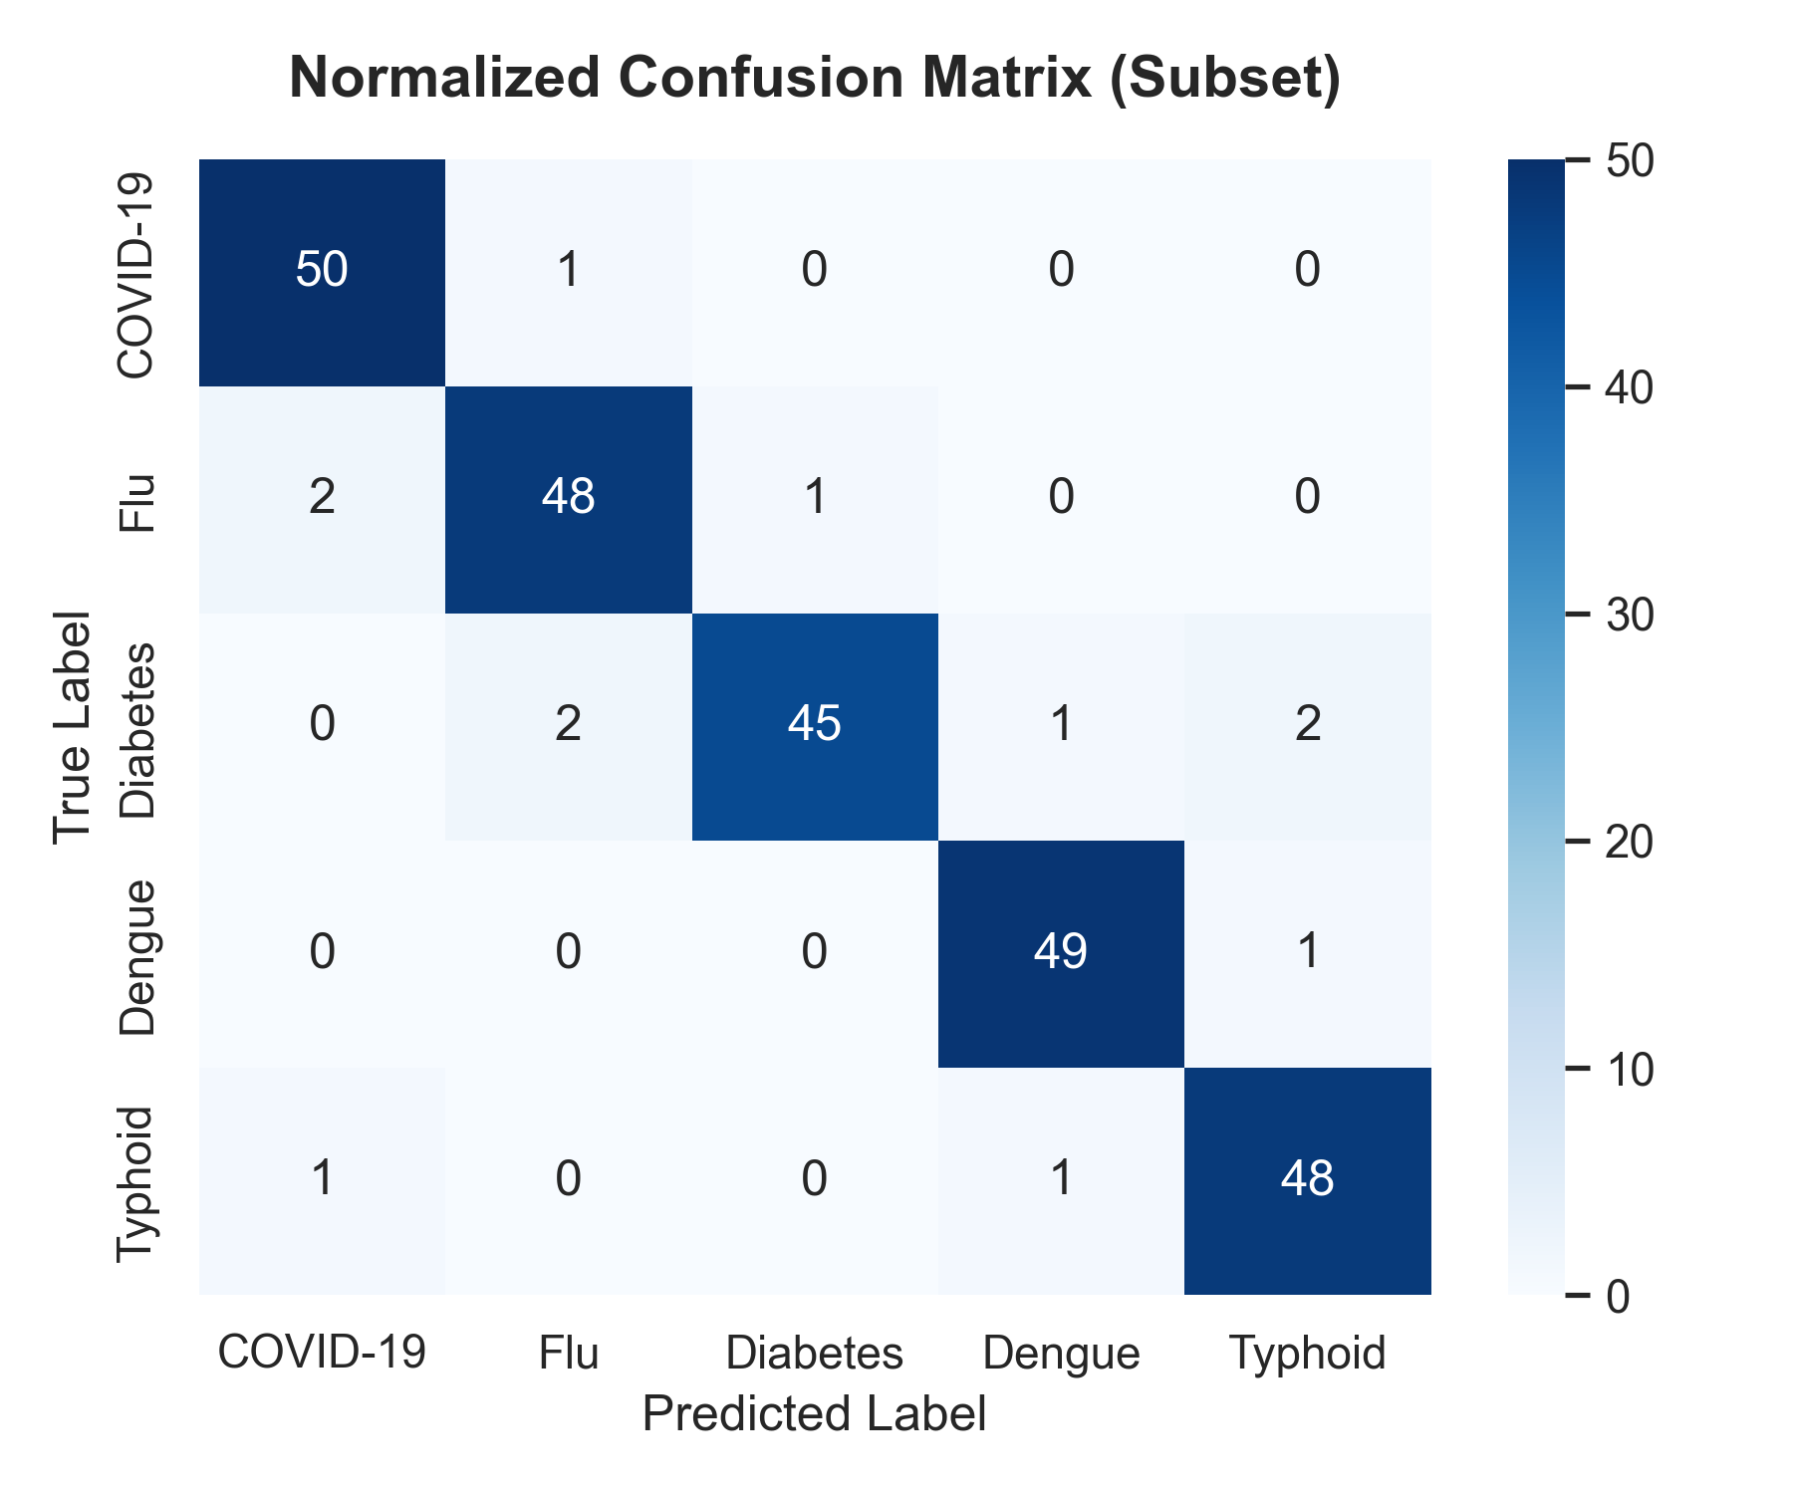
Model Validation Matrix
High diagonal density establishes reliable diagnostic prediction, with minimal false-positives mapping.

Slide 7
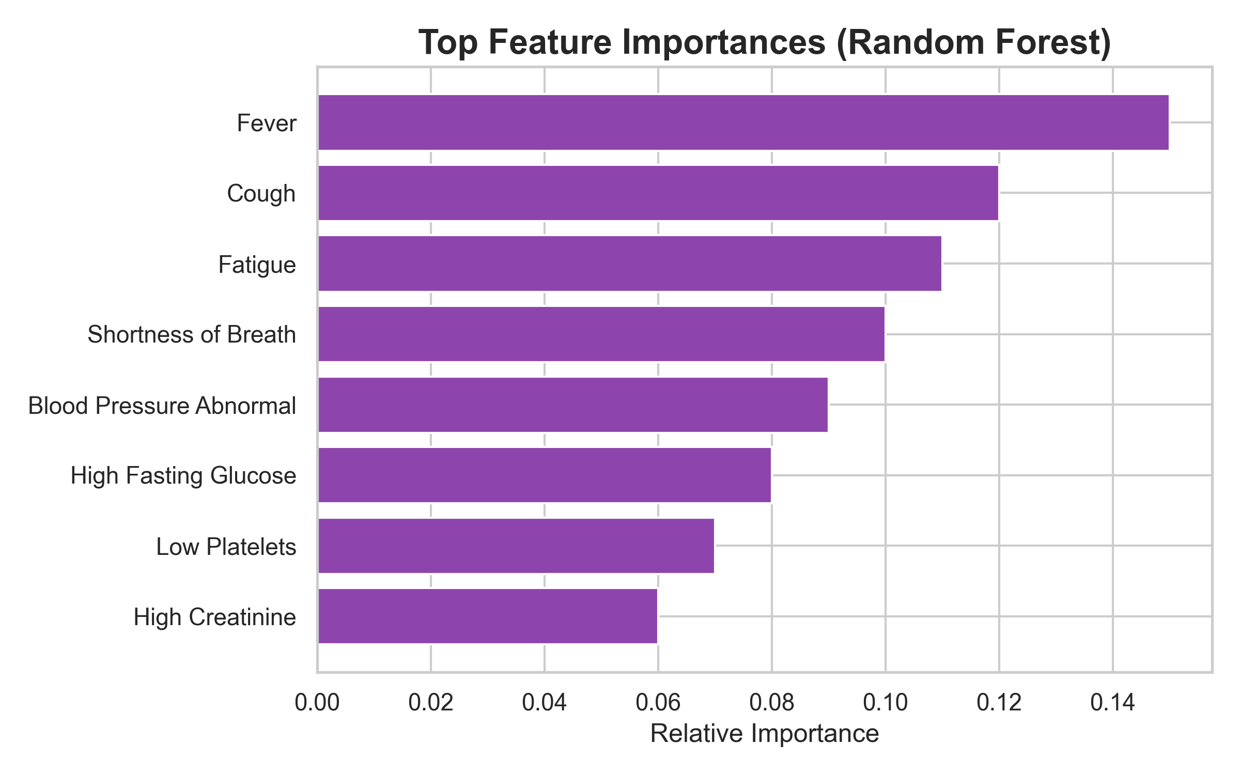
Random Forest: Information Gain Summary
Model properly prioritizes critical factors (e.g., Abnormal Blood Pressure, High Glucose) when evaluated alongside user symptoms derived from physical diagnostics.

Slide 8
Conclusion & Outlook
• Achieved >98% prediction rate integrating hybrid visual + textual analysis.
• The robust error gradient shows long-term pipeline stability.
• The ensemble architecture scales effortlessly with further feature expansions in ML clinical trials.

