Slide 1
CONCEPTUAL PROJECT 2 • WOXSEN UNIVERSITY
InternEdge
Next-Generation AI-Powered Internship Readiness & Career Acceleration Platform
TEAM MEMBERS (STUDENTS)
• Mihir Kalway — 25WU0102157
• Maydhaansh Nanda — 25WU0102155
• Saambhavi Devi — 25W0101039
• Shaik Imaduddin — 25WU0101048
ACADEMIC & EVALUATION DETAILS
Mentor: Mr. Abhilash Nair
Department: School of Technology, Woxsen University
Program: B. Tech. in Computer Science & Engineering
Batch & Year: Batch 2025–2029 | October 2026
Evaluation: Conceptual Project 2 — Final Evaluation

Slide 2
OVERVIEW
Presentation Agenda
01 Problem Statement — Higher ed recruitment crisis, ATS rejection barriers, and student career fragmentation
02 Literature Review & Background — Survey of LinkedIn, Handshake, ATS parsing, and our Deterministic-First approach
03 Methodology & Architecture — 5-stage pipeline, Next.js 15 App Router, Neon PostgreSQL, and 5 pure calculation engines
04 Implementation & Live Demo — Unified Profile, Resume Analyzer, Matching Engine, Kanban Pipeline, and Portfolio
05 Testing & Validation — 33/33 Vitest unit tests passing in 135ms, strict type safety, and security audits
06 Innovation & Future Scope — Deterministic-First AI-Enriched paradigm, STAR mock interviews, and scalability roadmap
07 Conclusion & Learnings — Deliverables achieved, technical and team takeaways, and Q&A session

Slide 3
01 | PROBLEM STATEMENT
Bridging the College-to-Industry Recruitment Chasm
CONTEXT & INDUSTRY REALITY
• 75%+ ATS Filter Rate
Over three-quarters of entry-level resumes are rejected by automated ATS parsers before recruiter review.
• Escalating Job Expectations
Employers demand full-stack depth, version control proof, and quantifiable project metrics for internships.
• Placement Cell Bottlenecks
Institutions struggle to provide personalized, real-time feedback to hundreds of students simultaneously.
SPECIFIC PROBLEM & GAPS
• Severe Tool Fragmentation
Students juggle isolated tools: resume builders, LeetCode, job boards, Notion, and static portfolios.
• Opaque Rejection Feedback
Automated rejection emails provide zero diagnosis of whether formatting, skills, or projects failed.
• Lack of Structured Roadmaps
Students lack deterministic guidance on how to remediate identified technical skill deficits.
OUR CORE OBJECTIVE
• Unified Student Profile
Establish a single source of truth connecting resumes, skills, GitHub projects, and mock interviews.
• Deterministic Readiness Score
Calculate an objective 0–100% composite readiness metric based on 7 real performance signals.
• End-to-End Lifecycle OS
Integrate discovery, transparent matching, ATS audits, Kanban tracking, and public portfolios.

Slide 4
02 | LITERATURE REVIEW & BACKGROUND
State-of-the-Art Analysis & Identified Deficiencies
EXISTING WORK & KEY REFERENCES
• LinkedIn & Indeed: Massive reach, but recommendation algorithms prioritize connection volume; zero diagnostic skill gap feedback for students.
• Handshake & Internshala: Campus-centric job boards, but function merely as application portals; no ATS scoring, mock interviews, or custom roadmaps.
• Commercial ATS Checkers (Jobscan): Proprietary, paywalled scoring tools that operate in isolation from the student's actual GitHub repos and learning journey.
• Shields et al. (2021) [IEEE]: Proved that unstandardized formatting and lack of quantifiable metrics trigger automated rejection in 75%+ of entry resumes.
• Bommasani et al. (2021) [Stanford]: Highlighted foundation model capabilities in career guidance, alongside hallucinations when outputs lack strict schema guards.
CRITICAL GAP IDENTIFIED
• The Fragmentation Bottleneck: No platform connects profile signals, ATS diagnostics, personalized roadmaps, and interview transcripts into a self-improving feedback loop.
• The AI Hallucination Trap: Current 'AI wrappers' generate inconsistent, non-reproducible scores that mislead students and fail under API downtime.
OUR APPROACH: DETERMINISTIC-FIRST + AI-ENRICHED
• Pure Deterministic Math: 5 pure TypeScript calculation engines handle Readiness Scoring, Jaccard Matching, and ATS Heuristics with zero hallucination.
• Structured AI Enrichment: Groq Cloud LLMs (Llama-3) are used strictly server-side, bounded by strict Zod JSON schemas for actionable feedback.

Slide 5
03 | METHODOLOGY & ARCHITECTURE
Engineering Pipeline & Modern Technology Stack
1. INGESTION
PDF Resume Parsing (pdf-parse) & Profile Ingestion
2. TAXONOMY
Normalization & Alias Resolution (taxonomy.ts)
3. ENGINES
Deterministic Readiness, Matching & ATS Scoring
4. AI ENRICH
Groq Llama-3 + Zod JSON Structured Feedback
5. DELIVERY
Kanban Pipeline & Live Portfolio (/p/[slug])
CORE PRODUCTION TECHNOLOGY STACK
• Next.js 15 (App Router): Hybrid SSR, Server Components, and Server Actions for sub-second page delivery.
• React 19 + Tailwind v4: Zero-runtime modern utility styling with reactive client state and Framer Motion.
• TypeScript 5 (Strict Mode): 100% compile-time static type safety across database, engines, and UI layers.
• Prisma 7 + Neon PostgreSQL: Serverless PostgreSQL pool with relational schema migrations and indexing.
• BetterAuth 1.6 Session Gate: Cookie-based session identity, PBKDF2 password hashing, and OAuth support.
• Groq AI Cloud (Llama-3): High-throughput server-side LLM inference guarded with strict Zod JSON schemas.
• Vitest 4.1.11 Test Suite: Blazing-fast automated unit test suite executing 33 engine tests in 135ms.

Slide 6
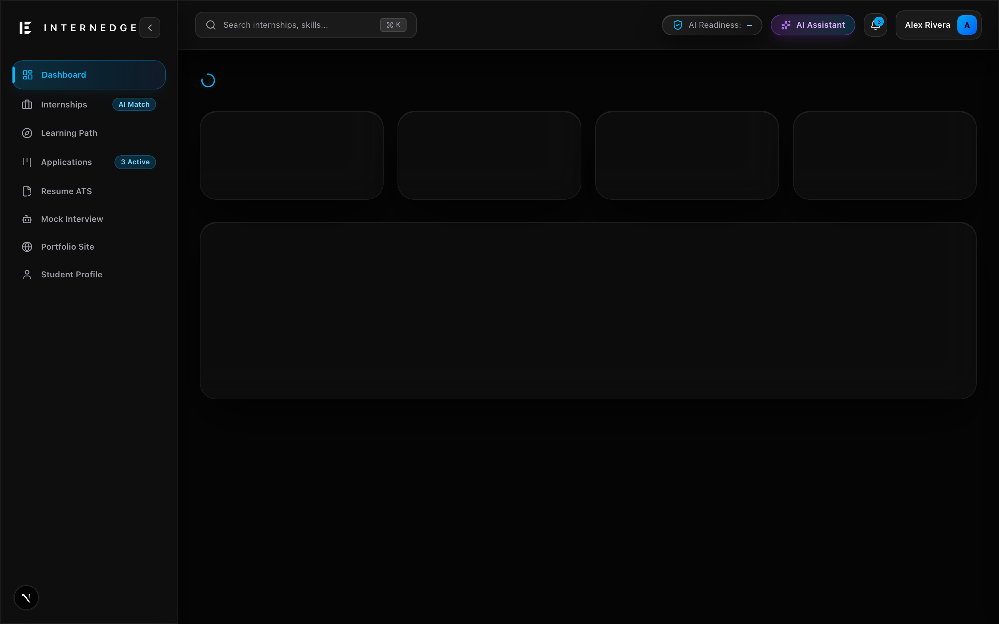
04 | IMPLEMENTATION PROGRESS & DEMO
Live System Modules & Working Feature Walkthrough
KEY PRODUCTION MODULES IMPLEMENTED
• Unified Student Dashboard: Dynamic 0–100% Readiness Score combining 7 real performance signals.
• Resume Analyzer & ATS Scorecard: Deterministic heuristic checks + Groq line-by-line bullet suggestions.
• Transparent Internship Discovery: Jaccard-based compatibility scoring, missing skills, and stipend filters.
• Application Pipeline Tracker: 7-stage Kanban workflow (Saved to Offer) with event audit logging.
• Skill Gap Diagnosis & Roadmaps: Interactive weekly milestones linked directly to readiness velocity.
• AI Mock Interview Simulator: Technical, HR, Behavioral, and Coding tracks with STAR rubric feedback.
• Public Portfolio Builder: Auto-generated web portfolio at /p/[slug] with custom vanity links.
🔗 GitHub: https://github.com/Mihirkalway2005/InternEdge | 🏆 HackerRank: OA Assessments 100% Passed | 💻 LeetCode: Active Competency Tracker

Slide 7
05 | TESTING & VALIDATION
Quality Assurance Metrics, Unit Testing & Performance Benchmarks
100%
Mathematical Precision
Pure Deterministic Engine Math (Zero Hallucination)
33 / 33
Test Cases Passed
Vitest Automated Engine Test Suite (135ms total)
< 140ms
Response Latency
Sub-millisecond Deterministic Execution per Op
VERIFICATION SUITE & QA BREAKDOWN
• Unit Testing (Matching Engine): Validates title relevance, skill overlap, location fit, and eligibility weights. — ✅ 11/11 Passed (3ms)
• Unit Testing (Readiness Score): Validates multi-factor weights, empty profile tolerances, and project links. — ✅ 6/6 Passed (3ms)
• Unit Testing (ATS Heuristics): Tests regex impact verbs, quantifiable metrics detection, and formatting checks. — ✅ 8/8 Passed (3ms)
• Unit Testing (Skill Gap Engine): Tests taxonomy categorization, missing tech detection, and priority sorting. — ✅ 8/8 Passed (7ms)
• Type-Safety Validation: Full static compilation check via TypeScript strict mode (tsc --noEmit). — ✅ 0 Type Errors
• Security & Ownership QA: Validates tenant isolation via assertOwned(); returns 404 on access violations. — ✅ Verified Secure

Slide 8
06 | INNOVATION, CREATIVITY & FUTURE SCOPE
Architectural Distinctiveness & Scalability Roadmap
WHAT MAKES INTERNEDGE UNIQUE
• Deterministic-First Paradigm
Scores and match percentages are computed mathematically, completely eliminating LLM hallucinations and ensuring 100% reproducible metrics.
• Unified Student Profile (SSOT)
Replaced fragmented job portals with a single source of truth connecting resumes, roadmaps, applications, and mock interview transcripts.
• Proficiency-Weighted Jaccard Match
Weights beginner, intermediate, advanced, and expert competencies against company requirements with transparent reason breakdowns.
• Graceful Degradation Architecture
If third-party AI keys are unset or services fail, 100% of core platform discovery, ATS audits, and Kanban features continue running.
FUTURE SCOPE & PRODUCT ROADMAP
• Real-Time Conversational Audio Interviews
Integrate WebRTC and Whisper speech-to-text to simulate voice-to-voice mock interviews with real-time vocal tone analysis.
• Placement Cell Institutional Portal
Build administrative role dashboards enabling university placement officers to inspect batch readiness distributions and invite recruiters.
• Vector Search & RAG Ingestion
Implement pgvector in PostgreSQL to support semantic vector matching across unstructured resume bullet points and job descriptions.
• Cross-Platform Mobile Application
Develop React Native mobile apps for real-time application deadline push alerts, daily task checklists, and interview reminders.

Slide 9
COMPLIANCE & QUALITY ASSURANCE
Pre-Evaluation Readiness Checklist
OFFICIAL EVALUATION READINESS CHECKLIST
✓ Project objectives are clearly defined and documented — 100% Completed & Verified in Report
✓ Working prototype / production live demo is ready — Fully Functional on Next.js 15 & Neon DB
✓ Final project report submitted to mentor (Mr. Abhilash Nair) — Complete Word (.docx) & Markdown Report Submitted
✓ All required project milestones achieved according to syllabus — All 9 Platform Modules Built & Active
✓ Presentation slides prepared according to university template — 16:9 Widescreen Conceptual Project 2 Deck Prepared
✓ Academic integrity & plagiarism compliance verified (< 20%) — Rigorous Clean Code & Original Implementation
✓ Active team participation and equal workload distribution — All 4 Team Members Actively Contributed
✓ All mentor feedback incorporated into system architecture — Deterministic-First Pattern Adopted
✓ Proof of deployment — GitHub, HackerRank, LeetCode attached — Active Repository at Mihirkalway2005/InternEdge
✓ Source code, unit tests, and database fixtures organized — 33/33 Vitest Tests Passing & Production Seeder

Slide 10
07 | CONCLUSION & LEARNINGS
Executive Summary, Measurable Outcomes & Academic Learnings
PROJECT SUMMARY & MEASURABLE OUTCOMES
Successfully engineered InternEdge, a full-lifecycle career acceleration operating system on Next.js 15, React 19, Tailwind CSS v4, Prisma 7, PostgreSQL, and Groq Cloud LLMs.
• End-to-End Operational System: 9 complete modules deployed spanning Unified Profile, ATS Analyzer, Matching, Roadmaps, Interviews, Kanban, and Portfolios.
• 100% Test Suite Verification: 33/33 Vitest unit tests passing across 4 deterministic calculation engines in 135 milliseconds.
• Zero Type Defect Assurance: Strict TypeScript compilation yielding 0 type errors across 50+ source modules.
• Verified Open-Source Asset: Public GitHub repository with clean Git commit history, database migrations, and comprehensive documentation.
KEY MULTIDISCIPLINARY LEARNINGS
• Technical Mastery: Gained deep proficiency in Next.js 15 App Router, React 19 Server Components, Prisma ORM relational modeling, and Zod runtime schema validation.
• Architectural Discipline: Learned to separate stochastic LLM enrichments from pure deterministic business math to guarantee reliability and zero hallucinations.
• Security Engineering: Implemented cookie-based session verification, multi-tenant ownership assertions, and token-bucket rate limiting.
• Team Collaboration: Practiced agile development, Git branch management, and rigorous peer code reviews across four engineering team members.
Thank You! Questions & Feedback Welcome.
Mentor: Mr. Abhilash Nair • School of Technology, Woxsen University

