Slide 1
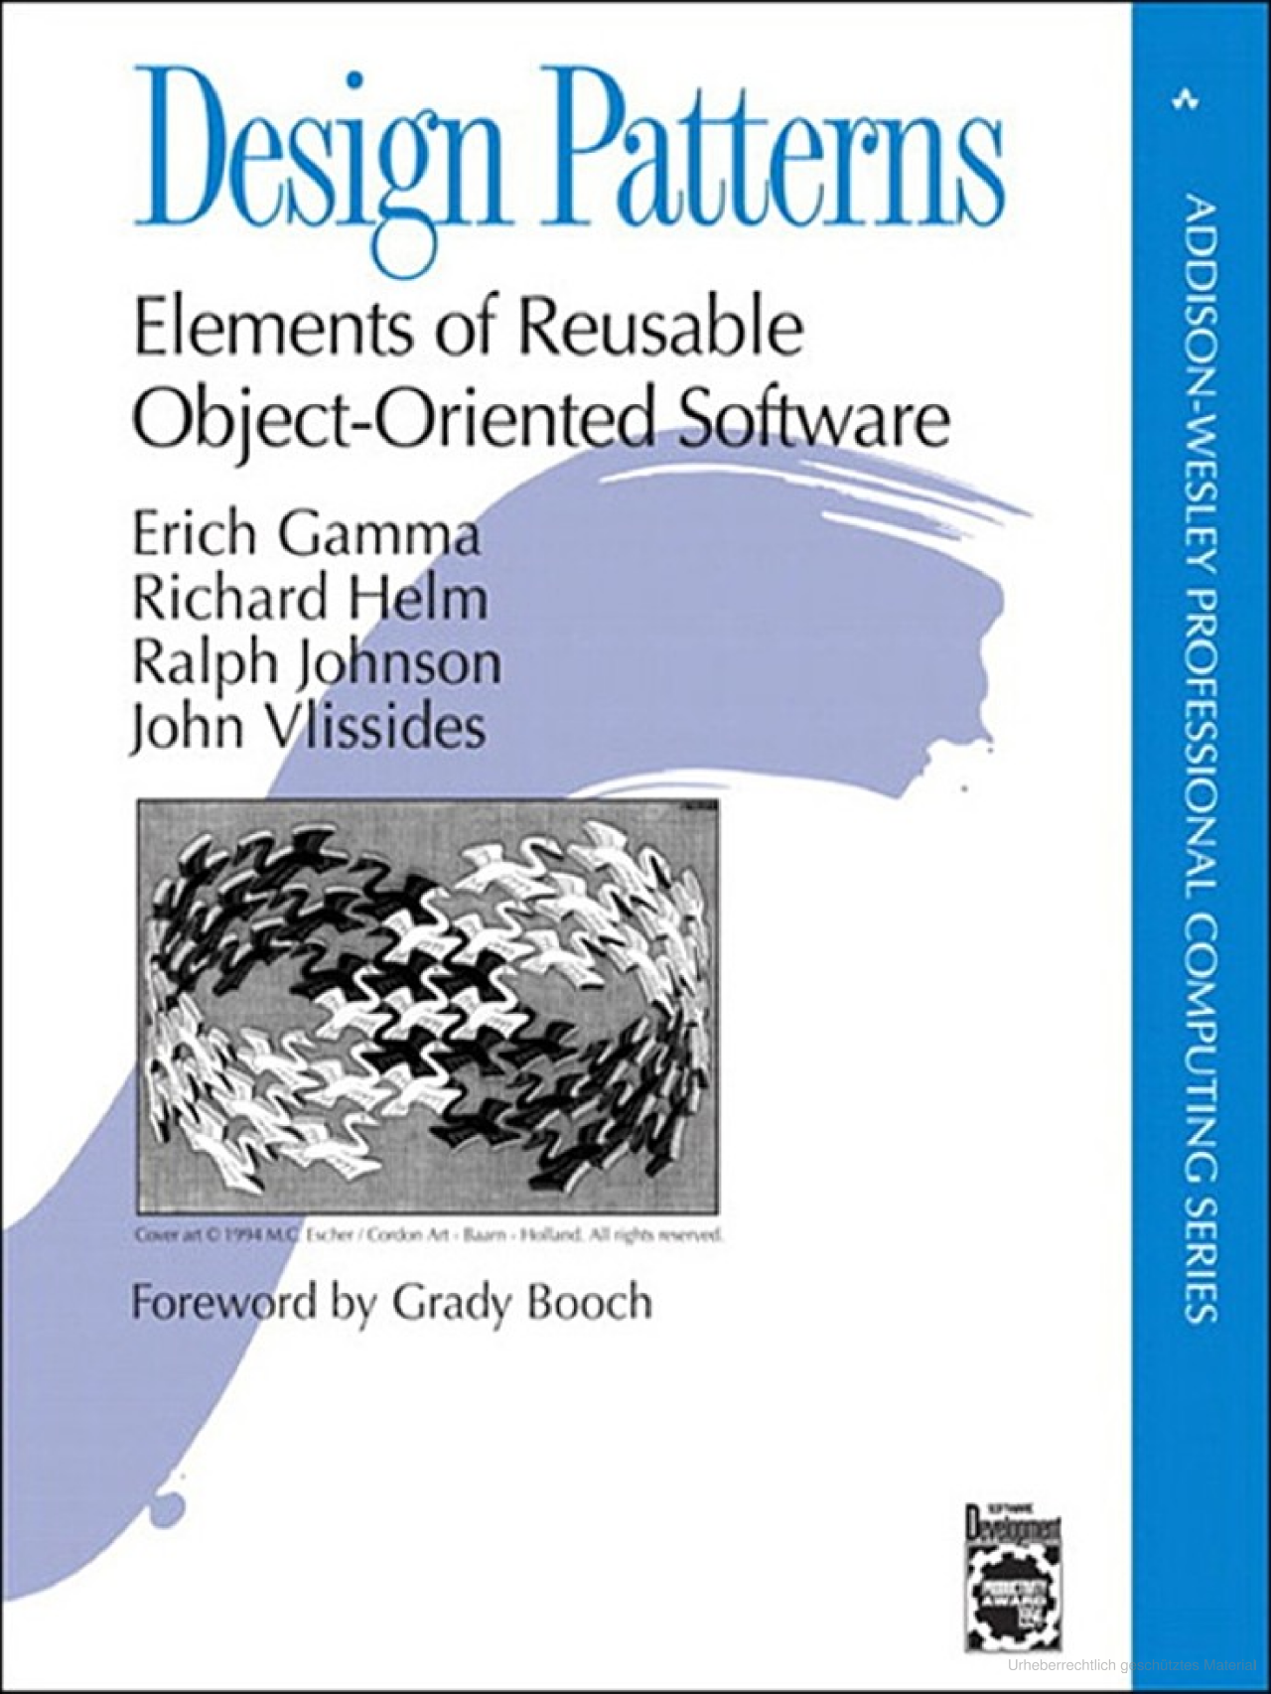
What ARE DESIGN PATTERNS
A Design Pattern is an abstracted solution to a commonly occuring problem customized
for some context, generally described by:
a name
a problem
a solution
consequences / trade-offs

Slide 2

What ARE DESIGN PATTERNS
Each pattern describes a problem which occurs over and over again
in our environment, and then describes the core of the solution
to that problem, in such a way that you can use it a million times over,
without ever doing it the same way twice.”
(C. Alexander et al., A Pattern Language: Towns, Buildings, Construction, p. x)

Slide 3
Pattern types
Creational: abstracting the instantiation process
(Builder, Factory Method, Abstract Factory etc.)
Structural: composing classes/objects to create other classes/objects
(Adapter, Decorator, Flyweight etc.)
Behavioural: algorithms and assigning responsibilities between objects
(Template Method, Iterator, Memento, Strategy, Visitor etc.)

Slide 4
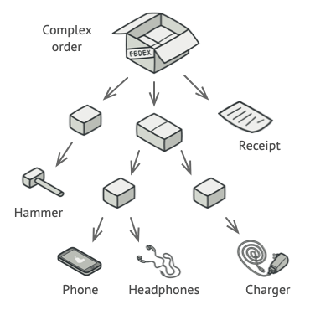
Composite Pattern
Structural pattern
Compose objects into tree structures
Let clients treat individual objects and compositions of objects uniformly.

Slide 5
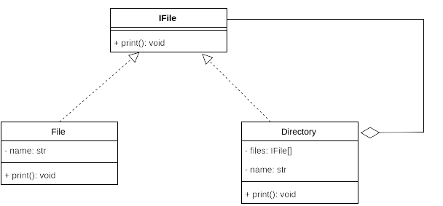
Why do we do this
Unified logic for all classes
Complexity is abstracted to implementation
Example:
Code does not care what it is working with, only the interface
Directory can delegate operations to inner objects
Component (IFile)
Leaf objects (File)
Composite (Directory)

Slide 6
Composite Task
https://innogam.es/lf10
If you have any questions feel free to ask us :^)

Slide 7
Remarks
Can make the design overly general, which can make it hard to restrict composite objects.
Client becomes simpler
Easy to add new kinds of components
Have you already worked with this pattern?
Create complex views in a GUI framework
Represent dir structure of os
Represent ASTs in a compiler

Slide 8
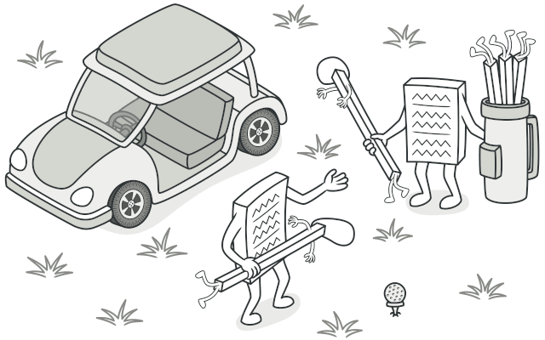
Strategy Pattern
Behavioral pattern
Family of algorithms
Encapsulate implementations away
Make them interchangeable

Slide 9
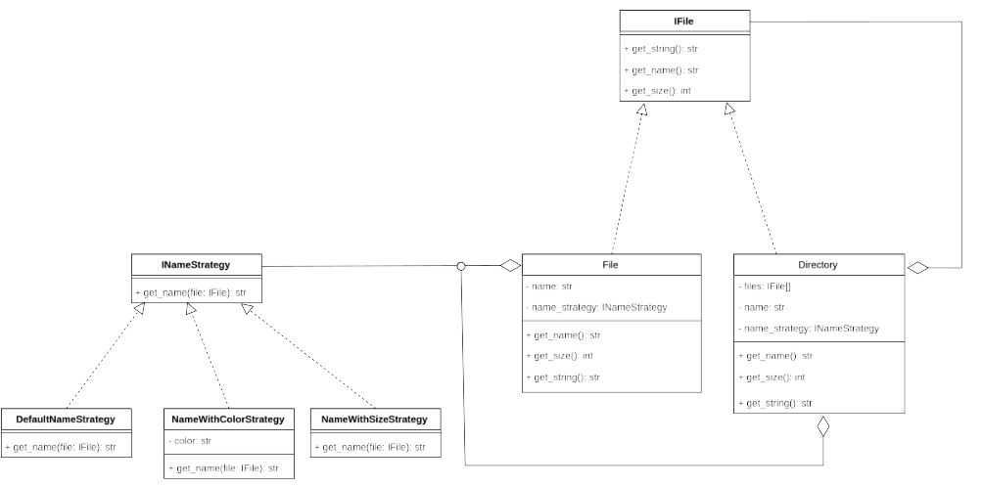
Why we do this
Different algorithm requirements
Configure class without inheritance
Avoid exposing algorithms to clients
Avoid complex conditional statements

Slide 10
Strategy Task
https://innogam.es/lf10
If you have any questions feel free to ask us :^)

Slide 11
Remarks
Clients must be aware of different strategies
Communication overhead
Increased number of objects
Different implementations for the same behavior
Eliminate conditional statements
Alternative to sub classing
Have you already worked with this pattern?
Sorting algorithms
Line breaking algorithm in text
Memory allocation strategies
Input validation strategies

Slide 12
Sources
E. Gamma et al., Design Patterns: Elements of Reusable Object-Oriented Software
C. Alexander et al., A Pattern Language: Towns, Buildings, Construction, p. x
Refactoring Guru, retrieved 2024-09-03 (https://refactoring.guru/)

Slide 13
The End

