Slide 1
Buyer behavior and target market selection

Slide 2
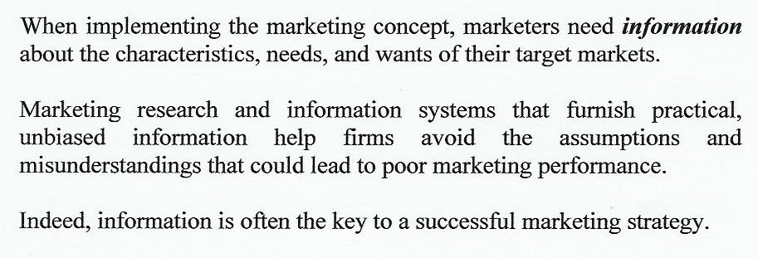

The nature and importance of information systems

Slide 3


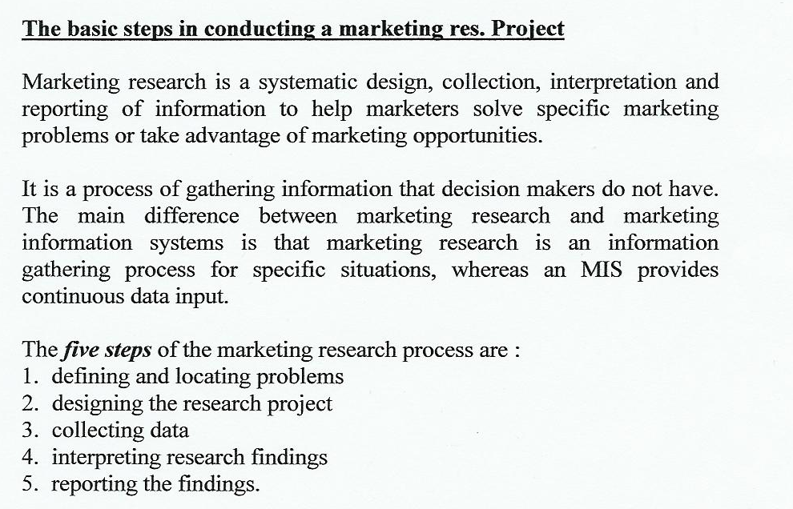


Slide 4

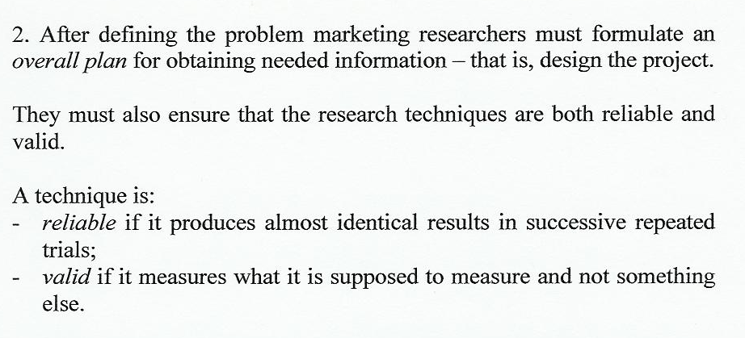
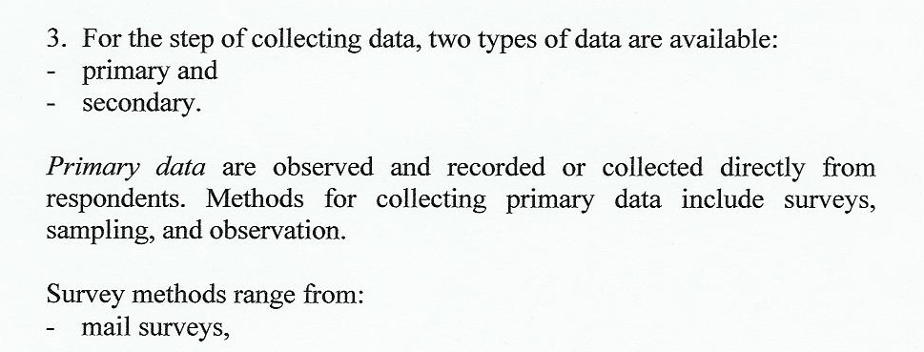

Slide 5

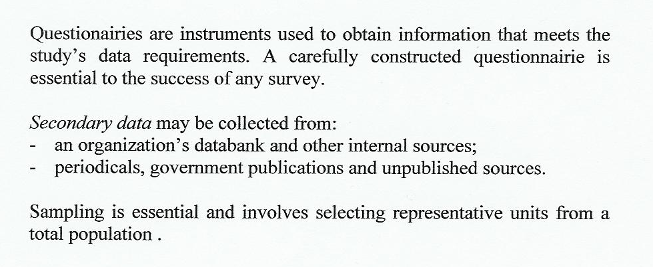


Slide 6


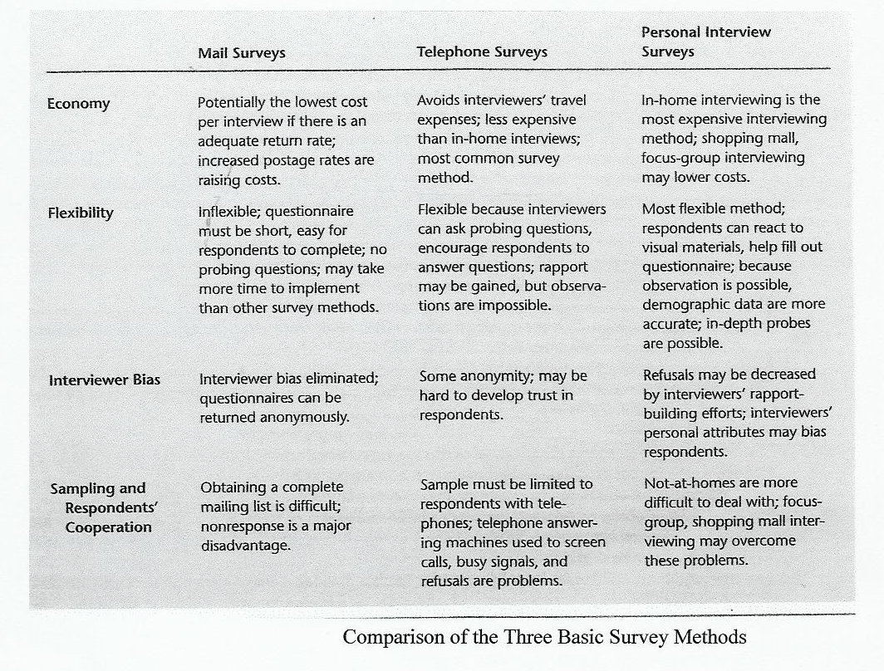

Slide 7

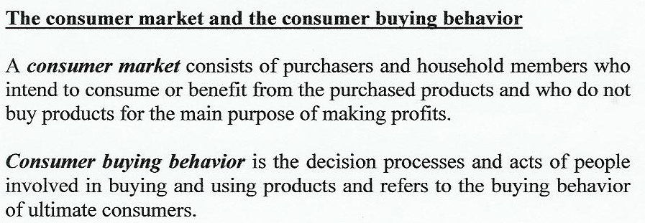
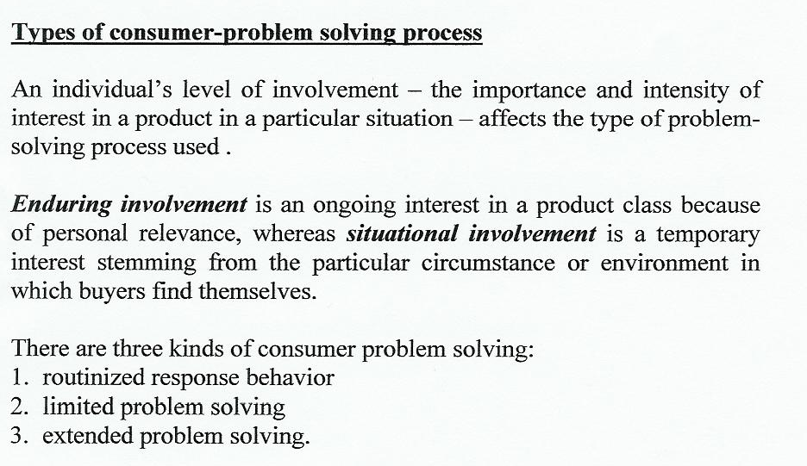

Slide 8
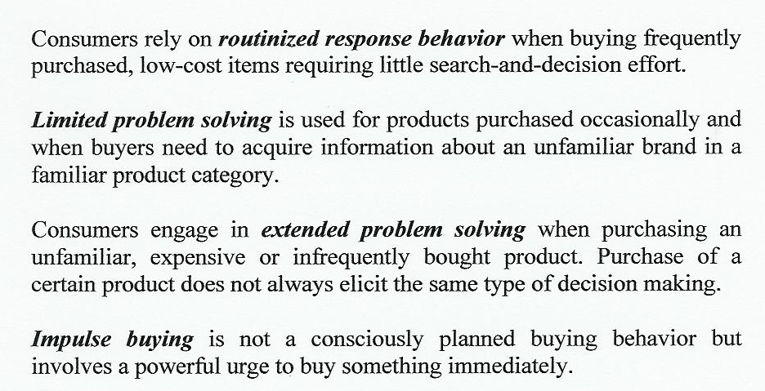
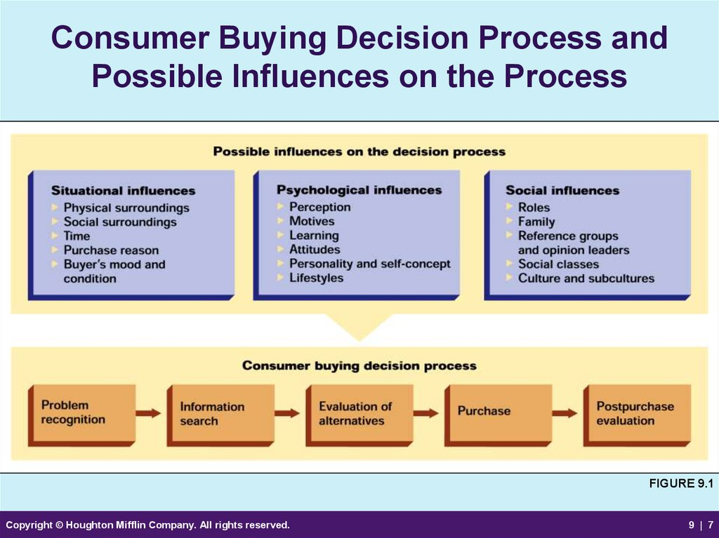

Slide 9


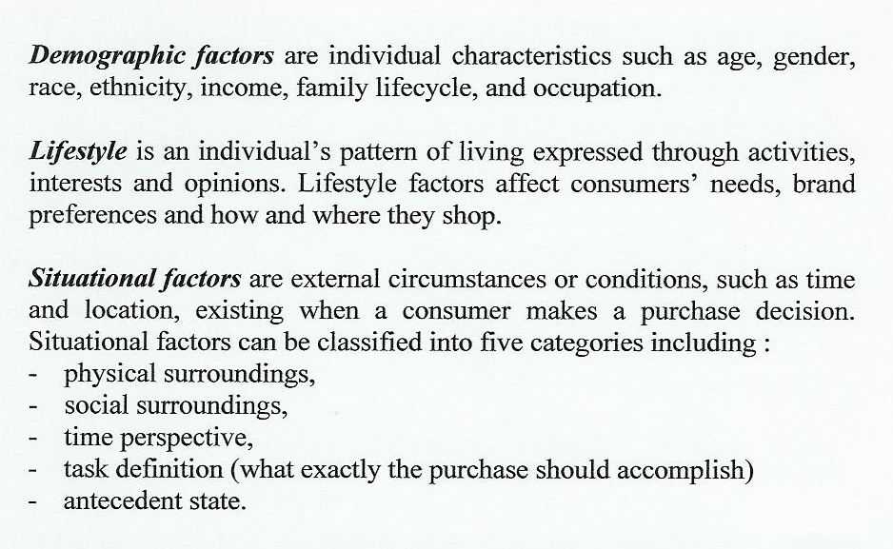

Slide 10
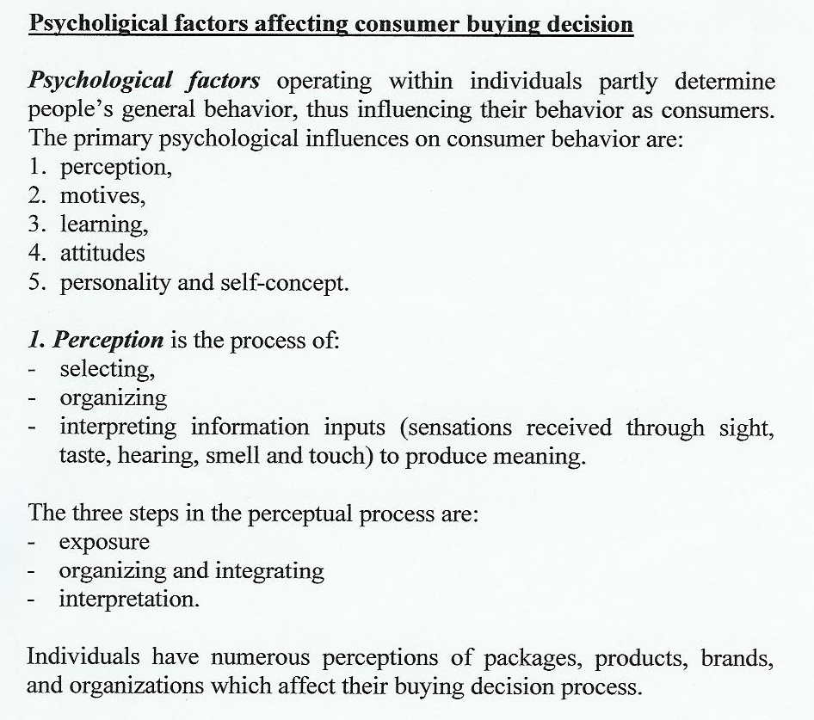
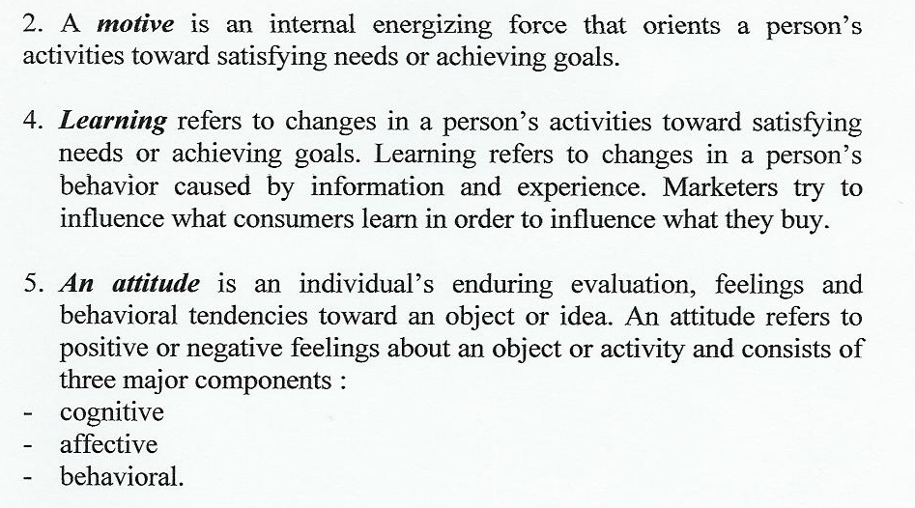

Slide 11

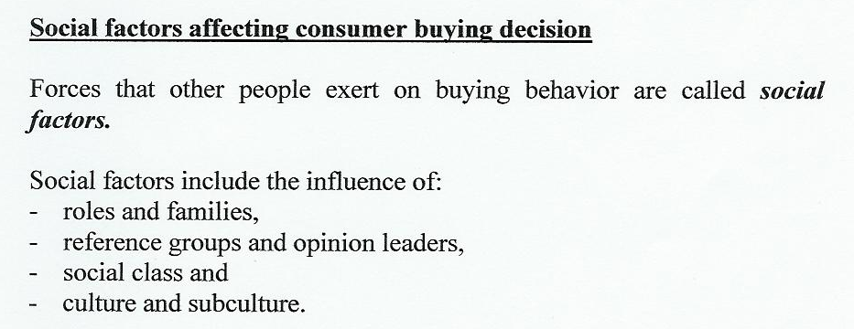

Slide 12
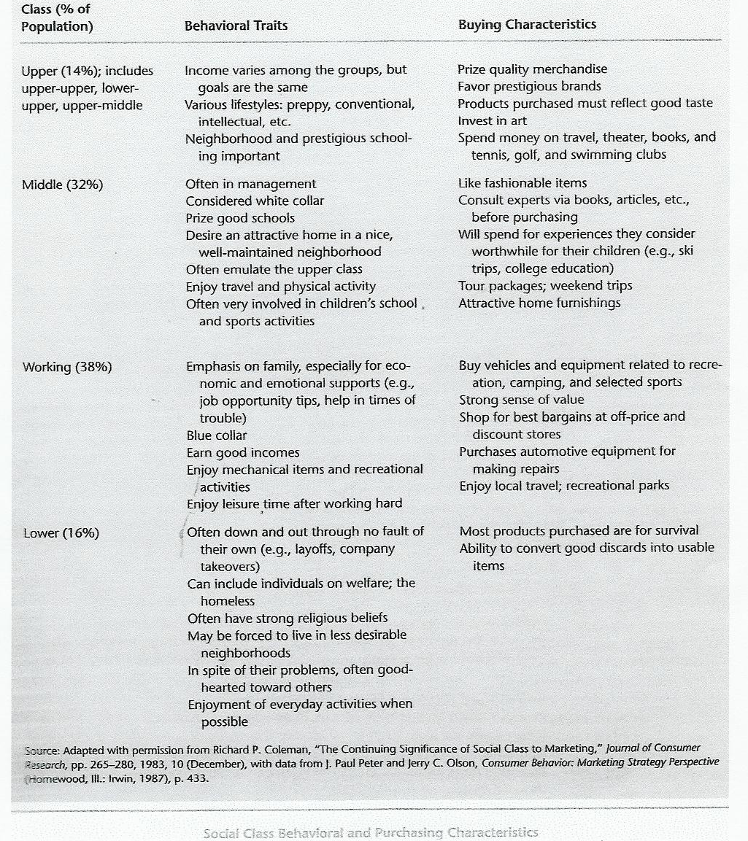

Slide 13

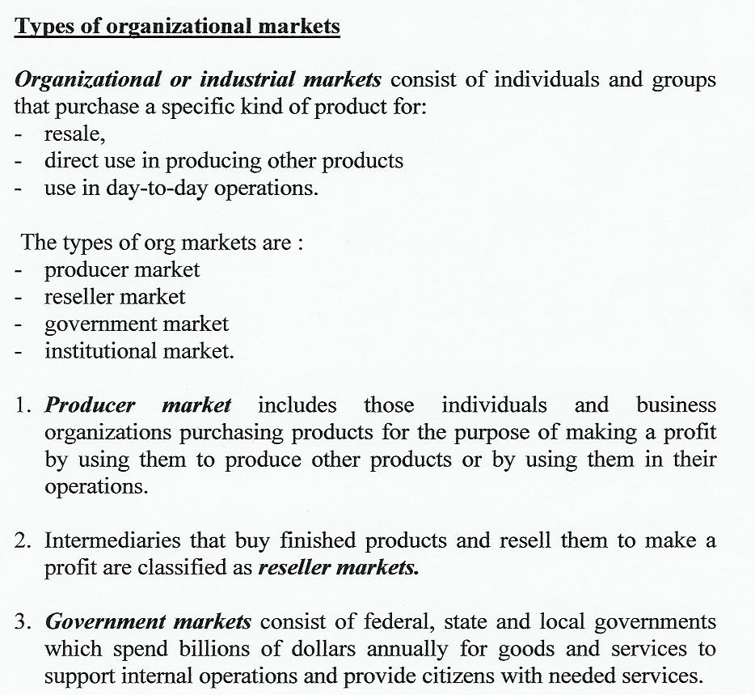

Slide 14

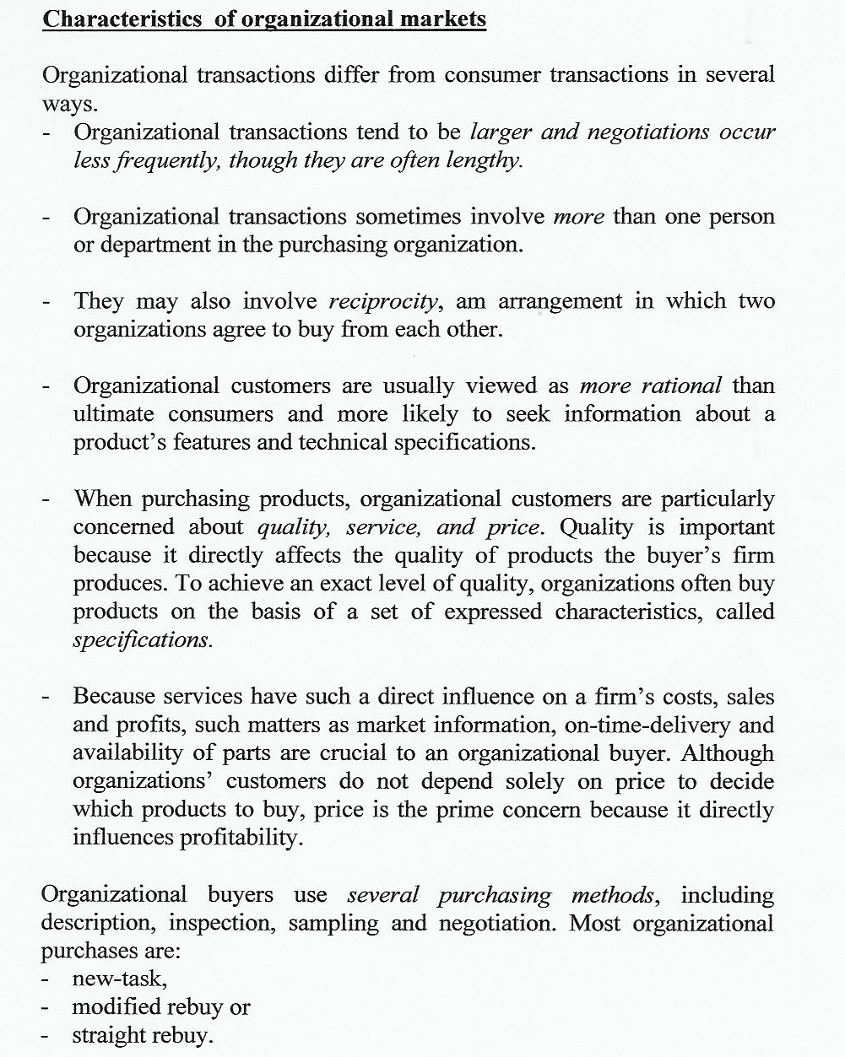

Slide 15
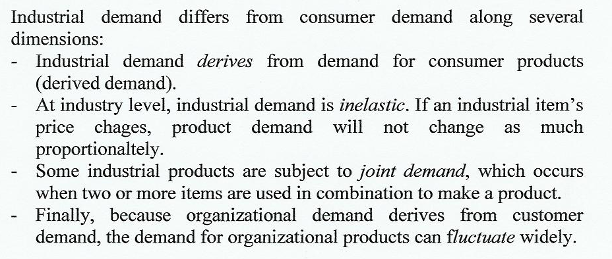
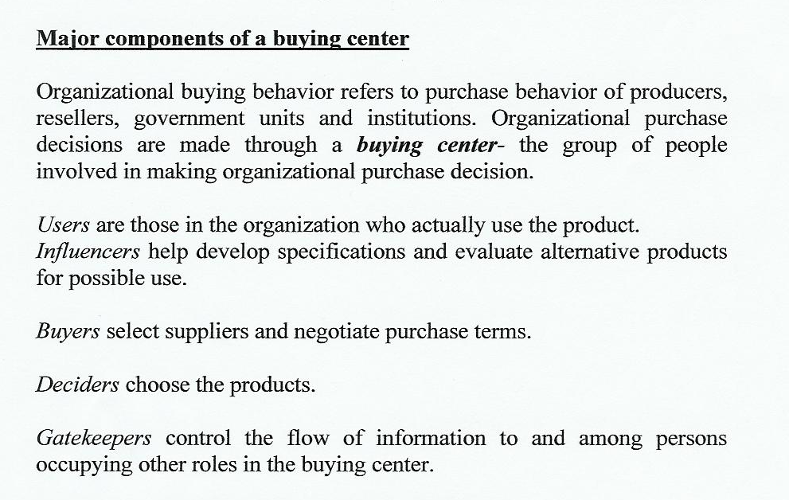

Slide 16

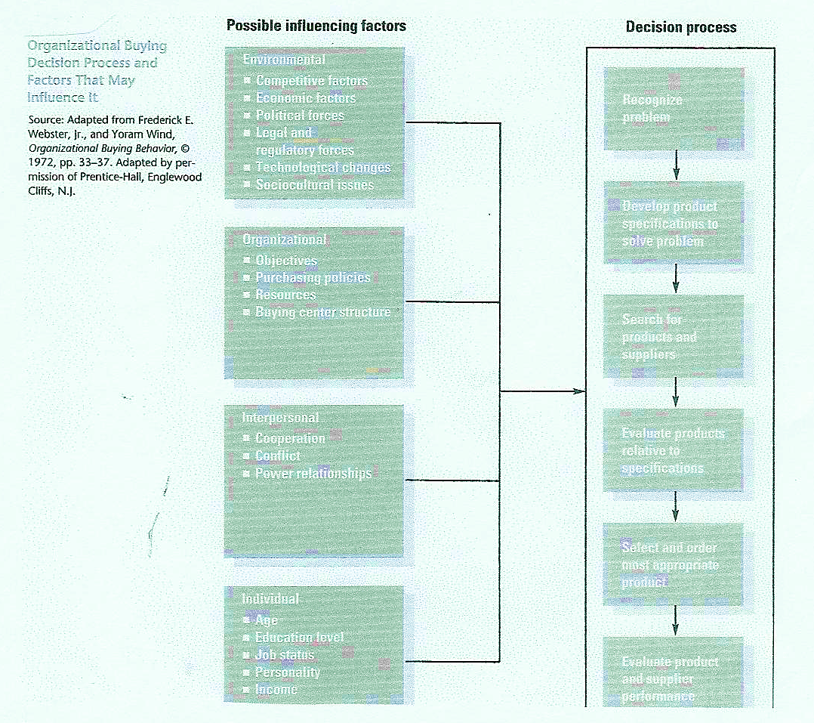

Slide 17


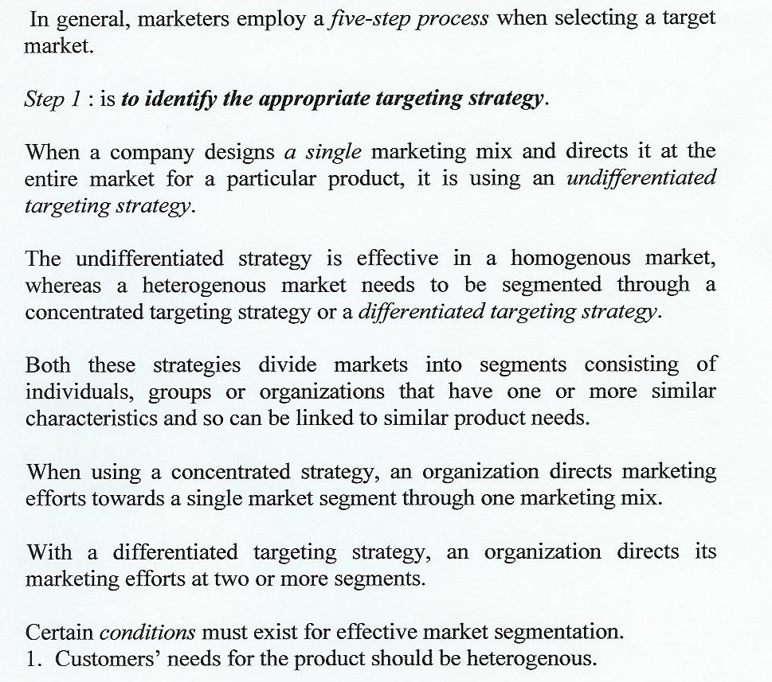

Slide 18

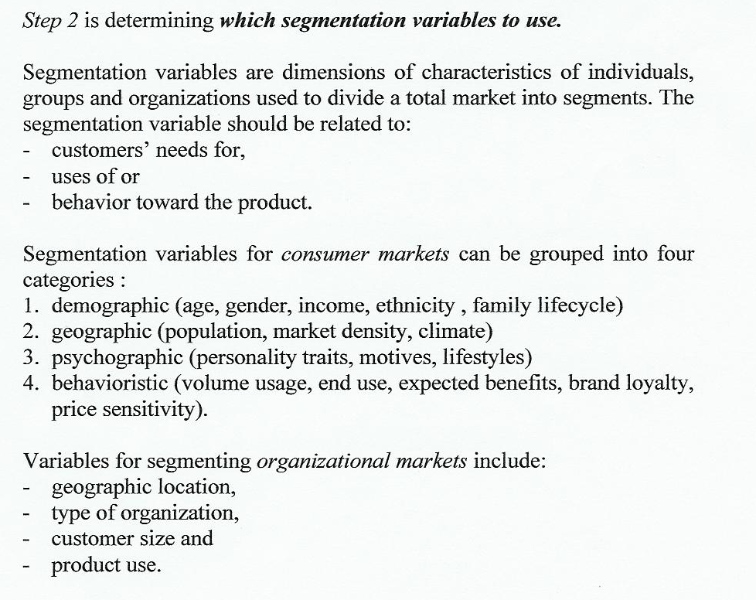

Slide 19
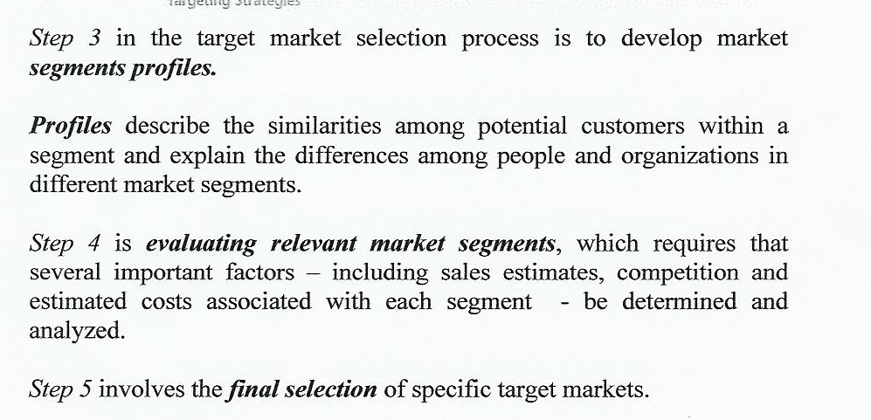

Slide 20
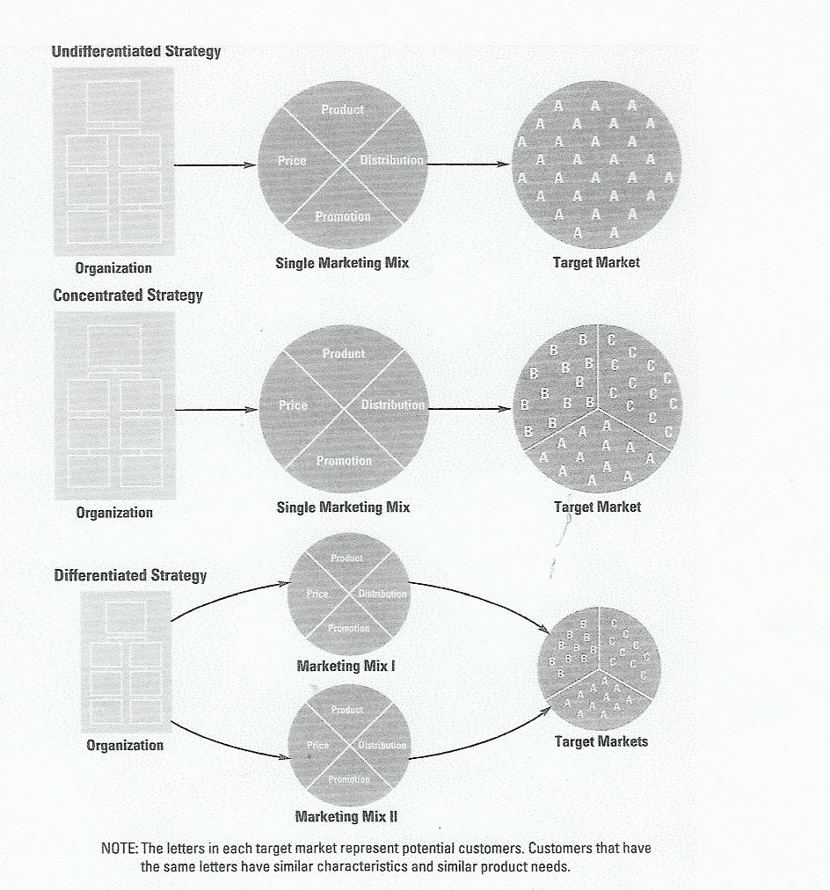

Slide 21
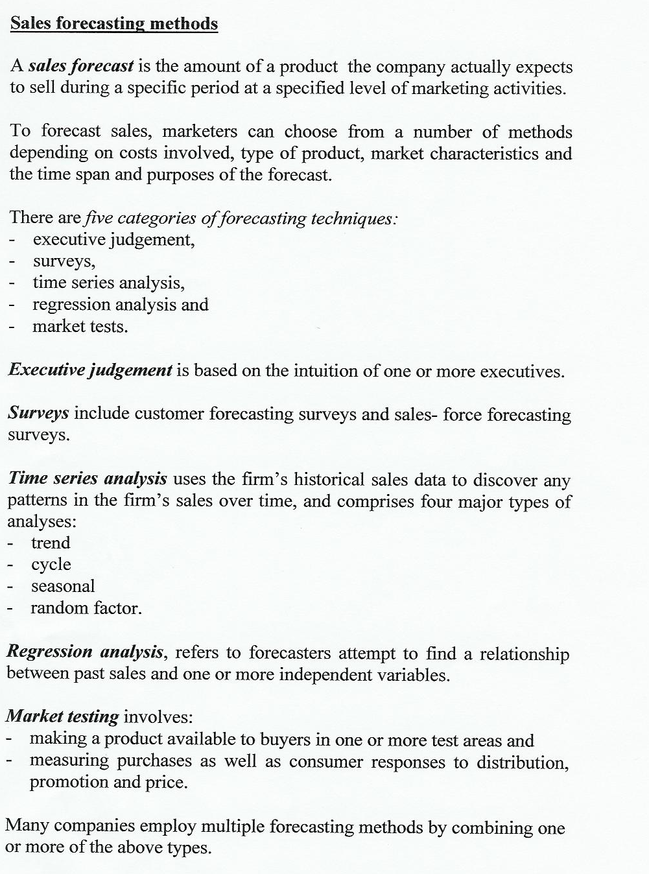

Slide 22
Target market analisys example
Products | Gender/ Rural/urban area/ age | Occupation/ income | How much and where presence online? | Hobby and lifestyle | Brands /smartphone
Books
Toys | Womens 27-43/ urban area | Business/ Montessori orientation/ Education /1000euro-2000 euro | Lunch/ at night/ facebook/ blogs | Cooking/ healthy nutrition/ casual style | Samsung, Apple Mothercare/ H&M
Wine | Men 30-35 urban area | Business relationship with the client/ corporations | Afternoon/ evening/ facebook/ instagram/ 9gag | Cooking, hiking/ fitnes/ smart casual/ city breaks | Fossil/ NB/ Levis/ 7 card/ Salomon Huawei /

