Slide 1
DISTRIBUTION DECISIONS
Marketing Channels

Slide 2
The nature of marketing channels
A marketing channel, or channel of distribution is a group of individuals and organizations that directs the flow of products from producers to customers.
The major role of marketing channels is to make products available at the right:
time ,
place
in the right amounts.
In most channels of distribution, producers and consumers are linked by marketing intermediaries or middlemen.
two major types of intermediaries:
retailers purchase products and resell them to ultimate consumers and
wholesalers buy and resell products to other wholesalers, retailers and industrial customers.

Slide 3
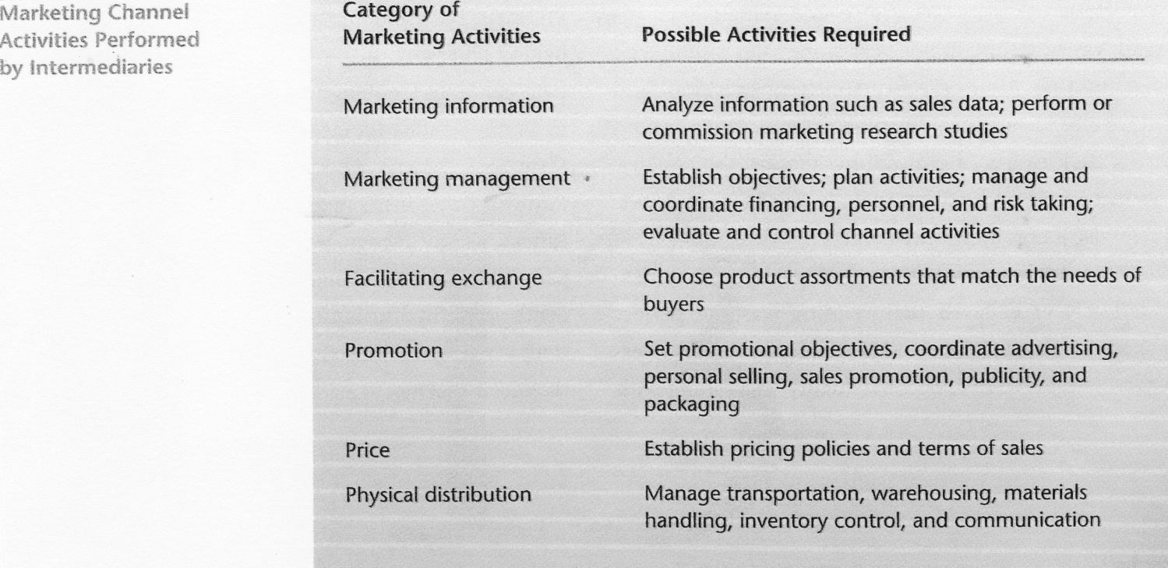

Slide 4
The functions of marketing channels
Marketing channels serve many functions.
1. They create:
time,
place and
possession utility
by making products available when and where customers want them and providing customers with access to product use through sale or rental.
2. Marketing intermediaries facilitate exchange efficiencies often reducing the costs of exchanges by performing certain services and functions.
critics suggest eliminating wholesalers, but their functions must be performed by someone in the marketing channel.
Because intermediaries serve both producers and buyers they reduce the total number of transactions that would otherwise be needed to move products from producers to ultimate users.

Slide 5
3. Marketing channels also help to overcome discrepancies in quantity and discrepancies in assortment through their sorting activities and through allocation.
4. Marketing channels help standardize transactions and provide customer services.

Slide 6
Types of marketing channels
Channels of distribution are broadly classified as:
channels for customer products or
channels for industrial products.
Although consumer goods can move directly from producers to consumers, consumer product channels including wholesalers and retailers are usually more economical and efficient.
Distribution of industrial products differs from that of consumer products in:
the type of channels used
the kinds of intermediaries available
transportation
storage and
inventory policies.
A direct distribution channel is common to industrial marketing.
Also used are channels containing manufacturers’ agents, industrial distributors or both agents and distributors.

Slide 7
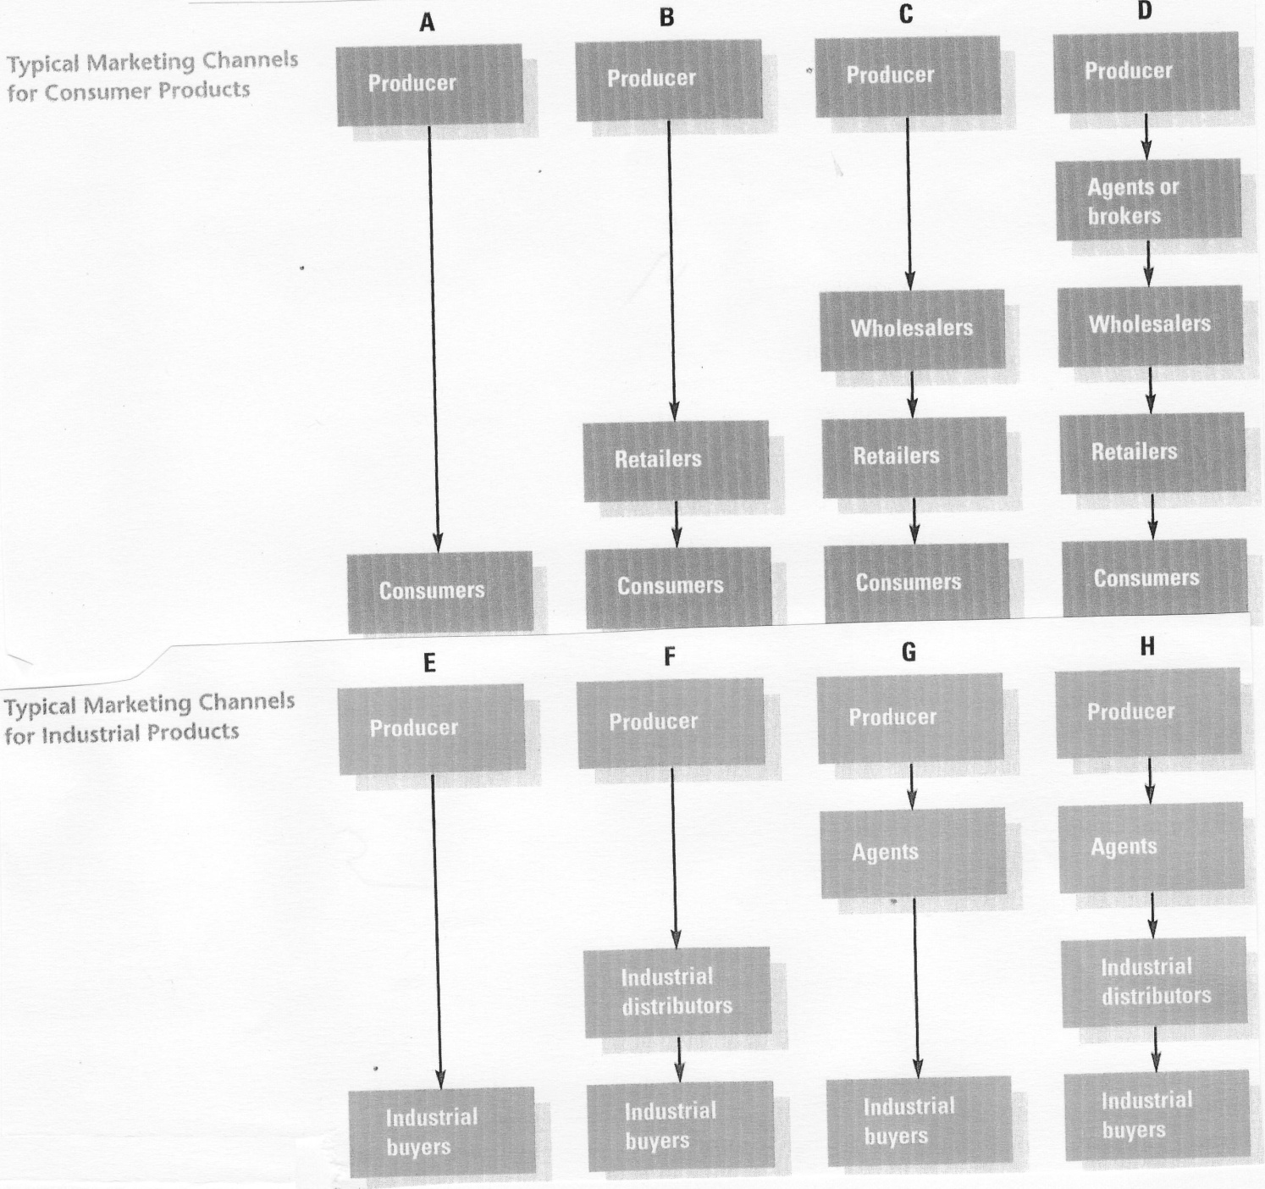

Slide 8
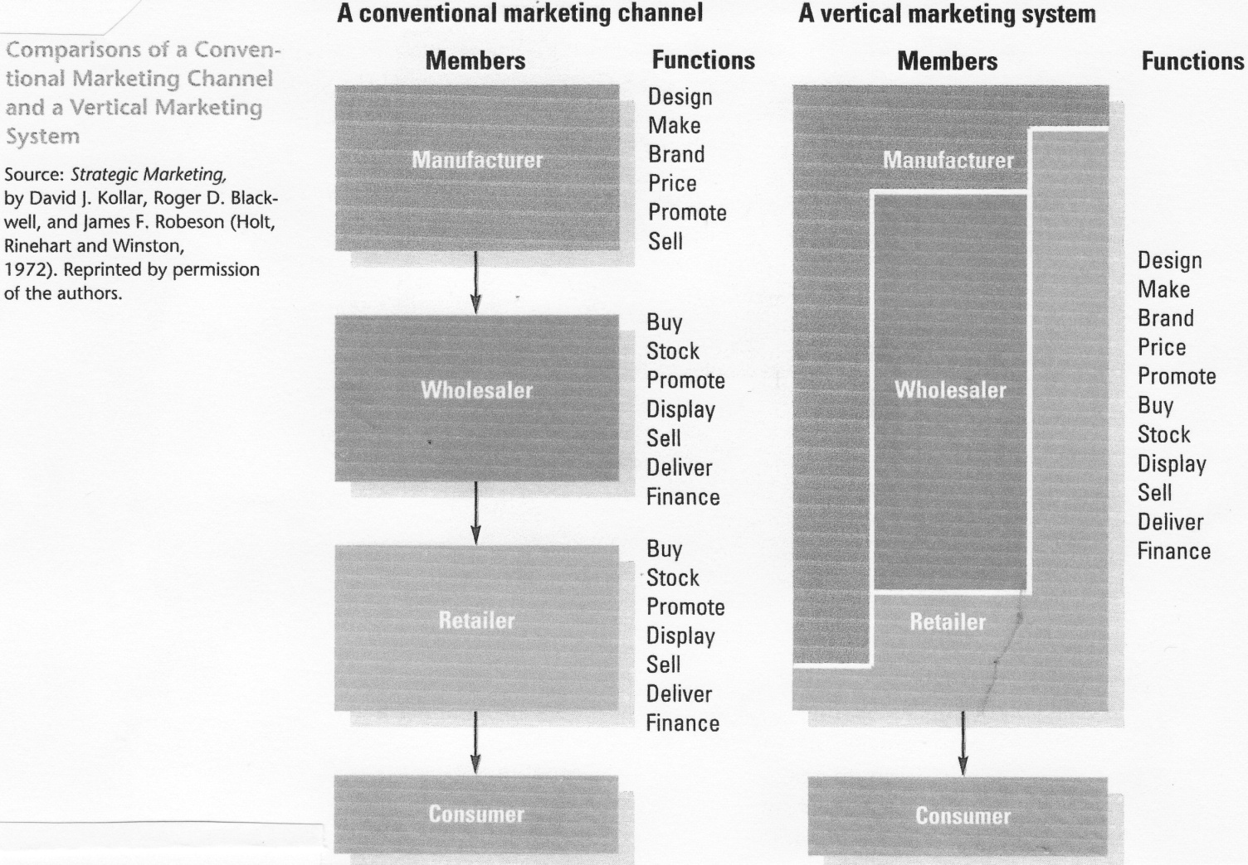
Channel integration
Integration of marketing channels brings various activities under one channel member’s management.
Vertical integration combines two or more stages of the channel under one management. The vertical marketing system is managed centrally for the mutual benefit of all channel members.
Vertical marketing systems may be:
corporate,
administered or
contractual.
Horizontal integration combines institutions at the same level of channel operation under a single management.

Slide 9
Levels of market coverage
A marketing channel is managed so that products receive appropriate market coverage.
In choosing intensive distribution, producers strive to make a product available to all possible dealers.
In selective distribution, only some outlets in an area are chosen to distribute a product.
Exclusive distribution usually gives one dealer exclusive rights to sell a product in a large geographic area.
Factors that affect marketers’ selection of distribution channels
Producers also consider:
the organization’s objectives
the available resources
the location
the density and size of the market
the buyers’ behaviour in the target market
the characteristics of the product
the outside forces in the marketing environment.

Slide 10
Legal issues
State and local laws regulate channel management to protect competition and free trade.
Courts may prohibit or permit a given practice depending on whether it violates this underlying principle.
Various procompetitive legislation applies to distribution practices.
Channel management practices frequently subject to legal restraint include:
  dual distribution,
  restricted sales territories
  tying agreements
  exclusive dealing
  refusal to deal.

Slide 11
Wholesaling
Wholesaling includes all transactions in which the purchaser intends to use the product for:
resale,
making other products
general business operations.
It does not include exchanges with ultimate consumers
The wholesalers’ function
Wholesalers are individuals or organizations that facilitate and expedite primarily wholesale transactions.
More than half of all goods are exchanged through wholesalers, although distribution of any product requires some wholesaling functions, whether or not a wholesaling institution is involved,
For producers, wholesalers:
perform specialized accumulation and allocation functions for a number of products
For retailers, wholesalers provide:
buying expertise,
wide product lines,
efficient distribution
warehousing
storage.

Slide 12
How wholesalers are classified
depends on:
  whether the wholesaler is owned by a producer,
  whether it takes title to products, the range of services it provides and the breadth and depth of its product lines.
The three general categories of wholesalers are:
  merchant wholesalers
  agents and brokers
  manufacturers’ sales branches and offices.
1. Merchant wholesalers are independently owned businesses that take title to goods and assume risk. They make up about two thirds of all wholesale firms.
They are:
  either full-service wholesalers, offering the widest possible range of wholesaling functions
  or limited-service wholesalers, providing only some marketing services and specializing in a few functions.
    Full-service merchant wholesalers include:
  general merchandise wholesalers offering a wide but relatively shallow product mix,
  limited-line wholesalers offering extensive assortments in a few product lines
  specialty-line wholesalers offering depth in a single product line or in a few items within a line. Rack jobbers are specialty-line wholesalers that own and service display racks in supermarkets and drugstores.

Slide 13
There are four types of limited-service merchant wholesalers:
cash-and-carry wholesalers sell to small businesses, require payment in cash and do not deliver
truck wholesalers sell a limited line of products from their own trucks directly to customers
drop shippers own goods and negotiate sales but never take possession of products
mail order wholesalers sell to retail, industrial and institutional buyers through direct-mail catalogues.
Agents and brokers, sometimes called functional middlemen:
negotiate purchases
expedite sales but do not take title to products.
are usually specialists, providing valuable sales expertise.
Agents represent buyers and sellers on a permanent basis.
Brokers negotiate exchanges between buyers and sellers on a temporary basis.

Slide 14
Changing patterns in wholesaling
Facilitating agencies do not buy, sell or take title but perform certain wholesaling functions. They include:
public warehouses,
finance companies
transportation companies
trade shows
trade marts.

Slide 15
Retailing
Retailing includes all transactions in which buyers intend to consume products through:
personal
family
household use.
Retailers – organizations that sell products primarily to ultimate consumers - are important links in the marketing channel because they are both marketers for and customers of wholesalers and producers.
Although retailing often takes place inside stores or service establishments, it also occurs through direct selling, direct marketing and vending machines.
Types of retailers
Retail stores can be classified by form of ownership.
The three major forms are :
  independent
  chain
  franchise stores.
Retail stores can also be classified according to the breadth of products offered

Slide 16
Two broad categories include:
general merchandise retailers
specialty retailers.
The primary types of general merchandise retailers include:
  department stores
  discount stores
  supermarkets
  superstores
  combination stores
  hypermarkets
  warehouse clubs
  warehouse
  catalogue showrooms.
Department stores are large retail organizations employing at least twenty-five people and characterized by wide product mixes in considerable depth for most product lines. Their products are organized into separate departments, which function like self-contained businesses.
Discount stores are self-service, low price, general merchandise outlets.
Supermarkets are large, self-service food stores that also carry some nonfood products.

Slide 17
Superstores are giant retail outlets carrying all products found in supermarkets and many consumer products purchased on a routine basis.
Combination stores stock both food items and general merchandise.
Hypermarkets offer supermarket and discount store shopping at one location.
Warehouse clubs are large-scale, members-only discount operations
Warehouse and catalogue showrooms are low-cost operations characterized by warehouse methods of materials handling and display, large inventories and minimum services.
Specialty retailers offer substantial assortments in a few product lines.
They include:
  traditional specialty retailers, which carry narrow product mixes with deep product lines
  off-price retailers, which sell brand name manufacturers’ seconds and production overruns at deep discounts,
  category killers – large specialty stores that concentrate on a single product line and compete on the basis of low prices and enormous product availability.

Slide 18
Nonstore retailing
Nonstore retailing is selling goods or services outside the confines of a retail facility.
The three major types of nonstore retailing include;
  direct selling, (marketing of products to ultimate consumers through face-to face sales presentations at home or in the workplace)
  direct marketing,(the use of telephone and nonpersonal media to communicate product and organizational information to consumers who then can purchase products by mail or telephone)
  automatic vending. (the use of machines to dispense products selected by customers when money is inserted)
Forms of direct marketing include:
  catalogue marketing,
  direct response marketing,
  telemarketing,
  television home shopping,
  and computer –interactive retailing.

Slide 19
Franchising
Franchising is an arrangement whereby a supplier grants a dealer the right to sell products in exchange for some type of consideration.
Retail franchises are of three general types :
a manufacturer may authorize a number of retail stores to sell a certain brand name item
a producer may license distributors to sell a given product to retailers
a franchiser may supply brand names, techniques or other services instead of a complete product.

Slide 20
Strategic issues in retailing.
To increase sales and store patronage, retailers must consider strategic issues.
Location determines the trading area from which a store draws its customers and should be evaluated carefully.
When evaluating potential sites, retailers take into account a variety of factors, including:
  the location of the firm’s target market within the trading area
  the kinds of products being sold
  the availability of public transportation
  customer characteristics
  competitors’ locations.
Retailers can choose among several types of locations:
  free-standing structures,
  traditional business districts,
  neighbourhood shopping centres,
  community shopping centres,
  regional shopping centres,
  non-traditional shopping centres.
The width, depth and quality of the product assortment should be of the kind that can satisfy the retailer’s target market customers.

Slide 21
Retail positioning involves identifying an unserved or underserved market niche or segment and serving the segment through a strategy that distinguishes the retailer from others in people’s minds.
Atmospherics comprises the physical elements of a store’s design that can be adjusted to appeal to customers’ emotions and thus induce customers to buy.
Store image, which various consumers perceive differently, derives not from atmosphere but also from location, products offered, customer services, prices, promotion and the store’s overall reputation.
Scrambled merchandising adds unrelated product lines to an existing product mix and is being used by a growing number of stores to generate sales.
The wheel-of-retailing hypothesis holds that new retail institutions start as low-margin and low price operations. As they develop, they increase service and prices and eventually become vulnerable to newer institutions, which enter the market and repeat the cycle.

Slide 22
Physical Distribution
Physical distribution is a set of activities that moves products from producers to consumers or end users.
These activities include:
  order processing,
  materials handling,
  warehousing,
  inventory management and
  transportation.
  The main objective of physical distribution is:
    to decrease costs while
    increasing customer service.

Slide 23
Activities of physical distribution
Order processing
Order processing, the first stage in a physical distribution system is the receipt and transmission of sales order information.
Order processing consists of three main tasks.
  Order entry is placing purchase orders from customers or salespersons by mail, telephone or computer.
  Order handling involved checking customer credit, verifying product availability and preparing products for shipping.
  Order delivery is provided by the carrier most suitable for a desired level of customer service.
Materials handling
Materials handling or physical handling of products is an important element of physical distribution.
Packaging, loading and movement systems must be coordinated to take into account both cost reduction and customer requirements.
Warehousing
Warehousing involves design and operation of facilities for storing and moving goods.
Private warehouses are owned and operated by a company for the purpose of distributing its own products.
Public warehouses are business organizations renting storage space and relate physical distribution facilities to other firms.

Slide 24
Public warehouses may furnish security for products that are being used as collateral for loans by establishing field warehouses. They may also provide bonded storage for companies wishing to defer tax payments on imported or taxable products.
In many cases, a combination of private and public facilities is the most flexible warehousing approach.
Inventory management
The objective of inventory management is to:
  minimize inventory costs
  maintain a supply of goods adequate for customers’ needs.
The order size that has the lowest total of both order- processing costs and inventory costs is called the economic order quantity (EOQ). Some organizations have abandoned EOQ and use the just-in-time (JIT) approach instead. The just-in-time approach means that products arrive just as they are needed for use in production or resale.

Slide 25
Transportation
Transportation adds:
  time utility
  place utility to a product by moving it from where it is made to where it is purchased and used.
The five major modes of transporting goods are:
railroads
trucks
waterways
airways
pipelines.
Marketers evaluate transportation modes with respect to:
  costs,
  speed,
  dependability,
load flexibility,
  accessibility
  frequency.

