Slide 1


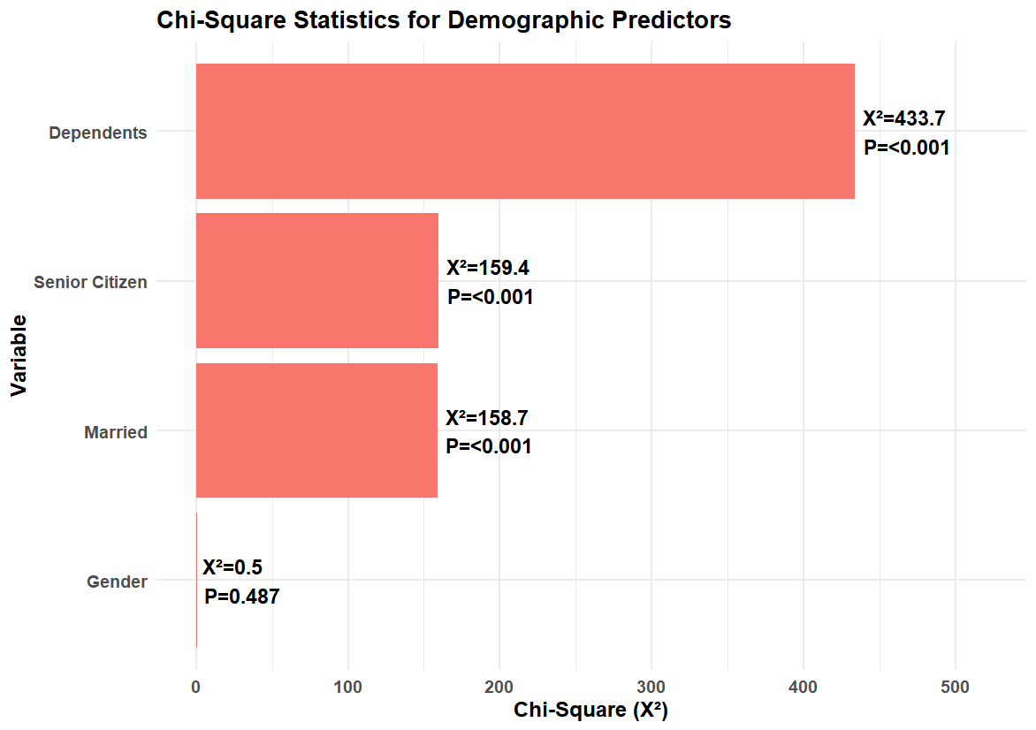
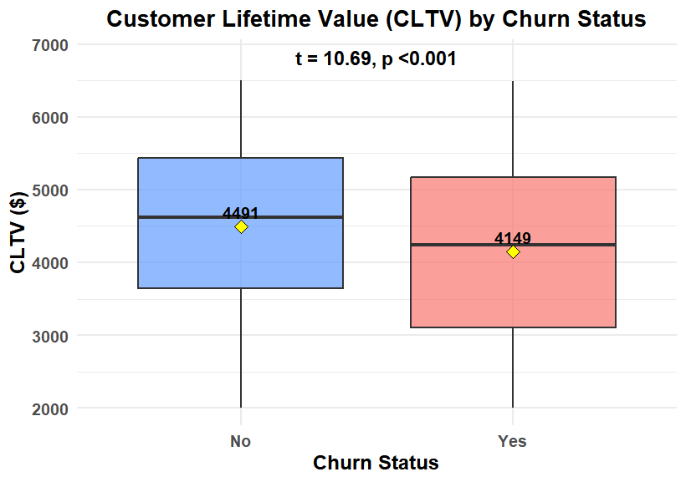
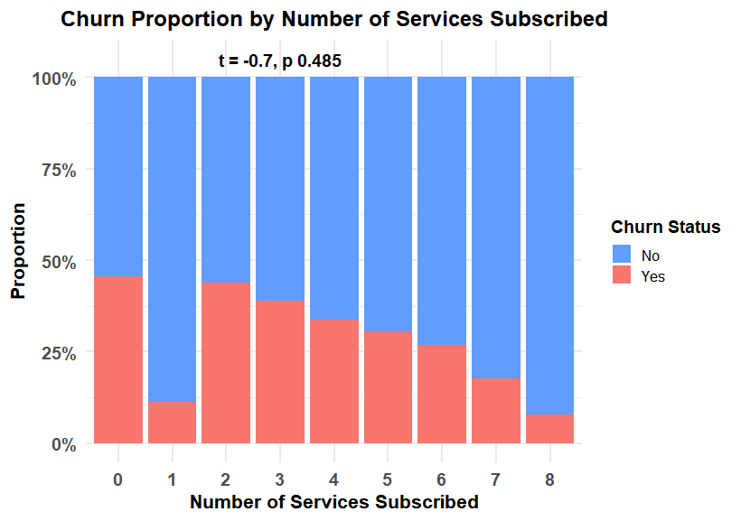
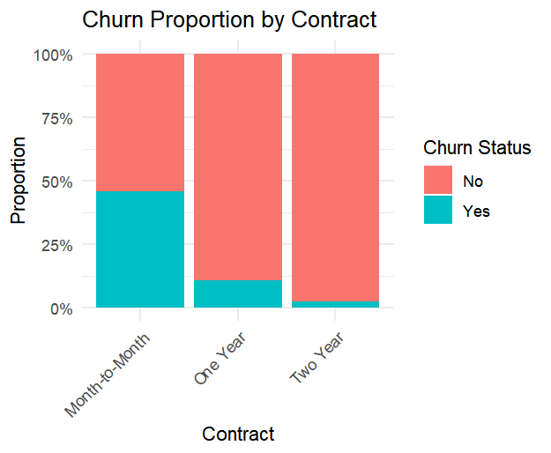
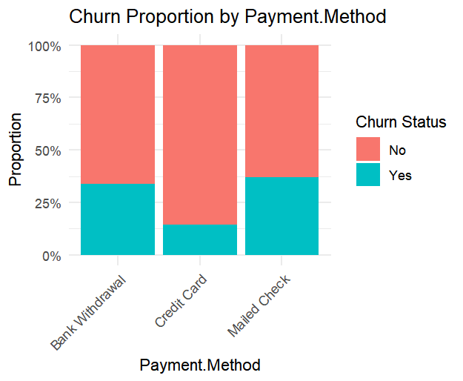
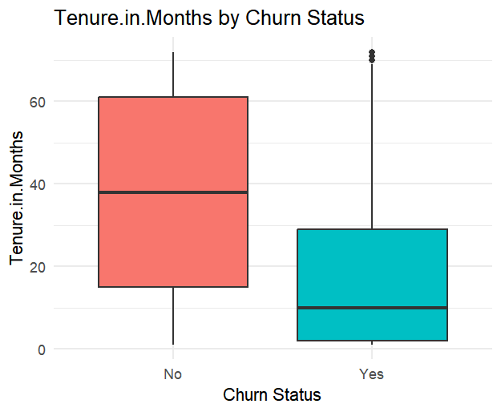
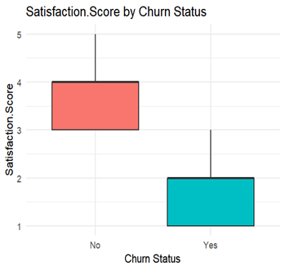
Predicting Customer Churn in Telecom Services Mihret Tesfaye Advisor: Jitendra Sai Kota, Ph.D.
Introduction
missing/inconsistent values
Created new features:
Tenure Group (0–12, 13–24, 25+ months)
Service Count (total services subscribed)
Exploratory Analysis
Bar charts: churn by contract type, internet type, payment method
Boxplots: tenure, CLTV, satisfaction score by churn vs. non-churn
Scatterplots: CLTV vs. churn score
Statistical Testing
Chi-square tests for categorical predictors vs. churn
t-tests / ANOVA for numeric differences (tenure, CLTV, satisfaction)
Customer churn is a major challenge in the telecommunications industry, where retaining customers is more cost-effective than acquiring new ones.
Identifying the factors that influence churn helps companies improve service quality and develop targeted retention strategies.
This project uses the Telco Customer Churn dataset (7,043 customers) from a fictional California telecom provider.
Focus areas include demographic characteristics, service usage, satisfaction indicators, and customer lifetime value.
Objectives
Identify the customer characteristics and service attributes that most strongly predict churn.
Assess how contract type, internet service, and payment method influence churn likelihood.
Evaluate the relationship between tenure, satisfaction score, and CLTV with churn behavior.
Determine which demographic groups (e.g., senior citizens, dependents, marital status) are more likely to churn.
Provide data-driven insights to support effective customer retention strategies.
Results
Conclusion
Month-to-month contracts & electronic check payments highest churn (p < 0.001)
Churned customers: shorter tenure, lower satisfaction (p < 0.001); slightly lower CLTV
Higher churn among senior citizens, unmarried customers, and those without dependents (Chi² p < 0.001)
High-risk segments should be prioritized for targeted retention strategies
Methods
Dataset Overview
n = 7,043 customers from a fictional California telecom provider
Variables included:
Demographics (Age, Senior Citizen, Married, Dependents)
Services (Internet Type, Phone, Streaming, Security, Contract, Payment)
Performance (Satisfaction Score, Churn Score, CLTV)
Data Preparation
Imported Excel dataset; checked for
χ² = 1445.3, p < 2.2e-16
χ² = 337.8, p < 2.2e-16
Limitations
Dataset limited to one region; results may not generalize.
Some variables, like customer interactions, complaints, or promotional offers, are not included.
Future work: Use machine learning models (logistic regression, random forest) to predict churn.
t = 34.88, p < 2.2e-16
t = 94.97, p < 2.2e-16

Slide 2
Reference
OpenAI. (2025). ChatGPT (version 5.1) [Large language model]. https://chat.openai.com/
YBI Foundation. (n.d.). Telecom customer churn prediction [Notebook]. Kaggle. https://www.kaggle.com/code/ybifoundation/telecom-customer-churn-prediction

