Slide 1
Monitoring - network traffic – on the terminal side
Gábor Fehér, Balázs Lajtha – Budapest University of Technology and Economics

Slide 2
Outline
Monitoring
Terminal side traffic monitoring scenarios
Android capabilities for monitoring
The application
Firewall solution
VPN solution
Summary and future work

Slide 3

Monitoring
Data helping to improve QoE and detect white spots
User device
Used applications
Running services
Location and speed
User network technology
Packet level network traffic data

Slide 4
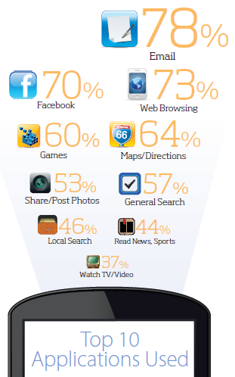
Monitoring scenarios – for the provider
Know more
About your customer
What devices do customers use
What applications does customers use
When do they use it
Where do they use it
About your service
What quality do you provide at the endpoint
Remote assistance

Slide 5

Monitoring scenarios – for the user
Self diagnostics
Check how your network performs without active synthetic measurements
Check if app performance is related to a network issue
Provide proof of network defects
Malware detection
With the proper analysis tools detect misbehaving applications

Slide 6
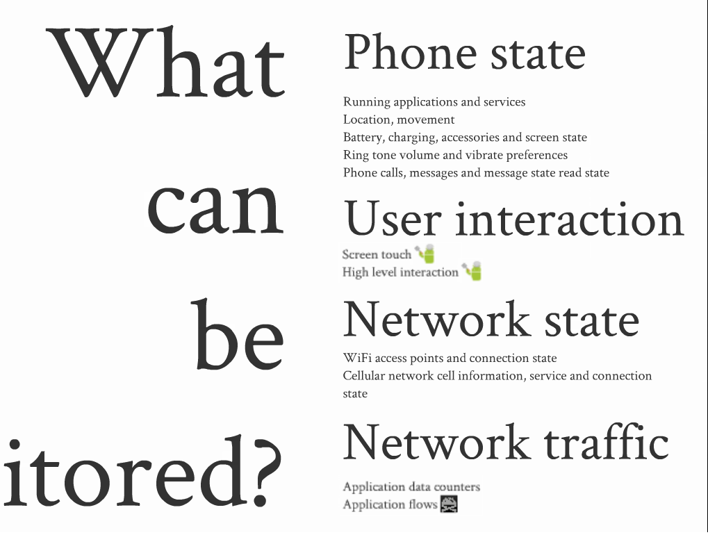
Android capabilities

Slide 7

Android capabilities – network traffic
API
TrafficStats – since 2.2
Total/cellular traffic
Traffic by userId
Traffic by protocol (TCP vs UDP)
Linux
tcpdump
Firewall rules
Apps
tPacketCapture
VPNService – since 4.0

Slide 8
The application
Features
Collected data
Running applications and services
Foreground application and activity
Battery level and charging state
CPU and memory usage
Easy to extend through Task interface
Data polled periodically
Polling each second doesn’t drain battery
File format
Each Task has it’s own output file, string log message required
Data collection
Data is uploaded periodically to a server through selected network protocol and SSID

Slide 9
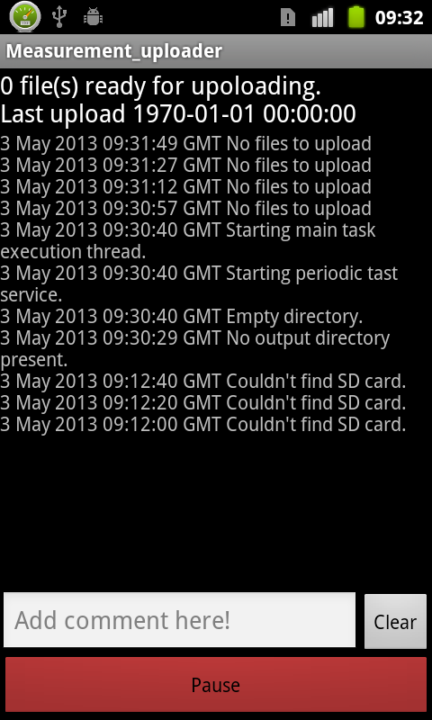
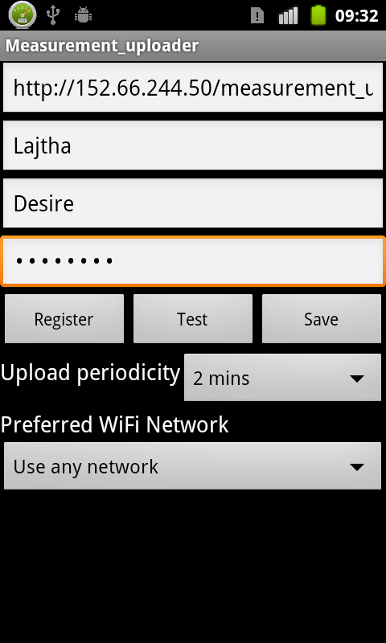
The application – user interface
Notification – required by the platform
Main screen – system log, start/stop monitoring, tagging
Settings – server and credentials, timing, network

Slide 10
The firewall solution
Linux tools
Uses firewall rules to capture packets
Find applications when TCP syn packet found
softflowD counts data volume and packets
Flow data is saved with application id
Requires root access

Slide 11
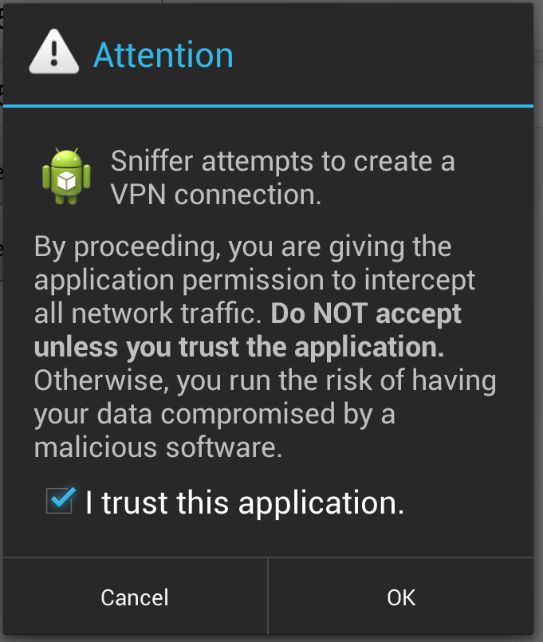
VPN solution
Since 4.0
Needs user’s permission to create VPN interface
Doesn’t require root access
Intended for VPN purposes

Slide 12
The VPN solution – technical details
Raw IP packets sent through the tunnel interface can be read from an InputStream
Raw IP packets are expected by an OutputStream
Normal operation
Open a socket, exclude socket from VPN
Read data from InputStream
Send data through the socket to a VPN server
Receive data on the socket
Write received data to the tunnel’s stream
Sniffer operation
Sending and receiving of raw IP packets is a root protected feature
Have to use high level sockets to send out and receive data

Slide 13
The VPN solution –operation
Receive data from InputStream
Find packets
Extract IP and transport headers from packets
Create the appropriate sockets
Send data
Receive data
Build raw headers for received data
Write packets to OutputStream

Slide 14
The VPN solution – issues
Managing sockets
Timeout parameters, window size
Implementing TCP signaling
Sequence numbers, acknowledgments, SYN message flow is required in the raw IP packets but is not accessible from the TCP sockets
Packet information is lost for TCP
No incoming packets: no timing no packet length, only stream
Synchronization
Performance
Not measured yet

Slide 15
Current state
The application
Ready
Minor modifications needed in the upload procedure
The softflow based solution
Ready
Tested and ran on several devices
Overall a couple of month worth of traffic data collected
VPN solution
UDP in prototype phase
TCP solution under development
Testing infrastructure under development

Slide 16
Future work
Finish and deploy VPN based solution
Process data
Use data as training set for flow based application authentication
Perform controlled experiments to generate flows with known quality of experience for some applications

Slide 17
www.hsnlab.hu hsnlab.tmit.bme.hu
Thank you!
Questions?

