Slide 1
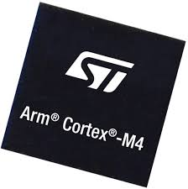

Slide 2


Slide 3
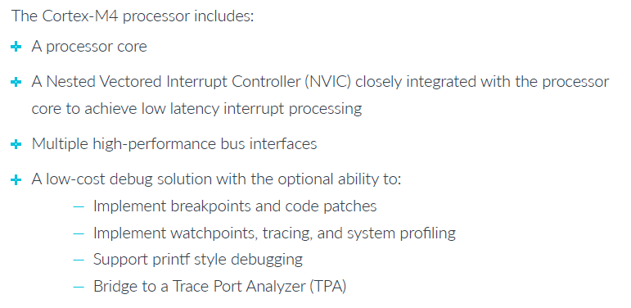

Slide 4
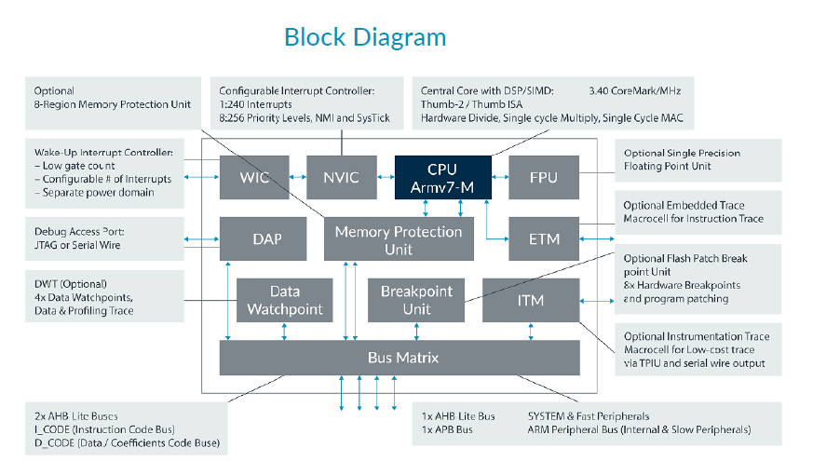

Slide 5
Cortex-M4 Components
Processor
The Cortex-M4 processor features a low gate count processor core, with low latency
interrupt processing that has:
A subset of the Thumb instruction set
Banked Stack Pointer (SP)
Hardware divide instructions, SDIV and UDIV
Support for interruptible-continued instructions LDM, STM, PUSH, and POP
for low interrupt latency
Automatic processor state saving and restoration for low latency Interrupt Service Routine (ISR) entry and exit
Big-endian byte-invariant or little-endian accesses

Slide 6
Floating Point Unit (FPU) in the Cortex-M4 with FPU processor providing:
32-bit instructions for single-precision (C float) data-processing operations
Combined Multiply and Accumulate instructions for increased precision (Fused MAC)
Hardware support for conversion, addition, subtraction, multiplication with optional accumulate, division, and square root
Hardware support for denormals and all IEEE rounding modes
32 dedicated 32-bit single precision registers, also addressable as 16
double-word registers
Decoupled three-stage pipeline

Slide 7
ETM (Embedded Trace Microcell) interface
The ETM interface enables simple connection of an ETM to the processor. It provides a channel for instruction trace to the ETM.

Slide 8
