Slide 1
TECHNOPRENEURSHIP - ACTIVITY 6
Bantayledger
(BantayLedger AI)
An offline-first Ionic + Capacitor inventory, sales and forecasting ledger
for small Philippine retail businesses.
Kim G. Decierdo
BSIT 4A

Slide 2
System Overview
What it is
Main features
Bantayledger is a mobile-first business ledger for small retailers (e.g. sari-sari stores / mini groceries) that tracks inventory, sales, purchases, suppliers, expenses and waste - and layers demand/cost forecasting and recommendations on top.
▸ Inventory tracking - stock levels, minimums, supplier pricing per product
▸ Sales & purchases - record transactions, see trends and summaries
▸ Suppliers & expenses - manage supplier pricing and non-stock costs
▸ Waste tracking - log spoilage/damage and its cost impact
▸ Forecast & AI Insights - demand/price/cost projections and recommendations
▸ Alerts & Reports - low-stock/price signals and consolidated reports
▸ Offline-first + optional cloud sync - on-device SQLite or Supabase backend
Problem it addresses
Small store owners typically track stock, sales and expenses on paper or memory, with no visibility into what is running low, what suppliers are charging over time, or what to expect next week - leading to stockouts, overbuying and waste.
Target users
▸ Small retail / sari-sari store owners and staff in the Philippines
▸ Multi-role businesses (Owner, Admin, Staff) sharing one ledger
▸ Users needing offline access - the app works fully without internet
Bantayledger - Technopreneurship
2

Slide 3
System UI Flow
Screen-by-screen walkthrough of the actual running application
Bantayledger - Technopreneurship
3

Slide 4
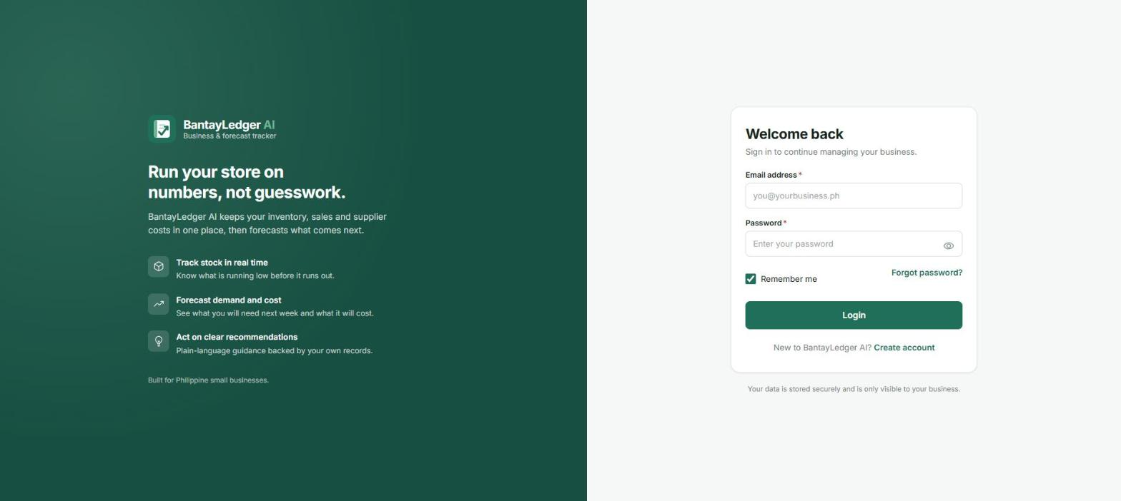
Login
Entry screen - sign in
▸ What it is: The app's entry point, shown to any signed-out visitor.
▸ Purpose: Authenticate an existing user against Supabase (or the on-device account) so the app can load their business's data.
▸ User can: Enter email/password, toggle password visibility, use “Remember me”, or jump to Forgot Password / Create account.
▸ Notable feature: Marketing panel communicates the app's three pillars - track stock, forecast demand, act on recommendations.
System UI Flow
4

Slide 5
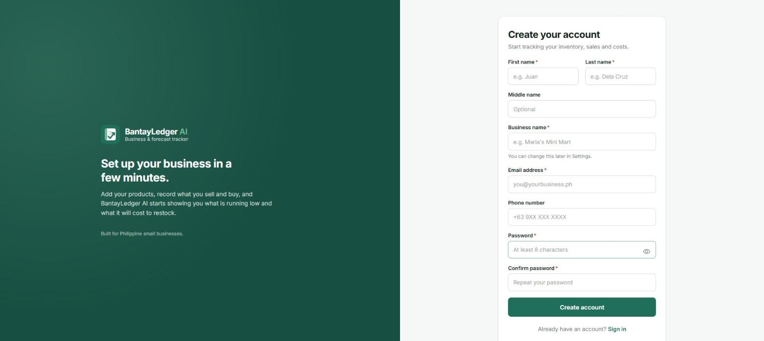
Register
Account & business creation
▸ What it is: New-user sign-up screen.
▸ Purpose: Creates a user account and a new business record in one step.
▸ User can: Enter name, business name, email, optional phone, and a password (confirmed).
▸ Notable feature: On submit, the new user is automatically enrolled as the business's OWNER - seen next on the Dashboard.
System UI Flow
5

Slide 6
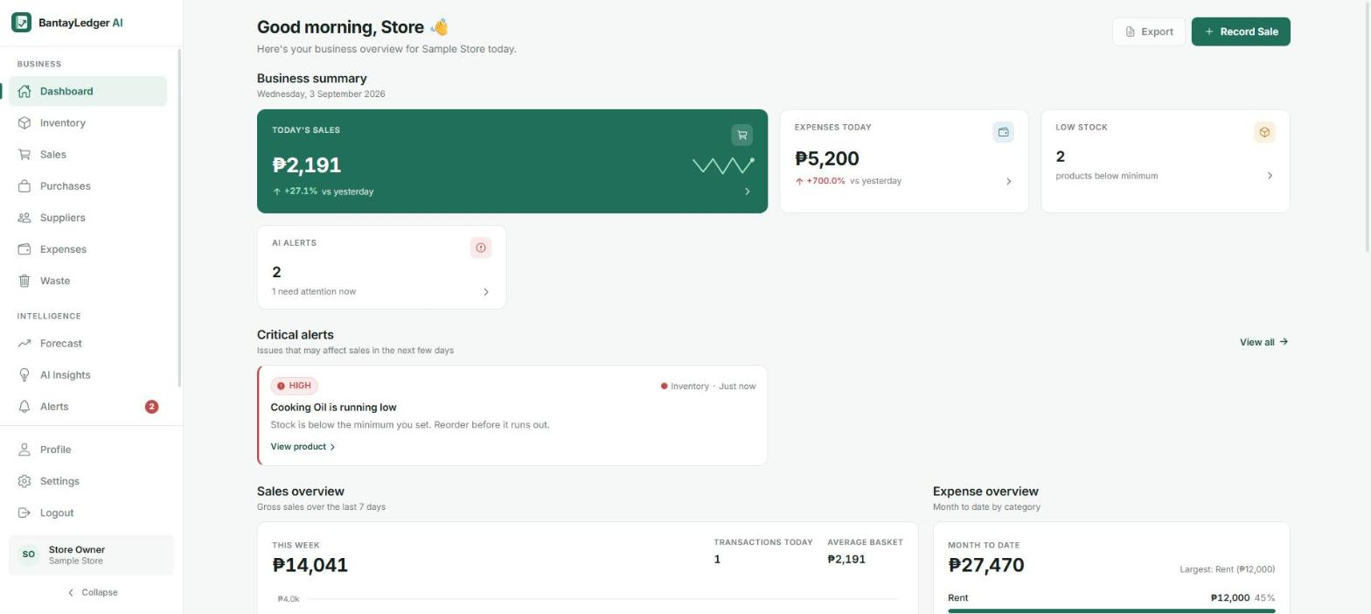
Dashboard
Home / business overview
▸ What it is: The landing screen after login - a snapshot of the whole business.
▸ Purpose: Surface what needs attention today: sales, expenses, low stock, and AI alerts, at a glance.
▸ User can: Jump into Record Sale, export data, or drill into any summary card / critical alert.
▸ Notable feature: “Critical alerts” and “AI Alerts” cards surface the app's rule-based decision-support layer right on the home screen.
System UI Flow
6

Slide 7
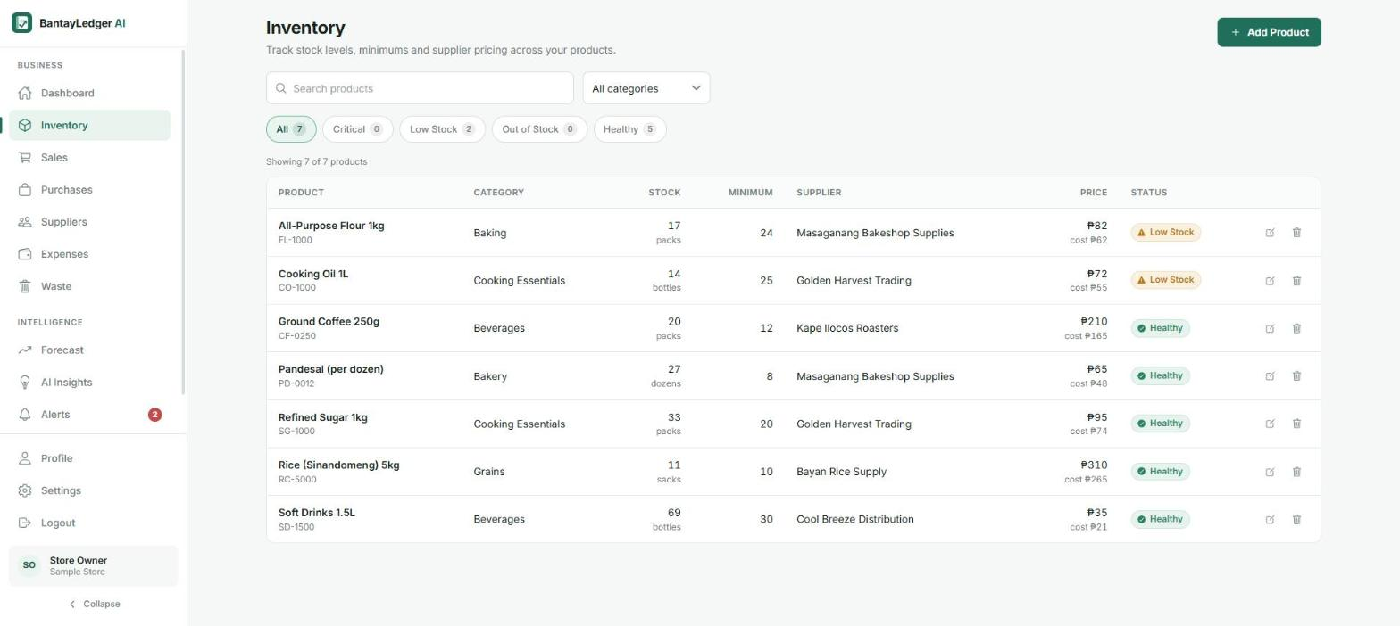
Inventory
Product catalogue & stock levels
▸ What it is: The full product catalogue for the business.
▸ Purpose: Track stock on hand against minimum thresholds, supplier, and pricing per product.
▸ User can: Search/filter by status (Critical/Low/Healthy), add a product, or edit/delete existing ones (manager roles only).
▸ Notable feature: Status badges (Low Stock, Healthy) are computed live from stock vs. minimum - feeding the Alerts and AI features.
System UI Flow
7

Slide 8
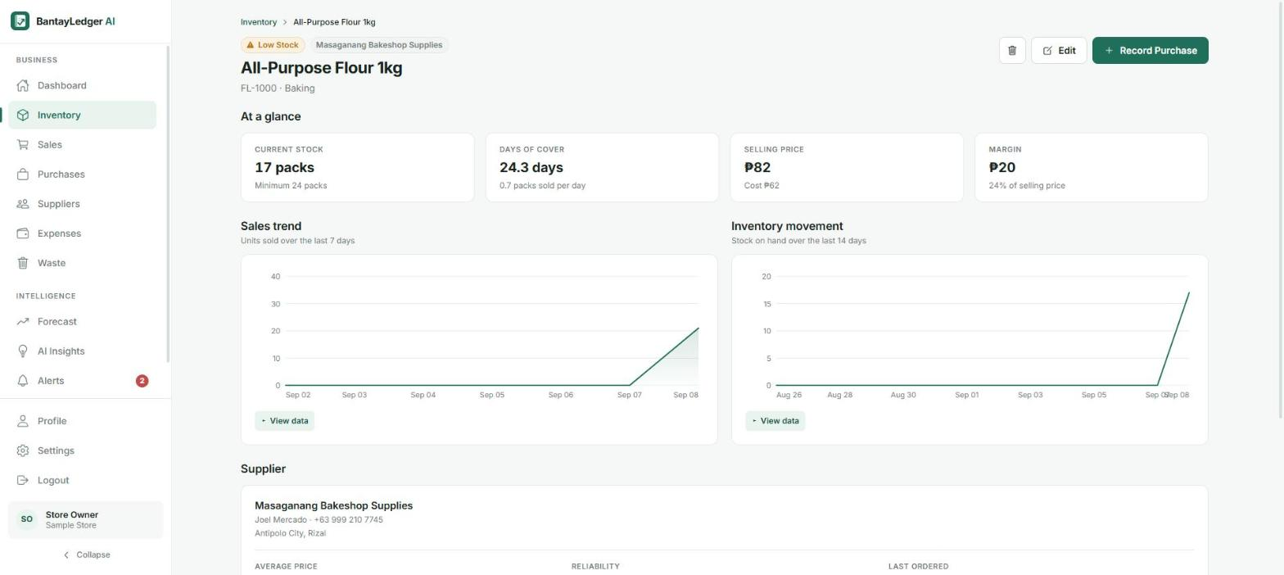
Product Details
Single product deep-dive
▸ What it is: A drill-down view for one product.
▸ Purpose: Show sales trend, inventory movement, margin, and supplier info for that specific item.
▸ User can: Review 7/14-day trend charts, view supplier reliability/pricing, or record a purchase directly.
▸ Notable feature: “Days of cover” is calculated from the recent sale rate - an early, simple example of the app's forecasting logic.
System UI Flow
8

Slide 9
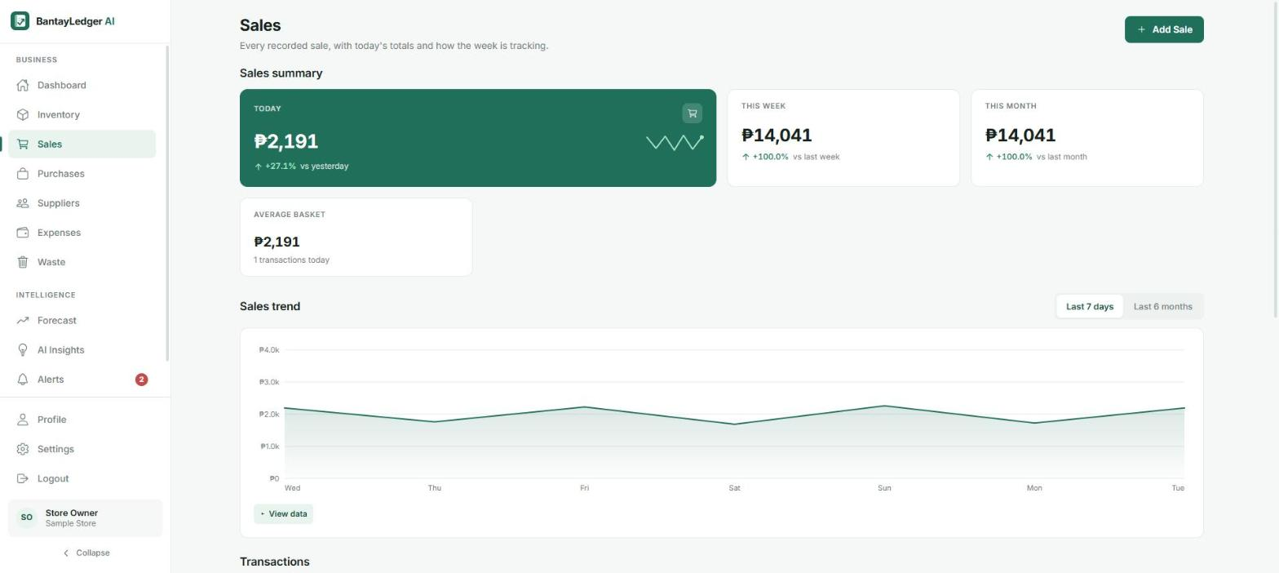
Sales
Record & review transactions
▸ What it is: The sales ledger - every recorded sale, plus daily/weekly/monthly summaries.
▸ Purpose: Capture revenue as it happens so downstream forecasts and reports stay accurate.
▸ User can: View today/this week/this month totals and a 7-day trend, or add a new sale.
▸ Notable feature: “Add Sale” opens the app's modal-based data-entry pattern (next slide).
System UI Flow
9

Slide 10
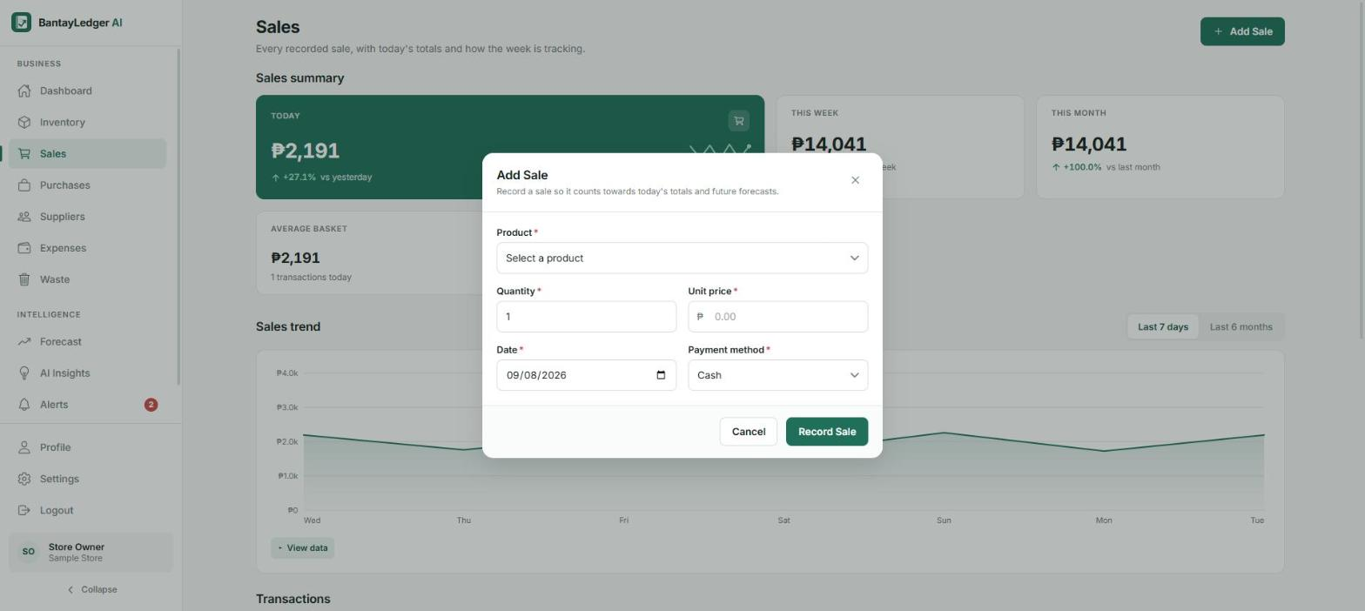
Add Sale (Modal)
Data-entry example
▸ What it is: The data-entry dialog used to record a new sale.
▸ Purpose: Capture a transaction (product, quantity, unit price, date, payment method) without leaving the Sales page.
▸ User can: Pick a product, set quantity/price/date/payment method, then confirm or cancel.
▸ Notable feature: This dialog is built on Ionic's IonModal component - the same pattern reused for every add/edit/confirm flow in the app.
System UI Flow
10

Slide 11
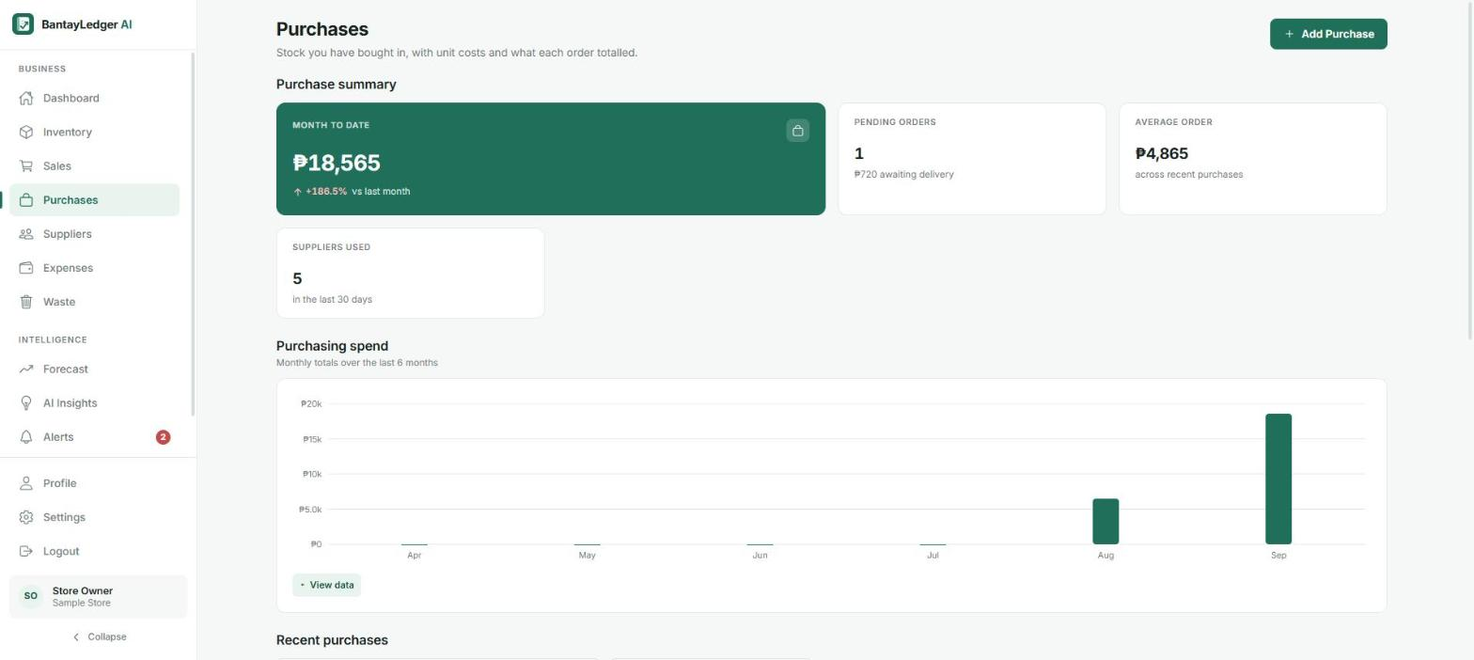
Purchases
Stock replenishment orders
▸ What it is: The purchasing ledger - stock bought in from suppliers.
▸ Purpose: Record what was restocked, at what cost, so inventory and cost trends stay current.
▸ User can: Review month-to-date spend, pending orders, and add a new purchase.
▸ Notable feature: Monthly purchasing-spend chart feeds directly into the Purchasing Cost Forecast on the Forecast page.
System UI Flow
11

Slide 12
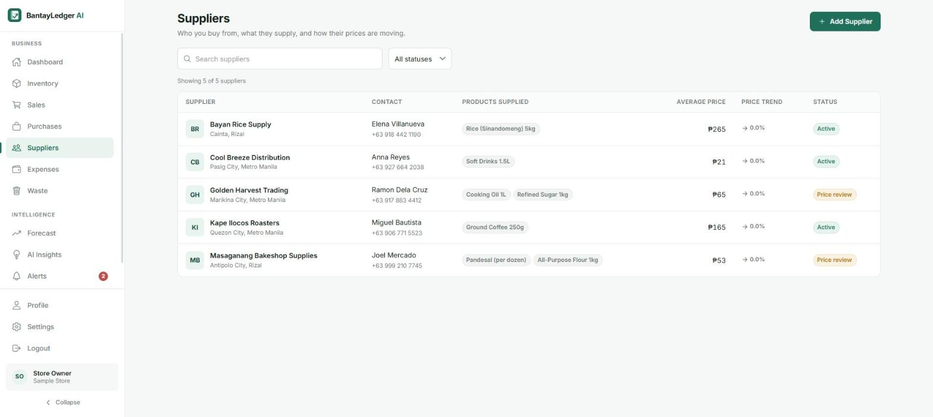
Suppliers
Supplier & pricing management
▸ What it is: The list of suppliers the business buys from.
▸ Purpose: Track contact info, products supplied, and how each supplier's pricing is trending.
▸ User can: Search suppliers, and (managers) add or edit supplier records.
▸ Notable feature: “Price review” status flags suppliers whose prices are rising - direct input to the Alerts and Price Forecast features.
System UI Flow
12

Slide 13
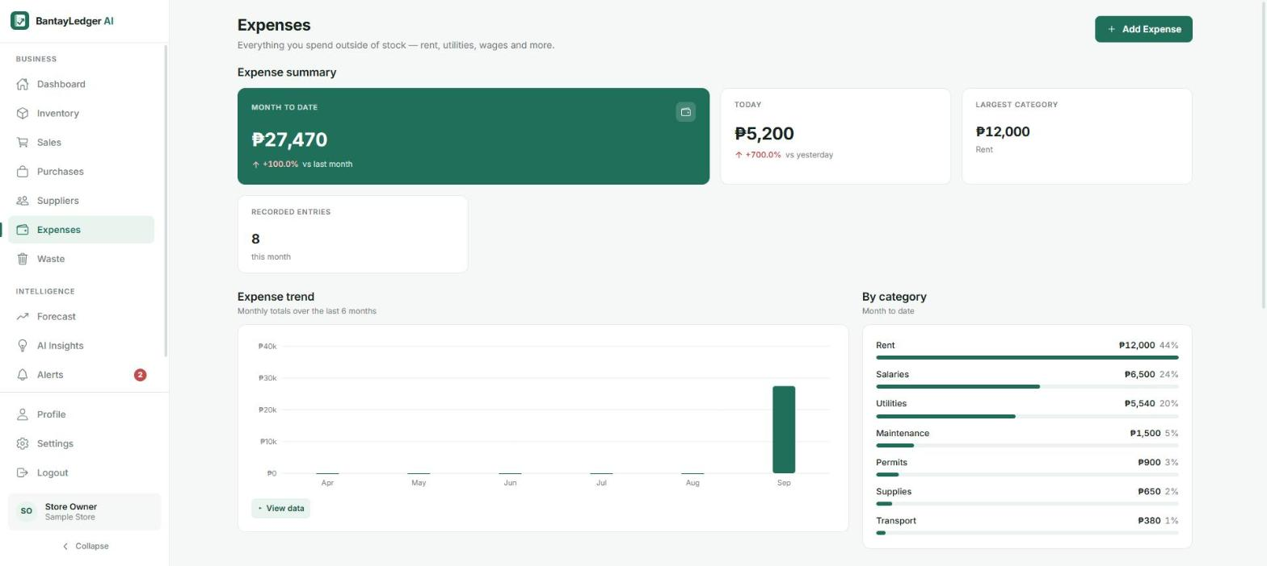
Expenses
Non-stock spending
▸ What it is: A record of business costs outside of inventory - rent, utilities, wages, etc.
▸ Purpose: Give a complete financial picture beyond just stock, for accurate Reports.
▸ User can: View month-to-date totals by category and add a new expense entry.
▸ Notable feature: Category breakdown chart mirrors the same visual language used across Sales, Purchases, and Waste.
System UI Flow
13

Slide 14
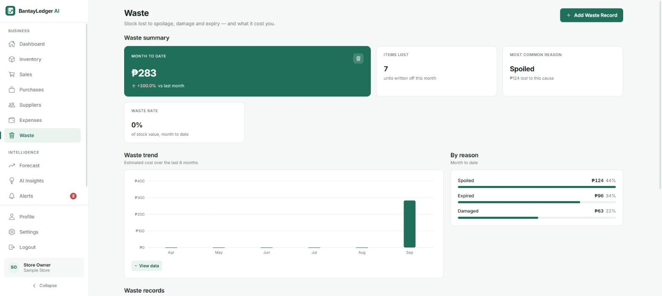
Waste
Stock loss tracking
▸ What it is: A log of stock lost to spoilage, damage, or expiry.
▸ Purpose: Quantify shrinkage cost and its causes, feeding the “high waste” recommendation rule.
▸ User can: View waste rate and breakdown by reason, and log a new waste record (which decreases stock).
▸ Notable feature: Waste-by-reason breakdown is one of the three inputs (with stock and pricing) behind the app's rule-based recommendations.
System UI Flow
14

Slide 15
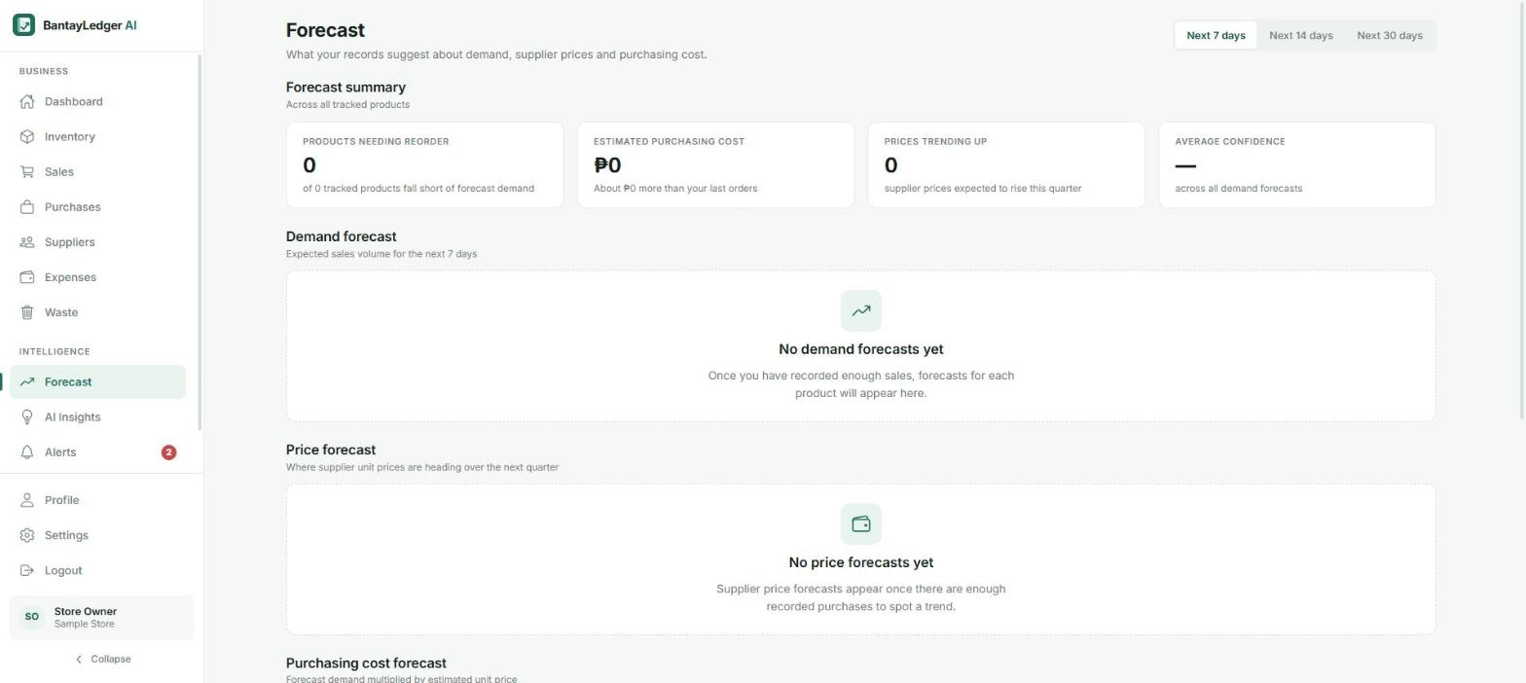
Forecast
AI forecasting hub
▸ What it is: A consolidated view of demand, supplier-price, and purchasing-cost forecasts across all products.
▸ Purpose: Help the owner anticipate what to reorder and what it will cost, before it becomes urgent.
▸ User can: Switch between Next 7/14/30-day windows and drill into per-product forecasts.
▸ Notable feature: Shown here with no forecasts yet - this business is brand-new, so there isn't enough sales history for a projection (see AI Integration section for how this is actually computed).
System UI Flow
15

Slide 16
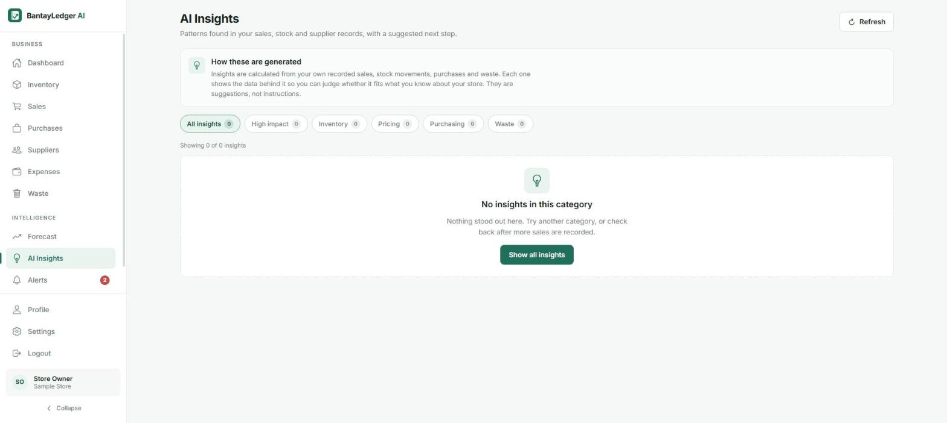
AI Insights
Pattern-based recommendations
▸ What it is: A feed of suggested next steps drawn from the business's own records.
▸ Purpose: Turn raw sales/stock/purchase/waste data into plain-language, actionable suggestions.
▸ User can: Filter by category (Inventory, Pricing, Purchasing, Waste) and read the reasoning behind each insight.
▸ Notable feature: The page is explicit in-app that insights are calculated from the user's own records, not an external AI - covered in depth in the next section.
System UI Flow
16

Slide 17
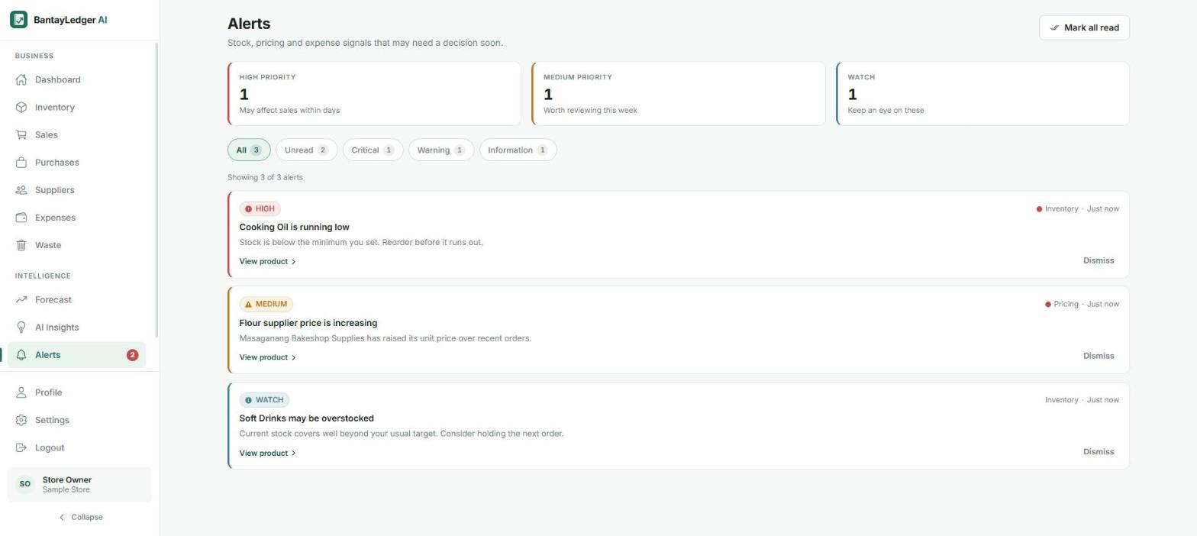
Alerts
Signals needing a decision
▸ What it is: A prioritized list of stock, pricing, and expense signals.
▸ Purpose: Make sure nothing urgent (like a stockout) gets missed.
▸ User can: Filter by priority (Critical/Warning/Information), jump to the affected product, or dismiss an alert.
▸ Notable feature: This is the app's working, rule-based decision-support engine in action - e.g. “Cooking Oil is running low”, generated live from real stock and pricing data.
System UI Flow
17

Slide 18
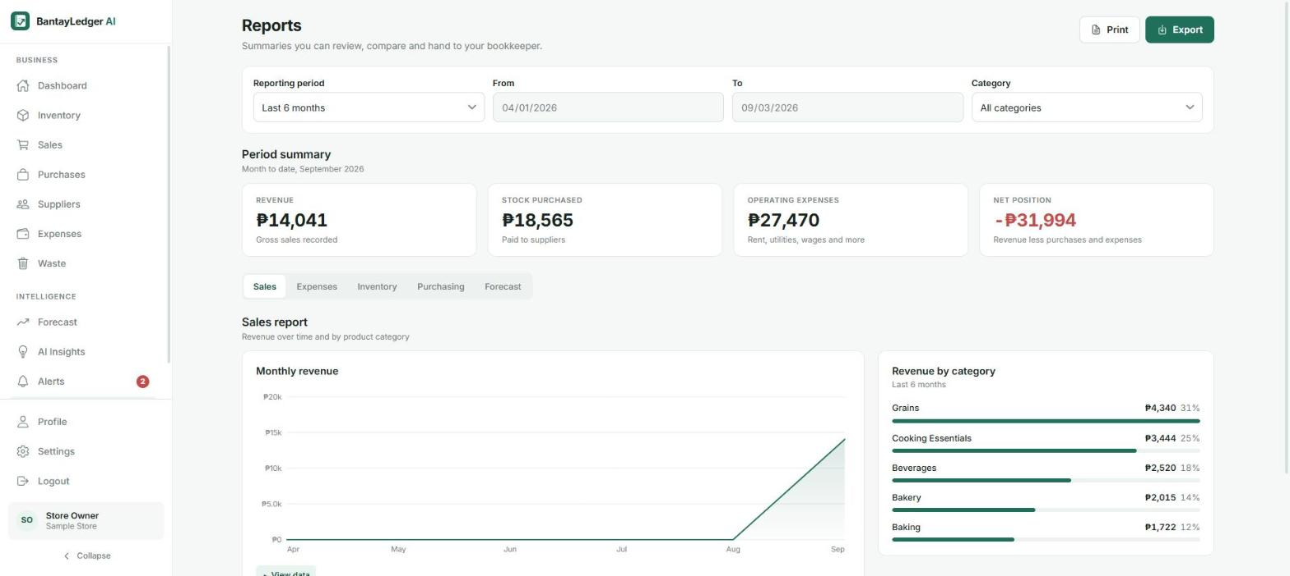
Reports
Consolidated business reports
▸ What it is: Aggregated Sales / Expenses / Inventory / Purchasing / Forecast reports for a chosen period.
▸ Purpose: Give a printable/exportable summary suitable for review or handing to a bookkeeper.
▸ User can: Change the reporting period and category, switch report tabs, print, or export.
▸ Notable feature: “Net position” combines revenue, purchases, and expenses into a single bottom-line figure.
System UI Flow
18

Slide 19
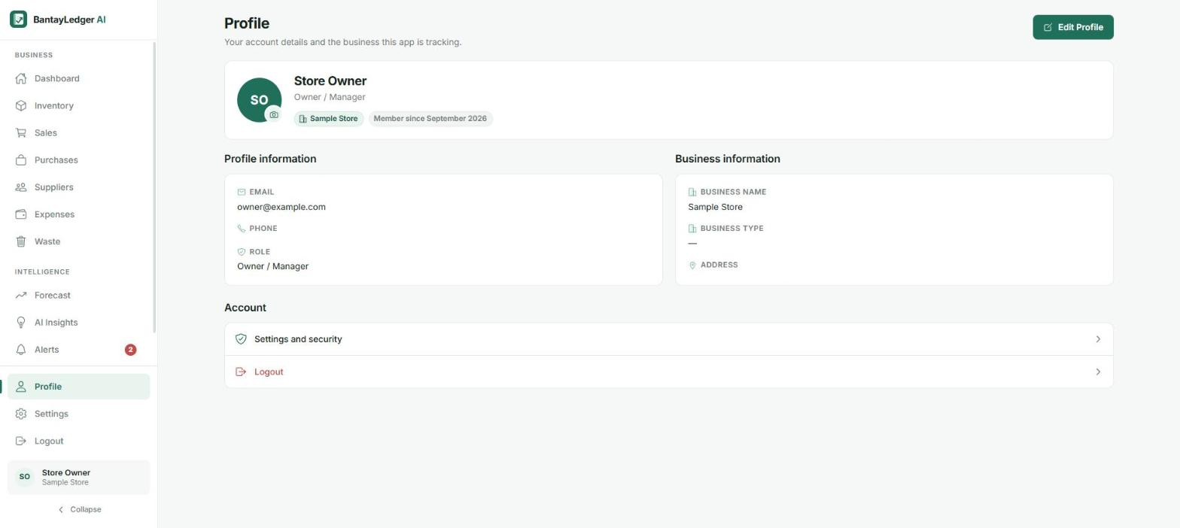
Profile
Account & business info
▸ What it is: The signed-in user's account and business summary.
▸ Purpose: Show who's logged in, their role, and which business they're viewing.
▸ User can: Edit their profile, or jump to Settings and Security or Logout.
▸ Notable feature: Surfaces the OWNER/ADMIN/STAFF role that gates manager-only actions across Inventory, Suppliers, and more.
System UI Flow
19

Slide 20
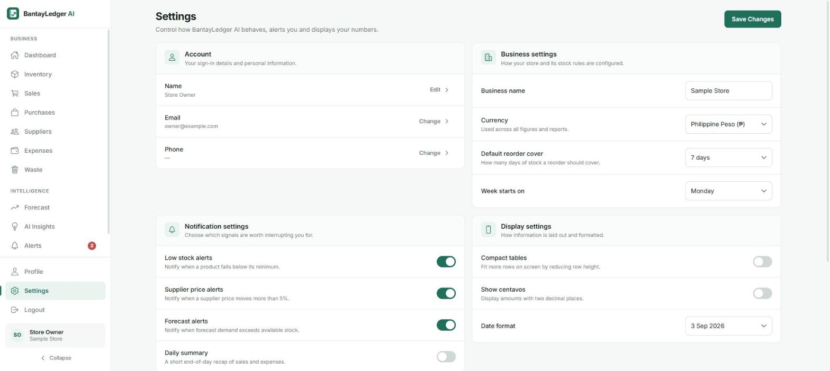
Settings
Account, business & notification preferences
▸ What it is: Configuration for the account, the business, and notifications.
▸ Purpose: Let the owner tune currency, reorder-cover days, week start, and which alerts fire.
▸ User can: Toggle low-stock/supplier-price/forecast alerts, change currency and date format, and save changes.
▸ Notable feature: “Default reorder cover” directly configures how the demand-forecast/recommendation logic decides when stock is “low”.
System UI Flow
20

Slide 21
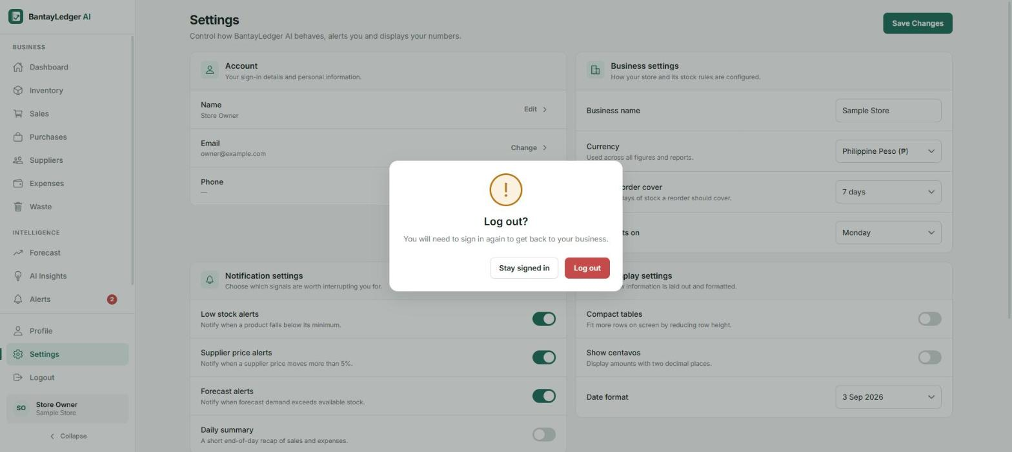
Logout
Sign-out confirmation
▸ What it is: A confirmation dialog shown before signing the user out.
▸ Purpose: Prevent an accidental logout from interrupting the user's work.
▸ User can: Confirm (“Log out”) to end the session and return to Login, or cancel (“Stay signed in”).
▸ Notable feature: Another example of the shared IonModal-based ConfirmDialog component used throughout the app.
System UI Flow
21

Slide 22
Ionic Implementation
How the Ionic Framework was used to build and package the app
Bantayledger - Technopreneurship
22

Slide 23
Routing & Navigation
IMPLEMENTATION
IonReactRouter + IonRouterOutlet wrap react-router-dom's Switch/Route/Redirect in src/App.tsx, handling all top-level navigation (/login, /dashboard, /inventory, /sales, ... /settings).
PURPOSE
Give the app a single-page, native-feeling navigation shell while still using react-router's familiar declarative routing, with pages lazy-loaded to keep the initial bundle small.
RESULT
Every screen in the previous section is a route rendered inside IonRouterOutlet. Protected routes redirect signed-out users to Login; public-only routes bounce signed-in users away from Login/Register.
Ionic Implementation
23

Slide 24
Modals (IonModal)
IMPLEMENTATION
IonModal is wrapped once in src/components/common/Modal.tsx and reused as a shared Modal / ConfirmDialog component across the app.
PURPOSE
Provide a consistent, native-feeling dialog for every add/edit/confirm action - recording a sale, adding a product, confirming a logout - without rebuilding dialog behavior per page.
RESULT
Used for add/edit dialogs on Inventory, Sales, Purchases, Suppliers, Expenses, Waste, Profile and Settings, plus confirmation dialogs like the Logout screen shown earlier.
Ionic Implementation
24

Slide 25
Icons (IonIcon + ionicons)
IMPLEMENTATION
IonIcon renders the ionicons icon set and is used in roughly two dozen files: navigation items, buttons, form field errors, empty/error states, and toast notifications.
PURPOSE
Keep iconography consistent and lightweight across the whole UI without shipping a separate icon library or custom SVGs for every screen.
RESULT
Every nav item, alert severity badge, and status indicator across the app (as seen throughout the UI flow) uses the same ionicons set for visual consistency.
Ionic Implementation
25

Slide 26
Responsive App Shell
IMPLEMENTATION
A custom AppShell (src/components/layout/AppShell.tsx) switches between a bottom tab bar (mobile), a collapsed icon rail (tablet), and a full sidebar (desktop) using a useBreakpoint hook, while the app's design tokens are bridged into Ionic's own CSS variables (--ion-color-primary, etc.).
PURPOSE
Deliver one codebase that adapts cleanly from a phone-sized screen up to a desktop browser, while keeping Ionic's own UI primitives (like IonModal) visually on-brand.
RESULT
The sidebar navigation seen throughout this deck's screenshots (Business / Intelligence / Account groups) is this shell's desktop layout; the same routes render a bottom nav bar on narrow screens.
Ionic Implementation
26

Slide 27
Native Packaging (Capacitor)
IMPLEMENTATION
capacitor.config.ts (appId ph.bantayledger.app) plus full native android/ and ios/ projects, backed by @capacitor/android, @capacitor/ios, and @capacitor-community/sqlite for on-device storage.
PURPOSE
Ship the same Ionic/React web app as an installable Android and iOS app that also works fully offline via on-device SQLite - essential for small store owners without reliable connectivity.
RESULT
The web build in dist/ is synced into real Android Studio and Xcode projects (npm run cap:sync), ready to be built and installed as a native mobile app.
Ionic Implementation
27

Slide 28
Artificial Intelligence Integration
Where AI is used, what it does, and how it helps the user
Bantayledger - Technopreneurship
28

Slide 29
AI Feature: Alerts & AI Insights
▸ Where it's used: The AI Alerts card on the Dashboard, the dedicated Alerts screen, the AI Insights page, and the Forecast page.
▸ What it does: Analyzes the business's own sales, stock, purchase and waste history to flag issues (e.g. “Cooking Oil is running low”, “Flour supplier price is increasing”) and, on Forecast/AI Insights, project demand, price and cost trends.
▸ Technology used: Client-side deterministic logic in src/services/local/signalService.ts - moving averages, trend deltas, and threshold rules. There is no external LLM/AI API call in the current codebase.
▸ How it communicates: Runs entirely in-app against the local dataset (no network call for the computation itself); in cloud mode it reads from Supabase tables reserved for a not-yet-built “Python forecasting service”.
AI Integration
29

Slide 30
Example: Input → AI Output
EXAMPLE INPUT
AI-GENERATED OUTPUT
⚠ HIGH - Cooking Oil is running low
“Stock is below the minimum you set.
Reorder before it runs out.”
⚠ MEDIUM - Flour supplier price is increasing
“Masaganang Bakeshop Supplies has raised
its unit price over recent orders.”
(both computed live and shown on the
Alerts screen earlier in this deck)
Product: Cooking Oil 1L
Current stock: 14 bottles
Minimum threshold: 25 bottles
Recent sales history: ~0.7 units/day average
Recent purchase costs: rising over last 3 orders
(the same kind of data shown on the Inventory,
Sales and Purchases screens earlier in this deck)
AI Integration
30

Slide 31
Value to the User & Architecture Roadmap
How it helps
What's planned next
▸ Surfaces issues the owner might otherwise miss until it's too late (stockouts, rising costs)
▸ Explains its reasoning in plain language, backed by the owner's own records - not a black box
▸ Works fully offline, since it needs no external API or network connection to compute
▸ Python forecasting service: the database schema already reserves tables (forecast_runs, demand_forecasts, price_forecasts, cost_forecasts, recommendations) for a machine-learning backend described in the project's own setup docs.
▸ Model-backed forecasts: once built, Forecast and AI Insights will read real model output instead of local arithmetic, with a model_version recorded per run.
▸ Natural-language insights: a future LLM layer could turn the same underlying signals into more conversational, tailored guidance.
Current honesty note
Today's “AI” is rule-based decision support (moving averages, trend detection, threshold alerts) run against the business's own data - not a trained model or an LLM.
AI Integration
31

Slide 32
System Completion & Summary
Wrapping up: features, technology, challenges, and what's next
Bantayledger - Technopreneurship
32

Slide 33
Final System Screenshot
Reports - the consolidated view of everything the system tracks: sales, expenses, inventory and purchasing.
Bantayledger - Technopreneurship
33

Slide 34
Summary
Major features
AI integration summary
▸ End-to-end ledger: sales, purchases, suppliers, expenses, waste
▸ Real-time inventory with low-stock status and alerts
▸ Forecast hub and AI Insights recommendation feed
▸ Multi-role business membership (Owner/Admin/Staff)
▸ Offline-first with optional Supabase cloud sync
Rule-based decision support today (moving averages, trend detection, threshold alerts) computed from the business's own records - with the database schema already designed for a planned machine-learning forecasting service.
Key challenges
▸ Multiple auth modes: supporting Supabase, local SQLite, and a demo fallback so the app never shows a dead end - addressed with a single AuthContext that resolves the mode once at startup.
▸ Design consistency: keeping custom UI visually consistent with Ionic's own primitives - addressed by bridging the app's design tokens into Ionic's CSS variables.
Ionic implementation summary
IonApp/IonReactRouter/IonRouterOutlet for the app shell and routing, IonModal for every data-entry and confirmation dialog, and IonIcon throughout - packaged into native Android and iOS apps via Capacitor.
Future improvements
▸ Build the planned Python ML forecasting service
▸ Add LLM-based natural-language insights/chat
Bantayledger - Technopreneurship
34

