Slide 1
Chapter 17
TCP: Transmission Control Protocol
2008/12/2
Network & System Lab, NSYSU
1
Introduction
□ The original specification for TCP is RFC 793, although some errors in that RFC are corrected in the Host Requirements RFC.
2008/12/2
2

Slide 2
TCP Service
TCP provides:
Connection-oriented: establish a TCP connection with each other before they can exchange data.
Reliability:
the application data is broken into what TCP considers the best sized chunks to send.
Acknowledge and retransmit: a timer for each TCP segment.
This acknowledgment is not sent immediately, but normally delayed a fraction of a second.
TCP maintains an end-to-end checksum on its header and data.
Re-sequencing: TCP segments can arrive out of order.
A receiver must discard duplicate data.
TCP also provides flow control.
2008/12/2
Network & System Lab, NSYSU
3
TCP Service (Cont.)
Byte stream service
A stream of 8-bit bytes is exchanged across the TCP connection between two applications.
TCP did not automatically insert record markers.
For example:
One end application writes 50 bytes, 20 bytes, and 10 bytes in three writes.
The other end application may read 20 bytes at a time in four reads.
TCP does not interpret the contents of the bytes at all.
No idea about the data bytes being exchanged to be binary data, ASCII characters, or whatever.
2008/12/2
4

Slide 3
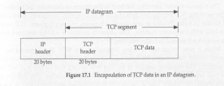
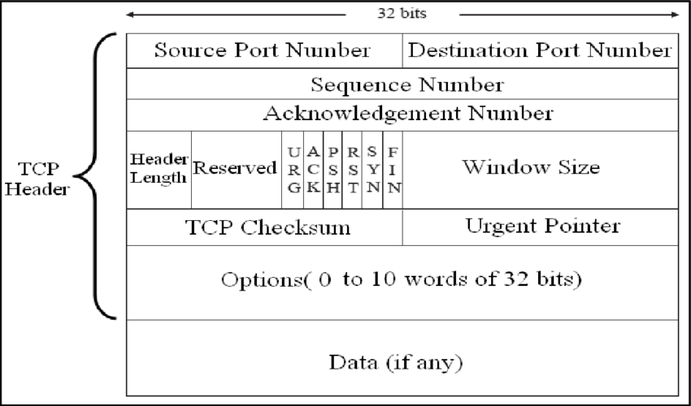
TCP Header
□ TCP data is encapsulated in an IP datagram
2008/12/2
Network & System Lab, NSYSU
5
TCP Header (Cont.)
□ The format of TCP header
2008/12/2
6

Slide 4
TCP Header (Cont.)
port number: to identify the sending and receiving application.
Socket: the combination of an IP address and a port number.
Socket pair: the 4-tuple consisting of the client IP address, client port number, server IP address, and server port number.
sequence number: identifies the byte in the stream of data from the sending TCP to the receiving TCP that the first byte of data in this segment represents.
TCP numbers each byte with a sequence number.
ISN: initial sequence number (seq# of the 1st data byte = ISN+1)
acknowledgment number: contains the next sequence number that the sender of the acknowledgment expects to receive.
header length: this is required because the length of the option field is variable.
2008/12/2
Network & System Lab, NSYSU
7
TCP Header (Cont.)
□ The six flag in the TCP header:
URG
ACK
PSH
RST
SYN
FIN
The urgent pointer is valid.
The acknowledgment number is valid.
Passing this data to the application as soon as possible. Reset the connection.
Synchronize sequence numbers to initiate a connection. The sender is finished sending data.
window size: TCP flow control (up to 65535 bytes)
checksum: calculated and stored by the sender and then verified by the receiver
urgent pointer: valid only if the URG flag is set. This pointer is a positive offset. TCP’s urgent mode is a way for the sender to transmit emergency data to the other end.
option: MSS (maximum segment size)
2008/12/2
8

Slide 5
Summary
TCP provides a reliable, connection-oriented, byte stream, full- duplex, transport layer service.
TCP packetizes the user data into segments, sets a timeout any time it sends data, acknowledges data received by the other end, re-orders out-of-order data, discards duplicate data, provides end- to-end flow control, and calculates and verifies a mandatory end- to-end checksum.
TCP is used by many of the popular applications, such as Telnet, Rlogin, FTP, and electronic mail (SMTP).
2008/12/2
Network & System Lab, NSYSU
9

