Slide 1
Chapter 18:
TCP Connection Establishment and Termination
2008/12/9
Network & System Lab, NSYSU
1
Introduction
TCP is a connection-oriented protocol. Before either end can send data to the other, a connection must be established between them.
This establishment of a connection between the two ends differs from a connectionless protocol such as UDP.
2008/12/9
2

Slide 2
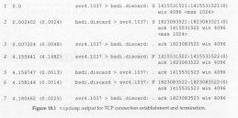
Connection Establishment and Termination
Scenario
We type the following command on the system svr4:
svr4 % telnet bsdi discard
Trying 140.252.13.35 … Connected to bsdi.
Escape character is ‘^]’.
^]
telnet> quit
connection closed.
2008/12/9
Network & System Lab, NSYSU
3
Connection Establishment and Termination (Cont.)
□ tcpdump Output
2008/12/9
4

Slide 3

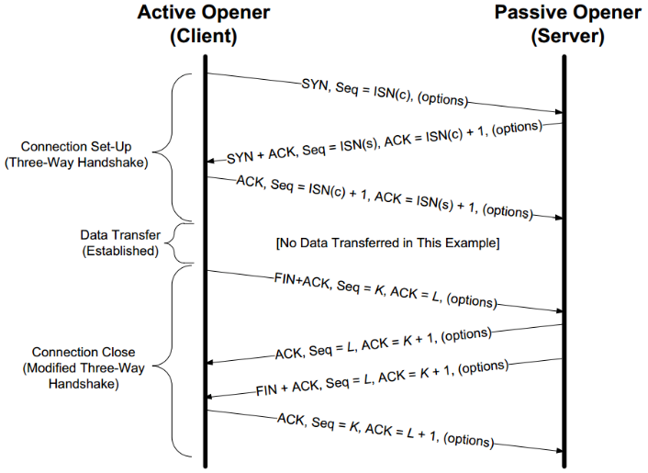
Connection Establishment and Termination (Cont.)
□ flag characters output by tcpdump for flag bits in TCP header
□ The other two TCP header flag bits - ACK and URG - are printed specially by tcpdump.
2008/12/9
Network & System Lab, NSYSU
5
Connection Establishment and Termination (Cont.)
□ Time Line
2008/12/9
6

Slide 4
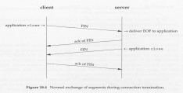
Connection Establishment and Termination (Cont.)
Connection Establishment Protocol
Three-way handshaking:
The client sends a SYN segment specifying the port number of the server that the client wants to connect to, and the client’s ISN.
The server responds with its own SYN segment containing the server’s ISN. The server also acknowledges the client’s SYN by ACKing the client’s ISN plus one. A SYN consumes one sequence number.
The client must acknowledge this SYN from the server by ACKing the server’s ISN plus one.
Active open
Passive open
The ISN should change over time, so that each connection has a different ISN.
ISN: To prevent packets delayed in the network from being delivered later and then misinterpreted as part of an existing connection.
2008/12/9
Network & System Lab, NSYSU
7
Connection Establishment and Termination (Cont.)
Connection Termination Protocol
half-close
active close
passive close
The receipt of a FIN only mean there will be no more data flowing in that direction.
2008/12/9
8

Slide 5
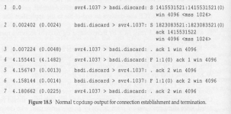
Connection Establishment and Termination (Cont.)
A TCP can still send data after receiving a FIN.
A FIN consumes a sequence number, just like a SYNC.
Sending the FINs is caused by the applications closing their end of connection, whereas the ACKs of these FINs are automatically generated by the TCP software.
TCP收到FIN後，只代表不會有新的data(seq不再增加)，但可能還會有data
2008/12/9
Network & System Lab, NSYSU
9
Connection Establishment and Termination (Cont.)
□ Normal tcpdump Output
2008/12/9
10

Slide 6

Timeout of Connection Establishment
Scenario
There are several instances when the connection cannot be established. To simulate this scenario we issue our telnet command after disconnecting the Ethernet cable from the server’s host.
tcpdump output
2008/12/9
Network & System Lab, NSYSU
11
Timeout of Connection Establishment (Cont.)
To see this we have to time the telnet command:
The time difference is 76 seconds. Most Berkeley-derived system set a time limit of 75 seconds on the establishment of a new connection.
bsdi % date ; telnet svr4 discard ; date
Thu Sep 24 16:24:11 MST 1992
Trying 140.252.13.34 …
telnet: Unable to connect to remote host: Connection timed out Thu Sep 24 16:25:27 MST 1992
2008/12/9
12

Slide 7


Timeout of Connection Establishment (Cont.)
First Timeout Period
What’s happening here is that BSD implementations of TCP run a timer that goes off every 500 ms.
Type-of-Service Field
The BSD/386 Telnet client sets the field for minimum delay.
2008/12/9
Network & System Lab, NSYSU
13
Maximum Segment Size
The MSS is the largest “chunk” of data that TCP will send to the other end.
When a connection is established, each end has the option of announcing the MSS it expects to receive.
In general, the larger the MSS the better, until fragmentation occurs.
If the destination IP address is “nonlocal”, the MSS normally default to 536.
Example
2008/12/9
14

Slide 8

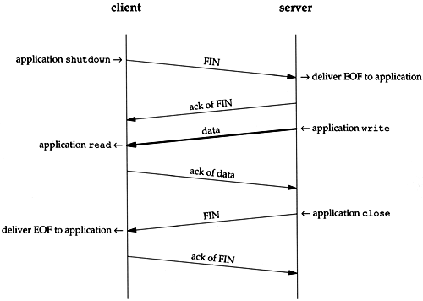
Maximum Segment Size (Cont.)
□ We initiate a TCP connection from sun to slip and watch the segment using tcpdump.
It’s OK for a system to send less than the MSS announced by the other end.
If both hosts are connected to Ethernets, and both announce an MSS of 536, but an intermediate network the MTU of 296, fragmentation will occur. The only way around this is the path MTU discovery mechanism.
2008/12/9
Network & System Lab, NSYSU
15
TCP Half-Close
Half close: TCP provides the ability for one end of a connection to terminate its output, while still receiving from the other end.
A typical scenario for a half close:
2008/12/9
16

Slide 9

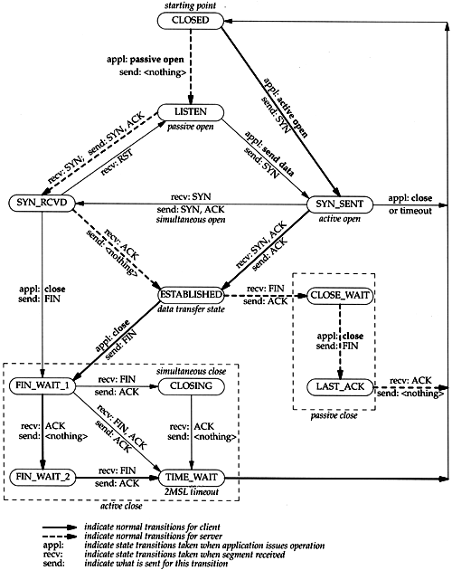
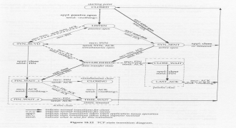
TCP Half-Close (Cont.)
□ Why is there a half-close? One example is the Unix rsh(1) command, which executes a command on another system. The command
sun % rsh bsdi sort < datafile
2008/12/9
Network & System Lab, NSYSU
17
TCP State Transition Diagram
2008/12/9
18

Slide 10
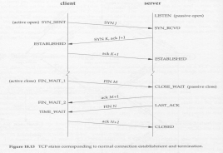
TCP State Transition Diagram (Cont.)
2008/12/9
Network & System Lab, NSYSU
19
2MSL Wait State
The TIME_WAIT state is also called the 2MSL wait state.
Maximum segment lifetime (MSL): the maximal amount of time any segment existing in the network before being discarded.
TCP segment are transmitted as IP datagrams, and the IP datagram has the TTL field that limits its lifetime.
The rule is: when TCP performs an active close, and sends the final ACK, that connection must stay in the TIME_WAIT state for twice the MSL.
Why 2MSL wait state?
Let TCP resend the final ACK in case this ACK is lost (the other end will time out and retransmit its final FIN).
The socket pair defining that connection cannot be reused, until the 2MSL wait is over.
2008/12/9
20

Slide 11
2MSL Wait State (Cont.)
What are the differences between IP TTL and TCP MSL?
A local port number cannot be reused while that port number is the local port number of a socket pair that is in the 2MSL wait.
Any delayed segments that arrive for a connection while it is in the 2MSL wait are discarded.
In client-server model, the server usually does the passive close, and does not go through the TIME_WAIT state.
2008/12/9
Network & System Lab, NSYSU
21
2MSL Wait State (Cont.)
Example I
Scenario:
Sun % sock –v –s 6666
Connection on 140.252.13.33.6666 from 140.252.13.35.1081
^?
Sun % sock –s 6666
Can’t bind local address: Address already in use Sun % netstat
Active Internet connections
Proto Tcp
Recv-Q Send-Q Local Address
Foreign Address (state)
bsdi.1081
0
0 sun.6666
TIME_WAIT
2008/12/9
22

Slide 12
2MSL Wait State (Cont.)
Example II
Scenario
Sun % sock –v bsdi echo
Connected on 140.252.13.33.1162 to 140.252.13.35.7
Hello there
Hello there
^D
Sun % sock –b1162 bsdi echo
Can’t bind local address: Address already in use
2008/12/9
Network & System Lab, NSYSU
23
2MSL Wait State (Cont.)
Example III
Scenario
Sun % sock –v –s 6666
Connection on 140.252.13.33.6666 from 140.252.13.35.1098
^?
Sun % sock –b6666 bsdi 1098
Can’t bind local address: Address already in use Sun % sock –A –b6666 bsdi 1098
Active open error: Address already in use
SO_REUSEADDR
2008/12/9
24

Slide 13
Quiet Time Concept
The 2MSL wait provides protection against delayed segments from an earlier incarnation of a connection. But this works only if a host with connections in the 2MSL wait does not crash.
What if a host with port in the 2MSL wait crashes, reboots within MSL seconds, and immediately establishes new connections using the same local and foreign IP address and port numbers corresponding to the local ports what were in the 2MSL wait before the crash?
To protect against this scenario, RFC 793 states that TCP should not create any connections for MSL seconds after rebooting. It is called the quiet time.
quiet time : 開機以後一段時間不建連線
2008/12/9
Network & System Lab, NSYSU
25
FIN_WAIT_2 State
□ Unless we have done a half-close, we are waiting for the application on the other end to recognize that it has received an end-of-file notification and close its end of the connection, which sends us a FIN. Only when the process at the other end does this close will our end move from the FIN_WAIT_2 to the TIME_WAIT state.
2008/12/9
26

Slide 14

Reset Segments
A bit in TCP header named RST is for “reset.”
In general, a reset is sent by TCP whenever a segment arrives that doesn’t appear correct for the referenced connection.
Connection Request to Nonexistent Port
Scenario
Bsdi % telnet svr4 20000
Trying 140.252.13.34 …
telnet: Unable to connect to remote host: Connection refused
This message is output by the Telnet client immediately.
The packet exchange corresponding to this command
2008/12/9
Network & System Lab, NSYSU
27
Abort a Connection
Orderly release: FIN is sent after all previously queued data has been sent, and there is normally no loss of data.
Abortive release
Any queued data is thrown away and the reset is sent immediately.
The receiver of the RST can tell that the other end did an abort instead of a normal close.
Scenario
Bsdi % sock –L0 svr4 8888
Hello, world
^D
2008/12/9
28

Slide 15

Abort a Connection
Show the tcpdump output
The RST segment elicits no response from the other end – it is not acknowledged at all. The receiver of the reset aborts the connection and advises the application that the connection was reset.
2008/12/9
Network & System Lab, NSYSU
29
Abort a Connection
We get the following error on the server for this exchange:
Svr4 % sock –s 8888
Hello, world
Read error: Connection reset by peer
2008/12/9
30

Slide 16
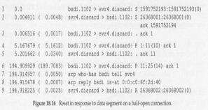
Detecting Half-Open Connections
□ Scenario: we’ll execute the Telnet client on bsdi, connecting to the discard server on svr4. We type one line of input, and watch it and reboot the server host. This simulates the sever host crashing.
Bsdi % telnet svr4 discard Trying 140.252.13.34 … Connected to svr4.
Escape character is ‘^]’.
Hi there
here is where we reboot the server
host
Another line and this one elicits a reset
Connection closed by foreign host.
2008/12/9
Network & System Lab, NSYSU
31
Tcpdump output
2008/12/9
32

Slide 17

Simultaneous Open
What is Simultaneous Open?
It is possible, although improbable, for two applications to both perform an active open to each other at the same time.
Each end must transmit a SYN, and the SYNs must pass each other on the network.
It also requires each end to have a local port number that is well known to the other end.
2008/12/9
Network & System Lab, NSYSU
33
Simultaneous Open (Cont.)
An Example
Scenario: We’ll execute one end on our host bsdi, and the other end on the host bangogh.cs.berkeley.edu. Since there is a dialup SLIP link between them, the round-trip time should be long enough to let the SYNs cross.
2008/12/9
34

Slide 18
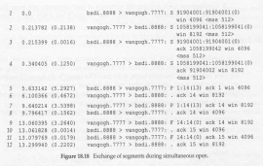
Simultaneous Open (Cont.)
On bsdi:
Bsdi % sock –v –b8888 vangogh.cs.berkeley.edu 7777
Connected on 140.252.13.35.8888 to 128.32.130.2.7777
TCP_MAXMEG = 512
Hello, world
And hi there
Connection closed by peer
On the other end:
Vangogh % sock –v –b7777 bsdi.tuc.onao.edu 8888
Connected on 128.32.130.2.7777 to 140.252.13.35.8888
TCP_MAXMEG = 512
Hello, world
And hi there
^D
2008/12/9
Network & System Lab, NSYSU
35
Simultaneous Open (Cont.)
Tcpdump output
2008/12/9
36

Slide 19
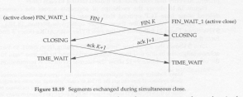
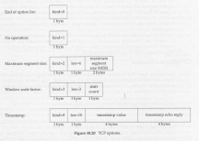
Simultaneous Close
□ It is also possible for both sides to perform an active close, and the TCP protocol allow.
2008/12/9
Network & System Lab, NSYSU
37
TCP Options
□ The only options defined in the original TCP specification are the end of option list, no operation, and the maximum segment size option.
2008/12/9
38

Slide 20
TCP Options (Cont.)
kind: type of option
len: the total length of option field, including kind and len bytes.
NOP: no operation option is to allow the sender to pad fields to a multiple of 4 bytes.
Example:
<mss 512, nop, wscale 0, nop, nop, timestamp 146647 0>
2008/12/9
Network & System Lab, NSYSU
39
TCP Server Design
When a new connection request arrives at a server, the server accepts the connection and invokes a new process to handle the new client.
Under Unix the common technique is to create a new process using the fork function. Ligntweight processes (threads) can also be used, if supported.
We need to answer the following questions: how are the port numbers handled when a server accepts a new connection request from a client, and what happens if multiple connection requests arrive at about the same time.
2008/12/9
40

Slide 21
TCP Server Design (Cont.)
TCP Server Port Numbers
We’ll watch the Telnet server using the netstat command.
Sun % netstat –a –n –f inet
Active Internet connections (including servers)
Proto Recv-Q Send-Q Local Address Foreign Address (state) Tcp 0 0 *.23 *.* LISTEN
We now start a Telnet client on the host slip (140.252.13.65) that connects to this server.
Proto Tcp Tcp
Recv-Q Send-Q Local Address Foreign Address (state)
0 0 140.252.13.33.23 140.252.13.65.1029 ESTABLISH
0 0 *.23 *.* LISTEN
2008/12/9
Network & System Lab, NSYSU
41
TCP Server Design (Cont.)
Restricting Local IP Address
If we specify an IP address to our sock program when we invoke it as a server, that IP address becomes the local IP address of the listening end point
Sun % sock –s 140.252.1.29 8888
restricts this server to connections arriving on the SLIP interface (140.252.1.29). The netsate output:
Proto Recv-Q Send-Q Local Address Foreign Address (state) Tcp
0 0 140.252.1.29.8888 *.* LISTEN
If we connect to this server across the SLIP link, from the host solaris
Proto Recv-Q Send-Q Local Address Foreign Address (state) Tcp 0 0 140.252.1.29.8888
140.252.1.32.34614ESTABLISH
Tcp
0 0 140.252.1.29.8888 *.* LISTEN
2008/12/9
42

Slide 22


TCP Server Design (Cont.)
□ But if we try to connect to this server from a host on the Ethernet (140.252.13), the connection request is not accepted by the TCP module.
The server application never sees the connection request – the rejection is done by the kernel’s TCP module.
2008/12/9
Network & System Lab, NSYSU
43
TCP Server Design (Cont.)
Restricting Foreign IP Address
The interface functions shown RFC 793 allow a server doing a passive open to have either a fully specified foreign socket or a unspecified foreign socket.
Unfortunately, most APIs don’t provide a way to do this.
The three types of address bindings that a TCP sever can establish for itself.
2008/12/9
44

Slide 23

TCP Server Design (Cont.)
Incoming Connection Request Queue
How dose TCP handle these incoming connection requests while the listening application is busy?
Each listening end point has a fixed length queue of connections that have been accepted by TCP, but not yet accepted by the application.
The application specifies a limit to this queue, commonly called the backlog. This backlog must be between 0 and 5, inclusive.
When a connection request arrives, an algorithm is applied by TCP to the current number of connections already queued for this listening end point, to see whether to accept the connection or not.
2008/12/9
Network & System Lab, NSYSU
45
TCP Server Design (Cont.)
If there is room on this listening end point’s queue for this new connection, the TCP module ACKs the SYN and completes the connection.
If there is no room on the queue for the new connection, TCP just ignores the received SYN.
If the listening server doesn’t get around to accepting some of the already accepted connections that have filled its queue to the limit, the client’s active open will eventually time out.
An example:
bsdi % sock -s -v -q1 -o30 7777
Set the backlog of the listening end point to 1
Cause the program to sleep for 30 seconds before accepting any client connections.
2008/12/9
46

Slide 24
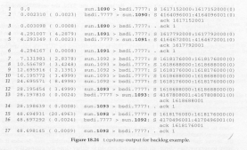
TCP Server Design (Cont.)
The tcpdump output
2008/12/9
Network & System Lab, NSYSU
47
Summary
Before two processes can exchange data using TCP, they must establish a connection between themselves.
We used tcpdump to show all the fields in the TCP header.
Fundamental to understanding the operation of TCP is its state transition diagram.
A TCP connection is uniquely defined by a 4-tuple: the local IP address, local port number,foreign IP address, and foreign port number.
2008/12/9
48

