Slide 1
Chapter 21:
TCP Timeout and Retransmission
2008/12/24
Network & System Lab, NSYSU
1
Introduction
Two examples of timeout and retransmission had already seen:
1. In the ICMP port unreachable (TFTP, Section 6.5)
2. In the ARP example to a nonexistent host (Section 4.5)
TCP manage four different timers for each connection:
1. A retransmission timer (this chapter)
2. A persist timer (Chapter 22)
3. A keepalive timer (Chapter 23)
4. A 2MSL timer (Section 18.6)
Simple Timeout and Retransmission Example:
Line 4 is the transmission of “hello,world” and line 5 is its ACK.
Line 6 shows “and hi”. Line 7-18 are 12 retransmissions
Line 19 is the TCP finally gives up and sends a reset
2008/12/24
2

Slide 2
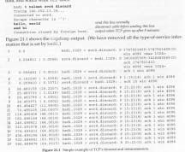


Simple Timeout and Retransmission Example
2008/12/24
Network & System Lab, NSYSU
3
Round-Trip Time: the time it takes for a data packet to be sent and the time it takes for an acknowledgment of that signal to be received.
Round-Trip Time (RTO) Measurement
Two methods of RTO calculate:
The original TCP specification method
R ← αR ＋ ( 1－α) M
RTO＝Rβ
R=>smoothed RTT estimator, α is smoothing factor = 0.9
β is delay variance factor = 2
The Jacobson method
Err ＝ M － A
A ← A ＋ g Err
D ← D ＋ h( |Err| － D)
RTO ＝ A ＋ 4D
A is the smoothed RTT average,D is mean deviation
The gain g is 1/8(0.125),h is 0.25
R: run trip time M: 最新的
會考演算法
更精確的RTO算法，但大部分都講原本的(不 講)
2008/12/24
4

Slide 3
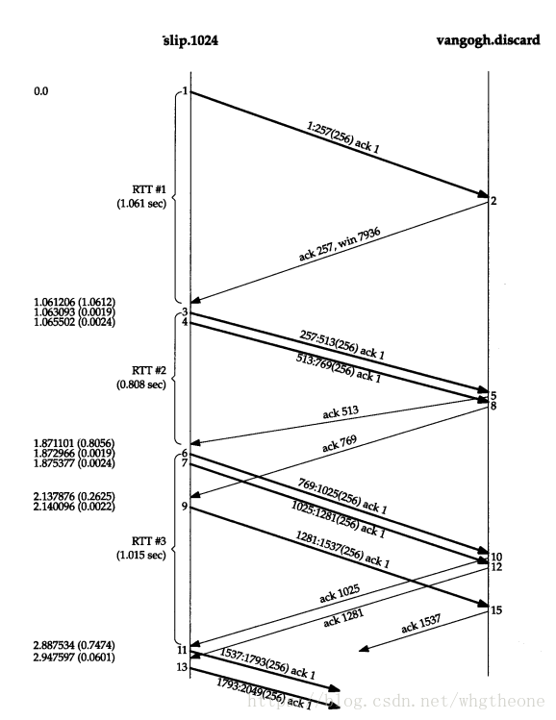
Round-Trip Time Measurement (Cont.)
Karn’s Algorithm:
A packet is transmitted,a timeout occurs,the packet is retransmitted with the longer RTO, and an acknowledgment is received
Is the ACK for the first transmission or the second?
This is called the retransmission ambiguity problem
Karn and Partridge: don’t count retransmitted packets into the RTT estimator.
An RTT Example:
sent 32768 bytes of data from slip to vangogh.cs.berkeley.edu
slip% sock -D -i -n32 vangogh.cs.berkeley.edu. discard
slip is connected to the 140.252.1 Ethernet by two SLIP links
MTU between slip and bsdi is 296
32 1024-byte => 128 segment with 256 bytes of user data
Network & System Lab, NSYSU
retransmission data 就不用算
2008/12/24
5
An RTT Example
2008/12/24
6

Slide 4

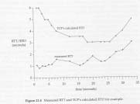
An RTT Example
Round-Trip Time Measurements:
One connection, one timer
RTT#1 is 1.061 seconds => 3 clock ticks
RTT#2 is 0.808 seconds => 1 clock tick
RTT#3 is 1.015 seconds => 2 clock ticks
Segment 4,7,9 cannot be timed,since the timer is already being used by segment 3 and 6
2008/12/24
Network & System Lab, NSYSU
7
An RTT Example
In this complete example 18 RTT samples were collected
2008/12/24
8

Slide 5

An RTT Example
RTT Estimator Calculations:
The initial RTO=A+2D => 0＋2×3 = 6 seconds
After 5.802 seconds RTO=A+4D => 0＋4×3 = 12 seconds
The ACK arrives 467 ms after the retransmission.The A and D are not updated because of retransmission ambiguity
The ACK on line 4 is not timed since it is only an ACK
2008/12/24
Network & System Lab, NSYSU
9
An RTT Example
RTO caculations
first segment arrives => RTO=6 seconds
second segment arrives => RTO=6.3125 seconds
Fixed-point calculations that are actually used =>RTO is 6 seconds (not 6.3125)
Slow Start
See the slow start algorithm in Section 20.6
Congetion Example:
Normally the data points should move up and to the right, with the slope of the points being the transfer rate.
Retransmissions will appear as motion down and to the right.
2008/12/24
10

Slide 6
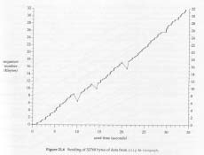
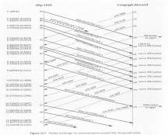
Congetion Example
2008/12/24
Network & System Lab, NSYSU
11
Congetion Example
2008/12/24
12

Slide 7
Congetion Example
The Jacobson‘s fast retransmit algorithm:
It is followed by his fast recovery algorithm.The third of the duplicate ACKs was received that forces to retransmit
Berkeley-derived implementation when the third one is received, assume that a segment has been lost and retransmit only one segment
When the missing data arrives (segment 63):
The receiving TCP now has data bytes 6657-8960 in its buffer, and passes these 2304 bytes to the user process.
All 2304 bytes are acknowledged in segment 72
-掉3個就能重送
2008/12/24
Network & System Lab, NSYSU
13
Congestion Avoidance Algorithm
What‘s congestion avoidance?
It is a way to deal with lost packets
Assumption: packet loss caused by damage is very small (< 1%)
The loss of a packet signals congestion somewhere in the path between the source and the destination.
Two indications of packet loss:
A timeout occurring
The receipt of duplicate ACKs
Congestion avoidance and slow start are independent algorithms with different objectives.
Two variables be maintained for each connection: cwnd and
ssthresh
減少封包遺失，以增加頻寬使用
考:
sender怎麼知道封包遺失?
ssthresh: 上升的限制
2008/12/24
14

Slide 8
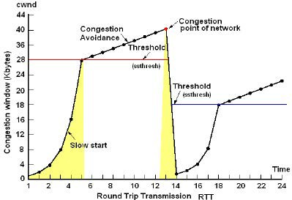
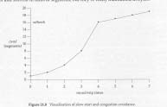
Congestion Avoidance Algorithm (Cont.)
Congestion avoidance algorithm operates:
1.Initialization=>cwnd is one segment, ssthresh is 65535 bytes
2.TCP output never sends more than the minimum of cwnd and the receiver‘s advertised window
3.When congestion occurs, one-half of the current window size is saved in ssthresh. If timeout, cwnd is set to one segment
4.When new data is acknowledged by the other end, increase cwnd
If cwnd is less than or equal to ssthresh, doing slow start. Otherwise, we’re doing congestion avoidance.
Congestion avoidance dictates that cwnd be increased by 1/cwnd, plus a small fraction of segment size, each time an ACK is received: an additive increase.
Increase cwnd by at most one segment each round-trip time (regardless how many ACKs are received in that RTT)
2008/12/24
Congestion algo:
原始版本
each 1 RTT
=> cwnd = cwnd +1 轉成
ACK arrived
=> cwnd = cwnd + 1 / # of ACKs
= cwnd + 1 / cwnd
Congestion Avoidance Algorithm
2008/12/24
16

Slide 9
Fast Retransmit and Fast Recovery Algorithms
TCP is required to generate an immediate ACK when an out-of- order segment is received.
Duplicate ACK: a segment is received out of order.
Two possible situations:
Packet loss – if two or more duplicate ACKs are received – a strong indication of segment loss.
First out last in
The receipt of the duplicate ACKs tells us more than just a packet has been lost:
A segment leaves the network into receiver’s buffer.
There still is data flowing between the two ends – DON’T reduce the flow abruptly by going into slow start.
2008/12/24
17
考
發生duplicate ACK時，不能貿然的進入slow start，因為還是有ACK進來， congestion 是完全收不到封包
Fast Retransmit and Fast Recovery Algorithms (Cont.)
Fast retransmit algorithm:
If three or more duplicate ACKs are received in a row, indicate a segment has been lost, then retransmission the missing segment
Fast recovery algorithm:
Next, congestion avoidance, but not slow start is performed
Congestion Example
In congestion avoidance:
考 ► cwnd←cwnd＋(segsize × segsize)／cwmd＋ segsize ／ 8
By fast retransmit and fast recovery, we can send a new data segment when cwnd > unacknowledged bytes
cwnd is allowed to keep increasing while the duplicate ACKs are received, since each duplicate ACK means the a segment has left the network.
2008/12/24
18

Slide 10
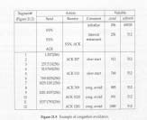
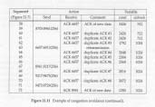
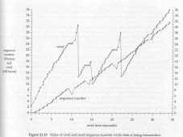
Congestion Example (Continued)
2008/12/24
Network & System Lab, NSYSU
19
Congestion Example (Continued)
Congestion window可以表示網路的好壞
2008/12/24
20

Slide 11
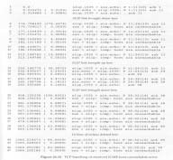
ICMP Errors
Berkeley-based implementations handle ICMP errors as follows:
A received source quench causes the cwnd set to one segment to initiate slow start, but the ssthresh is not changed
A received host unreachable or network unreachable is effectively ignored, since these two errors are considered transient.
An Example
slip% sock aix echo
test line
test line
►
SLIP link is brought down here type this line and retransmissions SLIP link is reestablished here
after the last line,SLIP link is brought
another line
►
…….. down
read error: No route to host
2008/12/24
TCP finally gives up
Network & System Lab, NSYSU
21
ICMP Errors
2008/12/24
22

Slide 12

考解釋名詞
TIMEOUT時，封包未必全部重送
看buffer裡有甚麼就送什麼
Repacketization
When TCP times out and retransmits, it does not have to retransmit the identical segment again. Instead, TCP is allowed to perform repacketization, sending a bigger segment, which can increase performance.
notice on bytes of line 3 and 6 in following illustration
2008/12/24
Network & System Lab, NSYSU
23
Summary
TCP calculates a smoothed RTT estimator and a smoothed mean deviation estimator. Then use these two estimators to calculate the next retransmission timeout value.
We see many of TCP’s algorithm in action:
slow start
congestion avoidance
fast retransmit
fast recovery
Effect which various ICMP errors have on a TCP connection
How TCP is allowed to repacketize its data
2008/12/24
24

