Slide 1
Chapter 22: TCP Persist Timer
2009/1/6
Network & System Lab, NSYSU
1
為什麼TCP掉ack影響不大?
因TCP是累加ack
Introduction
Why we use persist timer:
If an acknowledgment is lost, we could end up with both sides waiting for the other
To prevent deadlock from occurring the sender uses a persist timer
The sender queries the receiver periodically to find out if the window has been increased. These segments from the sender are called window probes.
An Example:
We’ll invoke the server as
svr4 % sock -i -s -P100000 5555
The server sleep for 100,000 seconds (27.8 hours) before reading from the network
The client on host bsdi and performs 1024-byte writes to port 5555 on the server
2009/1/6
2

Slide 2
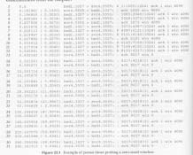
An Example
2009/1/6
Network & System Lab, NSYSU
3
Silly Window Syndrome
About persist timer:
It always bounded between 5 and 60 seconds
The persist state which is different from the retransmission timeout is that TCP never gives up sending window probes.
When it occurs small amounts of data are exchanged across the connection, instead of full-sized seqments.
What is Silly Window Syndrome
It can be caused by either end:
The receiver can advertise small windows
The sender can transmit small amounts of data.
Window size都很小，
2009/1/6
4

Slide 3
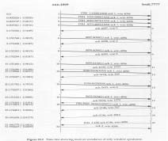
Silly Window Syndrome (Cont.)
Correct avoidance is performed on both ends:
The receiver must not advertise small windows
The sender is not transmitting unless one of conditions is true:
A full-sized segment can be sent
We can send at least one-half of the maximum sized window ever advertised
We can send everything we have if:
We are not expecting an ACK (no outstanding data), or
The Nagle algorithm is disabled (W ≠ 1)
2009/1/6
Network & System Lab, NSYSU
5
Silly Window Syndrome
2009/1/6
6

Slide 4
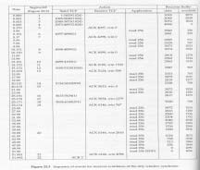
Silly Window Syndrome
2009/1/6
Network & System Lab, NSYSU
7
Summary
TCP’s persist timer is set by one end of a connection when it has data to send, but has been stopped because the other end has advertised a zero-sized window.
TCP’s avoidance of the silly window syndrome is to prevent TCP from advertising small windows or from sending small segments
2009/1/6
8

