Slide 1
Chapter 24:
TCP Futures and Performance
2009/1/6
Network & System Lab, NSYSU
1
比起一般連線，
為什麼 long fat pipe比較嚴重?
Introduction
Path MTU discovery mechanism: this time we focus on how it operates with TCP. This often lets TCP use an MTU greater than 536 for nonlocal connections, increasing its throughput .
Long fat pipes (networks that have a large bandwidth-delay product), and the TCP limits that are encountered on these networks.
A window scale option.
A timestamp option.
T/TCP, modifications to TCP for transactions, is a common paradigm for client-server computing.
The goal of T/TCP is to reduce the number of segments exchanged by the two ends, avoiding the 3-way handshake and the 4 segments to close the connection, so that the client receives the server’s reply in one RTT plus the time required to process the request.
考
2009/1/6
2

Slide 2
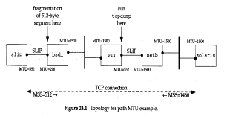
Path MTU Discovery
Path MTU is the minimum MTU on the any network that is currently in the path between two hosts.
TCP’s path MTU discovery operates as follows:
When a connection is established, TCP uses the minimum of the MTU of the outgoing interface, or the MSS announced by the other as the starting segment size.
All IP datagrams sent by TCP on that connection have the DF bit set. If a datagram need to be fragment, it discard the datagram and generates the ICMP “can’t fragment “ error .
If ICMP error is received, TCP decrease the segment and retransmits.
Since routes can change dynamically, when some time has passed since the last decrease of the path MTU, a larger value can be tried.
2009/1/6
Network & System Lab, NSYSU
3
Path MTU Discovery
□ An example : solaris % sock -I -n1 -w512 slip discard
2009/1/6
4

Slide 3
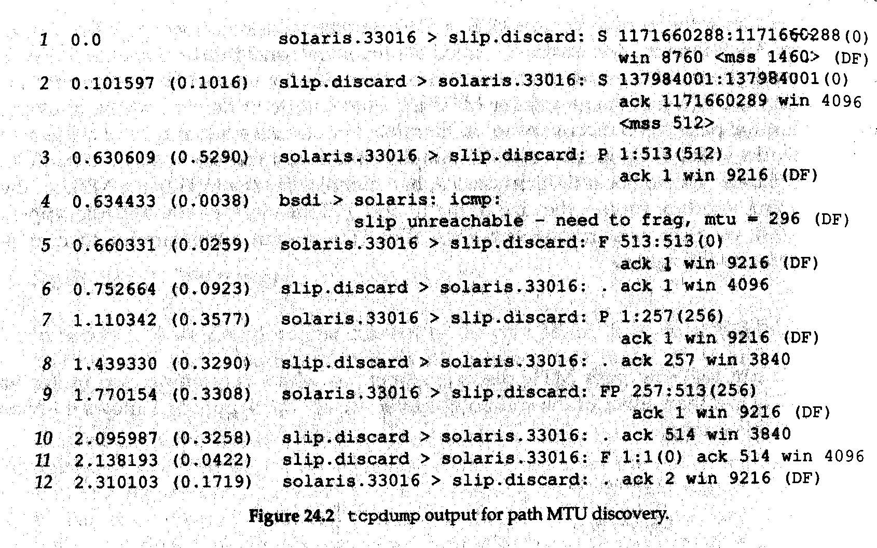
Page MTU Discovery
2009/1/6
Network & System Lab, NSYSU
5
Big Packets or Small Packets?
Big packets advantages:
The reduced cost is that associated with the network (packet header overhead), routers (routing decisions), and hosts (protocol processing and device interrupts).
Not everyone agrees with this, measurements indicate that bigger is not always better.
不一定是大封包比較好
會考舉例，何時小封包比較好?
2009/1/6
6

Slide 4
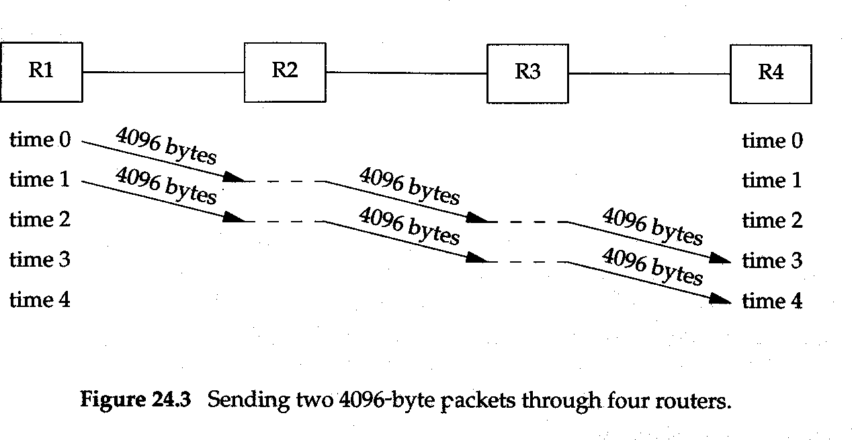
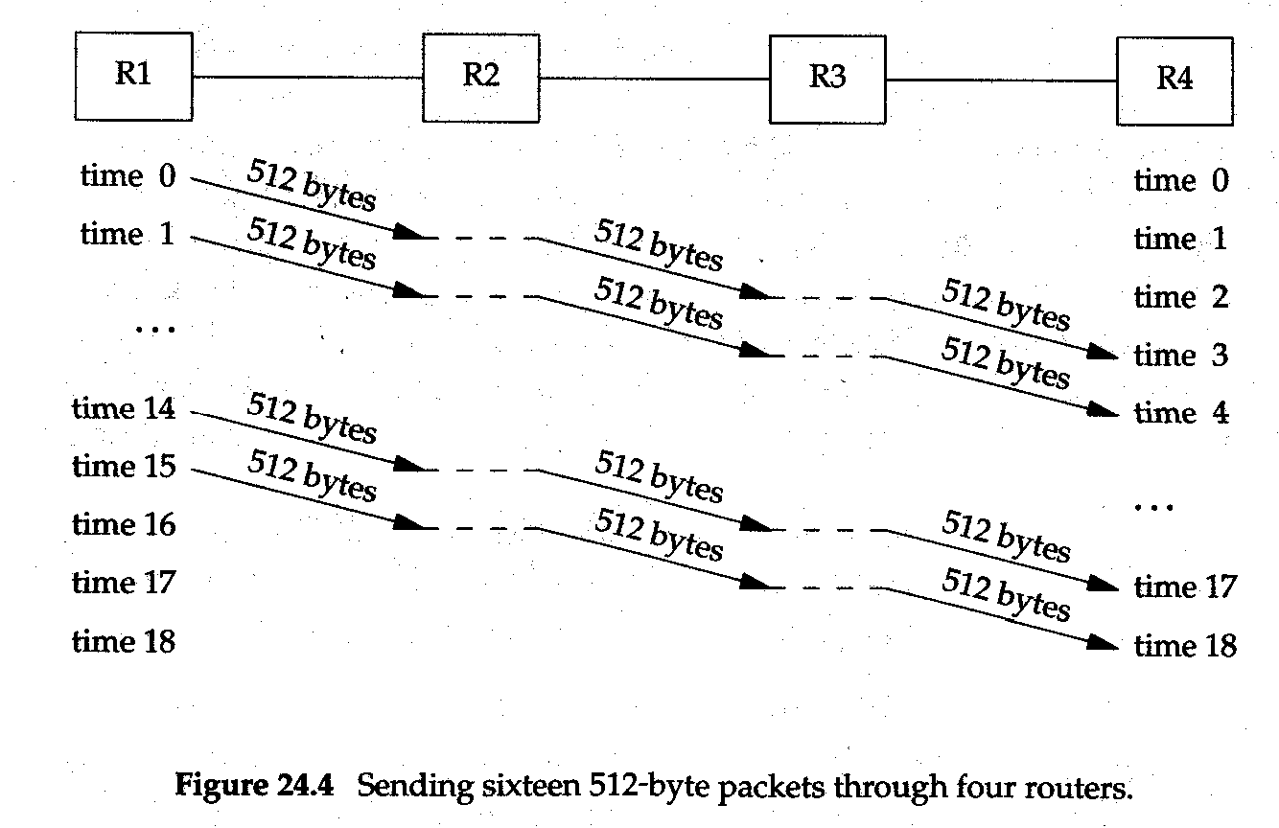
Big packets or Small Packets ?
□ (4096+40) x8 / 1544000 = 21.4 , 21.4 x4 = 85.6
2009/1/6
Network & System Lab, NSYSU
7
小封包傳比較快的例子
Big Packets or Small Packets ?
□ (512+40 ) x8 /1544000 = 2.9 , 2.9x18= 52.2
2009/1/6
8

Slide 5
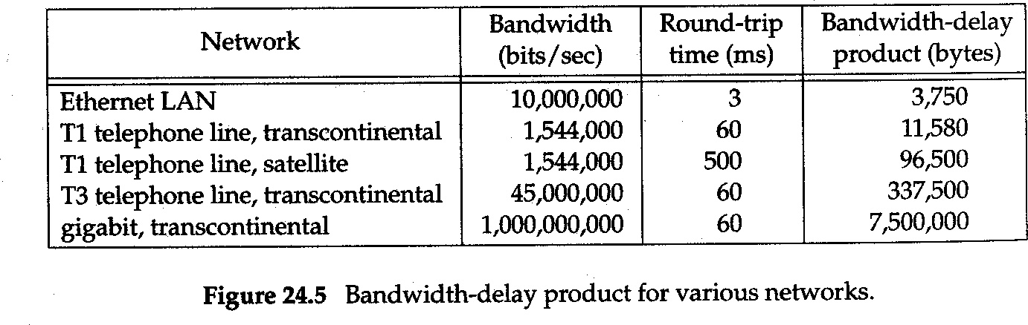
Long Fat Pipes
Bandwidth-delay product: the size of the pipe between the end points .
Capacity (bits) = bandwidth (bits/sec) x round-trip time (sec)
TCP封包只到65535
所以這三個都超過TCP的限制
2009/1/6
Network & System Lab, NSYSU
9
Long Fat Pipes (Cont.)
Networks with large bandwidth-delay products are called long fat networks (LFN) and a TCP connection operating on an LFN is called a long fat pipe.
Numerous problems are encountered with long fat pipes:
The TCP window size is a16-bit field in the TCP header, limiting the window to 65535 bytes.
Packets loss in an LFN can reduce throughput drastically. (why?)
Many implementations only measure one round-trip time per window, not measure the RTT of every segment.
TCP identifies each byte of data with a 32-bit unsigned.
This is only a problem if the same sequence number N is reused within the MSL period, that is, if the network is so fast that sequence number wrap occurs in less than MSL. (solution: PAWS algorithm)
考
雖然LFN比較不會掉封包，
但一旦掉了，會嚴重影響throughput
2009/1/6
10

Slide 6
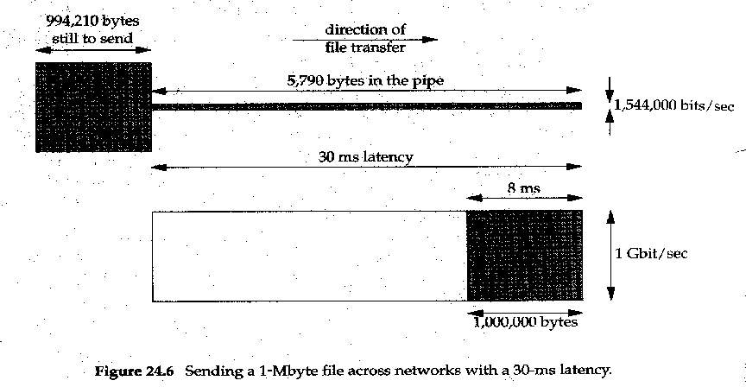
Long Fat Pipes (Cont.)
□
2009/1/6
Network & System Lab, NSYSU
11
Long Fat Pipes (Cont.)
The gigabit network the total time to transfer the file (1Mbytes) is :
0.038 seconds: the 30-ms latency plus the 8 ms for the actual file transfer.
0.034 seconds: the 30-ms latency plus the 4 ms for the actual file transfer (doubling bandwidth decreases the total time by only 10%)
The T1 network total time:
5.211 seconds: the 30 ms latency plus 5181 ms for the actual file transfer.
0.208 seconds (T3): the 30 ms latency plus 178 ms for the actual file transfer.
At gigabit speeds are latency limited, not bandwidth limited.
Latency is caused by the speed of light and cannot be decreased.
增加電路速度影響不大，
因為時間主要被30ms影響
在這邊則影響很大
2009/1/6
12

Slide 7
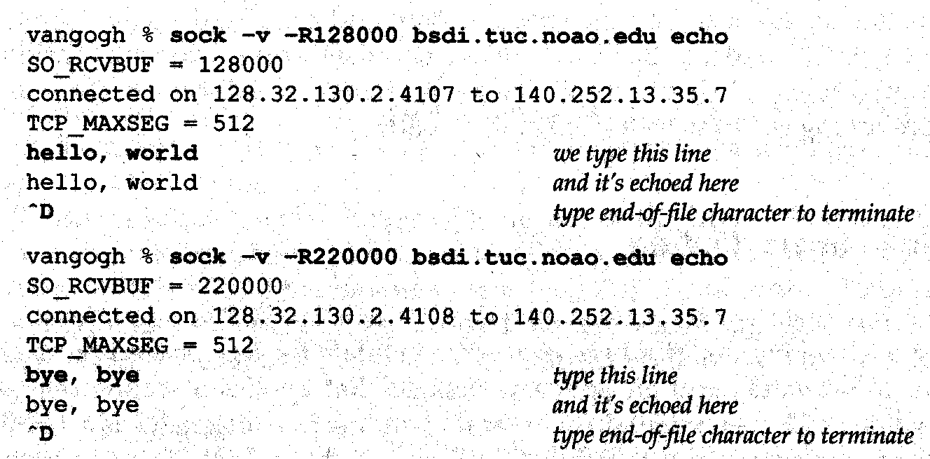
Window Scale Option
The window scale option increase the definition of the TCP window from 16 to 32 bits.
The option can only appear in a SYN segment, therefore the scale factor is fixed in each direction when the connection is established.
With a shift count of S for sending and a shift count of R for receiving. Receiving from the other end is left shift by R bits. Sending a window advertisement to the other end, take real 32-bit window size and right shift S bits.
The shift count is automatically chosen by TCP, based on the size of the receive buffer.
2009/1/6
Network & System Lab, NSYSU
13
Window Scale Option (Cont.)
□ An example:
2009/1/6
14

Slide 8
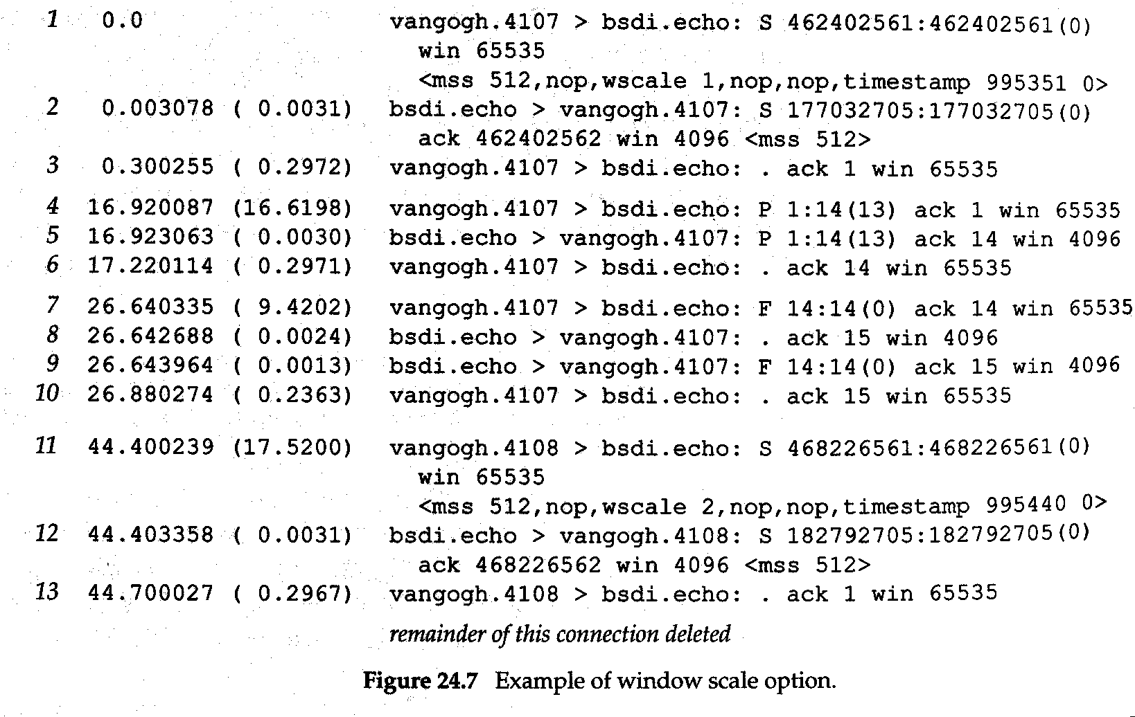
Window Scale Option
2009/1/6
Network & System Lab, NSYSU
15
Timestamp Option
The timestamp option lets the sender place a timestamp value in every segment.
The receiver reflects this value in the acknowledgment, allowing the sender to calculate an RTT for reach received ACK.
The timestamp is a monotonically increasing value. Since the receiver echoes what it receives, the receiver doesn’t care what the timestamp units are.
The end doing the active open specifies the option in its SYN. Only if it receives the operation in the SYN from the other end can the option be sent in the future segments.
2009/1/6
16

Slide 9
Timestamp Option (Cont.)
To minimize the amount of state maintained by either end, only a single timestamp value is kept per connection. The algorithm to choose when to update this value is simple.
TCP keeps track of the timestamp value to send in the next ACK (a variable named tsrecent) and the acknowledgment sequence number from the last ACK that was sent.
When a segment arrives, if the segment contains the byte numbered lastack, then the timestamp value from the segment is saved in tsrecent.
Whenever a timestamp option is sent, tsrecent is sent as the timestamp echo reply field and the sequence number field is saved in lastack.
TCP裡的變數怎麼算的，老師跳過
2009/1/6
Network & System Lab, NSYSU
17
Timestamp Option (Cont.)
Algorithm handles the following two cases:
If ACKs are delayed by the receiver, the timestamp value returned as the echo value will correspond to the earliest segment being acknowledged.
If a received segment is in-window but out-of-sequence, imply that a previous segment has been lost, when that missing segment is received, its timestamp will be echoed, not the timestamp from the out-of-sequence segment.
Timestamp option allows for better RTT calculation, it also provides a way for the receiver to avoid receiving old segments and considering them part of the existing data segment.
有Timestamp比較容易區分新的或舊的封包
2009/1/6
18

Slide 10
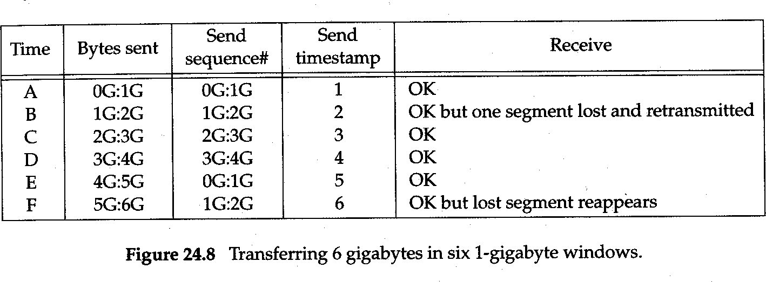
考
PAWS: Protection Against Wrapped Sequence Number
□ The timestamp option is being used and that the timestamp value assigned by the sender increments by one for each window that is sent. G means a multiple of 1073741824 , j:k means byte j through and including byte k-1.
2009/1/6
Network & System Lab, NSYSU
19
現在沒在用
T/TCP: A TCP Extension for Transactions
TCP provides a virtual-circuit transport service, there are three distinct phases in the life of a connection: establishment, data transfer, and termination.
A transaction is a client request followed by a server response with the following characteristic:
The overhead of connection establishment and connection termination should be avoid.
The latency should be reduced to RTT plus SPT, where RTT is the round-trip time and SPT is the server processing time to handle the request.
The server should detect duplicate requests and not reply the transaction when a duplicate request arrives.
2009/1/6
20

Slide 11
T/TCP : A TCP Extension for Transaction (Cont.)
The two modifications required for TCP to handle transactions are to avoid the three-way handshake and shorten the TIME_WAIT state.
T/TCP avoids the three-way handshake by using an accelerated open:
It assigns a 32-bit connection count (CC) value to connection it open, either actively or passively.
Every segment between two hosts using T/TCP includes a new TCP option named CC.
A host maintains a per-host cache of last CC value received in an acceptable SYN segment from that host.
When a CC option is received on an initial SYN, the receiver compares the value with the cached value for the sender.
2009/1/6
Network & System Lab, NSYSU
21
T/TCP: A TCP Extension for Transaction (Cont.)
The SYN, ACK segment in response to an initial SYN echoes the received CC value in another new option named CCECHO.
The CC value in a non-SYN segment detects and rejects any duplicate segments from previous incarnations of the same connection.
□ The accelerated open avoids the need for a three-way handshake unless either the client or server has crashed and reboot. The cost is that the server must remember the last CC received from each client.
2009/1/6
22

Slide 12
T/TCP: A TCP Extension for Transaction (Cont.)
The TIME_WAIT state is shortened by calculating the TIME_WAIT delay dynamically, based on the measured RTT between the two hosts.
Using these features the minimal transaction sequence is an exchange of three segments:
Client to server, caused by an active open: client-SYN, client- data(the request), client_FIN, and client-CC.
Server to client: server -SYN, server-data (reply), server-FIN, ACK of client-FIN, server-CC, and CCECHO of client-CC.
Client to server: ACK of server-FIN, which acknowledges the server’s SYN, data, and FIN.
2009/1/6
Network & System Lab, NSYSU
23
T/TCP: A TCP Extension for Transaction (Cont.)
Many fine points to the implementation of this TCP option that are covered in the references.
The server’s SYN, ACK (the second segment) should be delayed, to allow the reply to piggyback with it.
The request can require multiple segments, but the server must handle their possible out-of-order arrival.
The API must allow the server process to send data and close the connection in a single operation to allow the FIN in the second segment to piggyback with the reply.
The client is sending data in the first segment before receiving an MSS announcement from the server.
The client is also sending data to the server without receiving a window advertisement from the server.
2009/1/6
24

Slide 13
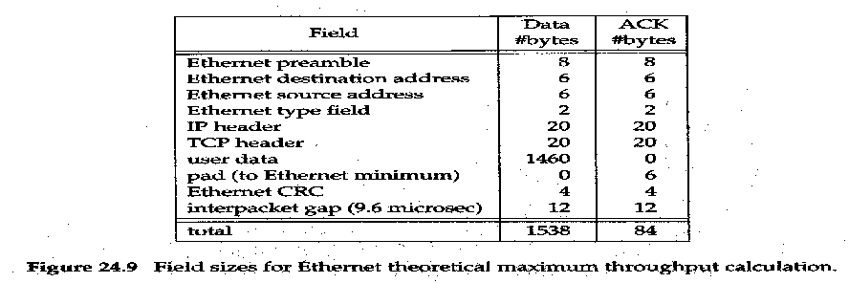


T/TCP : A TCP Extension for Transactions (Cont.)
With the minimal three-segment exchange there is only one RTT that can be measured in each direction. Plus the client’s measured RTT includes the server’s processing time.
VMTP, the Versatile Message Transaction Protocol. Unlike T/TCP, which is a small set of extensions to an existing protocol, VMTP is a complete transport layer that uses IP.
VMTP handles error detection, retransmission, and duplicate suppression. It also supports multicast communication.
2009/1/6
Network & System Lab, NSYSU
25
TCP Performance
□
2009/1/6
26

Slide 14
TCP Performance (Cont.)
The following practical limits apply for any real-world scenario.
You can’t run any fast then the speed of the slowest link.
You can’t go any faster than the memory bandwidth of the slowest machine.
You can’t go any faster than the window size offered by the receiver, divided by the round-trip time. (BW = Window/RTT = 1.073Gbytes/RTT)
How fast TCP can run is determined by the size of the TCP window (1.073 Gbytes) and the speed of light.
Many protocol performance problems are implementation deficiencies rather than inherent protocol limits.
頻寬算法(會考)
TCP最大到1G
雖然TCP看起來很多規則，
但通常最後是受到程式寫的好不好的限制
2009/1/6
Network & System Lab, NSYSU
27
Summary
Path MTU discovery allows TCP to use windows larger than the default of 536 for nonlocal connections, when the path MTU is larger.
The window scale option takes the maximum TCP windows size from 65535 bytes to just over 1 gigabytes.
The timestamp option lets more segment be accurately timed and also lets the receiver provide protection against wrapped sequence numbers (PAWS).
T/TCP allow a client-server request-reply sequence to be completed using only three segments in the usual case.
TCP performance is limited only by the maximum 1-gigabyte window and the speed of light.
TCP受到1G和光速限制
2009/1/6
28

