Slide 1
Chapter 23: TCP Keepalive Timer
2009/1/6
Network & System Lab, NSYSU
1
keepalive timer: 因為對方一直沒有回應，讓server知道對方是否還存在
Introduction
A conventional feature may not be placed in TCP (should be done by application, if desired).
The keepalive timer provides the capability to let a server know if the client’s host has either crashed and is down, or crashed and rebooted.
The keepalive feature is intended for server applications that might tie up resources on behalf of a client, and want to know if the client host crashes.
The keepalive feature is intended to detect those half-open connection from the the server side.
2009/1/6
2

Slide 2
Introduction (Cont.)
Keepalive feature is not part of the TCP specification. The Host Requirements RFC provides three reasons not to use them.
They can cause perfectly good connections to be dropped during transient failures.
They consume unnecessary bandwidth .
They cost money on an internet that charges by the packet.
2009/1/6
Network & System Lab, NSYSU
3
Description
The end that enables the keepalive option is server, and other is the client.
If there is no activity on a given connection for 2 hours, the server sends a probe segments to the client.
The client host must be one of 4 states:
The client host is still up and running and reachable from the server.
The client’s host has crashed and is either down or in the process of rebooting.
The client’s host has crashed and rebooted.
The client’s host is up and running, but unreachable from the server.
2009/1/6
4

Slide 3
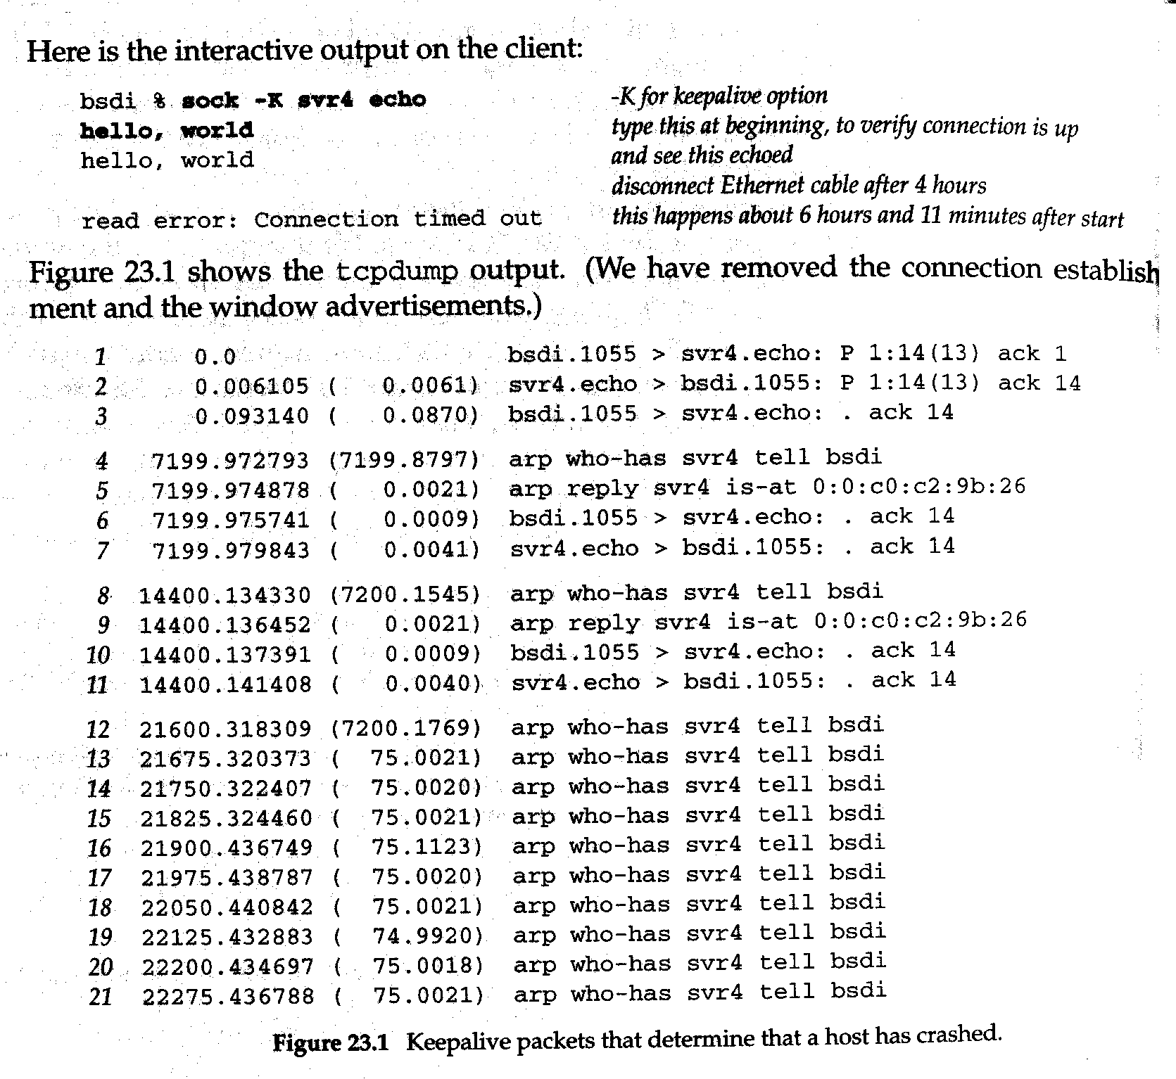
Keepalive Example
Other End Crashes
Establish a connection between a client bsdi and the standard echo server on the host svr4.
Verify that data can go across the connection.
Watch the client’s TCP send keepalive packets every 2 hours and see them acknowledged by the server’s TCP.
Disconnect the Ethernet cable from the server, and leave it off until the example is complete.
The client send 10 keepalive probes, 750 seconds apart before declaring the connection dead.
2009/1/6
Network & System Lab, NSYSU
5
Keepalive Example
2009/1/6
6

Slide 4
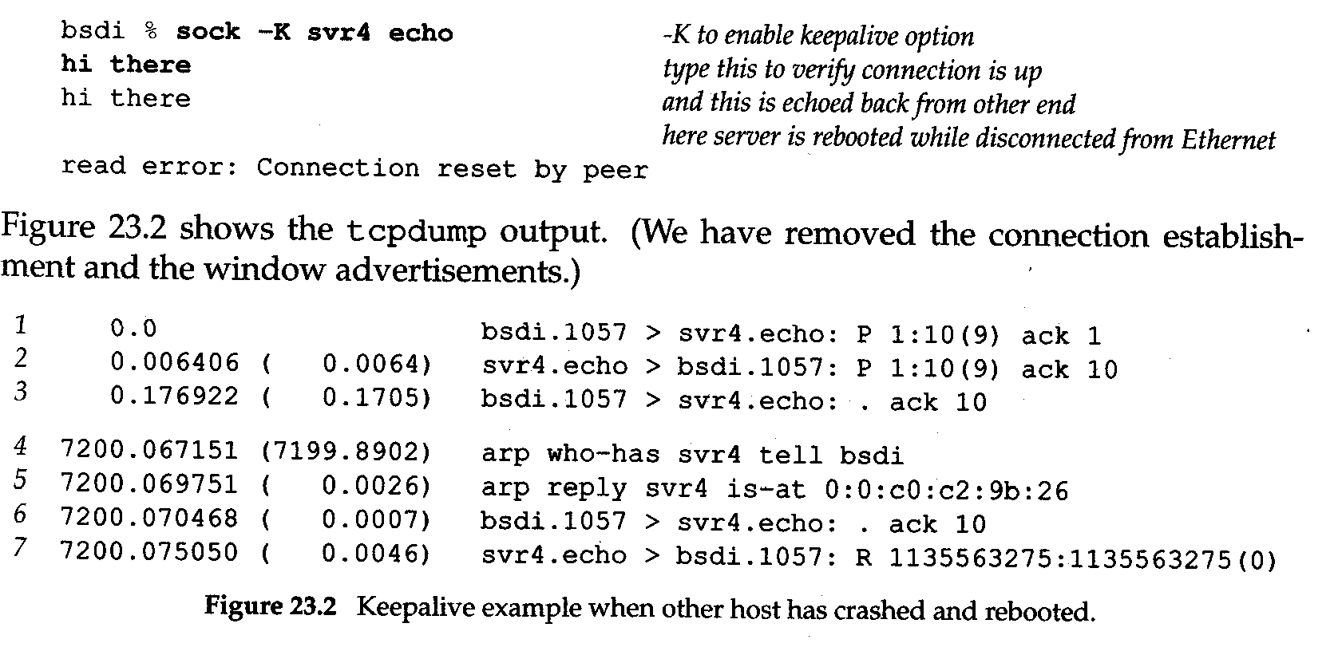

Keepalive Example
□ Other end crashes and reboots
2009/1/6
Network & System Lab, NSYSU
7
Keepalive example
□ Other end is unreachable
2009/1/6
8

Slide 5
Summary
The keepalive feature is controversial.
Sending a probe packet across a connection after the connection has been idle for 2 hours, four different scenarios can occur:
The other end is till there.
The other end has crashed.
The other end has crashed and reboot.
The other end is currently unreachable.
2009/1/6
Network & System Lab, NSYSU
9

