Slide 1

Chapter 20: TCP Bulk Data Flow
2008/12/16

Slide 2
Introduction
What we will see:
sliding window protocol: TCP’s flow control protocol
TCP’s PUSH flag
slow start: the technique used by TCP for getting the flow of data established on a connection
2008/12/16

Slide 3
Normal Data Flow
Examination:
transfer 8192 bytes from svr4 to bsdi
on bsdi:
bsdi % sock -i -s 7777
on svr4:
svr4 % sock -i -n8 bsdi 7777 --- (eight 1024-byte writes to the network)
Flags:
-i : sink, read from the network and discard the data
-s : as a server
-n8 : perform 1024-byte writes to the network
2008/12/16

Slide 4

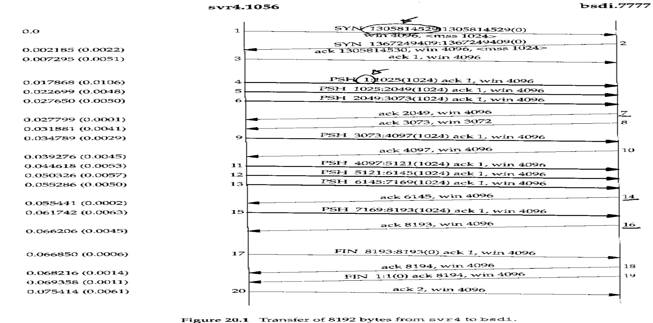
USER
2021-12-29 00:56:15
--------------------------------------------
在區網的例子
Normal Data Flow (Cont.)
□ (continued...)
2008/12/16

Slide 5
Normal Data Flow (Cont.)
Segment 7 ACKs 2049, not 3073:
segment 4, 5, 6 arrives, IP passes them to TCP in the same order
TCP processes segment 4, the connection is marked to generate a delayed ACK
TCP processes segment 5: since TCP now has two outstanding segments to ACK, the ACK of 2049 is generated (segment 7), and the delayed ACK flag for this connection is turned off
TCP processes segment 6: the connection is again marked for a delayed ACK. But before segment 9 arrives, the delayed ACK timer goes off, then segment 8 ACKs 3073
2008/12/16

Slide 6
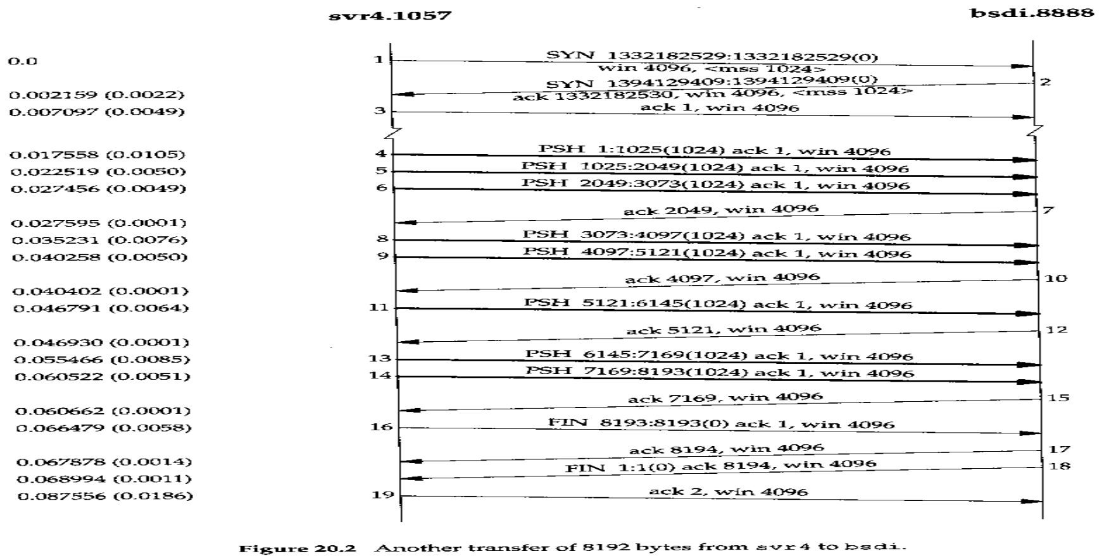
Normal Data Flow (Cont.)
□ Another Example:
2008/12/16

Slide 7
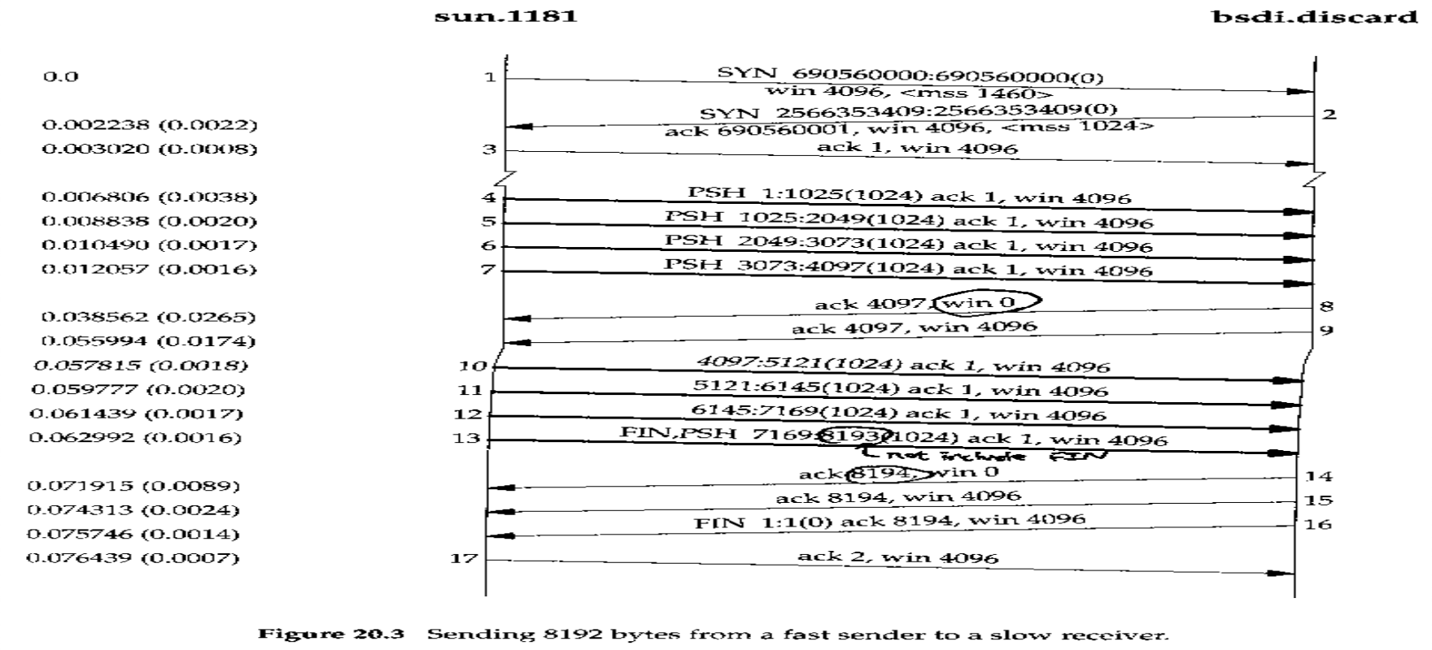
Fast Sender, Slow Receiver
□ From a fast sender (the host sun) to a slow receiver(the host bsdi):
88
傳輸快，接收慢 so, win回0
此時sender不再送 window update
2008/12/16

Slide 8
Fast Sender, Slow Receiver (Cont.)
Things we noticed:
the sender transmits segment 4 to 7 to fill the receiver’s window and then waits for an ACK (since segment 2 telled the host sun the window size is 4096)
the receiver sends the ACK(segment 8) but the advertised window is 0: the receiver has all the data, but it’s all in the receiver ‘s TCP buffer
another ACK (called a window update) is sent later, announcing that the receiver can now receive another 4096 bytes: it does not acknowledge any new data, it just advances the right edge of the window
segment 13 contains 2 flag bits: PUSH and FIN.
9號封包
Q: 如何解決 window update封包 loss? 加 timer
時間到，但reciever還沒收到封包，就再送一次window update
2008/12/16

Slide 9
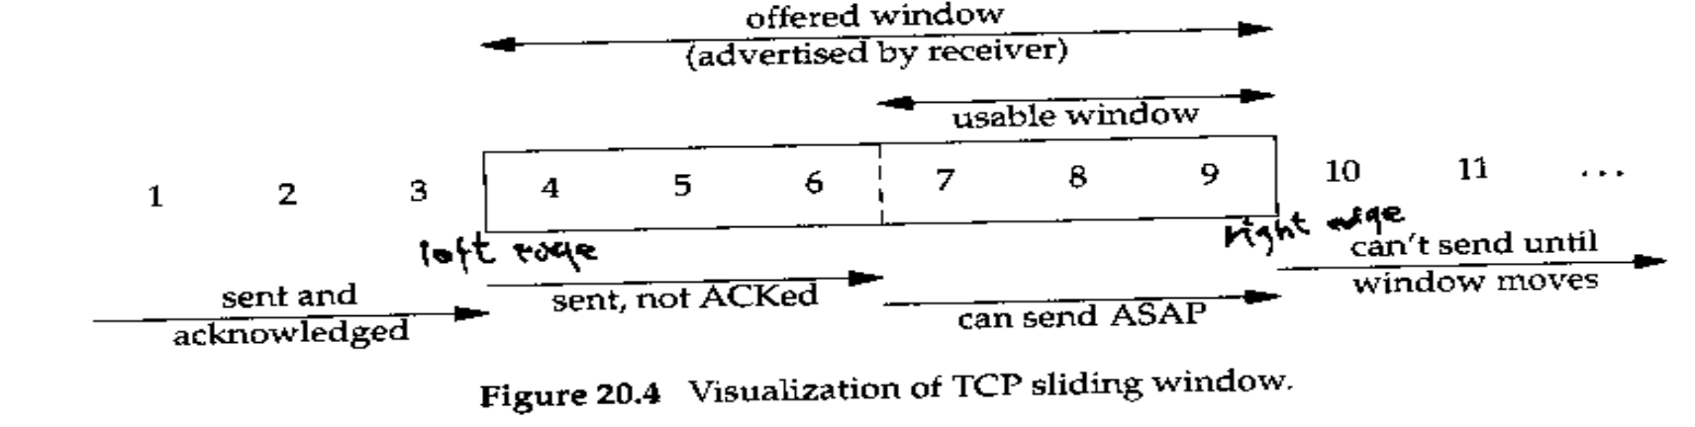
Sliding Windows
outstanding data多寡，決定 window size
□ Illustration of sliding windows:
offered window: 4 to 9
usable window: 7 to 9 (computed by the sender)
2008/12/16

Slide 10
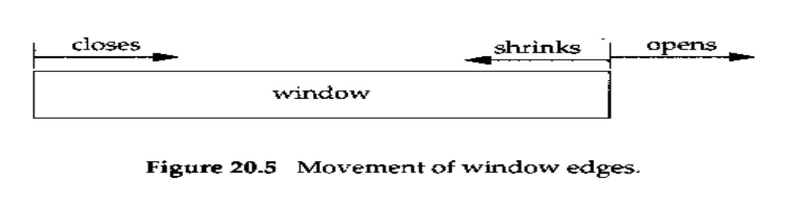
Sliding Windows (Cont.)
the window closes: the left edge advances to right
the window opens: the right edge moves to the right
the window shrinks: the right edge moves to the left; The Host Requirement RFC strongly discourages this
NEVER moves the left edge to the left: if an ACK were received that implied moving the left edge to the left, it is a duplicate ACK, and discarded
2008/12/16

Slide 11
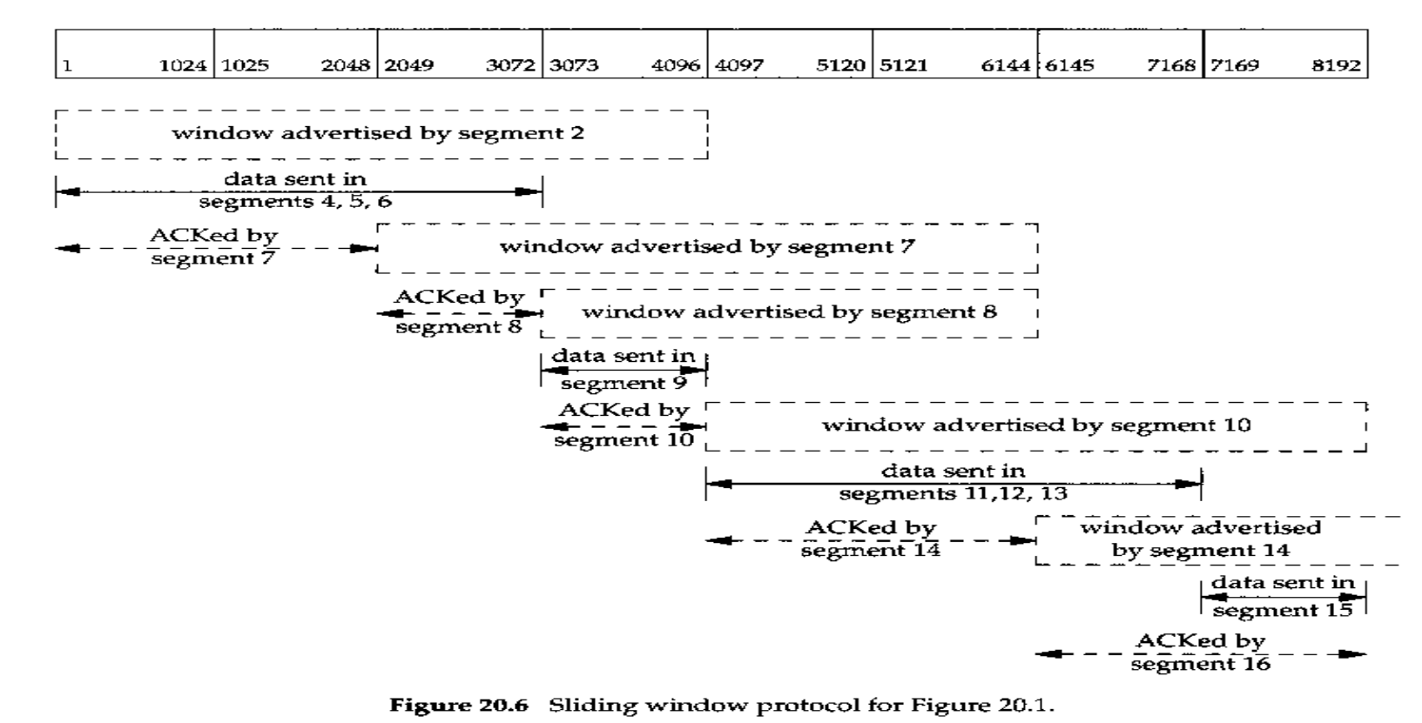
Sliding Windows (Cont.)
□ An Example for the data transfer in Figure 20.1:
2008/12/16

Slide 12
Window Size
The size of window offered by the receiver can usually be controlled by the receiving process (rather than receiver’s TCP). This can affect the TCP performance.
For file transfer between two workstations on a Ethernet, the common default of 4096 bytes for both is not optimal: An approximate 40% increase in throughput is seen by just increasing both buffer to 16384 bytes.
2008/12/16

Slide 13
Window Size (Cont.)
An Example: from sun (the client) to bsdi (the server)
bsdi % sock -i -s -R6144 5555
sun % sock -i -n1 -w8192 bsdi 5555
Flag:
-R6144: set the size of the receive buffer (as 6144 bytes)
-n1 -w 8192: perform one write of 8192 bytes
2008/12/16

Slide 14
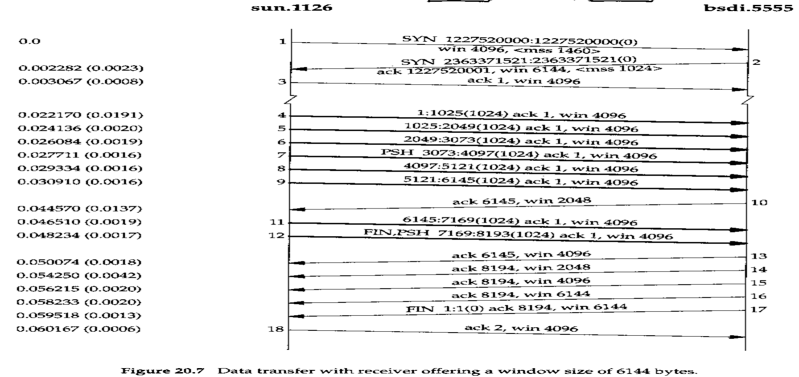
Window Size (Cont.)
2008/12/16

Slide 15
PUSH Flag
指示接收方應該儘快將這個報文段交給應用層而不用等待緩衝區裝滿
PUSH flag: a notification from the sender to the receiver for the receiver to pass all the data that it has to the receiving process
In the original TCP specification, it was assumed that the programming interface would allow the sending process to tell its TCP when to set the PUSH flag.
Today, however, most APIs don’t provide a way for the application to tell its TCP to set the PUSH flag. Indeed, many implementors feel the need for the PUSH flag is outdated, and a good TCP implementation can determine when to set the flag by itself.
Most Berkeley-derived implementations automatically set the PUSH flag if the data in the segment being sent empties the send buffer.
目前大多
不支援
push flag
2008/12/16

Slide 16
Slow Start
As we’ve seen for the sender starts off by injecting multiple segments into the network, up to the windows size advertised by the receiver. This naive approach is OK when two hosts are on the same LAN but reduce the throughput drastically of TCP connections between many routers and slow links.
TCP is now required to support an algorithm called slow start:
it operates by observing that the rate at which new packets should be injected into the network is the rate at which the ACKs are returned by the other end
slow start: 送出的流量慢慢增加，並觀察Ack回來的情況，
直到Ack回來的情況開始不理想
2008/12/16

Slide 17
Slow Start (Cont.)
Slow start adds another window to the sender’s TCP: the congestion window, or, cwnd
win: the window size advertised by the other end
Operations of slow start:
initial connection, cwnd = 1 segment (announced by the other end)
the sender can transmit up to the min(cwnd, win)
Each time an ACK is received, the congestion window is increased by one segment.
網路塞不塞
由 cwnd, win 最小的決定
2008/12/16

Slide 18
Slow Start (Cont.)
cwnd is maintained in bytes, but slow start always increments it by the segment size.
Congestion window (cwnd): sender’s flow control
Advertised window: receiver’s flow control
The sender starts by transmitting one segment and waiting for its ACK. When that ACK is received, cwnd is incremented from one to two, and two segments can be sent. When each of those two segments is ACKed, cwnd is increased to four. This provides an exponential increase.
指數上升
slow start algo
cwnd = 1
send( min(cwnd, win))
if ack received
cwnd++;
有 self-clocking 概念，
ack來的快，cwnd上升快
so，是指數上升
(直到timeout)
2008/12/16
TCP認為 timeout = 塞車

Slide 19
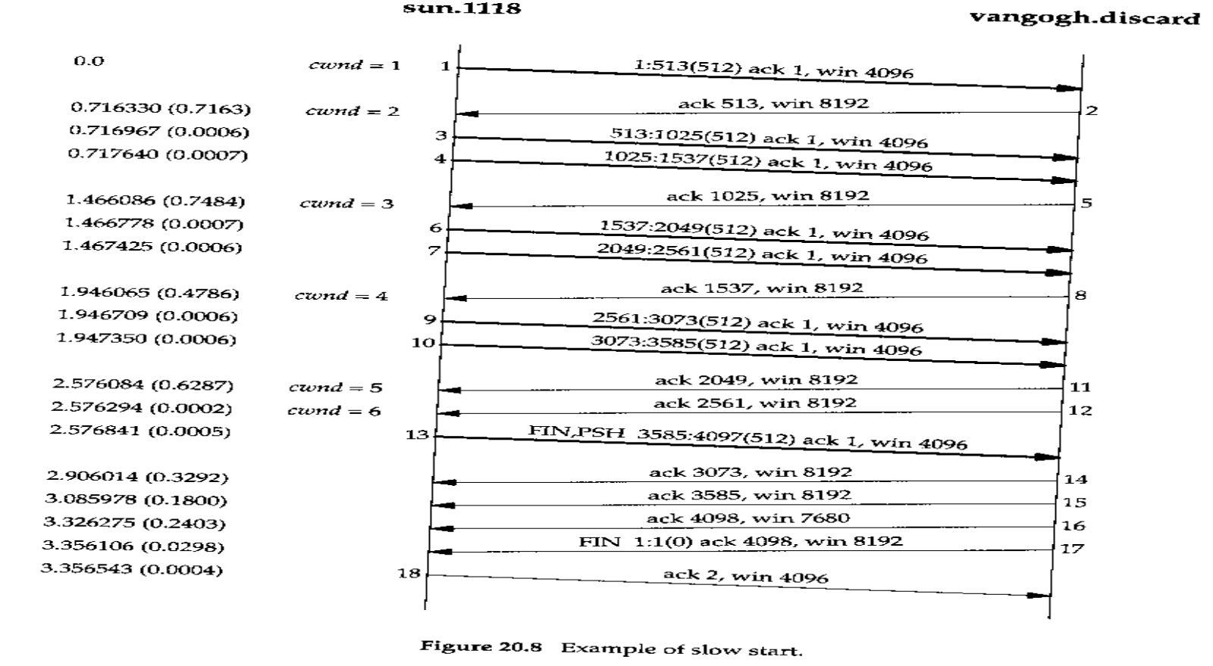
Slow Start
□ An Example:
2008/12/16

Slide 20
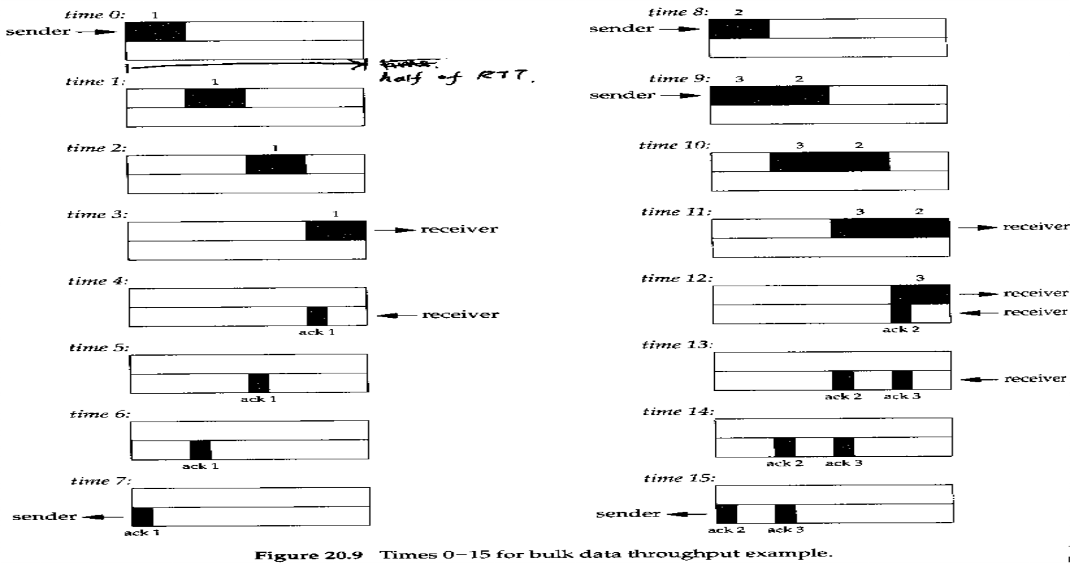
Bulk Data Throughput
2008/12/16

Slide 21
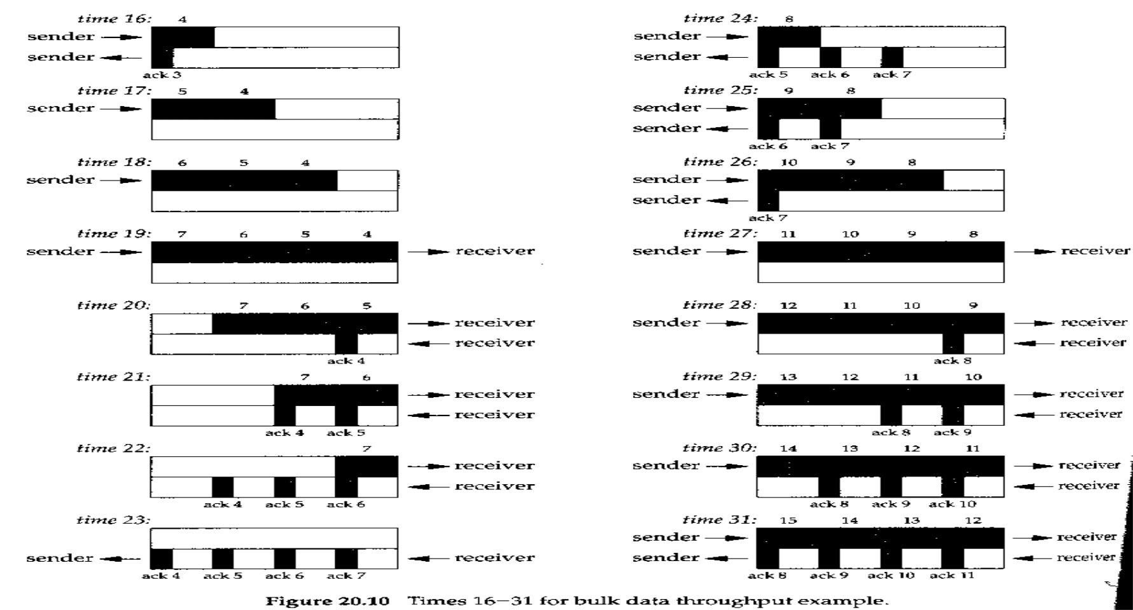
Bulk Data Throughput (Cont.)
2008/12/16

Slide 22

Bulk Data Throughput (Cont.)
USER
2021-12-22 01:34:21
--------------------------------------------
T3雖然只有45M,但很夠用了 ，因TCP會限制傳輸速度 (65535)
How big should the window be?
min(cwnd, advertised window)
Bandwidth-Delay Product.:
Capacity (bits) = bandwidth (bits/sec) * round-trip time (sec)
Examples:
T1 line (1,544,000 bits/sec) across US (about 60ms) => bandwidth- delay product (capacity) = 11,580 bytes
T3 line (45,000,000 bits/sec) across US (about 60ms) => bandwidth delay product (capacity)=337,500 bytes (>65,535) => Need new TCP window scale option
2008/12/16

Slide 23
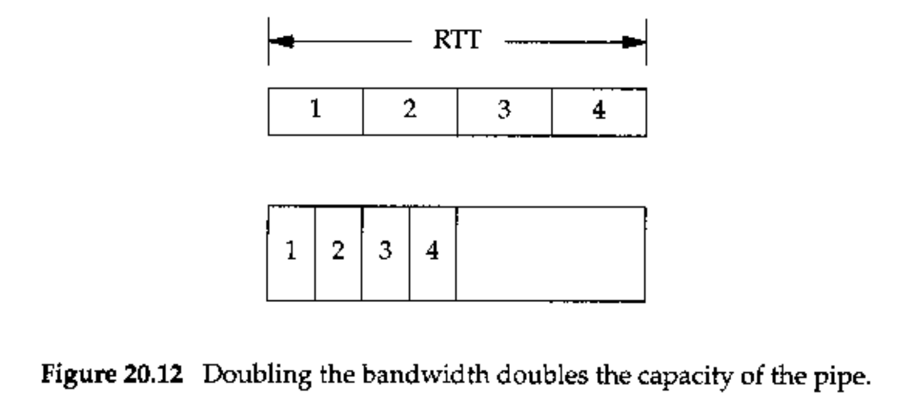

Bulk Data Throughput (Cont.)
USER
2021-12-22 01:35:20
--------------------------------------------
電路變大，但可能用不到那麼多
□ Relation between capacity, bandwidth and RTT:
2008/12/16

Slide 24
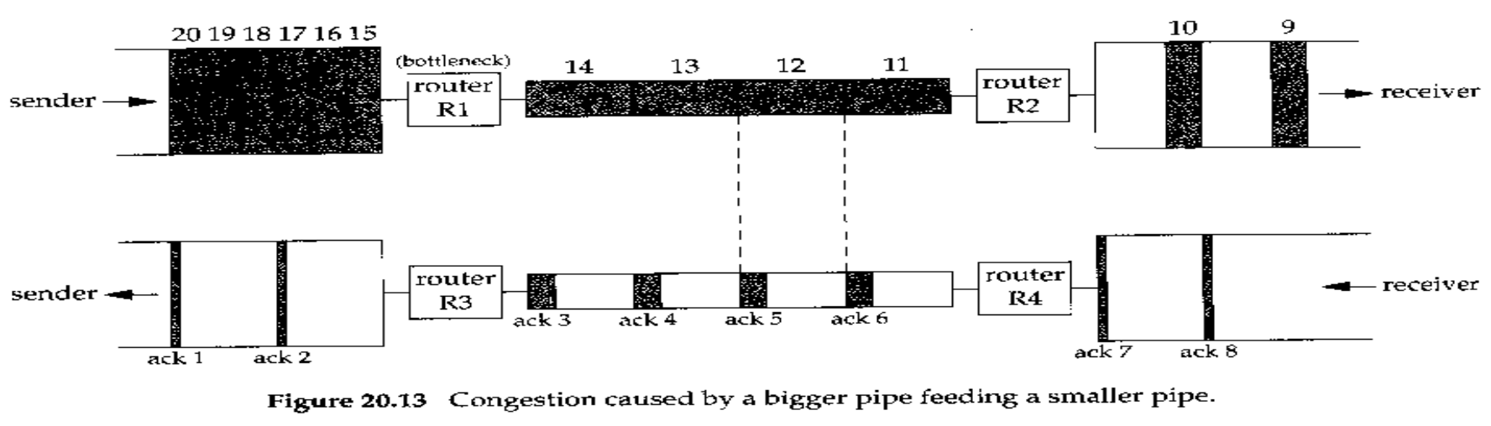
Congestion
Congestion:
can occur when data arrives on a big pipe (a fast LAN) and gets sent out a smaller pipe (a slower WAN)
can also occur when multiple input streams arrive at a router whose output capacity is less than the sum of the inputs
2008/12/16

Slide 25
Urgent Mode
USER
2021-12-22 01:44:34
--------------------------------------------
只能知道urgent data 結束的byte
TCP provides what it calls urgent mode, allowing one end to tell the other end that “urgent data” of some form has been placed into the normal stream of data.
Last byte of urgent data = urgent pointer + sequence #
There is no way to specify where the urgent data starts in the data stream.
The only information sent across the connection by TCP is that urgent mode has begun and the pointer to the last byte of urgent data.
out-of-band: 類似高速公路的路肩，避免封包太多進不去，但有緊急的是要通知對方
但在TCP裡，urgent data定義的不好，因為只知道urgent data尾巴，不知開頭，而且也沒講到urgent data怎麼送
2008/12/16

Slide 26
Urgent Mode (Cont.)
Telnet and Rlogin use urgent mode from the server to he client because it’s possible for this direction of data flow to be stopped by the client TCP (i.e., it advertises a window of 0). But if the server process enter urgent mode, the server TCP immediately sends the urgent pointer and the URG flag, even though it can’t send any data.
The urgent pointer just advances in the data stream, and its previous position at the receiver is lost.
2008/12/16

Slide 27
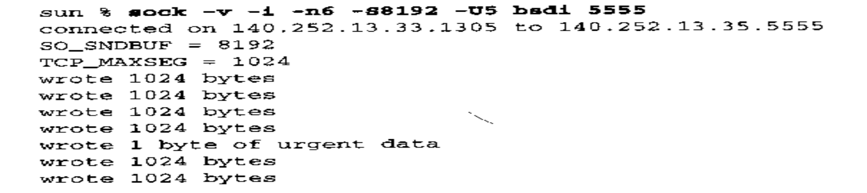
Urgent Mode (Cont.)
An Example:
bsdi % sock -i -s -P10 5555
-i : sink
-P : pause 10 secs
-S8192 : using a send buffer of 8192 bytes
-n6 : write six 1024-byte writes
-U5: write 1 byte of data and enter urgent mode before writing the fifth buffer to network
2008/12/16

Slide 28
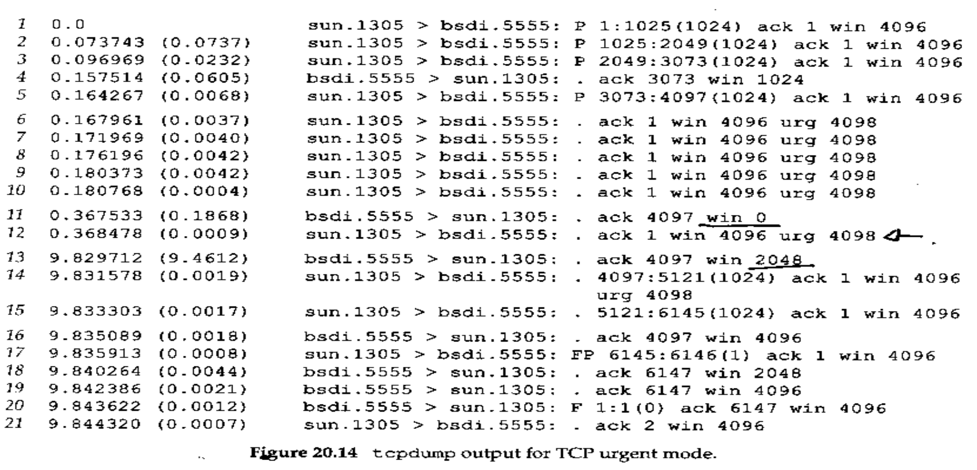
Urgent Mode (Cont.)
2008/12/16

Slide 29
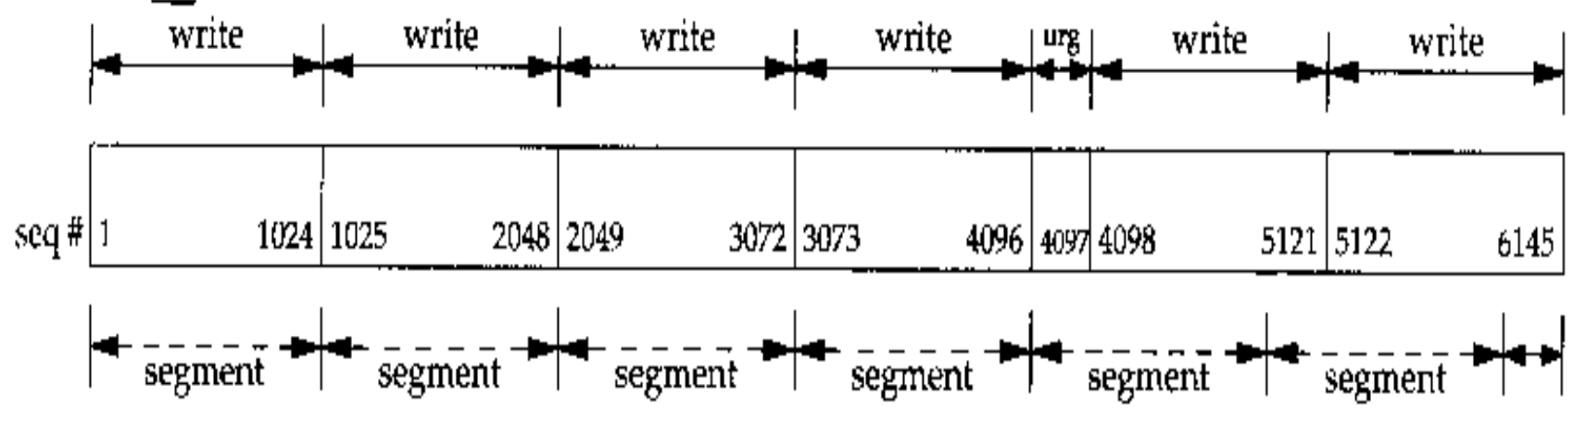
Urgent Mode (Cont.)
□ (continued...)
2008/12/16

Slide 30
Summary
TCP Bulk Data Flow
push flag
slow start
bandwidth-delay product
urgent mode
2008/12/16

