Slide 1

Cut the $$ Cable
How to cut the cord with your cable company and still watch almost anything

Slide 2

Ideal Customer
Loves movies, and having access to thousands of movies, new and old
Already has a ”smart TV” or TV with HDMI
Doesn’t watch a lot of live television
Doesn’t need a landline
Even if you are not an Ideal Customer,
streaming may save you money

Slide 3



What do you pay now?
$205-$260
TV pkg $70
Internet $90
Phone $40
Taxes/Fees $60
$260
TV pkg $60
Internet $120
Phone $25
Taxes/Fees $?
$205+?

Slide 4


Internet Only (300 Mbps)
$40/mo intro rate
(2 years), then $90/mo
$15/mo modem
$50/mo
No modem fee
$50-$105
$55/mo
$15/mo modem

Slide 5

New Potential Monthly Cost
(best scenario)
Internet $50
Streaming service
$7 (ads) / $16 (no ads)
TOTAL
$50-70
Add live TV
$70-80
TOTAL
$130-150

Slide 6
Ok, so what are the steps?
You’ll need a ”smart TV” or a TV with an HDMI port
Check with your provider to see if you can cancel without penalty
Decide on a streaming service (e.g.., Netflix, Hulu)
Log into the service(s) on your TV
Start exploring!

Slide 7

What’s a smart TV?
A “smart TV” has software built-in that will allow you to log into and use streaming services such as Netflix or Hulu

Slide 8
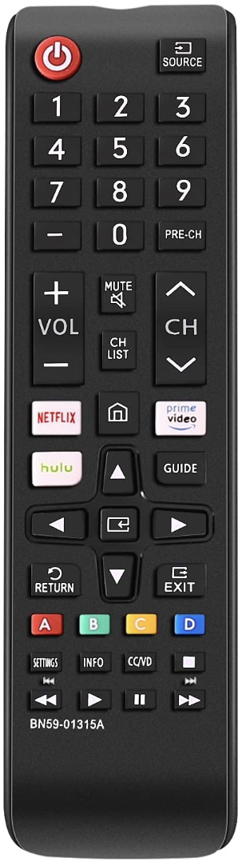

Do I have a smart TV?
Was your TV purchased within the last 5 years?
It likely has all the apps like Netflix, Prime, Apple,
Hulu, etc. you need.
Not sure?
Look at the remote that came with your TV.
Does it have buttons for Hulu, Netflix or Prime?
If yes, then you have a smart TV.
Still not sure? Press the Home or the Menu
button on your remote. Does your television
display small logos for Netflix, Prime, Apple TV+?
If yes, then you have a smart TV.

Slide 9

What if I don’t have a smart TV?
There’s still hope. You will need two things:
A television with an HDMI port.
A streaming device.
ou will connect a streaming device such as Roku, Amazon Fire Stick, or Google Chromecast to the HDMI port.
Prices range from $30-$50.
If you have no preference, then purchasing the least expensive one should be all you need.

Slide 10
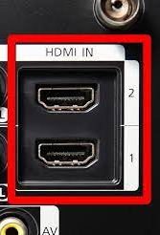
HDMI port

Slide 11
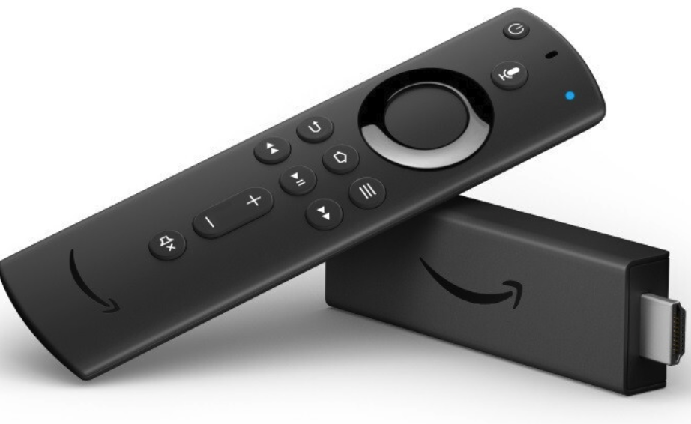
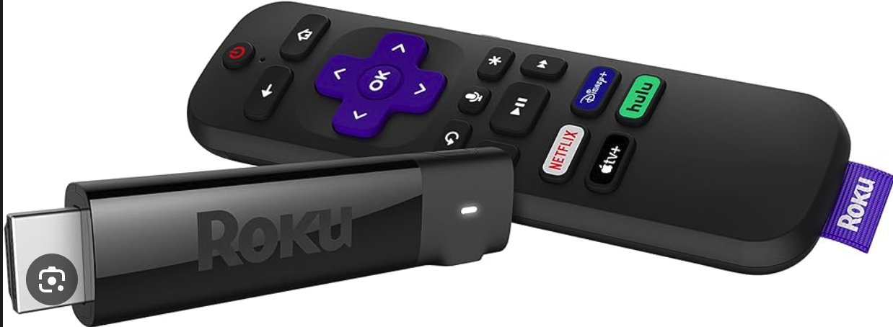
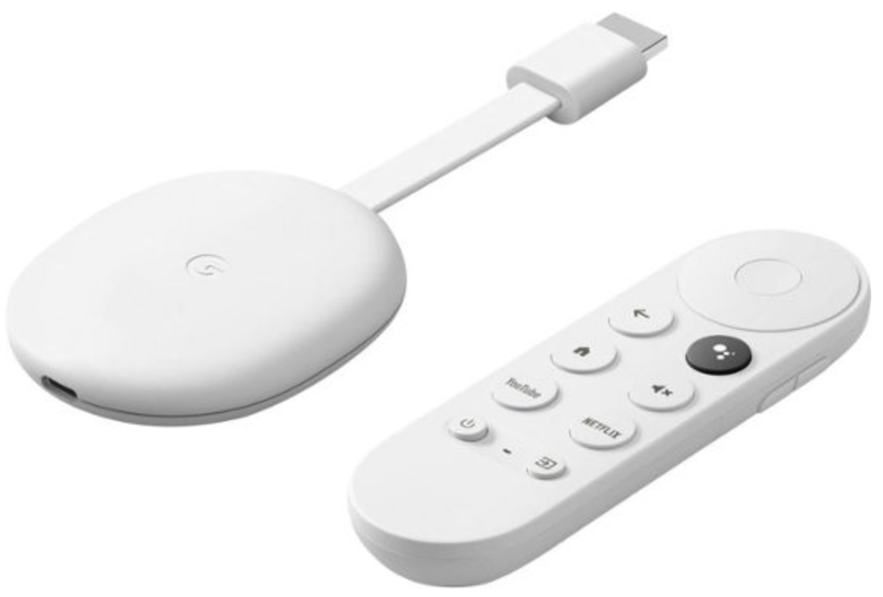
I have a TV with an HDMI port
Chromecast: $20
Roku: $30
Amazon Fire: $40

Slide 12

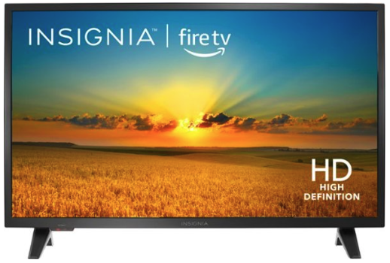

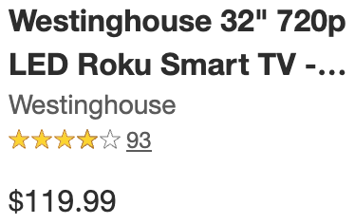



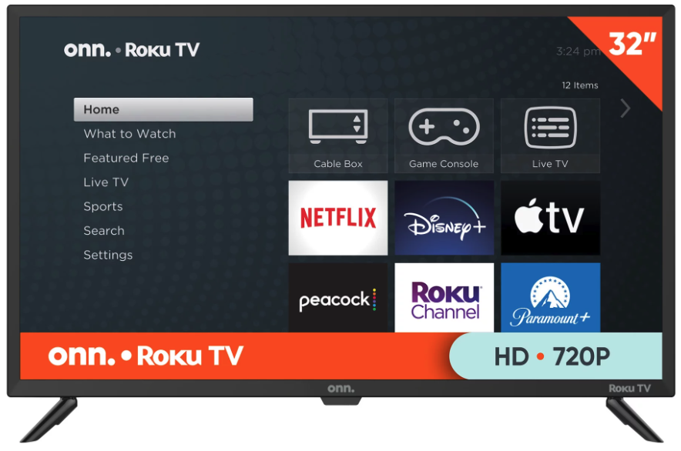
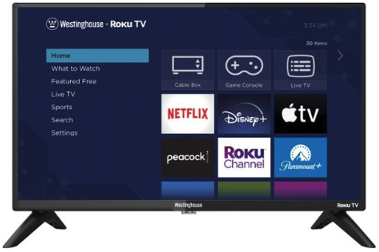
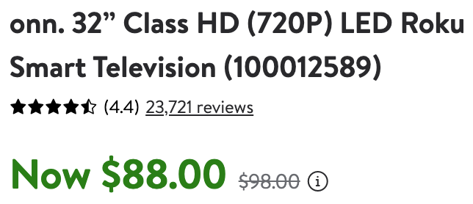

What if I don’t have a smart TV or a TV with an HDMI port?
Depending on how much you’re willing to spend up-front, it may be worth investing in a smart TV.
A new 32” smart TV from BestBuy, Walmart, or Target can be purchased starting at ~$90.

Slide 13

Ok, I have a smart TV, or at least a TV with an HDMI port. Now what?
Decide on a streaming service.
Some shows (e.g., Ted Lasso, The Bear) are proprietary to a specific service, while others are available on multiple services.
The least expensive streaming service is Netflix at $7 (with ads) and $16 (no ads).

Slide 14






Streaming Services
$7 ads
$16 no ads
$8 ads
$14 no ads
$10 no ads
$8 ads
$18 no ads
live TV
+$77 (ads)
+90 (no ads)
Free (ads) w/Prime
$3 (no ads) w/Prime
https://www.cnet.com/tech/services-and-software/best-streaming-service/

Slide 15

But what about live television?
What live coverage do you want?
News? Each local station typically has an app that lets you watch the news. Some are free, and some require a subscription.
Hulu has a more expensive service that includes access to national channels with local coverage.
($77 w/ads or $90/without)
If what you are really looking for is access just to local television channels, there are (surprise!) antennas you can attach to your TV for $20+.

Slide 16

Theresa Milewski
978-866-8491
marbleheadbytes@gmail.com
www.allcomputersgreatandsmall.com

