Slide 1


Demystifying Uber
Or, how to book a ride to just about anywhere!

Slide 2
Uber
Uber Technologies, Inc., commonly known as Uber, is an American multinational ride-hailing company offering services that include peer-to-peer ridesharing, ride service hailing, food delivery, and a micromobility system with electric bikes and scooters. The company is based in San Francisco and has operations in over 785 metropolitan areas worldwide. Its platforms can be accessed via its websites and mobile apps.
Founded: Mar 2009
Revenue: $11.27 Billion USD (2018)
Headquarters: San Francisco, CA
Founders: Travis Kalanick, Garrett Camp, Oscar Salazar
Subsidiary: Uber Eats, Careem, Otto, Mighty AI, deCarta, Social Bicycles, Jump Bikes, orderTalk Inc. (acquired by Uber Technologies Inc.)...
Chairman: Ronald Sugar
Notes:
QuickStarter has created an outline to help you get started on your presentation. Some slides include information here in the notes to provide additional topics for you to research.
More key facts:
Subsidiary: Uber Eats, Careem, Otto, Mighty AI, deCarta, Social Bicycles, Jump Bikes, orderTalk Inc. (acquired by Uber Technologies Inc.), Cornershop, Swipe Labs, Complex Polygon, Uber Advanced Technologies Group, UberRUSH, Geometric Intelligence Inc, Uber Freight, Rasier-CA llc, Rasier LLC, Uber India Technology, Xchange Leasing, LLC, Geometric Intelligence Inc., Complex Polygon, Inc., Uber International C.V.

Slide 3
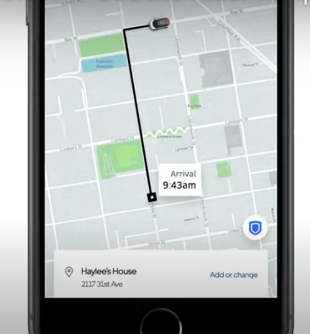
Uber safety: Video
Me: User since 2016 without incident in & around Boston, to Logan airport, in Las Vegas, Miami, Chicago, Lisbon Portugal, and in the Vineyard
Request your ride inside: wait until the app notifies you that the driver has arrived
Check Your Ride: match license plate, car make and model, and driver photo
Have the driver confirm your name: Ask, “Who are you here to pick up?”
We can set up your “Trusted Contacts”): They will receive notifications that track your trip and ETA.
Your personal information: phone number is masked and drop off address is not saved

Slide 4
Installing Uber
Laptop or tablet: uber.com
iPhone: App Store
Android or Jitterbug: Play Store
Create account with phone number or email address
Update Uber with a payment method
Make sure notifications are enabled for Uber

Slide 5
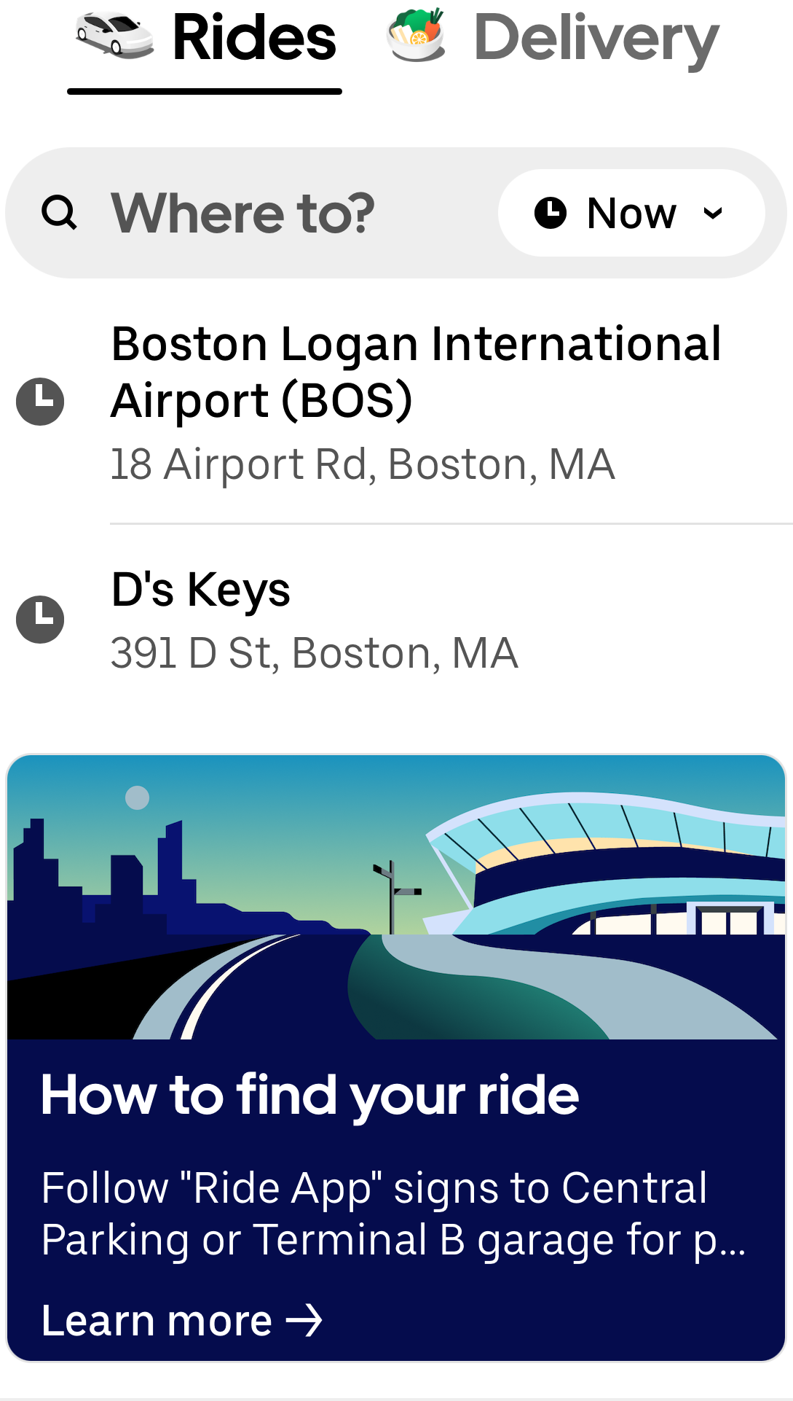
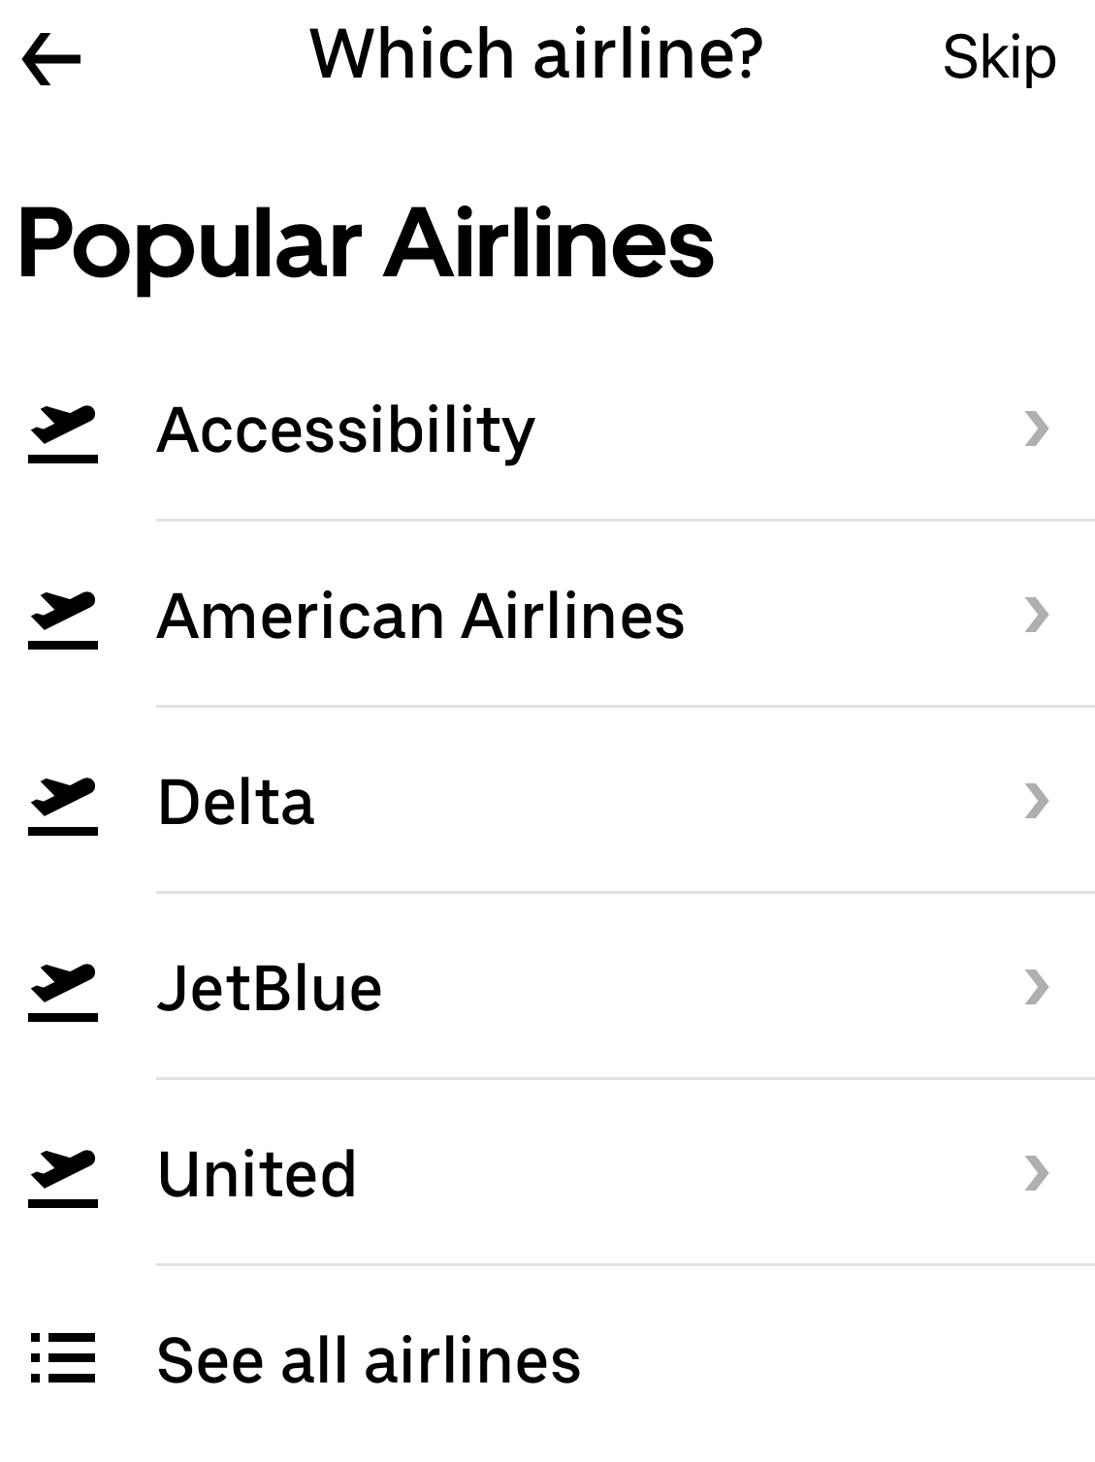
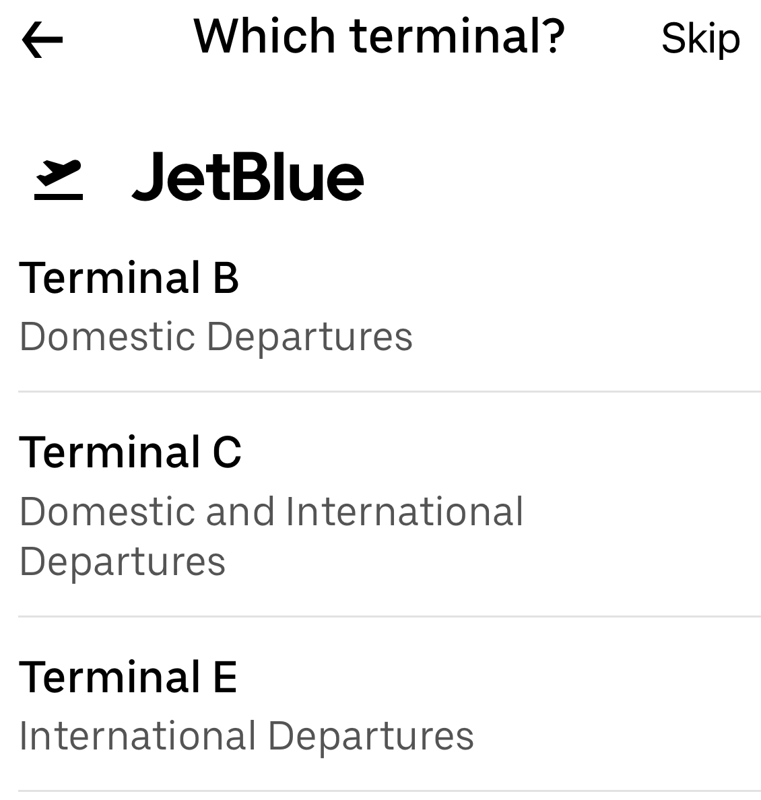
Booking a ride
Notes:
QuickStarter has created an outline to help you get started on your presentation. Some slides include information here in the notes to provide additional topics for you to research.
More key facts:
Subsidiary: Uber Eats, Careem, Otto, Mighty AI, deCarta, Social Bicycles, Jump Bikes, orderTalk Inc. (acquired by Uber Technologies Inc.), Cornershop, Swipe Labs, Complex Polygon, Uber Advanced Technologies Group, UberRUSH, Geometric Intelligence Inc, Uber Freight, Rasier-CA llc, Rasier LLC, Uber India Technology, Xchange Leasing, LLC, Geometric Intelligence Inc., Complex Polygon, Inc., Uber International C.V.

Slide 6
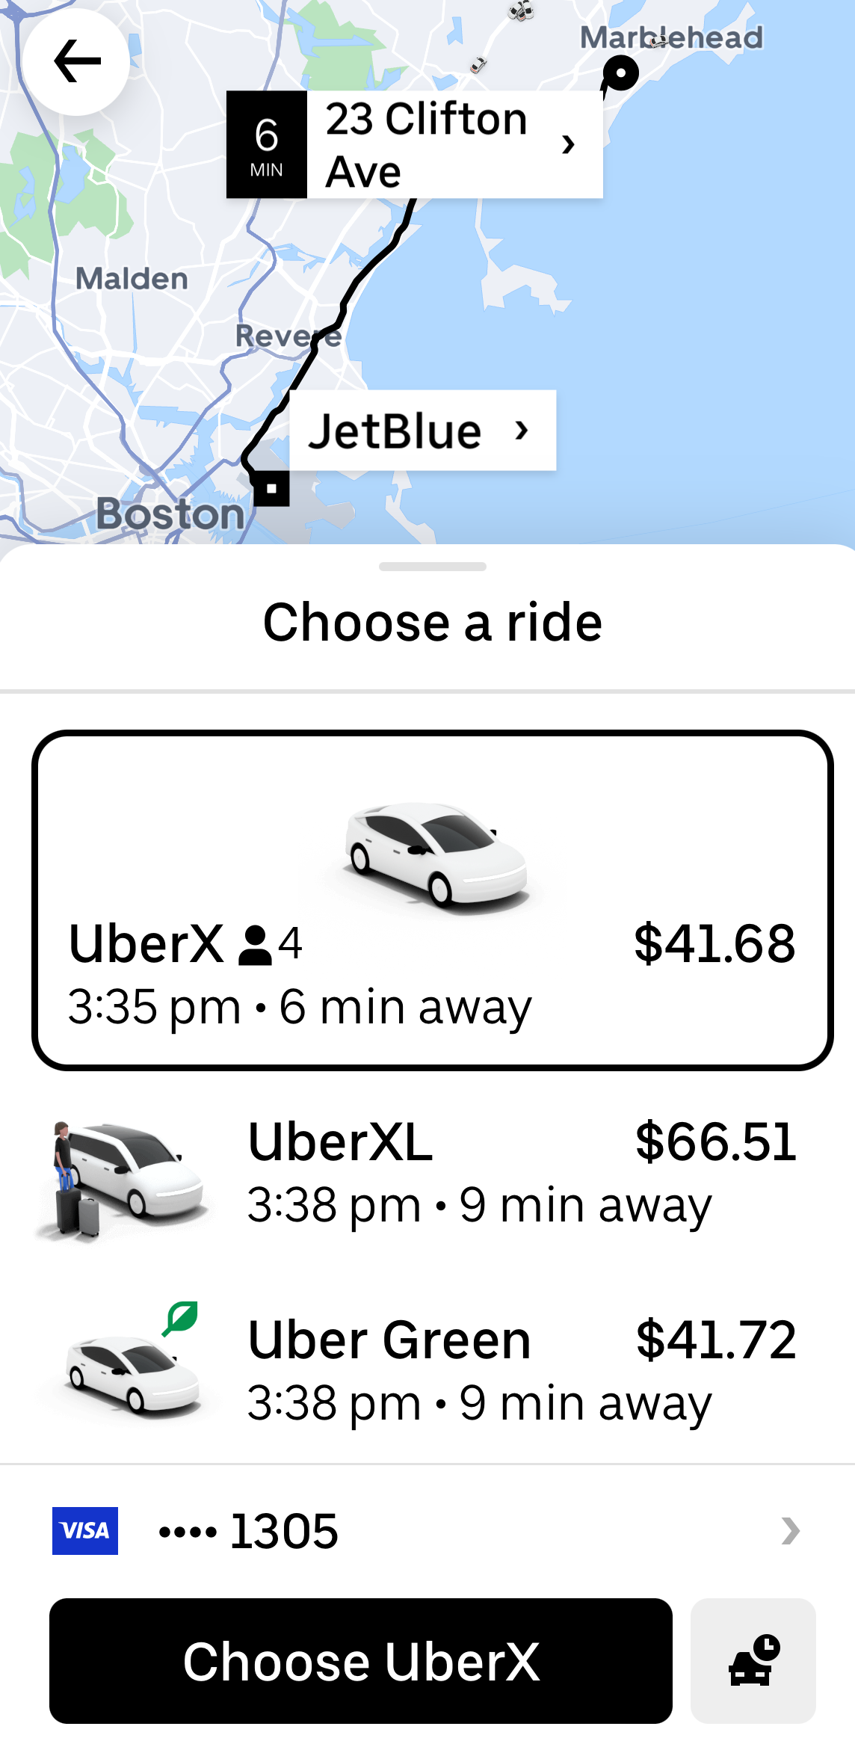
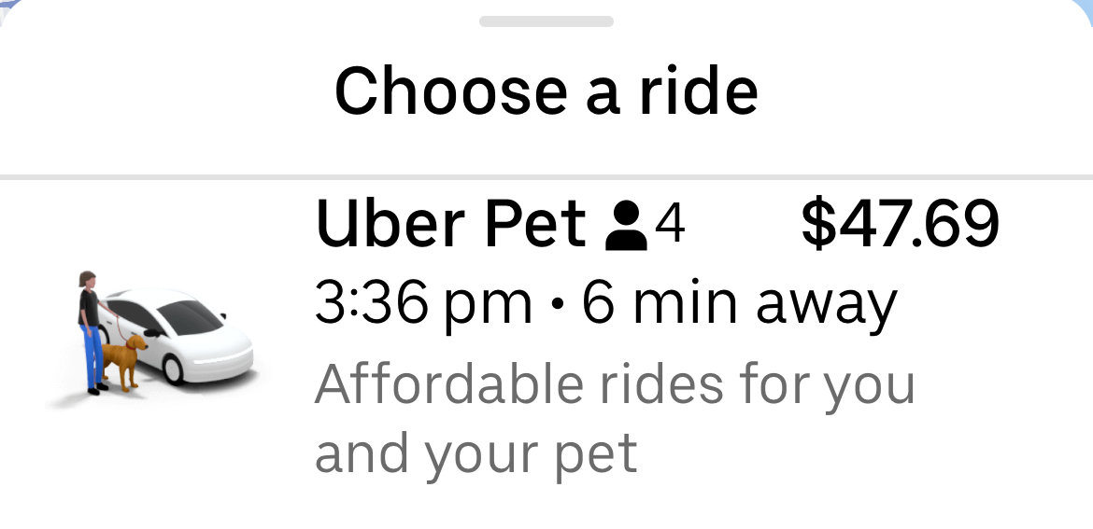
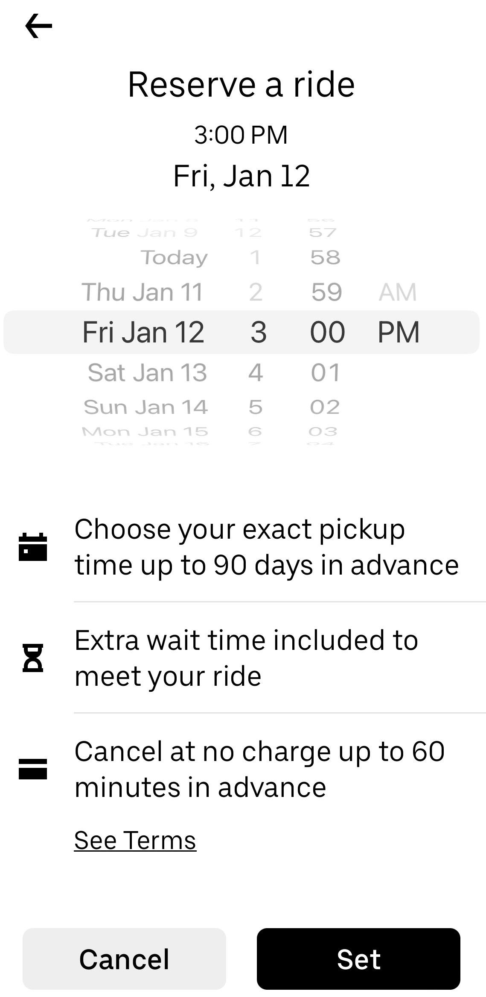
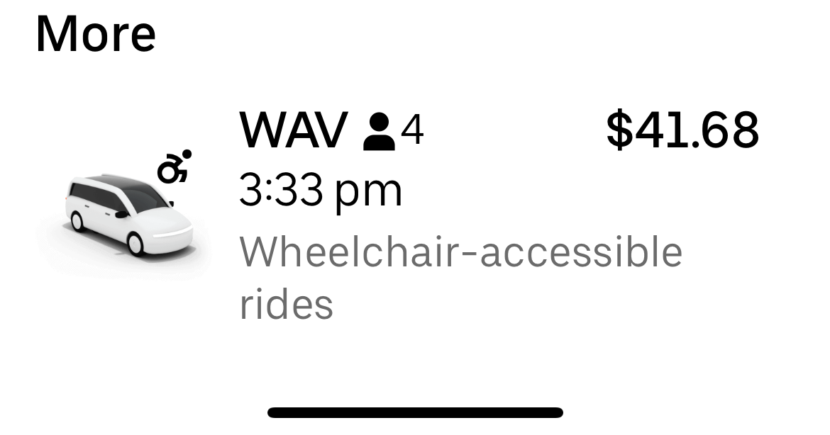
Booking a ride
Notes:
QuickStarter has created an outline to help you get started on your presentation. Some slides include information here in the notes to provide additional topics for you to research.
More key facts:
Subsidiary: Uber Eats, Careem, Otto, Mighty AI, deCarta, Social Bicycles, Jump Bikes, orderTalk Inc. (acquired by Uber Technologies Inc.), Cornershop, Swipe Labs, Complex Polygon, Uber Advanced Technologies Group, UberRUSH, Geometric Intelligence Inc, Uber Freight, Rasier-CA llc, Rasier LLC, Uber India Technology, Xchange Leasing, LLC, Geometric Intelligence Inc., Complex Polygon, Inc., Uber International C.V.

Slide 7
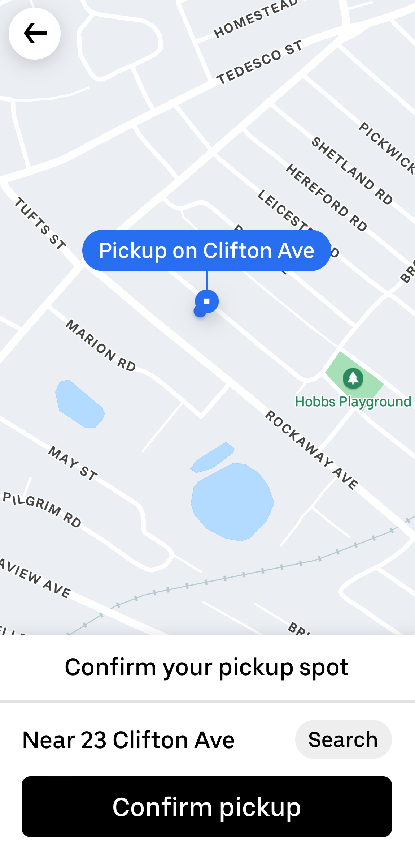
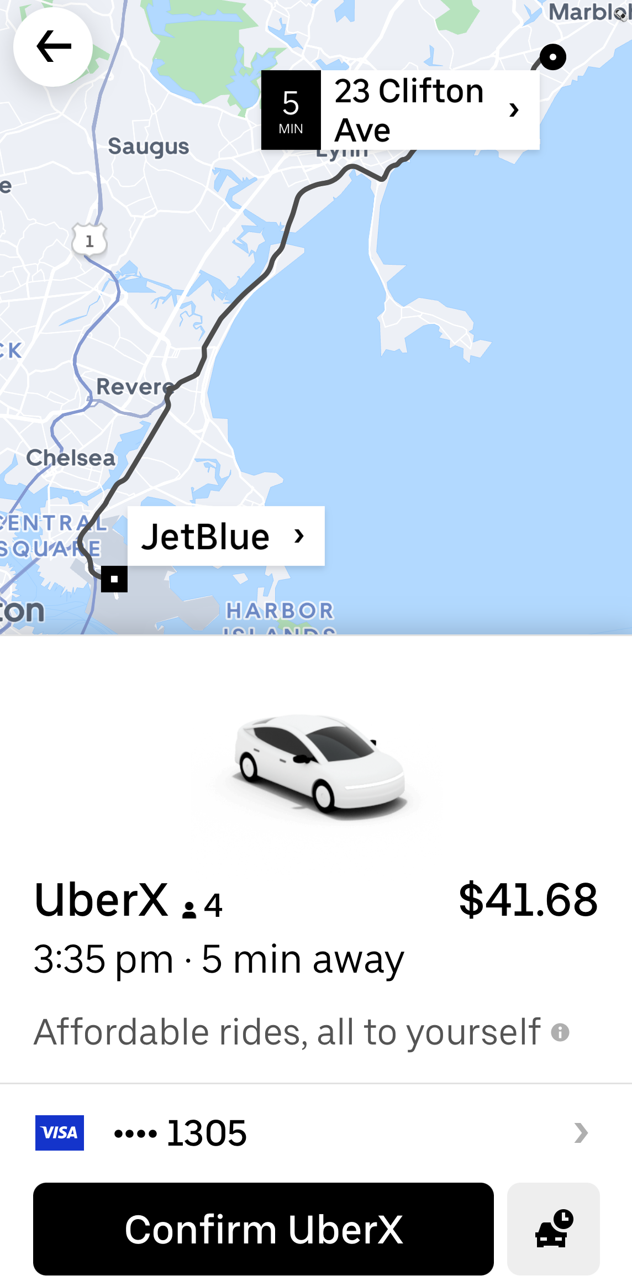
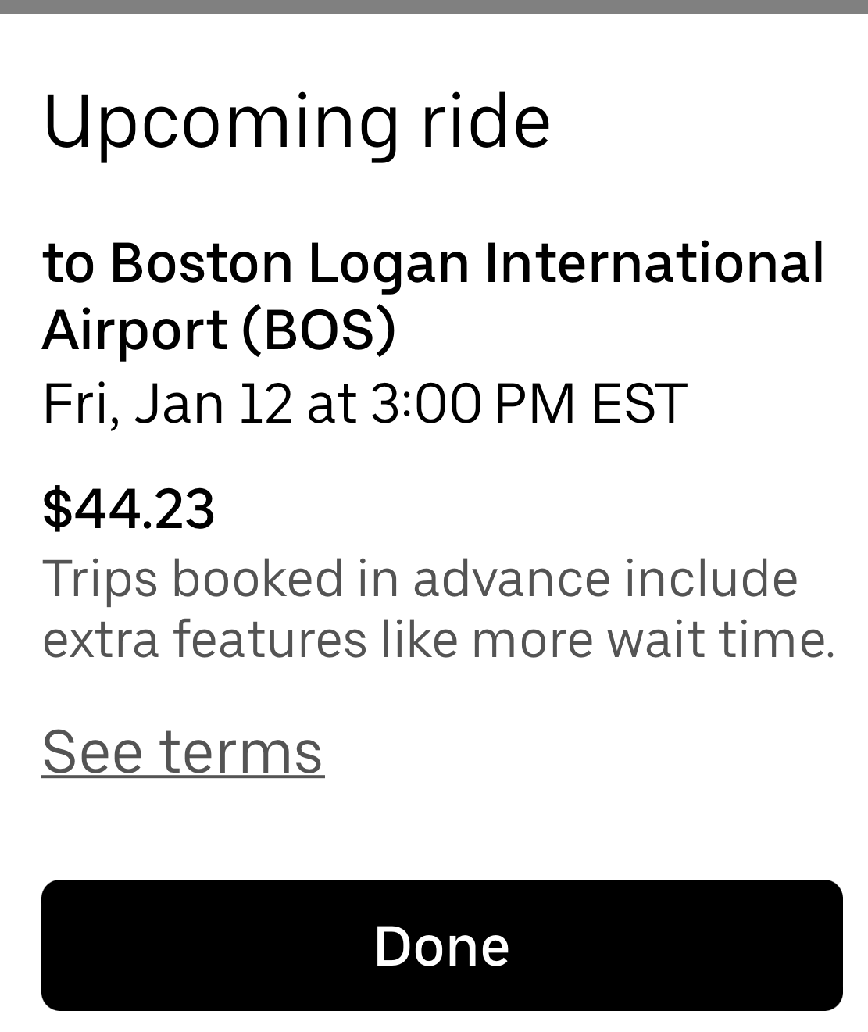
Booking a ride
Notes:
QuickStarter has created an outline to help you get started on your presentation. Some slides include information here in the notes to provide additional topics for you to research.
More key facts:
Subsidiary: Uber Eats, Careem, Otto, Mighty AI, deCarta, Social Bicycles, Jump Bikes, orderTalk Inc. (acquired by Uber Technologies Inc.), Cornershop, Swipe Labs, Complex Polygon, Uber Advanced Technologies Group, UberRUSH, Geometric Intelligence Inc, Uber Freight, Rasier-CA llc, Rasier LLC, Uber India Technology, Xchange Leasing, LLC, Geometric Intelligence Inc., Complex Polygon, Inc., Uber International C.V.

Slide 8
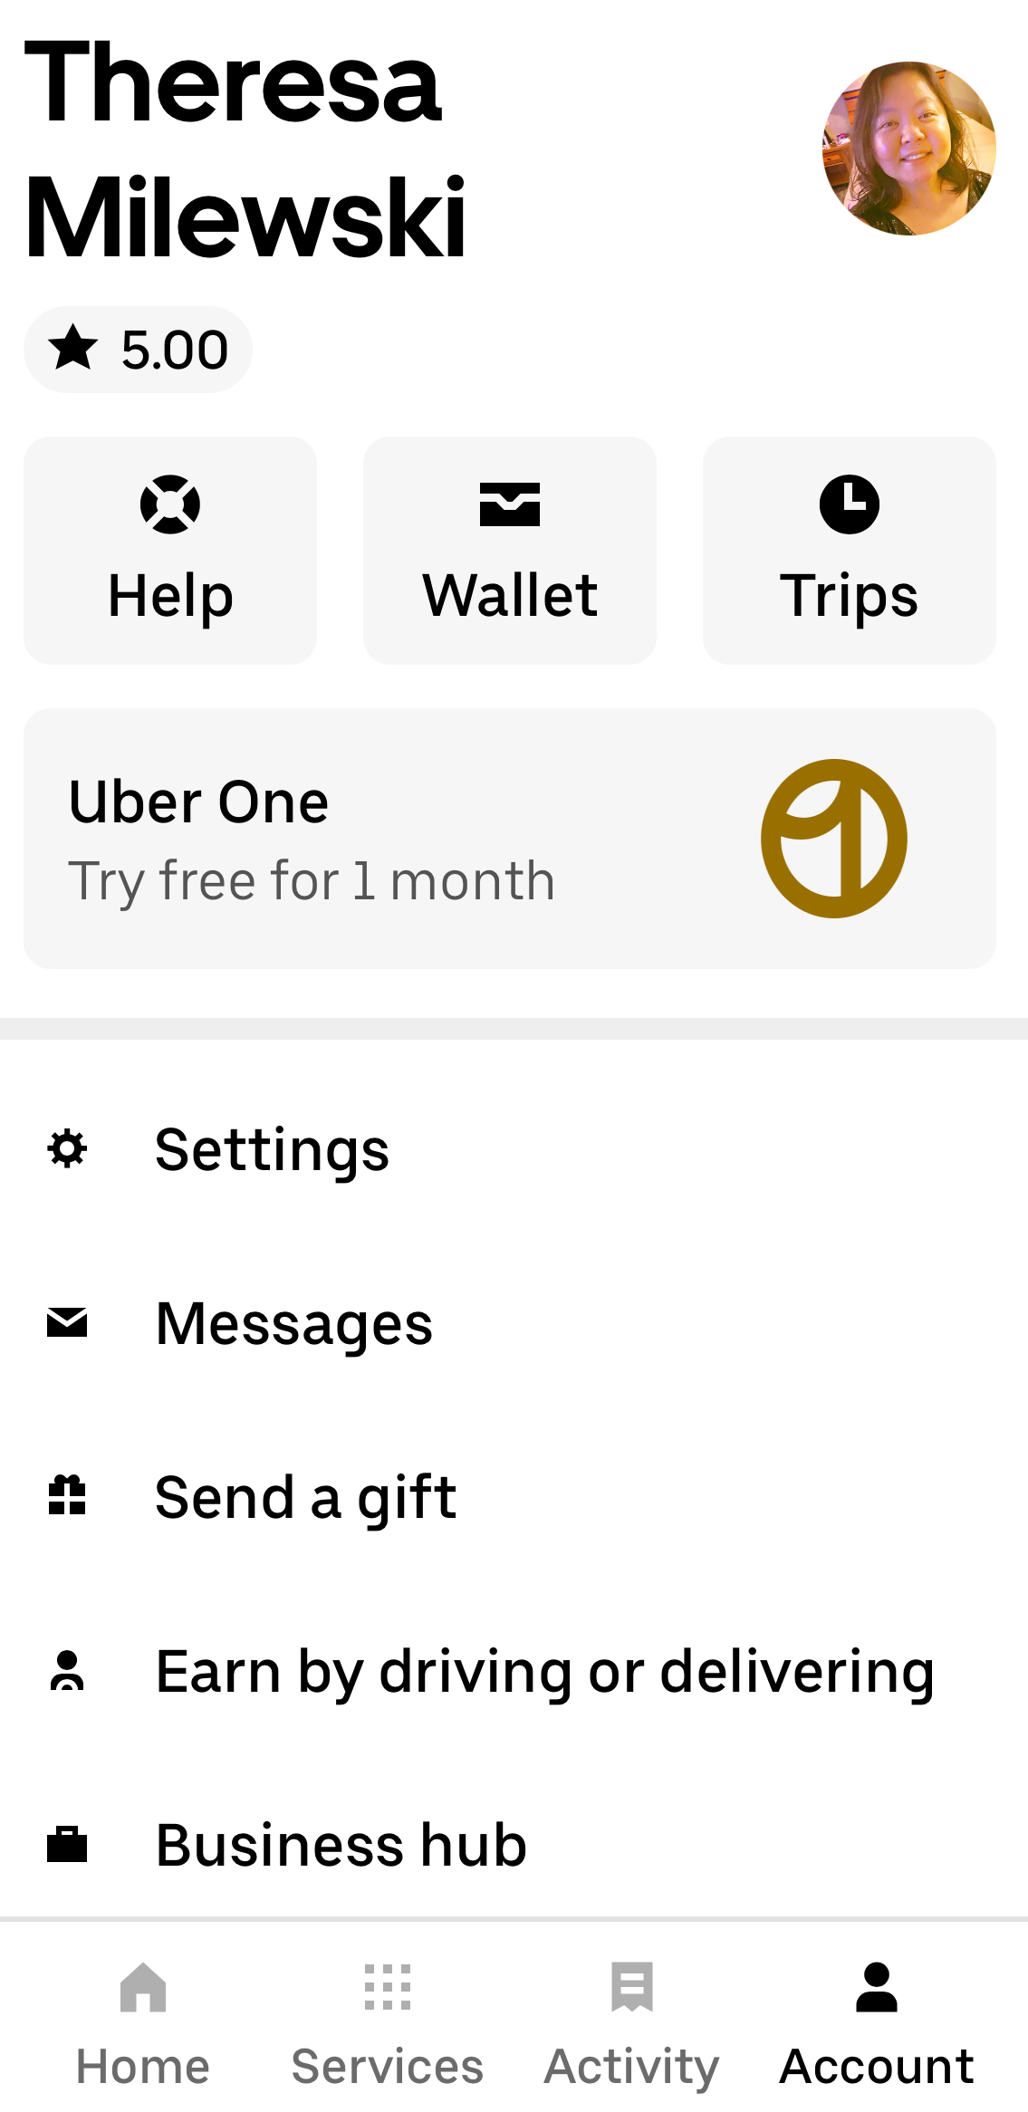
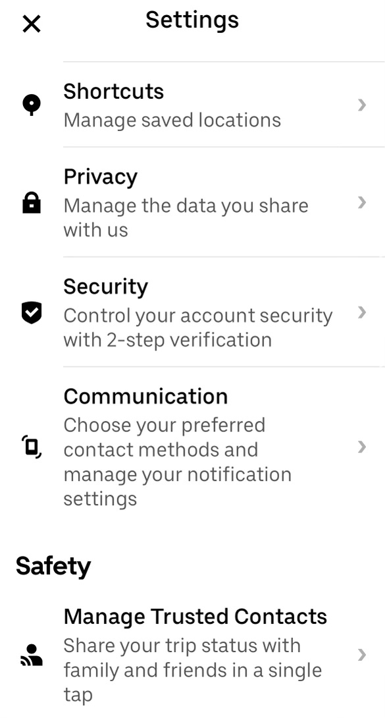
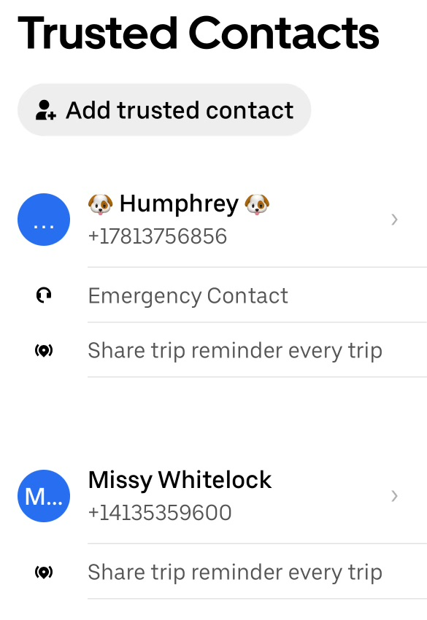
Trusted Contacts
Notes:
QuickStarter has created an outline to help you get started on your presentation. Some slides include information here in the notes to provide additional topics for you to research.
More key facts:
Subsidiary: Uber Eats, Careem, Otto, Mighty AI, deCarta, Social Bicycles, Jump Bikes, orderTalk Inc. (acquired by Uber Technologies Inc.), Cornershop, Swipe Labs, Complex Polygon, Uber Advanced Technologies Group, UberRUSH, Geometric Intelligence Inc, Uber Freight, Rasier-CA llc, Rasier LLC, Uber India Technology, Xchange Leasing, LLC, Geometric Intelligence Inc., Complex Polygon, Inc., Uber International C.V.

Slide 9
After your trip
You will receive an email with a receipt
The email contains a link that lets you leave a review and tip – optional!
If you tip, you will receive another email with an updated receipt
You may also tip with cash after the ride, if you wish

