Slide 1
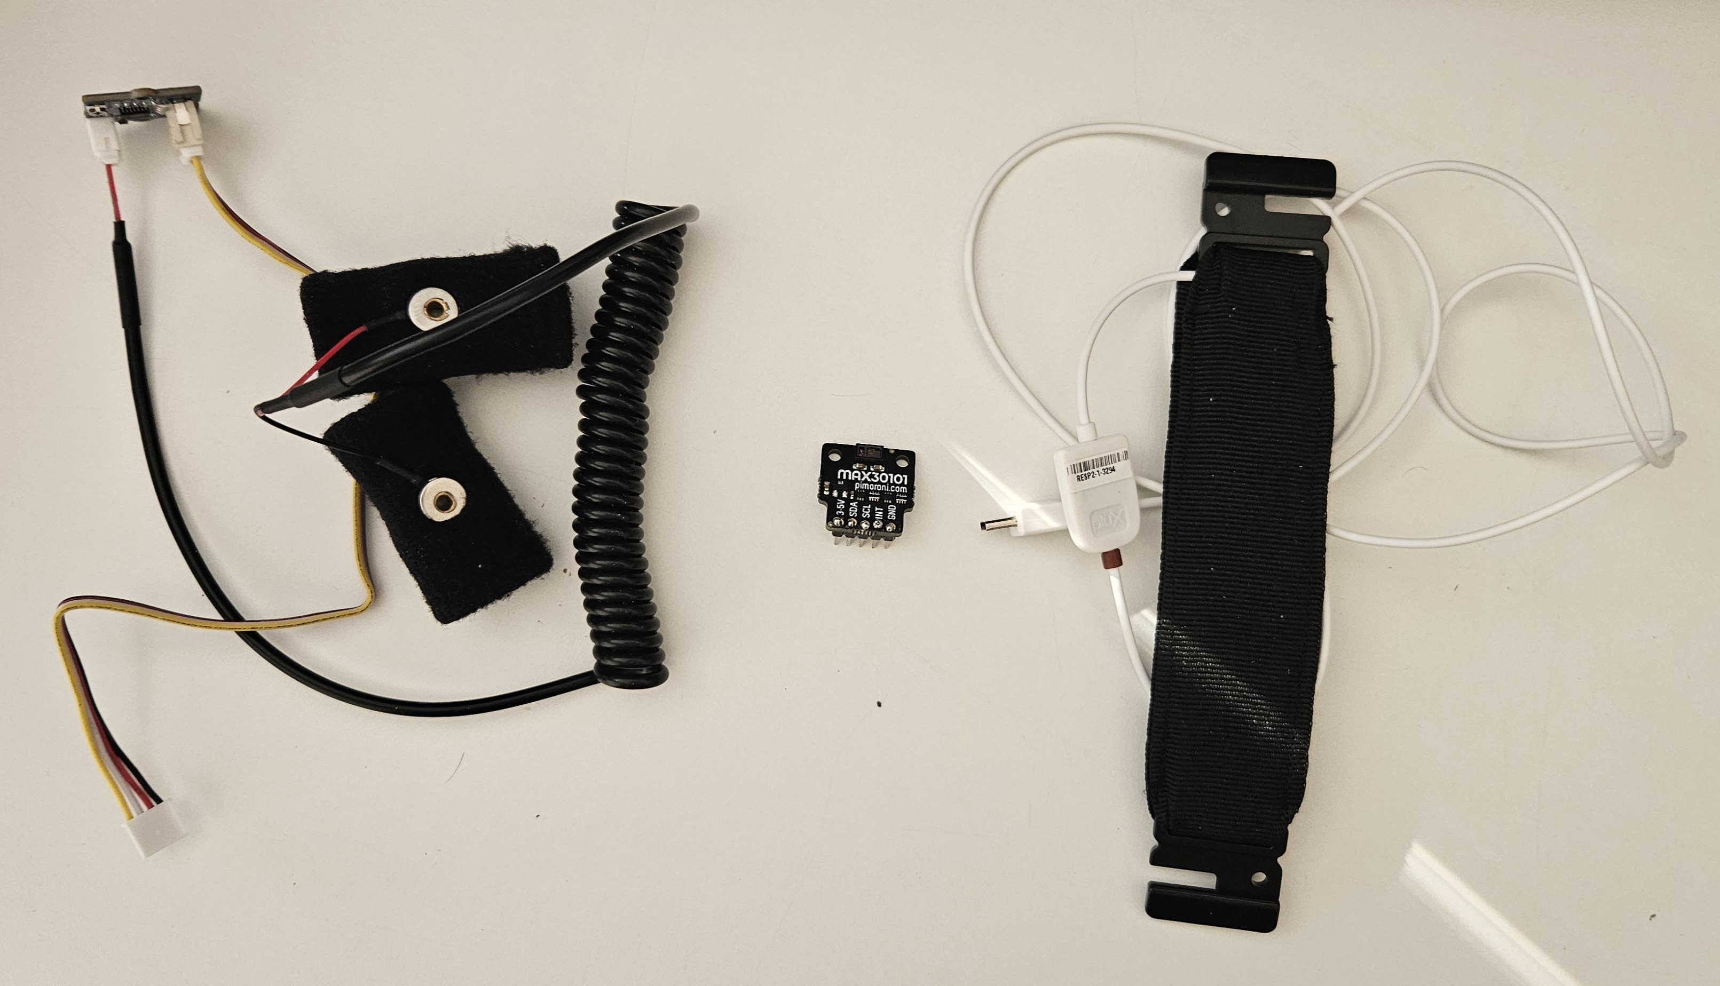
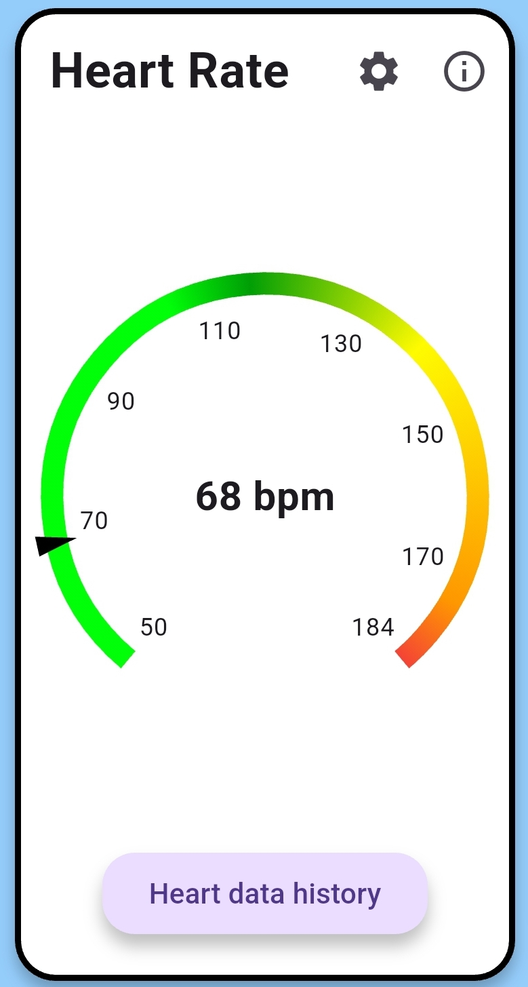
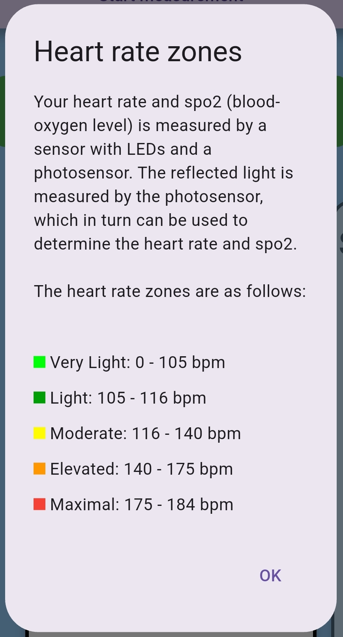
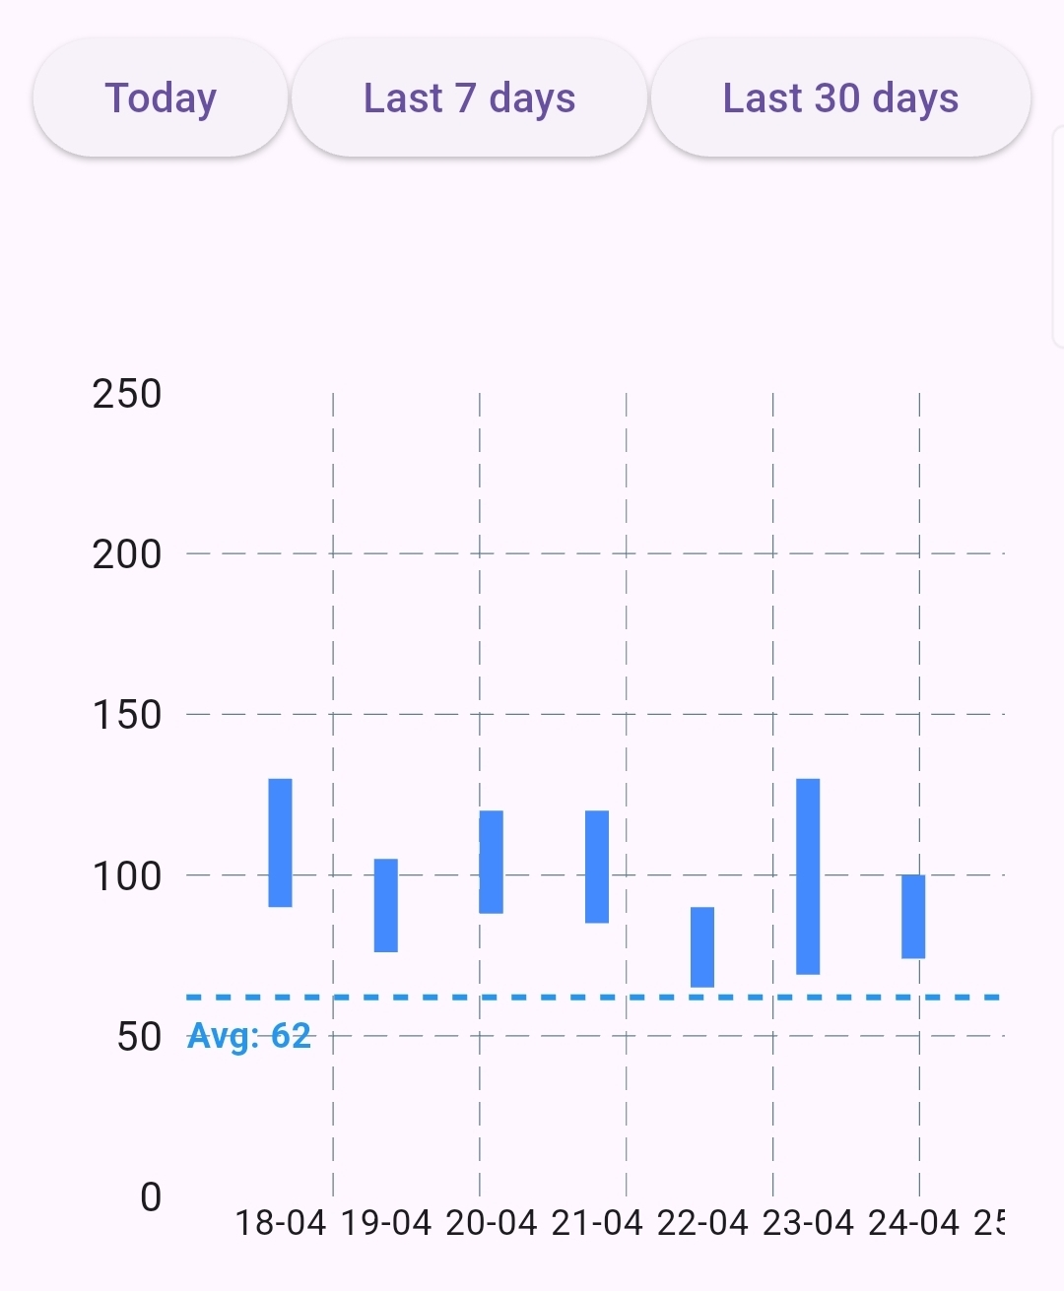
Mika Gielkens
2024-2025
Designing a tool for measuring well-being parameters
Software Systems Engineering Technology
Introduction
In the modern workplace, employee well-being is becoming ever more acknowledged as a central element in both job satisfaction and productivity [1]. While commercial products like smartwatches offer health monitoring, they often lack transparency in how measurements are taken and are typically limited to wrist-based sensing, which has its limitations for parameters like galvanic skin response (GSR) and respiration.
This project explores the development of an inexpensive, portable system for monitoring stress-related physiological parameters in real time. Using the Arduino Nano ESP32 microcontroller and a set of suitably selected sensors, the system records the vital measures of heart rate, GSR, and respiration rate. These are transmitted wirelessly via Bluetooth to a mobile app specially designed for this purpose.
The application is user-friendly and accessible, offering clear visual feedback, an estimation of the stress level, and the possibility to observe trends over time. By making health information easier to interpret and utilize, this system enables both individual users and organizations to more effectively monitor their health in an informed and cost-effective manner. The objective is to create a healthier and more sustainable work environment by introducing effective, data-driven stress management tools.
Materials & methodology
Materials
The portable stress measurement device is powered by the Arduino Nano ESP32, chosen for its compact size, low power consumption, and built-in Bluetooth, enabling real-time wireless data transmission to a smartphone. It collects data from three main sensors, as shown in figure 1.
MAX30102: An optical sensor that measures heart rate and blood oxygen saturation (SpO₂) using red and infrared LEDs.
Grove GSR Sensor: Measures skin conductance, an indicator of stress, by detecting changes in sweat gland activity.
Plux PZT Sensor: Captures respiration rate using a piezoelectric belt that detects chest movement.
Figure 1: From left to right: GSR sensor, MAX30102 and Plux PZT sensor
All sensor data is processed by the ESP32 in real-time and transmitted via Bluetooth Low Energy (BLE) using a custom GATT service. The firmware, written in C++, includes commands for starting/stopping individual or combined measurements. Sensor readings are combined into a single BLE message and sent to the smartphone for visualization.
Mobile application
To complement the stress measurement device, a mobile application was developed that focuses on usability, personalization, and clear data presentation. The app enables real-time monitoring and historical tracking of key physiological signals, making stress and health data accessible and understandable, even for non-technical users. Below is a summary of the main features and the reasons behind each design choice.
Shared Device, Multiple Users: A multi-user login system allows organizations to use a single device for several users, minimizing hardware costs and improving accessibility in budget-constrained settings.
Personalized Setup: New users enter their age to calculate personalized heart rate zones and complete a baseline measurement for heart rate, respiration, and GSR. This helps tailor the app’s feedback to individual physiology.
Intuitive Visualizations: Each parameter is shown using easy-to-read graphics: radial gauges for heart rate, GSR, and respiration and a progress bar for SpO₂ color-coded zones to help users instantly understand their health status. Figure 2 shows an example of the heart rate gauge.
Stress Detection: A color-coded stress indicator combines respiration and GSR data. Although exact thresholds are not the focus, this simplified system by using dummy thresholds allows the interface's usability to be tested and refined.
Trend Tracking: Users can review past data in a history view, with filters like “Today” or “Last 7 Days.” As shown in figure 3, bar graphs display daily min/max values to show trends without overwhelming detail, ideal for mobile screens.
Info Panels: Each health metric has an information button explaining what it measures, how it works, and why it matters. This improves understanding and builds trust in the system. As seen in figure 4, it shows the zones and how this parameter is obtained.
Figure 2: Heart rate widget
Figure 4: Info panel dialog
Figure 3: Heart rates history page, filtered on “Last 30 days”
Results
Participants had a positive overall impression of the app's onboarding experience. Device pairing was easy, while profile management was slightly less intuitive. Some users were confused by the identical login screens for new and existing users. Starting a measurement was generally straightforward. The app’s layout was clear, and the display of results was well received. Visual elements like gauges and progress indicators were appreciated, with the color-coded system especially helpful for interpreting values. Text content supported user understanding—particularly of the stress level indicator—though one participant found the amount of information a bit much. Graphs were preferred over tables for viewing data trends, but some users were unaware that the 30-day graph was interactive, leading to confusion about min/max values. The table format for min/max was considered unclear. The history function was fairly easy to access, and filtering by date was intuitive. Gauge settings were user-friendly, but their usefulness was unclear to some.
Overall, the app was easy to use, required little support, and was accessible to novices. However, motivation for daily use was low, pointing to a lack of perceived long-term value. Confidence in the app was moderate, with minimal prior knowledge needed.
Conclusion
This project demonstrates the potential of a low-cost, user-friendly toolkit for real-time monitoring of workplace well-being using physiological sensors and open-source hardware. By prioritizing accessibility and usability, it offers a practical alternative to commercial systems. The modular design supports future research and development, laying the groundwork for scalable, data-driven health interventions in occupational settings. With further refinement, the system could play a key role in promoting healthier, more productive work environments.
Dr. Eva Geurts
Prof. Dr. Gustavo Rovelo Ruiz
[1] T. Bui, R. Zackula, K. Dugan, and E. Ablah, “Workplace Stress and Productivity: A Cross-Sectional Study,” Kansas Journal of Medicine, vol. 14, no. 1, Feb. 2021, doi: https://doi.org/10.17161/kjm.vol1413424. Available: https://pmc.ncbi.nlm.nih.gov/articles/PMC7889069/. [Accessed: May 18, 2025]

