Slide 1
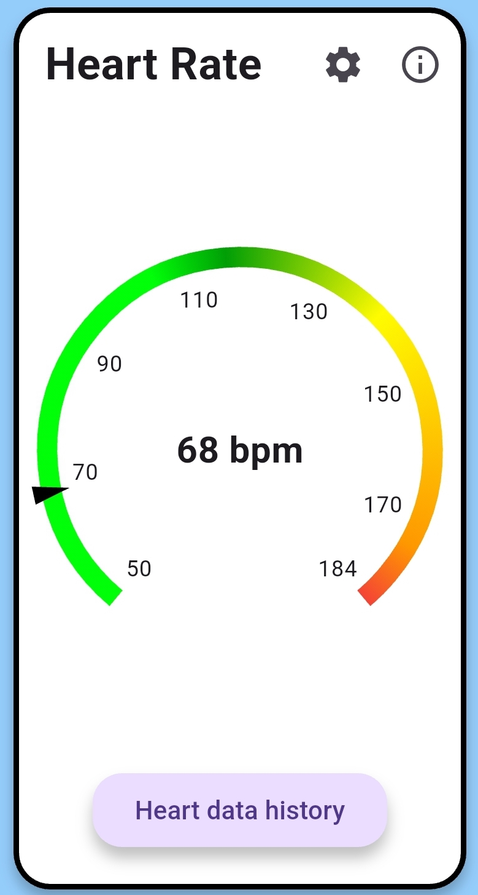
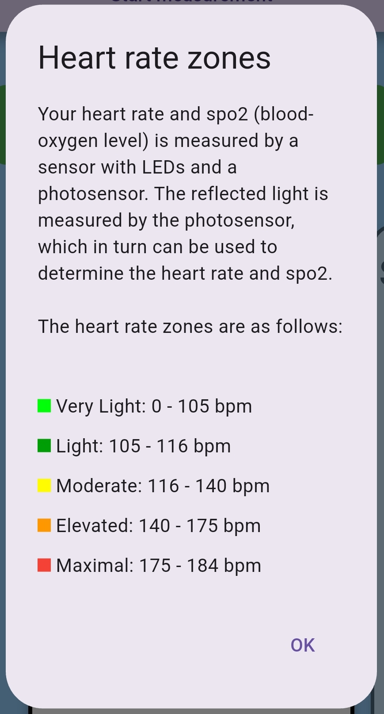
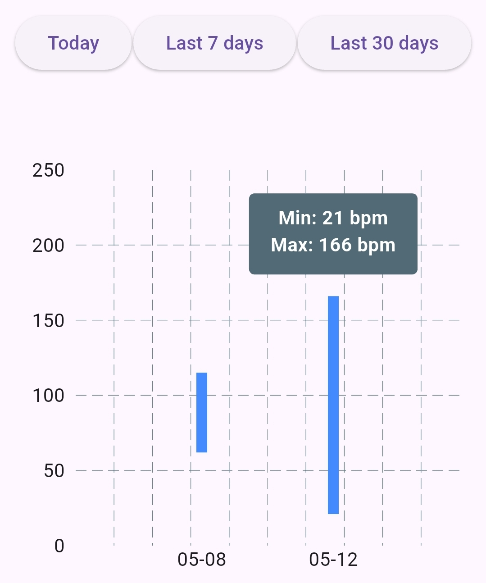
Mika Gielkens
2023-2024
Tool for measuring welfare parameters
Software Systems Engineering Technology
Introduction
In today’s workplace, stress is one of the leading causes of discomfort and reduced productivity. This bachelor thesis presents a compact and portable system designed to monitor stress-related physiological parameters in real time, with the aim of improving workplace well-being.
At the core of the system is the Arduino Nano ESP32, connected to a MAX30102, a Grove GSR and a Plux Piezo-Electric Respiration (PZT) sensor. These sensors capture biometric data known to correlate with stress levels. The device transmits this data wirelessly via Bluetooth to a custom-built mobile application. The accompanying application provides real-time feedback and historical tracking through intuitive visualizations, making the data easy to understand, even for non-technical users. Users can view their current heart rate, SpO₂, skin conductance, and respiration rate, while the app estimates stress levels based on individual baseline values.
This system was developed to be affordable, user-friendly, and scalable, making it suitable for shared use in workplace environments. The goal is to empower both individuals and organizations with actionable insights into stress, supporting healthier, more productive work settings.
Materials & methodology
Materials
The portable stress measurement device is powered by the Arduino Nano ESP32, chosen for its compact size, low power consumption, and built-in Bluetooth, enabling real-time wireless data transmission to a smartphone. It collects data from three main sensors:
MAX30102: An optical sensor that measures heart rate and blood oxygen saturation (SpO₂) using red and infrared LEDs.
Grove GSR Sensor: Measures skin conductance, an indicator of stress, by detecting changes in sweat gland activity.
Plux PZT Sensor: Captures respiration rate using a piezoelectric belt that detects chest movement.
All sensor data is processed by the ESP32 in real-time and transmitted via Bluetooth Low Energy (BLE) using a custom GATT service. The firmware, written in C++, includes commands for starting/stopping individual or combined measurements. Sensor readings are combined into a single BLE message and sent to the smartphone for visualization.
Mobile application
To complement the stress measurement device, a mobile application was developed that focuses on usability, personalization, and clear data presentation. The app enables real-time monitoring and historical tracking of key physiological signals, making stress and health data accessible and understandable, even for non-technical users. Below is a summary of the main features and the reasons behind each design choice:
Shared Device, Multiple Users: A multi-user login system allows organizations to use a single device for several users, minimizing hardware costs and improving accessibility in budget-constrained settings.
Personalized Setup: New users enter their age to calculate personalized heart rate zones and complete a baseline measurement for heart rate, respiration, and GSR. This helps tailor the app’s feedback to individual physiology.
Intuitive Visualizations: Each parameter is shown using easy-to-read graphics: radial gauges for heart rate, GSR, and respiration and a progress bar for SpO₂ color-coded zones to help users instantly understand their health status. Figure X show an example for the heart rate gauge.
Stress Detection: A color-coded stress indicator combines respiration and GSR data. Although exact thresholds aren't the focus, this simplified system by using dummy thresholds allows the interface's usability to be tested and refined.
Trend Tracking: Users can review past data in a history view, with filters like “Today” or “Last 7 Days.” Bar graphs display daily min/max values to show trends without overwhelming detail—ideal for mobile screens.
Info Panels: Each health metric has an information button explaining what it measures, how it works, and why it matters. This improves understanding and builds trust in the system. As seen in figure X, it shows the zones and how this parameter is obtained.
Figure 1: heart rate widget
Figure 2: info panel dialog
Figure 3: heart rates history page, filtered on “Last 30 days”
Results
To evaluate the usability and clarity of the stress monitoring app and hardware, a structured user study was designed. Participants were asked to complete a series of tasks, including device pairing, profile setup, individual and combined parameter measurements, and data visualization interpretation.
Most users found the Bluetooth pairing process straightforward and rated the interface as intuitive and easy to navigate. Users appreciated the visual clarity of health data, with color-coded gauges and stress indicators aiding interpretation. The info dialogs and explanations for parameters were found to be helpful by most participants, especially for understanding stress-related values such as GSR and respiratory rate. The history feature, including graph/table views and date filtering, was highlighted as useful for monitoring trends over time. Some users indicated that switching between views helped them better understand fluctuations in their stress levels.
Conclusion
This project demonstrates the feasibility of a low-cost, user-friendly health monitoring system that combines physiological sensors with real-time data visualization in a mobile application. By integrating heart rate, GSR, oxygen saturation, and respiration rate measurements, the system offers a comprehensive view of workplace stress. Preliminary user feedback suggests that the app is intuitive, the data is presented clearly, and the system has the potential to raise awareness about personal well-being. While more testing is needed to fully evaluate usability and effectiveness, this solution lays a strong foundation for future developments in accessible health monitoring technologies.
Dr. Eva Geurts
Prof. Dr. Gustavo Rovelo Ruiz
[1] “Building information modeling,” Autodesk. Available at: https://www.autodesk.com/solutions/aec/bim (Accessed: 12 August 2024).
[2] “Industry Foundation Classes (IFC),” buildingSMART International. Available at: https://www.buildingsmart.org/standards/bsi-standards/industry-foundation-classes/ (Accessed: 12 August 2024).
[3] Gutierrez Lopez, M., Rovelo, G., Haesen, M., Luyten, K., Coninx, K. (2017). Capturing Design Decision Rationale with Decision Cards. In: Bernhaupt, R., Dalvi, G., Joshi, A., K. Balkrishan, D., O'Neill, J., Winckler, M. (eds) Human-Computer Interaction - INTERACT 2017. INTERACT 2017. Lecture Notes in Computer Science(), vol 10513. Springer, Cham. https://doi.org/10.1007/978-3-319-67744-6_29

