Slide 1
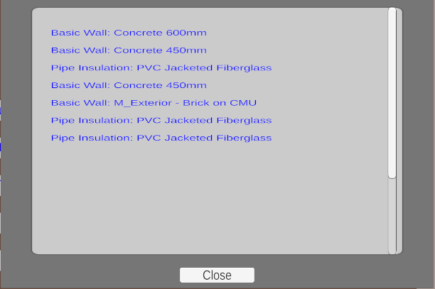
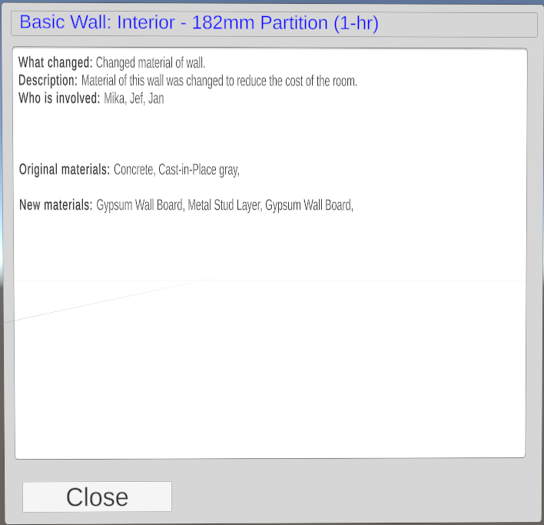
Mika Gielkens
2023-2024
Traceability of changes within BIM in AR
Software Systems Engineering Technology
Introduction
Building Information Modeling (BIM) is one of the central technologies in architecture, engineering, and construction, enabling detailed digital modelling of buildings [1]. As the BIM models change through multiple design stages, it gets difficult to manage or keep track of those changes. Version traceability, the exact history of modifications, is critical to maintaining the integrity of a project and avoiding huge mistakes.
This project looks at how Augmented Reality (AR) can be used to enhance version traceability in BIM. The BIM models are integrated into Unity using Industry Foundation Classes (IFC). IFC is a standardized digital format for describing assets in the built environment. As an open, international standard, it promotes vendor-neutral functionality and ensures compatibility across various hardware devices, software platforms, and interfaces, supporting a wide range of use cases [2]. This research proposes an AR-based solution that tracks changes more visibly across different versions of a BIM model, making management of the project's updates easier and more intuitive.
Methodology
Model loading and comparison
Different versions of the BIM models are loaded into the Unity-based program using an IFC importer add-on. The system identifies differences between these versions. It focuses on changes such as the addition of objects, removals, relocated objects, and changes in materials. These changes are stored in maps within the program for easy access and visualization.
Change visualization and interaction
The system provides an interactive list of detected changes. When a change is selected, the corresponding game object gets marked with a specific color to show the type of change made. The color coding is:
Red: The object has been removed.
Green: The object has been added.
Purple: The object has been moved.
Blue: Represents a change of the materials.
Figure 1: Example of how color coding is used to indicate a removed pipe
Figure 2: List of changes
Decision card
When a change gets selected in the list, the "decision card“ [3] pops up. The decision card is a pop-up window that gives specific information on what changed. The decision card displays the following items:
What changed: A short description of what changed [3].
Description: Why was this change needed or useful [3].
Who is involved: Sums up the main people or groups engaged during design and approval of the change [3].
Using this approach, the changes between versions are tracked and the user stays well informed about the changes made using the AR environment.
Figure 3: Decision card
Results
Based on the results of the user study, while the familiarity with AR had an average score of 1,6 out of 5 (on being the least familiar) the AR shows promise for change traceability. Features like the decision card, color coding and visualization in combination with the spatial context, makes It easier to explain the changes to stakeholders that not follow the project as closely. But participants did state that BIM offers more advanced features like filtering and clash detection. A notable thing is that participants forgot about the buttons on the smartphone screen. To lower the learning curve, displaying as much buttons as possible in AR is recommended. The results showed that the confidence of capturing all changes was very high with an average score of 4,2 out of 5.
Conclusion
In conclusion, with some further adjustments as adding features like filtering on kind of change, object or for specific jobs (ex. plumbers) AR could be a beneficial technologies in construction to trace all changes in a lifecycle of a project. Features like explanation in plain text used in the decision card and the spatial awareness makes it easier to explain and show changes to stakeholders not as closely involved. The high confidence level reached with the AR application suggests that with further refinement AR could be a useful asset in the construction industry. For future research, integrating more advanced features like filtering and clash detection while maintaining or improving a user friendly interface minimizing the learning curve is recommended. Another recommendation is researching how orienting in a bigger building can be made easier, for example by using a mini-map.
Prof. dr. Fabian Di Fiore
Prof. dr. Davy Vanacken
Jeroen Ceyssens
[1] “Building information modeling,” Autodesk. Available at: https://www.autodesk.com/solutions/aec/bim (Accessed: 12 August 2024).
[2] “Industry Foundation Classes (IFC),” buildingSMART International. Available at: https://www.buildingsmart.org/standards/bsi-standards/industry-foundation-classes/ (Accessed: 12 August 2024).
[3] Gutierrez Lopez, M., Rovelo, G., Haesen, M., Luyten, K., Coninx, K. (2017). Capturing Design Decision Rationale with Decision Cards. In: Bernhaupt, R., Dalvi, G., Joshi, A., K. Balkrishan, D., O'Neill, J., Winckler, M. (eds) Human-Computer Interaction - INTERACT 2017. INTERACT 2017. Lecture Notes in Computer Science(), vol 10513. Springer, Cham. https://doi.org/10.1007/978-3-319-67744-6_29

