Slide 1
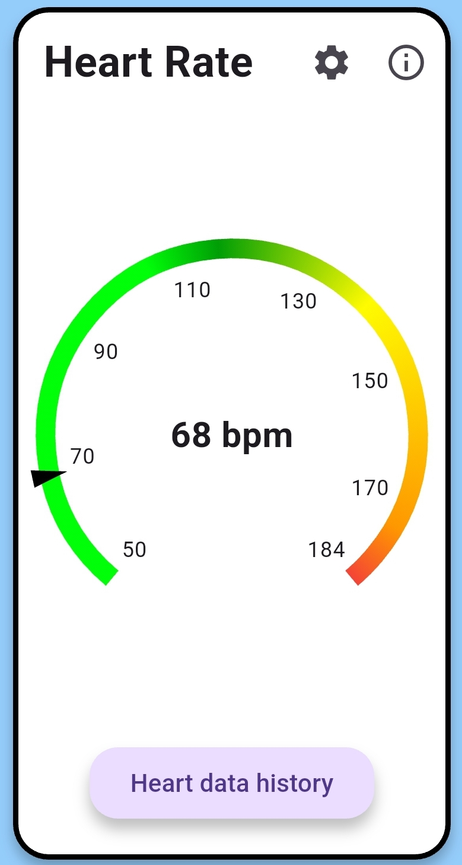
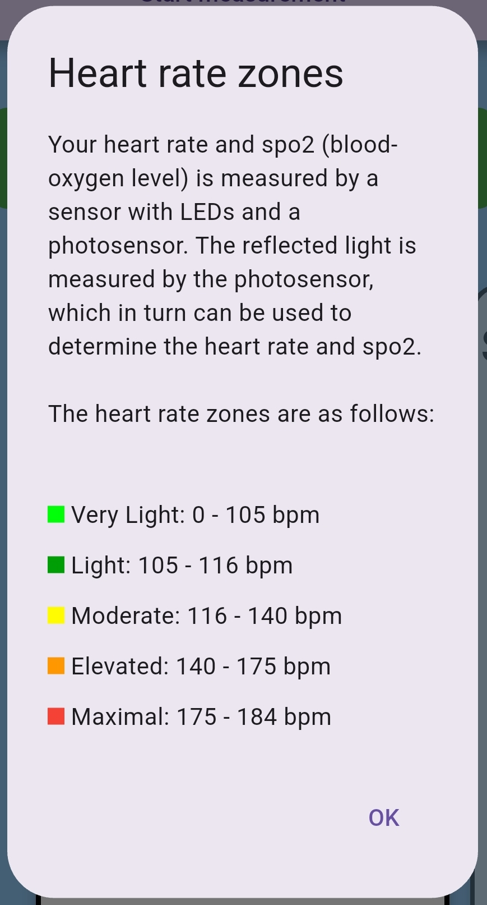
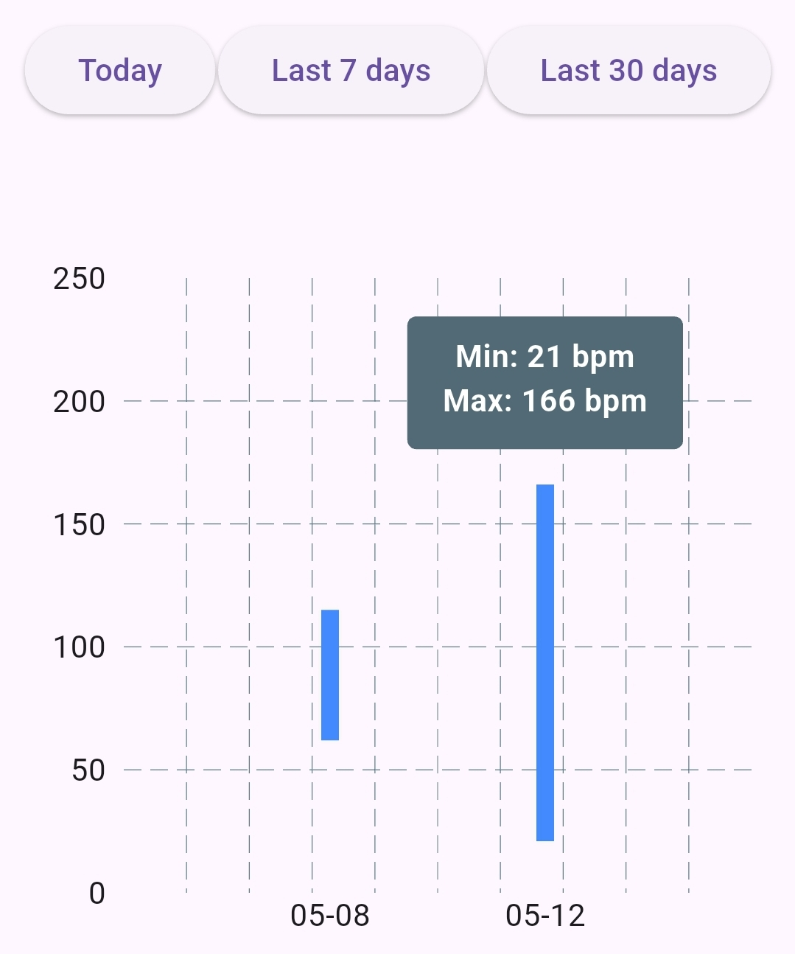
Mika Gielkens
2024-2025
Designing a tool for measuring welfare parameters
Software Systems Engineering Technology
Introduction
In the modern workplace, employee well-being is becoming ever more acknowledged as a central element in both job satisfaction and productivity. Although commercial products such as smartwatches exist for health monitoring, such solutions tend to be costly, not broadly available, or closed systems with minimal transparency.
This project explores the development of an inexpensive, portable system for monitoring stress-related physiological parameters in real time. Using the Arduino Nano ESP32 microcontroller and a set of suitably selected sensors, the system records the vital measures of heart rate, skin conductance (GSR), and respiration rate. These are transmitted wirelessly via Bluetooth to a mobile app specially designed for this purpose.
The application is user-friendly and accessible, offering clear visual feedback, an estimation of the stress level, and the possibility to observe trends over time. By making health information easier to interpret and utilize, this system enables both individual users and organizations to more effectively monitor their health in an informed and cost-effective manner. The objective is to create a healthier and more sustainable work environment by introducing effective, data-driven stress management tools.
Materials & methodology
Materials
The portable stress measurement device is powered by the Arduino Nano ESP32, chosen for its compact size, low power consumption, and built-in Bluetooth, enabling real-time wireless data transmission to a smartphone. It collects data from three main sensors:
MAX30102: An optical sensor that measures heart rate and blood oxygen saturation (SpO₂) using red and infrared LEDs.
Grove GSR Sensor: Measures skin conductance, an indicator of stress, by detecting changes in sweat gland activity.
Plux PZT Sensor: Captures respiration rate using a piezoelectric belt that detects chest movement.
All sensor data is processed by the ESP32 in real-time and transmitted via Bluetooth Low Energy (BLE) using a custom GATT service. The firmware, written in C++, includes commands for starting/stopping individual or combined measurements. Sensor readings are combined into a single BLE message and sent to the smartphone for visualization.
Mobile application
To complement the stress measurement device, a mobile application was developed that focuses on usability, personalization, and clear data presentation. The app enables real-time monitoring and historical tracking of key physiological signals, making stress and health data accessible and understandable, even for non-technical users. Below is a summary of the main features and the reasons behind each design choice:
Shared Device, Multiple Users: A multi-user login system allows organizations to use a single device for several users, minimizing hardware costs and improving accessibility in budget-constrained settings.
Personalized Setup: New users enter their age to calculate personalized heart rate zones and complete a baseline measurement for heart rate, respiration, and GSR. This helps tailor the app’s feedback to individual physiology.
Intuitive Visualizations: Each parameter is shown using easy-to-read graphics: radial gauges for heart rate, GSR, and respiration and a progress bar for SpO₂ color-coded zones to help users instantly understand their health status. Figure 1 shows an example of the heart rate gauge.
Stress Detection: A color-coded stress indicator combines respiration and GSR data. Although exact thresholds are not the focus, this simplified system by using dummy thresholds allows the interface's usability to be tested and refined.
Trend Tracking: Users can review past data in a history view, with filters like “Today” or “Last 7 Days.” As shown in figure 2, bar graphs display daily min/max values to show trends without overwhelming detail, ideal for mobile screens.
Info Panels: Each health metric has an information button explaining what it measures, how it works, and why it matters. This improves understanding and builds trust in the system. As seen in figure 3, it shows the zones and how this parameter is obtained.
Figure 1: Heart rate widget
Figure 3: Info panel dialog
Figure 2: Heart rates history page, filtered on “Last 30 days”
Results
To evaluate the usability and clarity of the stress monitoring app and hardware, a structured user study was designed. Participants were asked to complete a series of tasks, including device pairing, profile setup, individual and combined parameter measurements, and data visualization interpretation.
Most users found the Bluetooth pairing process straightforward and rated the interface as intuitive and easy to navigate. Users appreciated the visual clarity of health data, with color-coded gauges and stress indicators aiding interpretation. The info dialogs and explanations for parameters were found to be helpful by most participants, especially for understanding stress-related values such as GSR and respiratory rate. The history feature, including graph/table views and date filtering, was highlighted as useful for monitoring trends over time. Some users indicated that switching between views helped them better understand fluctuations in their stress levels.
Conclusion
This project demonstrates the feasibility of a low-cost, user-friendly health monitoring system that combines physiological sensors with real-time data visualization in a mobile application. By integrating heart rate, GSR, oxygen saturation, and respiration rate measurements, the system offers a comprehensive view of workplace stress. Preliminary user feedback suggests that the app is intuitive, the data is presented clearly, and the system has the potential to raise awareness about personal well-being. While more testing is needed to fully evaluate usability and effectiveness, this solution lays a strong foundation for future developments in accessible health monitoring technologies.
Dr. Eva Geurts
Prof. Dr. Gustavo Rovelo Ruiz

