Slide 1
Digital Logic Gates and Boolean Algebra
Part 1

Slide 2
Introduction
Boolean Algebra: named after mathematician George Boole (1815-1864).
Base 2 algebra
All variables hold the literal value True (1) or False (0)
A (5v) digital circuit can have one of two values:
Signal between 0 and 0.8 volt: 0 value
Signal between 2 and 5 volts: 1 value
Signal between 0.8 and 2 volts:
undefined, gate has no deterministic output.
Gates calculate various functions of one or more input values to generate an output.
NOT, AND, OR, XOR, etc.
Computers are made up of gates.
Performs all logical operations
Composed of connected transistors, resistors, capacitors, etc.
Digital circuits

Slide 3
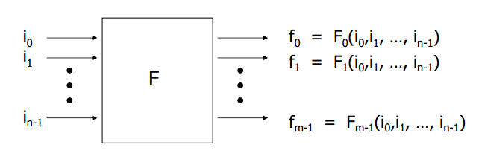
Combinational Logic
Translates a set of N input variables (0 or 1) by a mapping function.
Uses Boolean operations to produce a set of M output variables (0 or 1).

Slide 4
Boolean Operators
Basic Operators
AND
OR
NOT
Other Useful Operators
NAND
NOR
XOR
XNOR

Slide 5
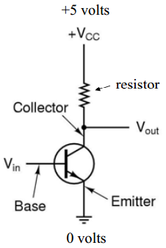
NOT Operator (Inverter)
1 goes in, 0 comes out and vice versa
Circuit:
When input (V_{in}) is low, transistor turns off
(infinite resistance) which means output
is V_{cc}
(0 in = 1 out)
When V_{in} is high, transistor acts like a wire
to ground making V_{cc} 0 volts.
(1 in = 0 out)
Instant switching of states?
Takes a few nanoseconds.

Slide 6
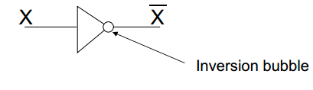
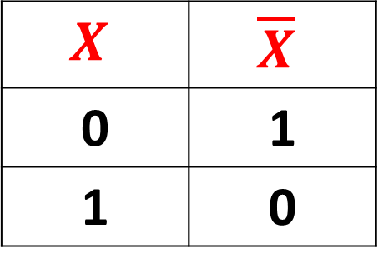
NOT Operator (Inverter)
NOT truth table:
NOT gate symbol
$$X$$ | $$\overline{X}$$
0 | 1
1 | 0

Slide 7
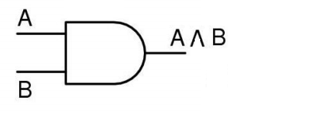
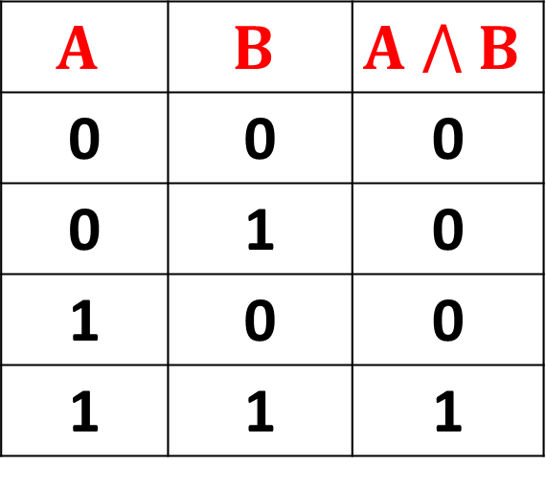
AND Operator
AND truth table:
Output is High if all inputs are
high.
Otherwise, output is low.
AND gate symbol
$$A$$ | $$B$$ | $$A ⋀ B$$
0 | 0 | 0
0 | 1 | 0
1 | 0 | 0
1 | 1 | 1

Slide 8
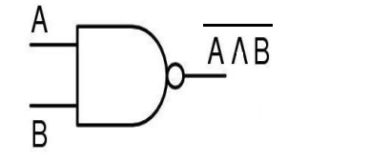
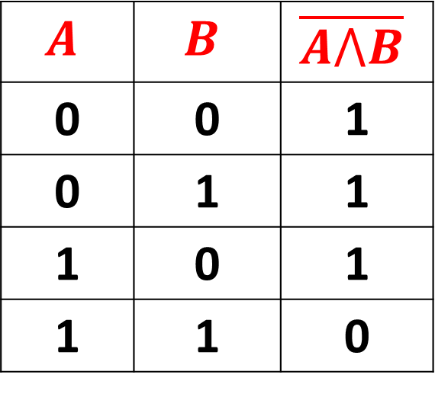
NAND Operator
NAND truth table:
Output is Low if all inputs are
high.
Otherwise, output is high.
NAND gate symbol
$$A$$ | $$B$$ | $$\overline{A⋀B}$$
0 | 0 | 1
0 | 1 | 1
1 | 0 | 1
1 | 1 | 0

Slide 9
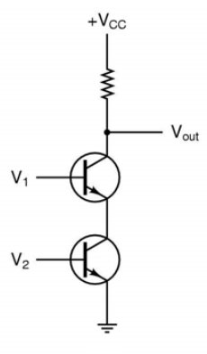
NAND Operator
Simplified Circuit:
If V₁ and V₂ are both high, both transistors
will conduct and produce a path to ground.
V_{out} will be low (0).
If either V₁ or V₂, or both, are low, the
corresponding transistor resists, not
allowing electricity to ground.
V_{out} will be high (1).

Slide 10
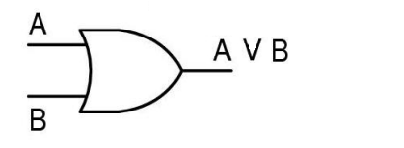
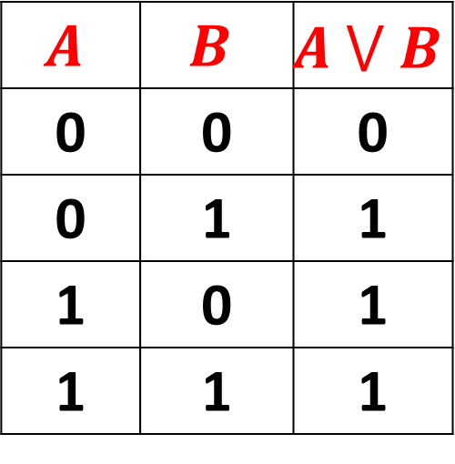
OR Operator
OR truth table:
Output is low if all inputs are
low.
Otherwise, output is high.
OR gate symbol
$$A$$ | $$B$$ | $$A ⋁ B$$
0 | 0 | 0
0 | 1 | 1
1 | 0 | 1
1 | 1 | 1

Slide 11
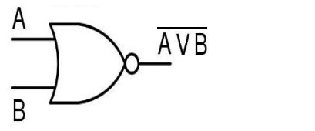
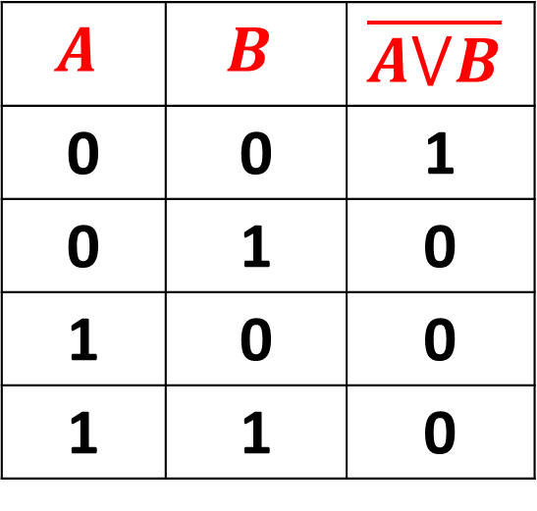
NOR Operator
NOR truth table:
Output is High if all inputs are
low.
Otherwise, output is low.
NOR gate symbol
$$A$$ | $$B$$ | $$\overline{A⋁B}$$
0 | 0 | 1
0 | 1 | 0
1 | 0 | 0
1 | 1 | 0

Slide 12
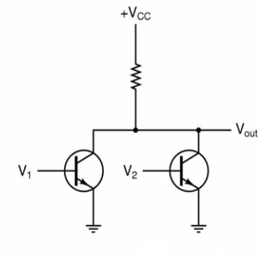
NOR Operator
Simplified Circuit:
If either V₁ or V₂, or both, are high, then transistor will conduct and produce a path to ground.
V_{out} will be low (0).
If both V₁ and V₂, are low, then
both transistors resist, not allowing
electricity to ground.
V_{out} will be high (1).

Slide 13

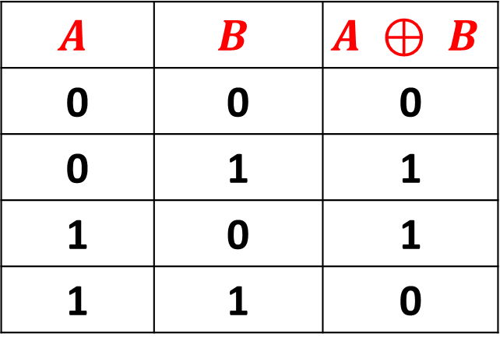
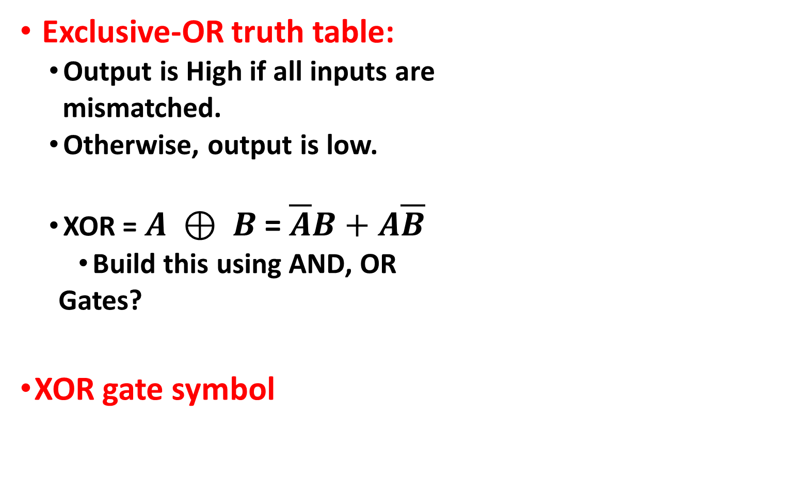
XOR Operator
Exclusive-OR truth table:
Output is High if all inputs are
mismatched.
Otherwise, output is low.
XOR = $A ⊕ B$ = $\overline{A}B+A\overline{B}$
Build this using AND, OR
Gates?
XOR gate symbol
$$A$$ | $$B$$ | $$A ⊕ B$$
0 | 0 | 0
0 | 1 | 1
1 | 0 | 1
1 | 1 | 0

Slide 14

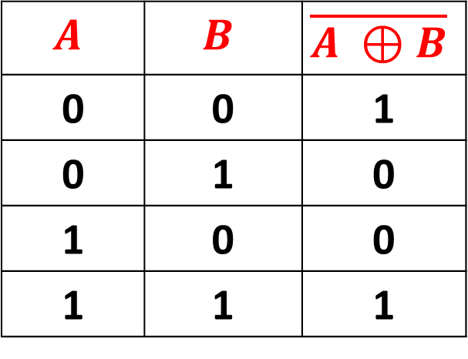
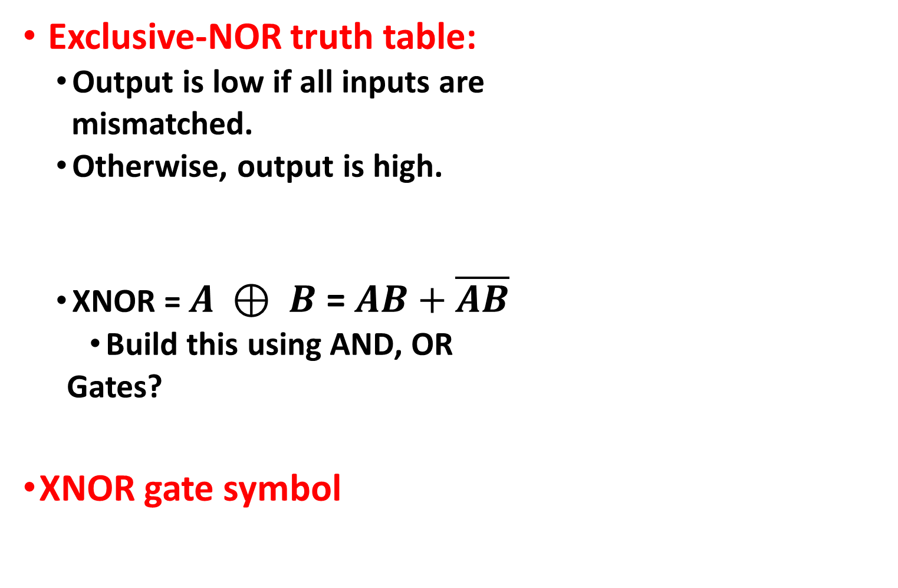
XNOR Operator
Exclusive-NOR truth table:
Output is low if all inputs are
mismatched.
Otherwise, output is high.
XNOR = $A ⊕ B$ = $AB+\overline{A}\overline{B}$
Build this using AND, OR
Gates?
XNOR gate symbol
$$A$$ | $$B$$ | $$\overline{A ⊕B}$$
0 | 0 | 1
0 | 1 | 0
1 | 0 | 0
1 | 1 | 1
___

Slide 15
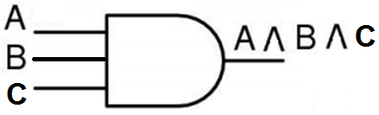
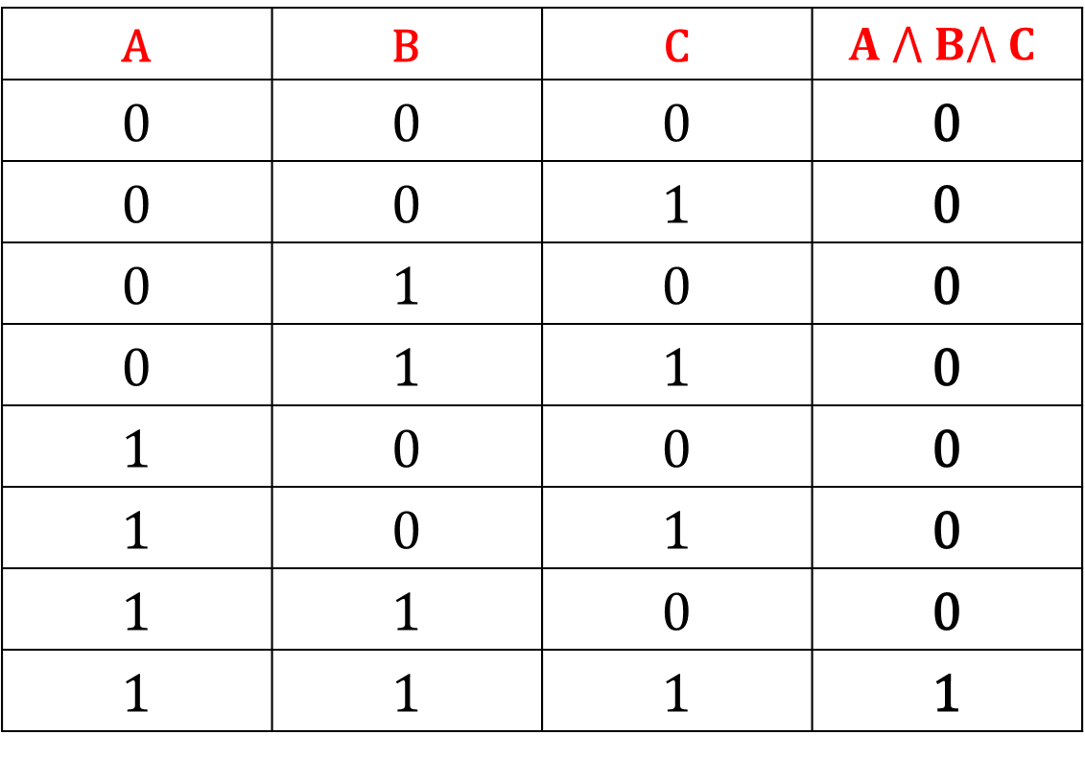
Three Input AND Gate
A | B | C | $$A ⋀ B⋀ C$$
0 | 0 | 0 | 0
0 | 0 | 1 | 0
0 | 1 | 0 | 0
0 | 1 | 1 | 0
1 | 0 | 0 | 0
1 | 0 | 1 | 0
1 | 1 | 0 | 0
1 | 1 | 1 | 1

Slide 16
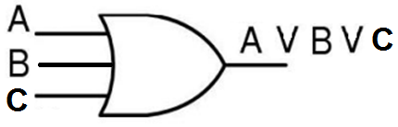

Three Input Or Gate
A | B | C | $$A⋁B⋁C$$
0 | 0 | 0 | 0
0 | 0 | 1 | 1
0 | 1 | 0 | 1
0 | 1 | 1 | 1
1 | 0 | 0 | 1
1 | 0 | 1 | 1
1 | 1 | 0 | 1
1 | 1 | 1 | 1

