Slide 1
Central Banking Expert System
Michael Pouget (40246798)
This set of slides will document the central banking rule-based expert system I developed in CLIPS using evidence-based logic as part of the second deliverable of Concordia University’s COMP 474 (Intelligent Systems) project. The knowledge used to redact a rule is virtually always described beside said rule in the knowledgebase, alongside proper citation and reference in IEEE format.
My goal for this project is to develop an expert system capable of helping individuals interested but mostly unknowledgeable in the topic of macroeconomics learn and understand central banking knowledge by simulating the advice and decision-making of central bankers.
April 10, 2026

Slide 2
Agenda
Lessons Learned from D1 (TODO 1)
Probabilistic Uncertainty (TODO 2)
Possibilistic Uncertainty (TODO 3)
Quality Attributes (TODO 4)
Conclusion

Slide 3
Lessons Learned from D1 (TODO 1)
Although I performed very well and received a good grade, a major part of my expert system that must change is the lack of interactivity, as brought up to me in the D1 demo feedback. I will thus allow users to interact with my expert system directly through the CLI rather than by expecting them to add, modify or remove facts from the database (aside from those that rarely need to change).

Slide 4
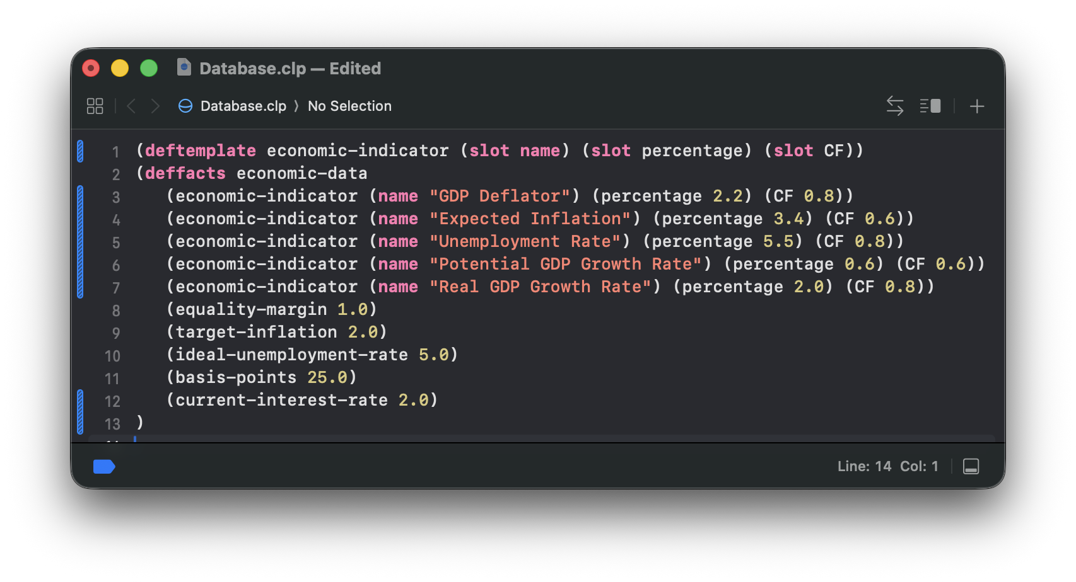
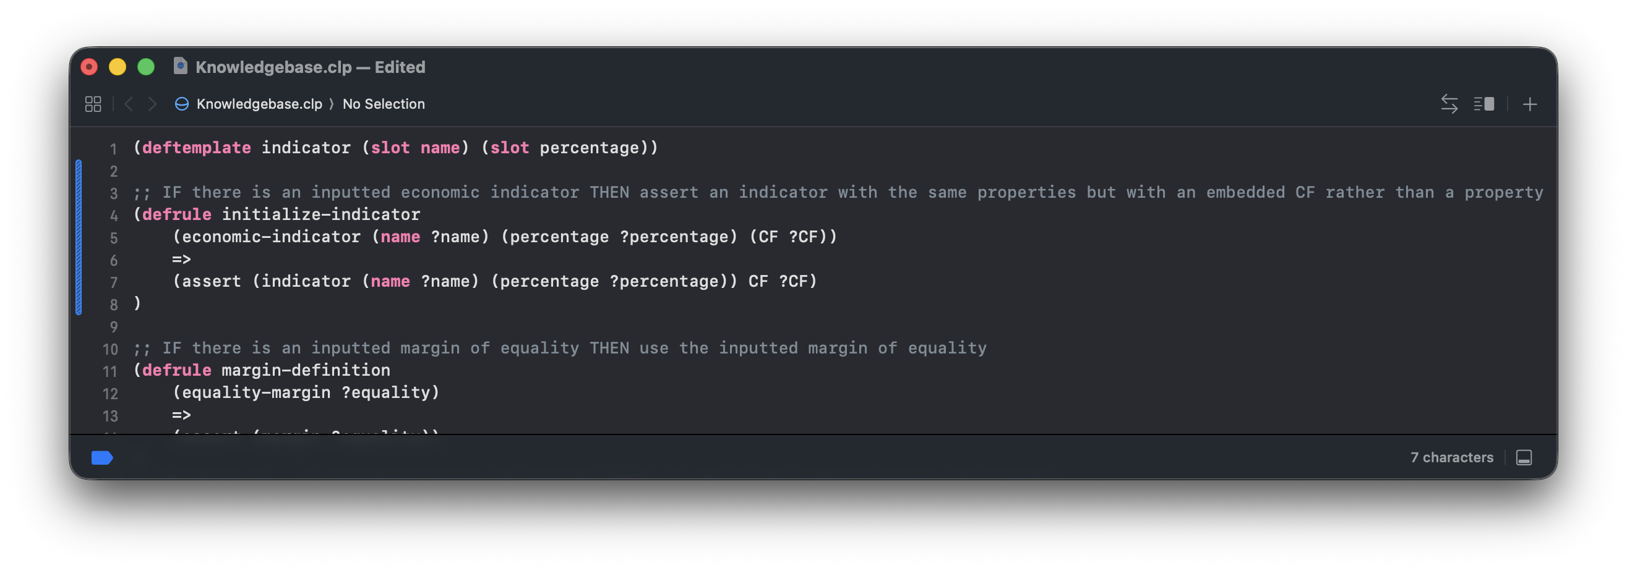
Probabilistic Uncertainty (TODO 2)
Certainty Factors were added to each economic indicator. Those that are largely based on measurements (the GDP Deflator, the Unemployment Rate, and the Real GDP Growth Rate) are almost certainly correct (CF 0.8), whereas those that are based on potential or expected values (the Expected Inflation and the Potential GDP Growth Rate) are estimated and thus probably (but not certainly) correct. Those are only default values.
https://github.com/Mikachupichu/central-banking-expert-system/tree/TODO2

Slide 5
Probabilistic Uncertainty (TODO 2)
Certainty Factors were also added to multiple rules. Inflation classification rules (high-inflation, low-inflation, and ideal-inflation) can be used with confidence. ideal-inflation classification is definitely correct (1.0) because it is purely based on the chosen ideal inflation rate. Whether an inflation rate is too far from the perfect value to be considered too low or too high relies slightly on judgement and situational properties. Thus, high-inflation and low-inflation are almost certainly correct (0.8). The same logic applies for unemployment classification rules (high-unemployment, low-unemployment, and ideal-unemployment, with 0.8, 0.8 and 1.0 respectively).
Output gap rules purely follow a formula (Output Gap = Real GDP Growth Rate – Potential GDP Growth Rate); there is absolutely zero uncertainty about them as long as the inputs are correct. Thus, all output gap rules (positive-output-gap, negative-output-gap, and zero-output-gap) are definitely correct (1.0).
Future inflation estimation rules (high-future-inflation, low-future-inflation, and ideal-future-inflation) are using heuristics to estimate whether future inflation will be high. Thus, they are probable (0.6) or almost certain (0.8; for whether the future inflation is ideal, for the same reason as for inflation and unemployment classification rules).
Lastly, decisions to change the interest rates (increase-interest-rate, lower-interest-rate, and maintain-interest-rate) are principally based on definitive logic (that excessively high inflation warrants rate increases for example) but with a small amount of judgment (to decide how to deal with conflicts between current and future inflation). Thus, they are all almost certain (0.8).

Slide 6
Probabilistic Uncertainty (TODO 2)
A new rule was added, which identifies stagflation: a major economic crisis caused by a combination of high inflation, high unemployment, and zero or negative real GDP growth. While central banks tend to be squarely focused on inflation, they do step in as lenders of last resort in cases of catastrophic economic crises. Since this rule simply uses a rule of thumb (it is not a mathematical formula) and the degree to which growth has to be low (negative, or around zero) involves some judgement. Thus, the rule is probable (CF 0.6) but not certain.

Slide 7
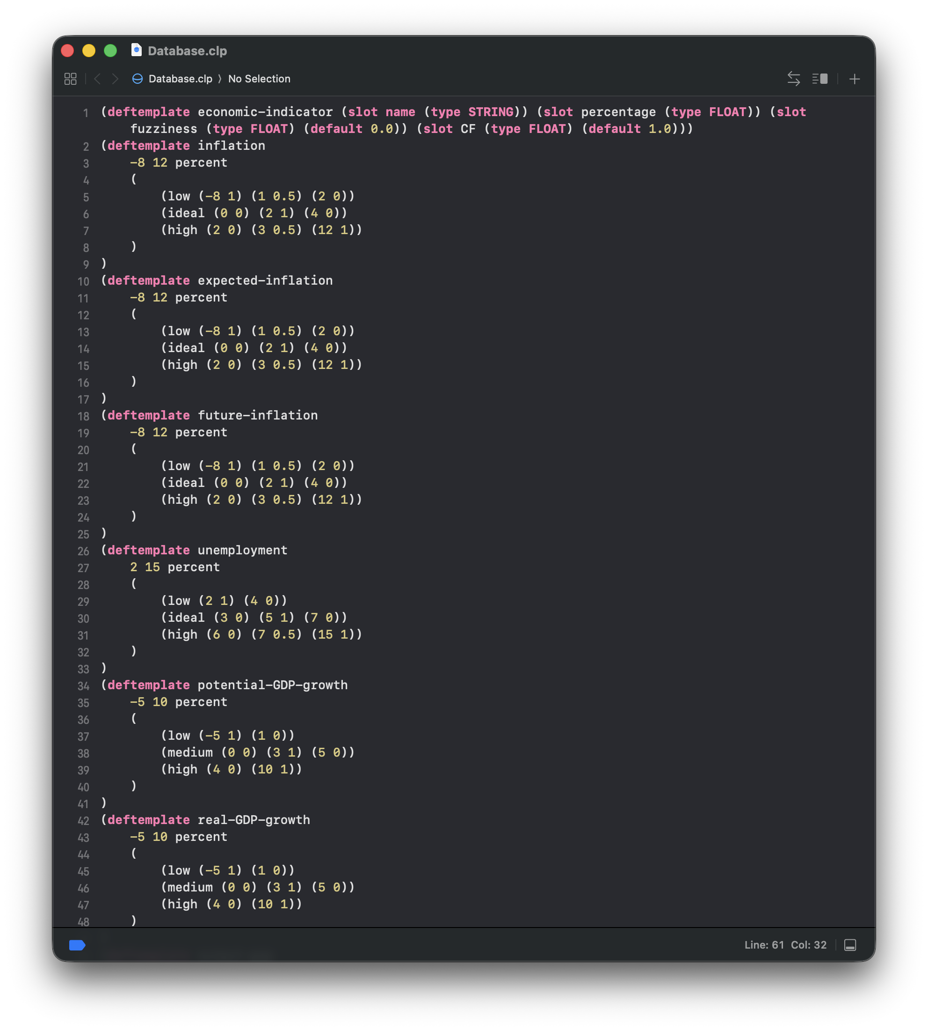
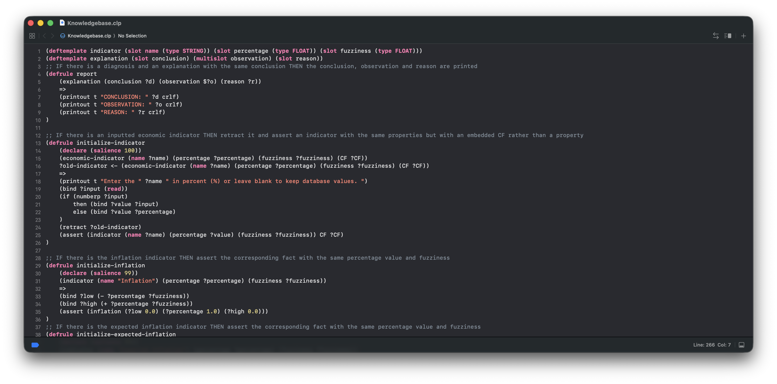
Possibilistic Uncertainty (TODO 3)
Indicators were replaced by standalone fuzzy facts (with their own templates), each with a fuzzy membership function. Fuzziness values were also assigned when asserted, in addition to certainty factors. Changes in inflation, real GDP growth rates and unemployment are significant, even minimal ones. Thus, small fuzziness triangles with 0.1, 0.1 and 0.2 half bottom side lengths were respectively assigned when asserted. Potential GDP growth rate is more conceptual and thus matters a bit less strictly, while expected inflation is obtained from consumer sentiment, which is a bit of a loose indicator. Thus, both received fuzziness triangles with half bottom side lengths of 0.3. Almost every rule had to be modified or replaced to accommodate the use of fuzzy facts. Some rules were completely deleted: they tried to categorize number values into linguistic ones, which was redundant (fuzzy facts do this automatically). Fuzziness considerably improved interest rate decisions, which are based on multiple input factors that may contradict each other with varying weights.
https://github.com/Mikachupichu/central-banking-expert-system/tree/TODO3

Slide 8
Quality Attributes (TODO 4)
Correctness
Rules must accurately represent central banking knowledge. For example, an economics student relying and trusting my expert system must not be taught incorrect information that may negatively impact his understanding and grades.
All theory behind all rules is cited and references authoritative and academic sources throughout my code, ensuring correctness. Comments above each rule and at the very bottom of the knowledgebase are used for this purpose.
Consequently, the impact of these guidelines is highly positive, as they allow knowledge to be accurately represented through the rules.
Consistency
Rules must not contradict each other, as that would render the expert system less trustworthy.
There are no repeating terms (concepts) between different contexts. Moreover, any potential contradictions are handled by the use of fuzziness (when fact assertions conflict), salience (in setup and conclusion rules to ensure all input data is ready to be used before the reasoning stage begins and that the conclusion only fires once the reasoning has been completed, which avoids rule firing repetition with varying results), and stop facts (when an output gap determination rule fires, to avoid repeats with less certain determinations that would contradict the first one).
The effect of such consistency is positive, as users can safely rely on the expert system’s answers without confusion.

Slide 9
Ç
P
Explainability
Essential for transparency, traceability, justifiability, and credibility.
Readable and descriptive names are used for each fact and rule, allowing for clear understanding of the system’s reasoning during debug. Some explanations are also printed, through explanation facts.
Explainability is very helpful for users and engineers seeking to understand the expert system’s reasoning. Making the system explainable thus has a positive impact.
Modifiability
Important for long-term maintainability.
Ripple effects when making modifications are prevented: all input fact values can be modified in one single place, in the database. This makes the code quick and easy to edit. Salience is correctly used as a meta-rule to separate the setup and the conclusion from the core reasoning, and the conclusion from each other without interfering with the rule firing order within the reasoning; this allows rules to easily be added without needing to modify other rules’ salience values, for instance.
Improving modifiability helps support a system’s long-term success by allowing engineers to easily make improvements, and is thus a positive force of the development process.
Quality Attributes (TODO 4)

Slide 10
Conclusion
In conclusion, the central banking expert system was improved significantly by including certainty factors and fuzziness, as well as by supporting various quality attributes.
https://github.com/Mikachupichu/central-banking-expert-system/tree/main

