Slide 1
Optimizing the Distributing of Donor Hearts
Mikael Huff

Slide 2

Importance of the Heart
Short Term
General Life
Long Term
Vascular
Anaerobic
Immune System

Slide 3
Heart Transplant Statistics
Current
Waitlist
New Additions
Transplants Performed
5,896
4,711
4,565

Slide 4
Dataset
Clinical trial dataset containing:
    Drug Status (D-penicillamine vs Placebo)
    Patient Data (Sex and Age)
    Medical Data (Cholesterol, Platelets, SGOL, etc)
    Disease Severity (Stage)
    Patient’s Outcome (Alive/Dead and Duration)

Slide 5
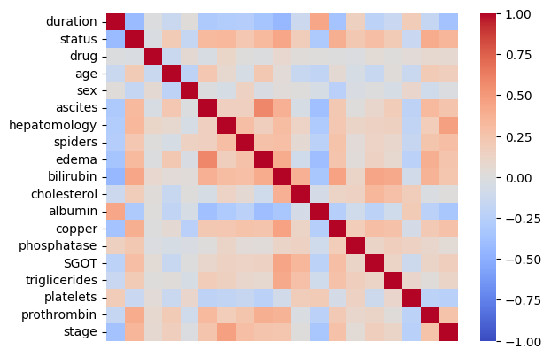
Feature Correlation
Important Features:
Drug
Stage
Sex
Duration

Slide 6
Dataset Problems
Problems with a Clinical Trial Dataset:
    Small Amount of Data
    Different Goal
    Biased Focus Group
    Single Check-up
    Limited Duration
    Mixed Ending Status

Slide 7
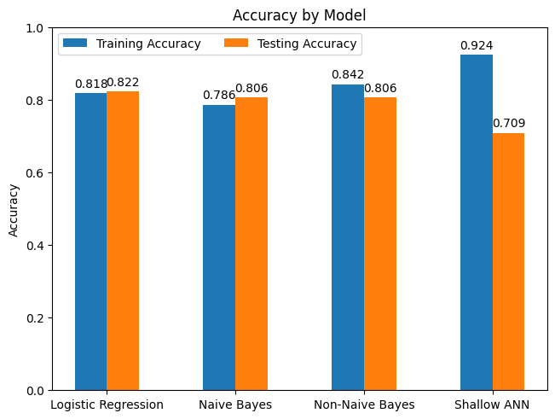
Model Accuracy
Shallow ANN performs the best on Training Data
Logistic Regression performs best on Testing Data

Slide 8
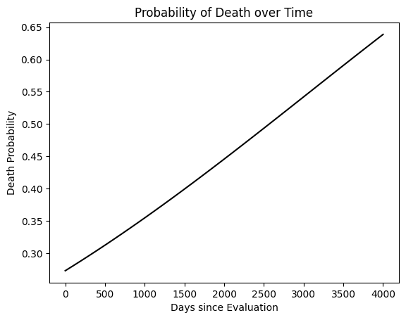
Life Expectancy
Linear increase over time
Starts at around 25% at evaluation
Maximum of 65% after 11 years

Slide 9
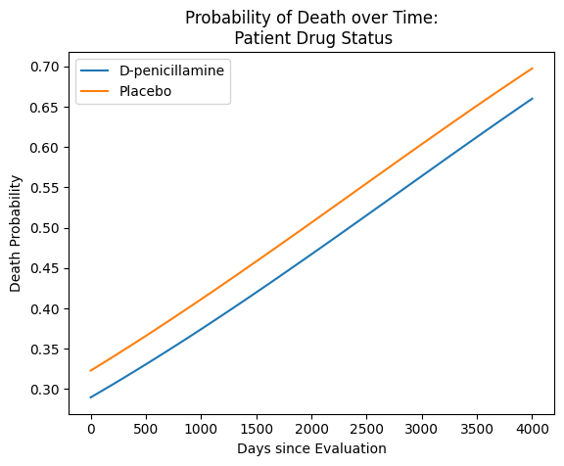
Life Expectancy
Drug
D-penicillamine provides a small benefit of around 3%
Relatively small, but is a matter of life or death

Slide 10
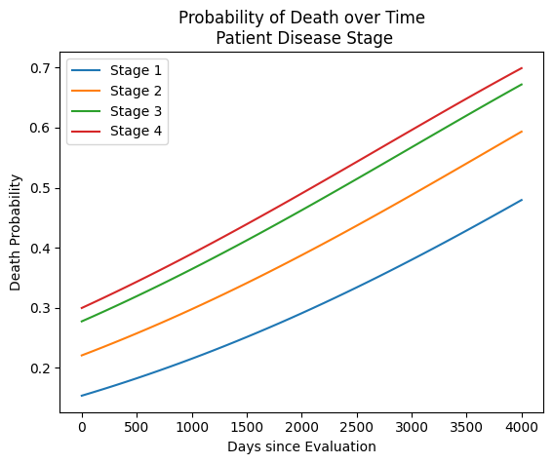
Life Expectancy
Disease Stage
Stage 1 has the lowest death rate
Stage 2 is about 5% above stage 1
Stage 3 is another 5% with Stage 4 another percent more

Slide 11
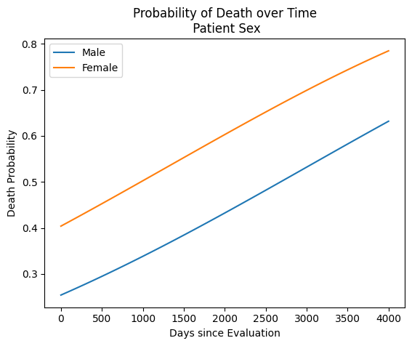
Life Expectancy
Sex
Woman Have a much higher risk of dying with about a 15-20% difference over time

Slide 12
Conclusion
Predict Alive vs Dead
Visualize rates over time
Evaluate various feature importance

Slide 13
Thanks for Listening

