Slide 1


Concurrent Tries with Efficient Non-blocking Snapshots
Aleksandar Prokopec
Phil Bagwell
Martin Odersky
École Polytechnique Fédérale de Lausanne
Nathan Bronson
Stanford

Slide 2
Motivation
val numbers = getNumbers()
// compute square roots
numbers foreach { entry =>
x = entry.root
n = entry.number
entry.root = 0.5 * (x + n / x)
if (abs(entry.root - x) < eps)
numbers.remove(entry)
}

Slide 3
Hash Array Mapped Tries (HAMT)

Slide 4
Hash Array Mapped Tries (HAMT)
0 = 000000₂

Slide 5
Hash Array Mapped Tries (HAMT)
0

Slide 6
Hash Array Mapped Tries (HAMT)
16 = 010000₂
0

Slide 7
Hash Array Mapped Tries (HAMT)
0
16

Slide 8
Hash Array Mapped Tries (HAMT)
4 = 000100₂
0
16

Slide 9
Hash Array Mapped Tries (HAMT)
4 = 000100₂
16
0

Slide 10
Hash Array Mapped Tries (HAMT)
16
0
4

Slide 11
Hash Array Mapped Tries (HAMT)
12 = 001100₂
16
0
4

Slide 12
Hash Array Mapped Tries (HAMT)
12 = 001100₂
16
0
4

Slide 13
Hash Array Mapped Tries (HAMT)
16
0
4
12

Slide 14
Hash Array Mapped Tries (HAMT)
16
33
0
4
12

Slide 15
Hash Array Mapped Tries (HAMT)
16
33
48
0
4
12

Slide 16
Hash Array Mapped Tries (HAMT)
16
48
0
4
12
33
37

Slide 17
Hash Array Mapped Tries (HAMT)
16
48
4
12
33
37
0
3

Slide 18
Hash Array Mapped Tries (HAMT)
4
12
16
20
25
33
37
48
57
0
1
3
8
9

Slide 19
Immutable HAMT
used as immutable maps in functional languages
4
12
16
20
25
33
37
0
1
3
8
9

Slide 20
Immutable HAMT
updates rewrite path from root to leaf
insert(11)
4
12
16
20
25
33
37
4
12
0
1
3
8
9
8
9
11

Slide 21
Immutable HAMT
updates rewrite path from root to leaf
insert(11)
4
12
16
20
25
33
37
4
12
0
1
3
8
9
8
9
11
efficient updates - log_{k}(n)

Slide 22
Node compression
48
57
1
0
1
0
48
57
1
0
1
0
48
57
10
48
57
BITPOP(((1 << ((hc >> lev) & 1F)) – 1) & BMP)

Slide 23
Node compression
48
57
1
0
1
0
48
57
1
0
1
0
48
57
10
48
57
48
57

Slide 24
Ctrie
Can mutable HAMT be modified to be
thread-safe?

Slide 25
Ctrie insert
4
9
12
16
20
25
33
37
48
57
0
1
3
17 = 010001₂

Slide 26
Ctrie insert
4
9
12
16
20
25
33
37
48
57
0
1
3
16
17
17 = 010001₂
1) allocate

Slide 27
Ctrie insert
4
9
12
20
25
33
37
48
57
0
1
3
16
17
17 = 010001₂
2) CAS

Slide 28
Ctrie insert
4
9
12
20
25
33
37
48
57
0
1
3
16
17
17 = 010001₂

Slide 29
Ctrie insert
4
9
12
20
25
33
37
48
57
0
1
3
16
17
18 = 010010₂

Slide 30
Ctrie insert
4
9
12
20
25
33
37
48
57
1) allocate
0
1
3
16
17
16
17
18
18 = 010010₂

Slide 31
Ctrie insert
4
9
12
20
25
33
37
48
57
0
1
3
2) CAS
16
17
18
18 = 010010₂

Slide 32
Ctrie insert
Unless…
4
9
12
20
25
33
37
48
57
0
1
3
2) CAS
16
17
18
18 = 010010₂

Slide 33
Ctrie insert
28 = 011100₂
Unless…
T2
4
9
12
20
25
33
37
48
57
T1-1) allocate
0
1
3
16
17
16
17
18
T1
18 = 010010₂

Slide 34
Ctrie insert
28 = 011100₂
Unless…
T2
4
9
12
20
25
20
25
28
T2-1) allocate
T1-1) allocate
0
1
3
16
17
16
17
18
T1
18 = 010010₂

Slide 35
Ctrie insert
T2-2) CAS
28 = 011100₂
T2
4
9
12
20
25
20
25
28
T1-1) allocate
0
1
3
16
17
16
17
18
T1
18 = 010010₂

Slide 36
Ctrie insert
T2-2) CAS
28 = 011100₂
T2
4
9
12
20
25
20
25
28
0
1
3
16
17
16
17
18
T1
T1-2) CAS
18 = 010010₂

Slide 37
Ctrie insert
28 = 011100₂
T2
4
9
12
20
25
28
0
1
3
16
17
T1
20
25
18 = 010010₂
16
17
18
Lost insert!

Slide 38
Ctrie insert – 2nd attempt
Solution: I-nodes
4
9
12
20
25
0
1
3
16
17

Slide 39
Ctrie insert – 2nd attempt
28 = 011100₂
T2
4
9
12
20
25
0
1
3
16
17
T1
18 = 010010₂

Slide 40
Ctrie insert – 2nd attempt
28 = 011100₂
T2
4
9
12
20
25
20
25
28
T2-1) allocate
0
1
3
16
17
16
17
18
T1-1) allocate
T1
18 = 010010₂

Slide 41
Ctrie insert – 2nd attempt
T2
T2-2) CAS
4
9
12
20
25
20
25
28
T1-2) CAS
0
1
3
16
17
16
17
18
T1

Slide 42
Ctrie insert – 2nd attempt
4
9
12
20
25
28
0
1
3
16
17
18

Slide 43
Ctrie insert – 2nd attempt
4
9
12
20
25
28
0
1
3
16
17
18
Idea: once added to the Ctrie, I-nodes remain present.

Slide 44
Ctrie insert – 2nd attempt
4
9
12
20
25
28
0
1
3
16
17
18
Remove operation supported as well - details in the paper.

Slide 45
Ctrie size
4
9
12
20
25
28
0
1
3
16
17
18

Slide 46
Ctrie size
size = 0
4
9
12
20
25
28
0
1
3
16
17
18

Slide 47
Ctrie size
size = 0
4
9
12
20
25
28
0
1
3
16
17
18

Slide 48
Ctrie size
size = 0
4
9
12
20
25
28
0
1
3
16
17
18

Slide 49
Ctrie size
size = 0
4
9
12
20
25
28
0
1
3
16
17
18

Slide 50
Ctrie size
size = 1
4
9
12
20
25
28
0
1
3
16
17
18

Slide 51
Ctrie size
size = 2
4
9
12
20
25
28
0
1
3
16
17
18

Slide 52
Ctrie size
size = 3
4
9
12
20
25
28
0
1
3
16
17
18

Slide 53
Ctrie size
size = 5
4
9
12
20
25
28
0
1
3
16
17
18

Slide 54
Ctrie size
size = 5
4
9
12
20
25
28
0
1
3
16
17
18
actual size = 12

Slide 55
Ctrie size
size = 5
4
9
12
20
25
28
0
1
0
1
3
16
17
18
actual size = 12

Slide 56
Ctrie size
size = 5
4
9
12
20
25
28
CAS
0
1
0
1
3
16
17
18
actual size = 11

Slide 57
Ctrie size
size = 5
4
9
12
20
25
28
0
1
16
17
18
actual size = 11

Slide 58
Ctrie size
size = 6
4
9
12
20
25
28
0
1
16
17
18
actual size = 11

Slide 59
Ctrie size
size = 6
4
9
12
20
25
28
0
1
16
17
18
19
actual size = 11

Slide 60
Ctrie size
size = 6
4
9
12
20
25
28
0
1
16
17
18
16
17
18
19
actual size = 11

Slide 61
Ctrie size
size = 6
4
9
12
20
25
28
CAS
0
1
16
17
18
16
17
18
19
actual size = 12

Slide 62
Ctrie size
size = 6
4
9
12
20
25
28
0
1
16
17
18
19
actual size = 12

Slide 63
Ctrie size
size = 6
4
9
12
20
25
28
0
1
16
17
18
19
actual size = 12

Slide 64
Ctrie size
size = 7
4
9
12
20
25
28
0
1
16
17
18
19
actual size = 9

Slide 65
Ctrie size
size = 8
4
9
12
20
25
28
0
1
16
17
18
19
actual size = 12

Slide 66
Ctrie size
size = 9
4
9
12
20
25
28
0
1
16
17
18
19
actual size = 12

Slide 67
Ctrie size
size = 10
4
9
12
20
25
28
0
1
16
17
18
19
actual size = 12

Slide 68
Ctrie size
size = 11
4
9
12
20
25
28
0
1
16
17
18
19
actual size = 12

Slide 69
Ctrie size
size = 12
4
9
12
20
25
28
0
1
16
17
18
19
actual size = 12

Slide 70
Ctrie size
size = 13
4
9
12
20
25
28
0
1
16
17
18
19
actual size = 12

Slide 71
Ctrie size
size = 13
But the size
was never 13!
4
9
12
20
25
28
0
1
16
17
18
19
actual size = 12

Slide 72
Global state information
size
find
filter
iterator
4
9
12
20
25
28
0
1
16
17
18
19

Slide 73
Global state information
size
find
filter
iterator
4
9
12
20
25
28
0
1
16
17
18
19
➔ snapshot

Slide 74

Snapshot using locks
4
9
12
20
25
28
0
1
16
17
18
19

Slide 75
Snapshot using locks
copy expensive
4
9
12
20
25
28
0
1
16
17
18
19

Slide 76
Snapshot using locks
copy expensive
not lock-free
4
9
12
20
25
28
0
1
16
17
18
19

Slide 77
Snapshot using locks
copy expensive
not lock-free
can insert or remove remain lock-free?
4
9
12
20
25
28
CAS
0
1
16
17
18
19
0
1
2

Slide 78
Snapshot using locks
copy expensive
not lock-free
can insert or remove remain lock-free?
4
9
12
20
25
28
CAS
0
1
16
17
18
19
0
1
2

Slide 79
Snapshot using logs
keep a linked list of previous values in each I-node
4
9
12
20
25
28
0
1
16
17
18
19

Slide 80
Snapshot using logs
keep a linked list of previous values in each I-node
4
9
12
20
25
28
0
1
2
0
1
16
17
18
19

Slide 81
Snapshot using logs
keep a linked list of previous values in each I-node
when is it safe to delete old entries?
4
9
12
20
25
28
0
1
2
0
1
16
17
18
19

Slide 82
Snapshot using immutability
root
4
9
12
20
25
28
0
1
16
17
18
19

Slide 83
Snapshot using immutability
root
#1
#1
#1
4
9
12
20
25
28
#1
#1
0
1
16
17
18
19

Slide 84
Snapshot using immutability
root
#1
#1
#1
4
9
12
20
25
28
#1
#1
0
1
16
17
18
19
snapshot!

Slide 85
Snapshot using immutability
root
#1
#2
1) create new I-node at #2
#1
#1
4
9
12
20
25
28
#1
#1
0
1
16
17
18
19
snapshot!

Slide 86
Snapshot using immutability
snapshot #1
root
2) set snapshot
#1
#2
#1
#1
4
9
12
20
25
28
#1
#1
0
1
16
17
18
19
snapshot!

Slide 87
Snapshot using immutability
snapshot #1
root
3) CAS root to new I-node
#1
#2
#1
#1
4
9
12
20
25
28
#1
#1
0
1
16
17
18
19
snapshot!

Slide 88
Snapshot using immutability
snapshot #1
root
#1
#2
#1
#1
4
9
12
20
25
28
#1
#1
0
1
16
17
18
19
2
subsequent insert

Slide 89
Snapshot using immutability
snapshot #1
root
#1
#2
generation #2 - ok!
#1
#1
4
9
12
20
25
28
#1
#1
0
1
16
17
18
19
2
subsequent insert

Slide 90
Snapshot using immutability
snapshot #1
root
#1
#2
generation #1
not ok, too old!
#1
#1
4
9
12
20
25
28
#1
#1
0
1
16
17
18
19
2
subsequent insert

Slide 91
Snapshot using immutability
snapshot #1
root
#1
#2
1) create updated node at #2
#1
#1
#2
#2
4
9
12
20
25
28
#1
#1
0
1
16
17
18
19
2
subsequent insert

Slide 92
Snapshot using immutability
snapshot #1
root
2) CAS to the updated node
#1
#2
#1
#1
#2
#2
4
9
12
20
25
28
#1
#1
0
1
16
17
18
19
2
subsequent insert

Slide 93
Snapshot using immutability
snapshot #1
root
#1
#2
#1
#1
#2
#2
4
9
12
20
25
28
#1 too old!
#1
#1
0
1
16
17
18
19
2
subsequent insert

Slide 94
Snapshot using immutability
snapshot #1
root
#1
#2
#1
#1
#2
#2
4
9
12
20
25
28
4
9
12
#1
#1
#2
1) create updated node at #2
0
1
16
17
18
19
2
subsequent insert

Slide 95
Snapshot using immutability
snapshot #1
root
#1
#2
2) CAS
#1
#1
#2
#2
4
9
12
20
25
28
4
9
12
#1
#1
#2
0
1
16
17
18
19
2
subsequent insert

Slide 96
Snapshot using immutability
snapshot #1
root
#1
#2
#1
#1
#2
#2
4
9
12
20
25
28
4
9
12
#1
#1
#2
finally, create a new leaf
and CAS
0
1
16
17
18
19
0
1
2
subsequent insert

Slide 97
Snapshot using immutability
snapshot #1
root
#1
#2
#1
#1
#2
#2
4
9
12
20
25
28
4
9
12
#1
#1
#2
0
1
16
17
18
19
0
1
2
3
another insert

Slide 98
Snapshot using immutability
snapshot #1
root
#1
#2
#1
#1
#2
#2
4
9
12
20
25
28
4
9
12
#1
#1
#2
0
1
16
17
18
19
0
1
2
0
1
2
3
another insert

Slide 99
Snapshot using immutability
snapshot #1
root
#1
#2
#1
#1
#2
#2
4
9
12
20
25
28
4
9
12
#1
#1
#2
0
1
16
17
18
19
0
1
2
0
1
2
3
But... this won't really work... why?

Slide 100
Snapshot using immutability
snapshot #1
root
#1
#2
#1
#1
#2
#2
4
9
12
20
25
28
4
9
12
#1
#1
#2
0
1
16
17
18
19
0
1
2
0
1
2
3
16
17
18
T2: remove 19

Slide 101
Snapshot using immutability
snapshot #1
root
#1
#2
#1
#1
#2
#2
4
9
12
20
25
28
4
9
12
#1
#1
#2
CAS
0
1
16
17
18
19
0
1
2
0
1
2
3
16
17
18
T2: remove 19

Slide 102
Snapshot using immutability
snapshot #1
root
#1
#2
#1
#1
#2
#2
4
9
12
20
25
28
4
9
12
#1
#1
#2
CAS
0
1
16
17
18
19
0
1
2
0
1
2
3
16
17
18
How to fail this last CAS?
T2: remove 19

Slide 103
Snapshot using immutability
snapshot #1
root
#1
#2
#1
#1
#2
#2
4
9
12
20
25
28
4
9
12
#1
#1
#2
DCAS
0
1
16
17
18
19
0
1
2
0
1
2
3
16
17
18
How to fail this last CAS?
DCAS
T2: remove 19

Slide 104
Snapshot using immutability
snapshot #1
root
#1
#2
#1
#1
#2
#2
4
9
12
20
25
28
4
9
12
#1
#1
#2
DCAS
0
1
16
17
18
19
0
1
2
0
1
2
3
16
17
18
How to fail this last CAS?
DCAS - software based
T2: remove 19

Slide 105
Snapshot using immutability
snapshot #1
root
#1
#2
#1
#1
#2
#2
4
9
12
20
25
28
4
9
12
#1
#1
#2
DCAS
0
1
16
17
18
19
0
1
2
0
1
2
3
16
17
18
How to fail this last CAS?
DCAS - software based
...creates intermediate objects
T2: remove 19

Slide 106
GCAS - generation-compare-and-swap
snapshot #1
root
#1
#2
#1
#1
#2
#2
4
9
12
20
25
28
4
9
12
#1
#1
#2
0
1
16
17
18
19
0
1
2
3
16
17
18
prev
1) set prev field
T2: remove 19

Slide 107
GCAS - generation-compare-and-swap
snapshot #1
root
#1
#2
#1
#1
#2
#2
4
9
12
20
25
28
4
9
12
#1
2) CAS
#1
#2
0
1
16
17
18
19
0
1
2
3
16
17
18
prev
T2: remove 19

Slide 108
GCAS - generation-compare-and-swap
snapshot #1
root
3) read root generation
#1
#2
#1
#1
#2
#2
4
9
12
20
25
28
4
9
12
#1
#1
#2
0
1
16
17
18
19
0
1
2
3
16
17
18
prev
T2: remove 19

Slide 109
GCAS - generation-compare-and-swap
snapshot #1
root
#1
#2
#1
#1
#2
#2
4
9
12
20
25
28
4
9
12
#1
#1
#2
0
1
16
17
18
19
0
1
2
3
16
17
18
prev
4) if root generation changed
CAS prev to FailedNode(prev)
FN

Slide 110
GCAS - generation-compare-and-swap
snapshot #1
root
#1
#2
#1
#1
#2
#2
4
9
12
20
25
28
4
9
12
#1
#1
#2
0
1
16
17
18
19
0
1
2
3
16
17
18
prev
4) if root generation changed
CAS prev to FailedNode(prev)
FN

Slide 111
GCAS - generation-compare-and-swap
snapshot #1
root
#1
#2
#1
#1
#2
#2
4
9
12
20
25
28
4
9
12
#1
#1
#2
0
1
16
17
18
19
0
1
2
3
16
17
18
prev
5) CAS to previous value
FN

Slide 112
GCAS - generation-compare-and-swap
snapshot #1
root
#1
#2
#1
#1
#2
#2
4
9
12
20
25
28
4
9
12
#1
#1
#2
0
1
16
17
18
19
0
1
2
3
16
17
18
prev
4) if root generation unchanged
CAS prev to null

Slide 113
GCAS - generation-compare-and-swap
snapshot #1
root
#1
#2
#1
#1
#2
#2
4
9
12
20
25
28
4
9
12
#1
#1
#2
0
1
16
17
18
19
0
1
2
3
16
17
18
4) if root generation unchanged
CAS prev to null

Slide 114
GCAS - generation-compare-and-swap
snapshot #1
root
#1
#2
#1
#1
#2
#2
4
9
12
20
25
28
4
9
12
#1
#1
#2
0
1
16
17
18
19
0
1
2
3
1) Replace all CAS with GCAS
2) Replace all READ with GCAS_READ
(which checks if prev field is null)

Slide 115
Snapshot-based iterator
def iterator =
if (isSnapshot) new Iterator(root)
else snapshot().iterator()

Slide 116
Snapshot-based size
def size = {
val sz = 0
val it = iterator
while (it.hasNext) sz += 1
sz
}

Slide 117
Snapshot-based size
def size = {
val sz = 0
val it = iterator
while (it.hasNext) sz += 1
sz
}
Above is O(n).
But, by caching size in nodes - amortized O(log_{k}n)!
(see source code)

Slide 118
Snapshot-based atomic clear
def clear() = {
val or = READ(root)
val nr = new INode(new Gen)
if (!CAS(root, or, nr)) clear()
}
(roughly)

Slide 119
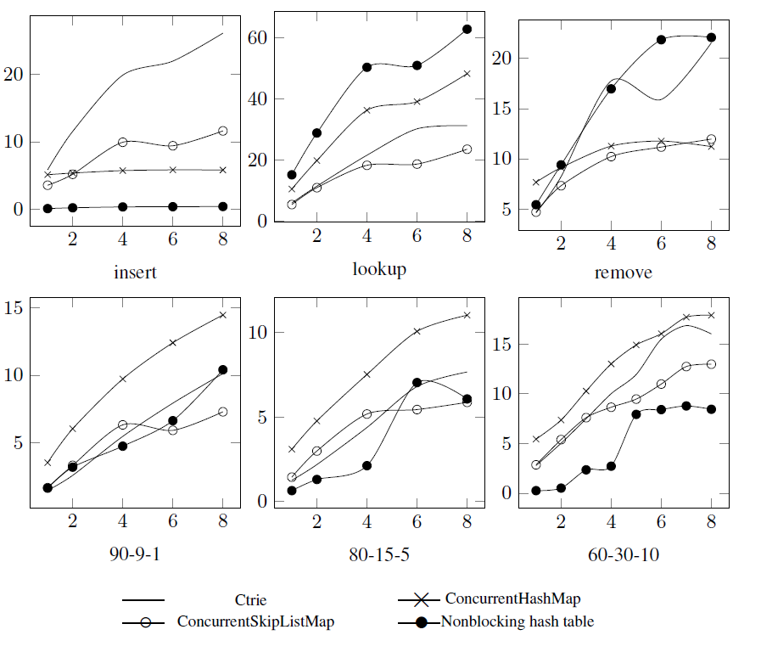
Evaluation - quad core i7

Slide 120
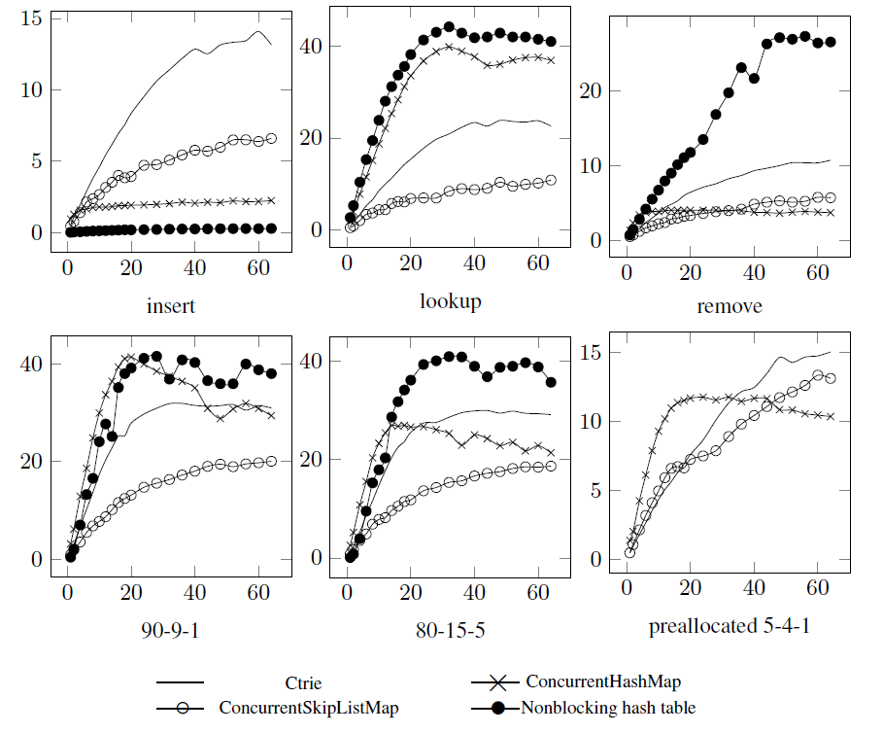
Evaluation – UltraSPARC T2

Slide 121
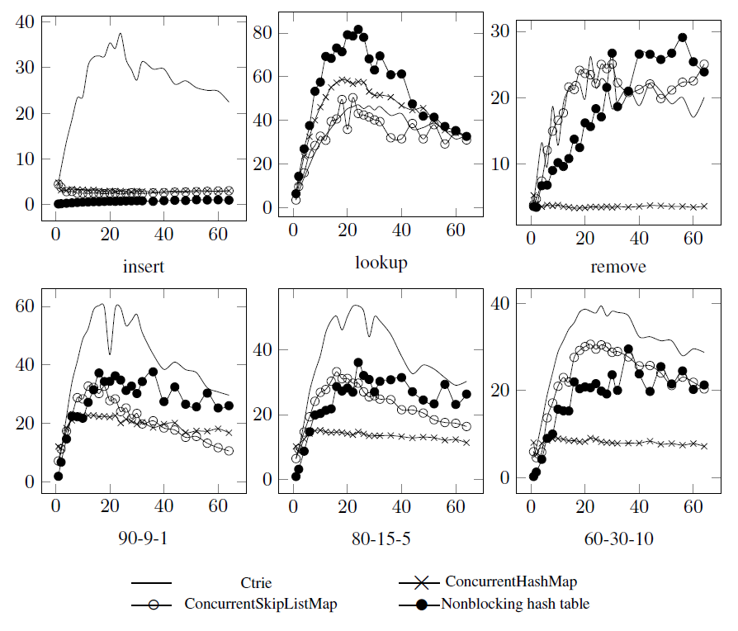
Evaluation – 4x 8-core i7

Slide 122
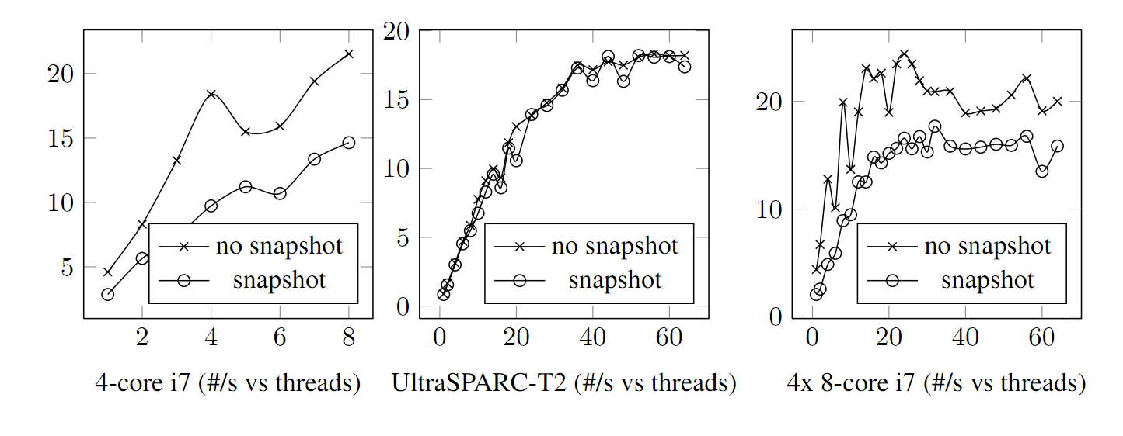
Evaluation – snapshot

Slide 123
Conclusion
snapshots are linearizable and lock-free
snapshots take constant time
snapshots are horizontally scalable
snapshots add a non-significant overhead to the algorithm if they aren't used
the approach may be applicable to tree-based lock-free data-structures in general (intuition)

Slide 124
Thank you!

