Slide 1



THE SCOPE OF COMPUTER GRAPHICS
Created by Micheal Salam

Slide 2
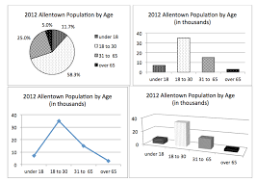
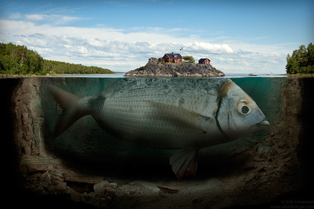


01
What is Computer Graphics
Is a branch of Computer Science focused on creating and manipulating visual representation using technology.
Topics include:
Text presentation
Graphs and charts construction
Graphical user interfaces (GUIs)
Photographic manipulation
Video game development
Animated motion picture creation

Slide 3
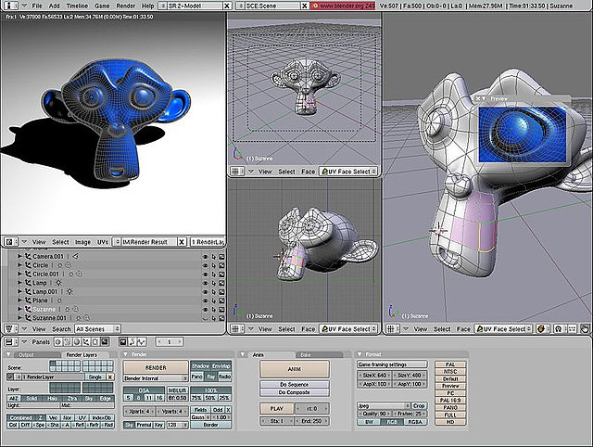
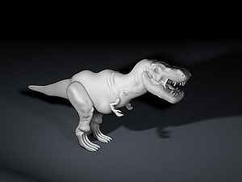
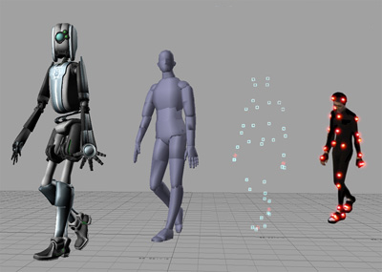
02
Focus On 3D Graphics
Increasing emphasis on 3D graphics within computer graphics.
3D graphics: Converting three-dimensional shapes into images.
Role of 3D graphics in broader computer graphics context.

Slide 4
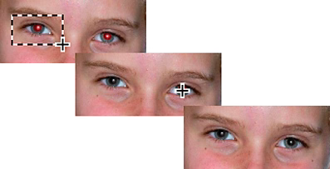
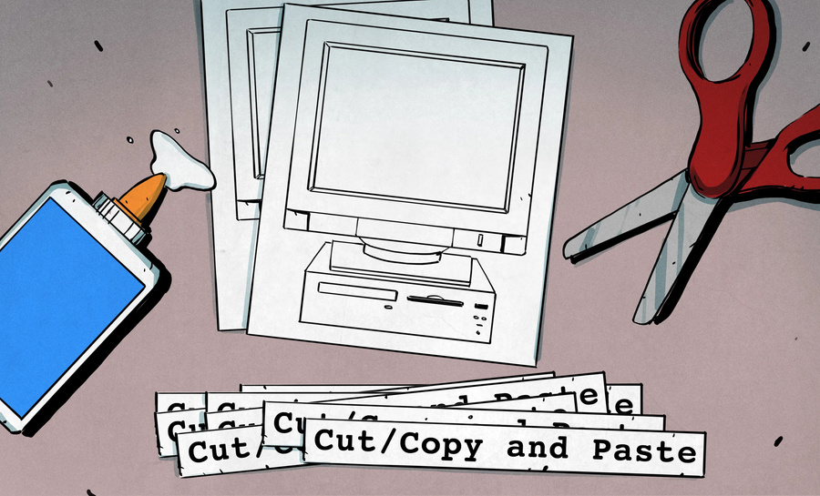
03
Growth Of Manipulation software
Emergence of digital cameras has led to increased use of image manipulation software.
Functions of software:
Touch-up photographs (blemish removal, red-eye correction).
Cut and paste different photographs to create new images.
Importance in creating images that may not reflect reality.

Slide 5
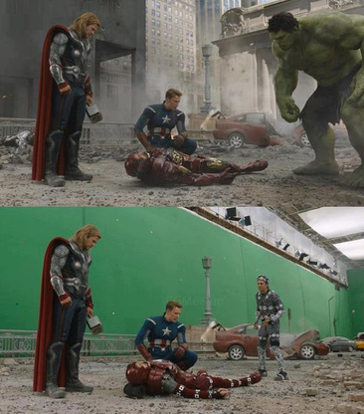
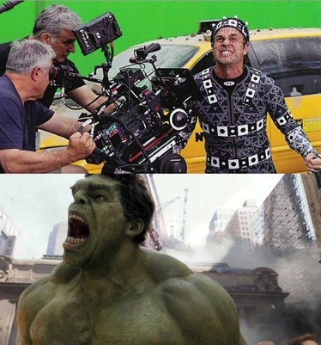
04
Applications in Films and television
Special effects in motion pictures and TV.
Shift from analog to digital systems.
Techniques include:
Removing support wires
Overlaying images
Altering captured actions

Slide 6
04
Applications in Films and television
Special effects in motion pictures and TV.
Shift from analog to digital systems.
Techniques include:
Removing support wires
Overlaying images
Altering captured actions

Slide 7
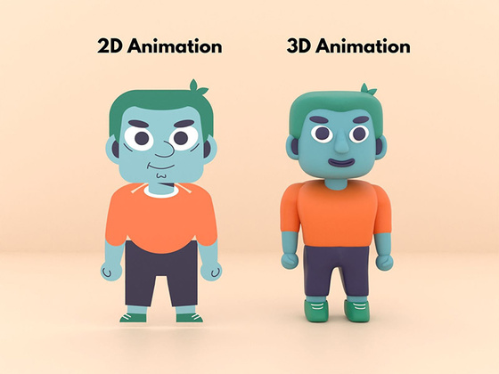
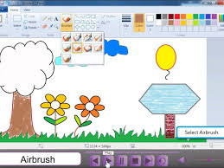
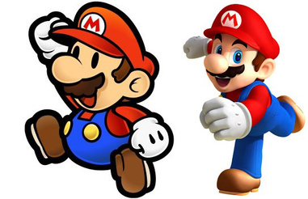
05
2D Graphics and Image Processing
Software for producing 2D images (e.g., Microsoft Paint).
Functions include:
Drawing shapes, filling colors, and cut/paste operations.
Distinction between:
2D Graphics: Producing images from shapes.
Image Processing: Analyzing and enhancing images.

Slide 8
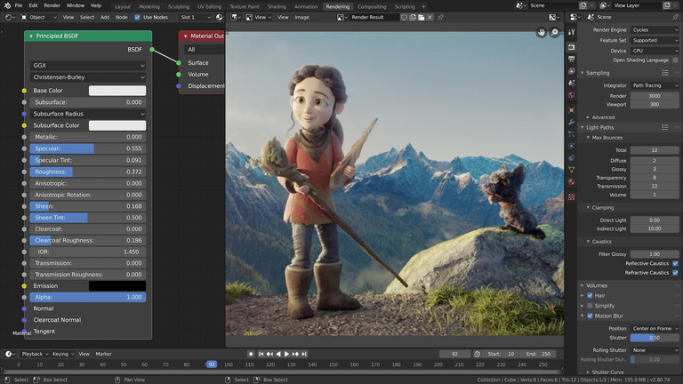
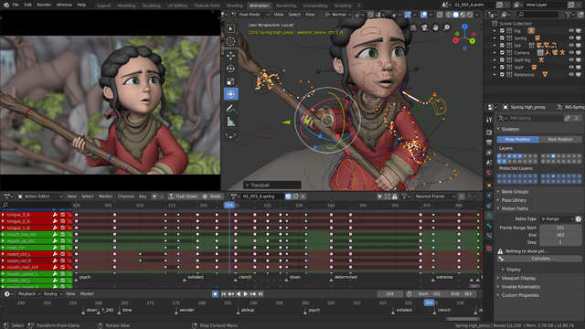
06
Understanding 3D Graphics
Process of constructing digitally encoded 3D scenes.
Simulating photographic processes for virtual worlds.
Difference from traditional photography: 3D scenes exist as data and algorithms.

Slide 9
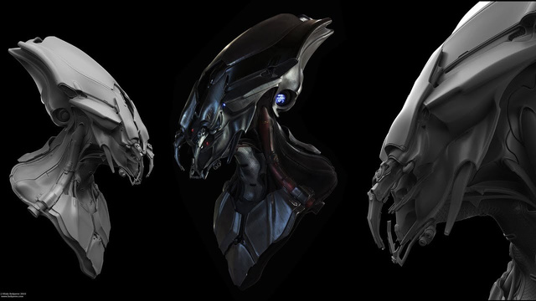
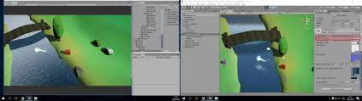
07
Steps In Creating 3D Graphics
Two main steps:
Scene Creation: Encoding, storage, and manipulation (artistic process).
Image Production: Computationally intense process.
Importance of both steps in producing quality graphics.

Slide 10

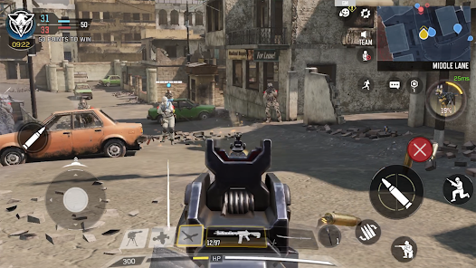
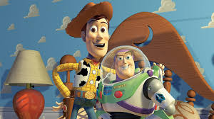
08
Applications of 3D Graphics
Ideal for interactive video games and animated films.
Video games: Players interact with 3D environments.
Animated films: Animators create scenes for viewer consumption.
Distribution as sequences of 2D images.

Slide 11
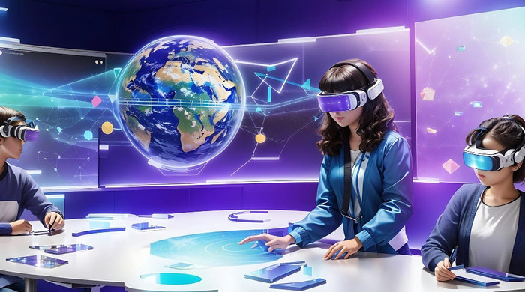

09
Future of 3D Graphics Technology
Potential advancements in creating realistic 3D virtual worlds.
Shift from 2D image distribution to sharing virtual worlds.
Interactive viewing experiences with 3D graphics projectors.
Future possibilities with human-machine interfaces.

Slide 12

THANK YOU

