Slide 1
A Shallow Parser for Bangla Course No: CSE 4000 – Project/Thesis Supervised By: Mohammad Insanur Rahman Shuvo Assistant Professor Department of Computer Science & Engineering Khulna University of Engineering & Technology (KUET)
Presented By:
Md. Rubel Hasan Mikail Biswas Mridu
Roll : 1507074 Roll : 1507081
Department Of CSE Department Of CSE
KUET KUET

Slide 2
Outlines
Introduction
Why use shallow parsing?
Aim of this thesis
Related Works
Proposed Methodology
Result Evaluation
Applications
Conclusion and Future work
References

Slide 3
Introduction
Parsing in NLP is the process of determining the syntactic structure of a text by analyzing its
constituent words based on an underlying grammar (of the language).
Shallow parsing is an analysis of a sentence which –
first identifies constituent parts of sentences (nouns, verbs, adjectives, etc.) and
then links them to higher order units that have discrete grammatical meanings (noun groups or phrases, verb groups, etc.).
Machine learning approach based shallow parsing can better reflect the syntactic relations
between the basic constituents.

Slide 4
Why use shallow parsing?
Algorithms capable of parsing simple sentences for determining syntax exist.
But parsing complex and long sentences is computationally expensive.
Shallow parsing is an attempt to address this problem.
In shallow parsing, the partial parse tree always in-corporate tokens with depth two.
It is exceptionally economical for linguistic computations

Slide 5
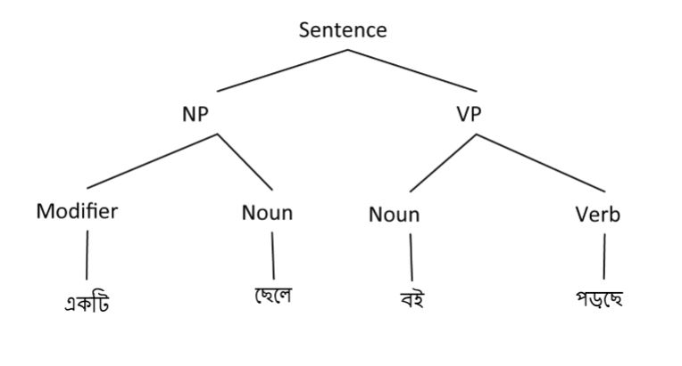
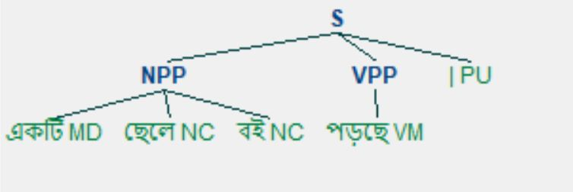
Why use shallow parsing?
The example of a complete parse tree using CFG of Bengali language and the shallow parsing of a simple Bengali sentence are illustrated bellow:
Figure 1: Complete parsing of a simple sentence using Bengali CGF [6]
Figure 2: Shallow parsing of a simple sentence

Slide 6
Aim of this thesis
Study of existing POS tagging and chunking methods for Bengali language.
Propose a shallow parsing method for Bengali language using machine learning
method.
Developing a basic shallow parser for Bangla with better accuracy rate.

Slide 7
Related works
Some of the previous works in this fields are –
Serial No | Details
01 | In 2007, Sandipan Dandapat developed a Bengali POS tagger with 40 tags using maximum entropy model in which tagging accuracy yields to 88.08% with morphology as features [3].
02 | In 2008, a maximum entropy based Bengali POS tagger with 26 tags were developed by Asif Ekbal, Rejwanul Haque, Sivaji Bandyopadhyay, which yields a accuracy of 88.2% [2].
03 | In 2006, Sivaji Bandyopadhyay and Asif Ekbal developed HMM based POS tagger and chunker for Bengali which demonstrated 81.61% chunking accuracy after POS tagging [7].
04 | There are some attempts to build a shallow parser for Tamil in 2014 [1] and a shallow parser for Khashi in 2018 [4].

Slide 8
Proposed Methodology
We developed a shallow parser in two steps –
1. Built a POS tagger for Bengali language using Maximum Entropy Model.
2. Built a rule based chunker using Regular Expression Parser of NLTK.

Slide 9
Proposed Methodology
Parts-of-Speech (POS) Tagging
The process of assigning a POS tag or other lexical marker to each word in a corpus.
Chunking
The process of separating and segmenting a sentence into its sub-constituents,
such as noun, verb, and prepositional phrases, denoted as NP, VP, and PP, respectively.

Slide 10
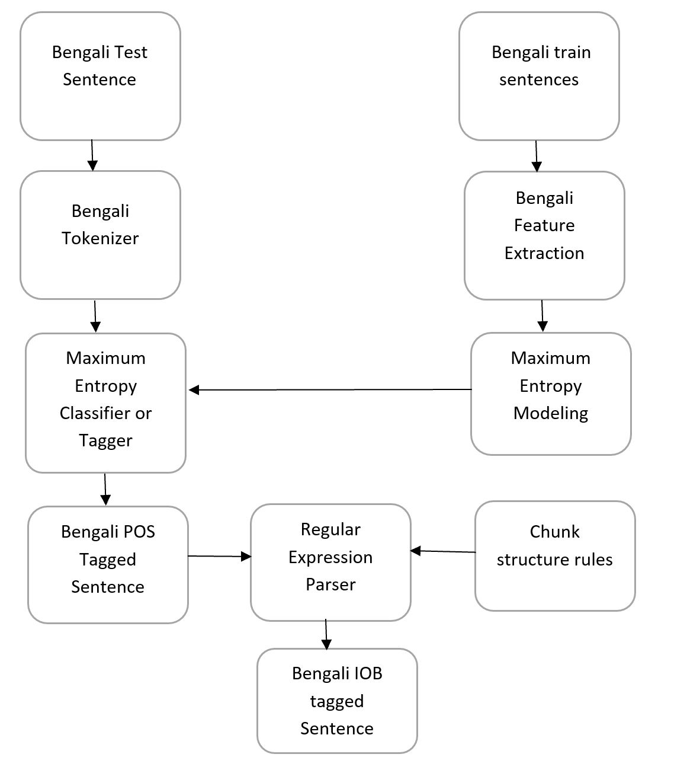
Proposed Methodology
Figure 3: Shallow Parsing Process of Bengali Sentence

Slide 11
Proposed POS Tag set
Our proposed POS tag set for maximum entropy based POS tagging is –
Serial No. | Description | POS tag | Example
1 | Proper Noun | NP | বাংলা, রাজা
2 | Common Noun | NC | সততা, ভাত
3 | Pronoun | PN | সে, আমাকে
4 | Adjective | AJ | মহৎ, পরিশ্রমী
5 | Main Verb | VM | খাচ্ছে, করছি
6 | Auxiliary Verb | VA | পায়, পারে
7 | Adverb | AV | দ্রুত
8 | Connectives | CJ | ও, তাই

Slide 12
Proposed POS Tag set
Our proposed POS tag set for maximum entropy based POS tagging is –
Serial No. | Description | POS tag | Example
9 | Interjection | IJ | আহা, ছিঃ
10 | Punctuation | PU | | , -
11 | Negative words | NG | না
12 | Quantifier | QT | পাঁচ, হাজার
13 | Modifier | MD | একটি
14 | Residuals | RD | Foreign words
15 | Preposition | PP | এর, কাছে
16 | Question related words | QQ | কি

Slide 13
Test data and Tokenization
The test data is a Bengali sentence of the form –
আমার সোনার বাংলা , আমি তোমায় ভালোবাসি |
The input sentence will be tokenized as follows –
['আমার', 'সোনার', 'বাংলা', ' , ' , 'আমি', 'তোমায়', 'ভালোবাসি', '|']

Slide 14
Maximum Entropy based POS tagging
For POS tagging, we used maximum entropy trainer –
At first we extracted Bengali language features from our train data.
Then using Megam optimization algorithm in maximum entropy modeling,
we trained our train data.
And then the maximum entropy classifier gives the appropriate tags to the
tokenized input sentence.

Slide 15
Maximum Entropy based POS tagging
The input sentence will be tokenized as follows –
['আমার', 'সোনার', 'বাংলা', ' , ' , 'আমি', 'তোমায়', 'ভালোবাসি', '|’]
The POS tagged format of the tokenized input is as follows –
[('আমার', 'PN'), ('সোনার', 'NC'), ('বাংলা', 'NP'), (',', 'PU'), ('আমি', 'PN'), ('তোমায়', 'PN’),
('ভালোবাসি', 'VM'), ('|', 'PU')]

Slide 16
Rule based Chunking
For chunking the POS tagged sentence, we defined some hand written rules
based on our train data.
The chunking rules can define noun phrases and verb phrases in Bengali
sentence.
The noun phrase chunks and verb phrase chunks are denoted as NPP, VPP,
respectively.

Slide 17
Rule based Chunking
The noun phrase chunking rule is as follows –
NPP: {<NP|NC>*<MD><AJ>*<NP|NC>*}
{<PN>*<NP|NC>*<PN>*}
The verb phrase chunking rule is as follows –
VPP: {<VM>*<VA>?}

Slide 18
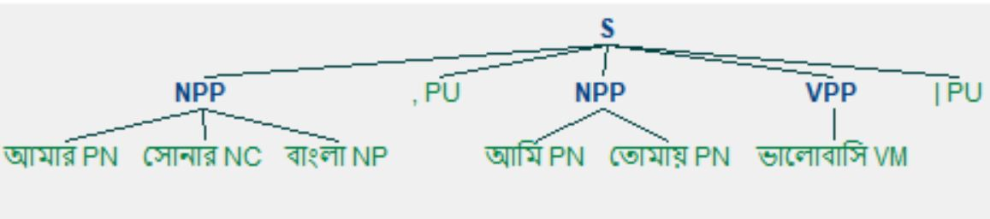
Rule based Chunking
NLTK Regular Expression Parser generates partially parse tree for the POS
tagged sentence using the chunk rules as follows –
Figure 4: Partially parsed tree structure of sentence

Slide 19
Rule based Chunking
Finally from the partially parsed tree we generated IOB tagged format for
input sentence as follows –
[('আমার', 'PN', 'B-NPP'), ('সোনার', 'NC', 'I-NPP'), ('বাংলা', 'NP', 'I-NPP'), (',', 'PU', 'O'), ('আমি’,
'PN', 'B-NPP'), ('তোমায়', 'PN', 'I-NPP'), ('ভালোবাসি ', 'VM', 'B-VPP'), ('|', 'PU', 'O')]

Slide 20
Result evaluation
We used nearly 500 words from different types of Bengali sentences as our
train data.
After POS tagging and IOB tagging we found nearly 90.78% accuracy for POS tagging and
nearly 88% accuracy after chunking the POS tagged data.

Slide 21
Applications
Our shallow parsing method is highly beneficial for different types of natural language
processing applications like –
Named entity recognition
Relation extraction
Information retrieval
Machine translation etc.

Slide 22
Conclusion and Future works
Our proposed method for shallow parsing outperforms other existing methods
of POS tagging and chunking of Bengali sentences.
In future we can add more words to our train data and add more feature set.
Currently we can take one input sentence, in future we can develop a shallow
parser to parse a Bengali paragraph.

Slide 23
References
I. Ariaratnam, A. R. Weerasinghe, C Liyanage, “A Shallow parser for Tamil”, International Conference on Advances in ICT for Emerging Regions (ICTer): 197 – 203, (2014, IEEE).
Asif Ekbal, Rejwanul Haque, Sivaji Bandyopadhyay, “Maximum Entropy Based Bengali Part of Speech Tagging”, Advances in Natural Language Processing and Applications Research in Computing Science 33, pp. 67-78, 2008.
Sandipan Dandapat, “Part-of-Speech Tagging for Bengali”, In Proceedings of the SPSAL Workshop, IJCAI,2007, pp. 56-75.
Medari Tham,“Khasi Shallow Parser”, Proc. of ICON-2018, NLPAI, pages 43–49.
Sivaji Bandyopadhyay and Asif Ekbal,” HMM Based POS Tagger and Rule-Based Chunker for Bengali”, Advances in Pattern Recognition, 2006, pp. 384-390.

Slide 24
References
Al-Mahmud, Bishnu Sarker, K M Azharul Hasan, “Parsing Bangla Grammar Using Context Free Grammar (CFG),” In Technical Challenges and Design Issues in Bangla Language Processing, IGI Global, pp. 137-154, 2013.

Slide 25


