Slide 1

Challenges in Fostering an Open and Safe Reporting Environment
Mikaila Steinbrugge
Assignment 9.2

Slide 2
Introduction to Just Culture
A Just Culture encourages open reporting of errors, aiming to learn and improve safety.
It emphasizes accountability, fairness, and transparency rather than punishment.
Implementing this culture can face significant challenges within organizations.

Slide 3
Blame Culture
Organizations with a blame-oriented culture discourage open reporting.
Employees may fear consequences and avoid sharing mistakes.
Leads to missed opportunities for learning and safety improvements.
Notes:
https://justculture.hqca.ca/overcoming-barriers-to-a-just-culture

Slide 4
Inconsistent Assessment Processes
Variability in how incidents are assessed leads to perceptions of unfairness.
Lack of consistency undermines trust and the effectiveness of the system.
Notes:
https://justculture.hqca.ca/overcoming-barriers-to-a-just-culture

Slide 5
Resistance to Change
Employees and management accustomed to traditional punitive methods resist a shift.
Change requires overcoming deep-seated beliefs and organizational norms.
Notes:
https://academic.oup.com/milmed/article/188/7-8/1596/6589441

Slide 6
Leadership Commitment
Leaders play a crucial role in modeling and promoting just culture principles.
Lack of genuine commitment from leadership leads to poor adoption.
Notes:
https://bmchealthservres.biomedcentral.com/articles/10.1186/s12913-022-08418-z

Slide 7
Fear of Legal Repercussions
Employees may fear legal consequences for disclosing errors or unsafe practices.
This fear hinders open communication and transparency.
Notes:
https://www.safety.inc/post/a-just-culture-understanding-its-roots-and-role-in-modern-organizations

Slide 8
Communication Barriers
Lack of effective communication or misunderstanding of just culture principles.
Inconsistent implementation and lack of clarity across teams.
Notes:
https://humanisticsystems.com/2023/10/18/why-is-it-just-so-difficult-barriers-to-just-culture-in-the-real-world

Slide 9
Organizational Hierarchies
Rigid hierarchical structures may suppress open dialogue.
Can lead to reluctance in reporting errors or raising concerns at lower levels.
Notes:
https://www.safety.inc/post/a-just-culture-understanding-its-roots-and-role-in-modern-organizations

Slide 10
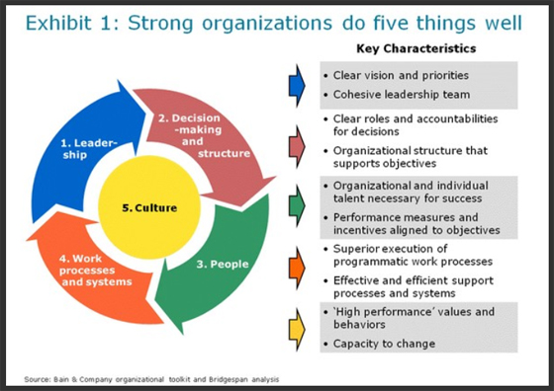
This Photo by Unknown Author is licensed under CC BY

Slide 11
References
https://www.safety.inc/post/a-just-culture-understanding-its-roots-and-role-in-modern-organizations
https://humanisticsystems.com/2023/10/18/why-is-it-just-so-difficult-barriers-to-just-culture-in-the-real-world
https://bmchealthservres.biomedcentral.com/articles/10.1186/s12913-022-08418-z
https://academic.oup.com/milmed/article/188/7-8/1596/6589441
https://justculture.hqca.ca/overcoming-barriers-to-a-just-culture

