Slide 1
Spring-security
Prepared by Group 3.

Slide 2

AGENDA
Introduction to Spring Security
3 Laws of Spring Security Configuration
Core Concepts
Authentication Mechanisms
Authorization Strategies
CSRF and Session Management
Configuring Spring Security
Best Practices and Wrap-Up

Slide 3
Introduction to Spring Security
What is Spring Security?
Spring Security is a powerful framework for securing Java and Spring applications, providing essential tools for authentication (verifying identity) and authorization (controlling access).
Why Use It
- Integrated with Spring: Easy to use within Spring projects.
- Comprehensive Protection: Guards against common threats like CSRF and session fixation.
- Flexible Authentication: Supports Basic Authentication, OAuth2, SSO, and more.
Popular Uses
- Securing web applications and REST APIs
- Enabling role-based access control (RBAC)

Slide 4
Core Concepts of Spring Security
Authentication vs. Authorization
Authentication: Verifying the identity of a user (e.g., logging in with credentials).
Authentication is how we verify the identity of who is trying to access a particular resource.
Once authentication is performed we know the identity and can perform authorization.
Authorization: Determining what actions or resources an authenticated user can access (e.g., user permissions).
Spring Security provides built-in support for authenticating users.
WOW !

Slide 5
Authentication Mechanisms
Authentication Methods
HTTP Basic Authentication:
Simple method where credentials are sent with each HTTP request. Typically used for APIs.
Form-Based Login: Custom login forms that handle user authentication with feedback for failed attempts.
Advanced Authentication
- OAuth2: Used for third-party logins (e.g., Google, Facebook).
- JWT: Provides stateless authentication via signed tokens, ideal for REST APIs.
Let‘s dive in technically

Slide 6
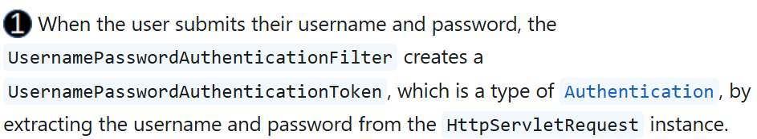
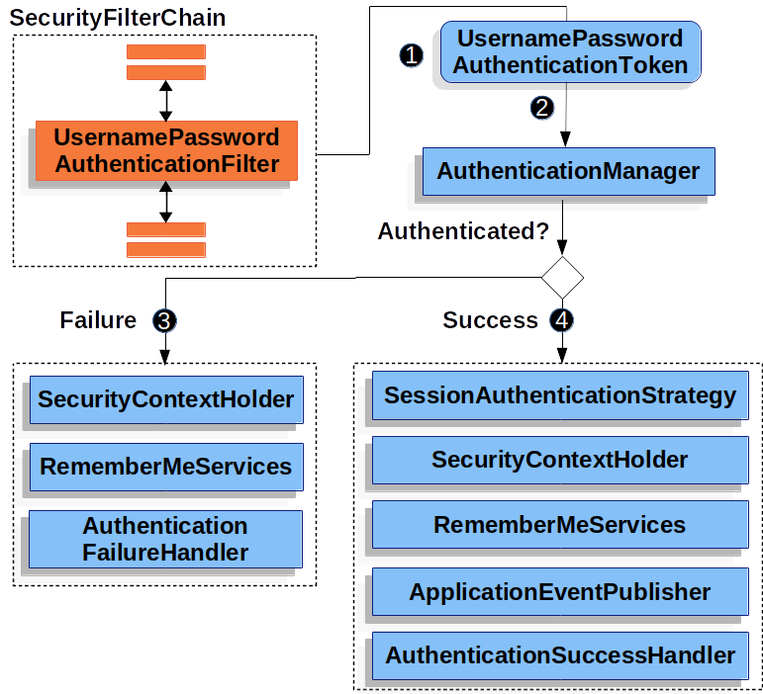
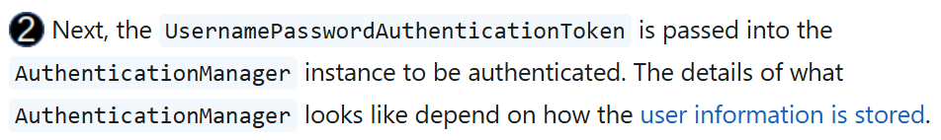
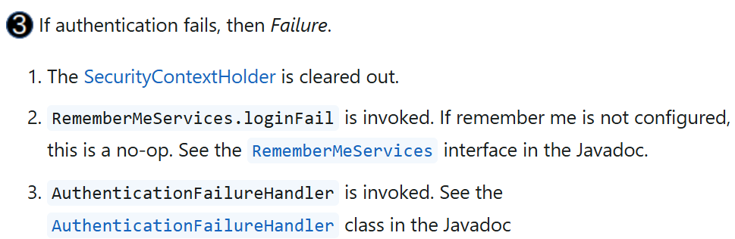

Authentication Mechanisms (Continued)
Finally

Slide 7
Authorization Strategies
Method-Level Security
@PreAuthorize / @Secured: Annotations to enforce access control on methods, checking user roles before execution.
URL-Based Security
HttpSecurity: Configures URL-based security rules, specifying which roles can access certain URLs.
Example: http.authorizeRequests().antMatchers("/admin/**").hasRole("ADMIN")
Role-Based Access Control (RBAC)
Authorities: Users are assigned specific roles (e.g., ADMIN, USER) that determine what resources they can access.

Slide 8
CSRF and Session Management
Authentication for REST APIs
Stateless Authentication: REST APIs usually use token-based authentication (e.g., JWT or OAuth2), ensuring no session state is stored on the server.
HTTP Headers: Tokens are passed in the Authorization header.

Slide 9
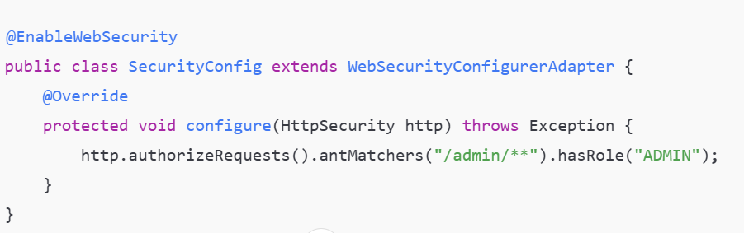
Configuring Spring Security
Java Config: Spring Security can be configured using Java configuration (i.e, @EnableWebSecurity and HttpSecurity.
Example:
then

Slide 10
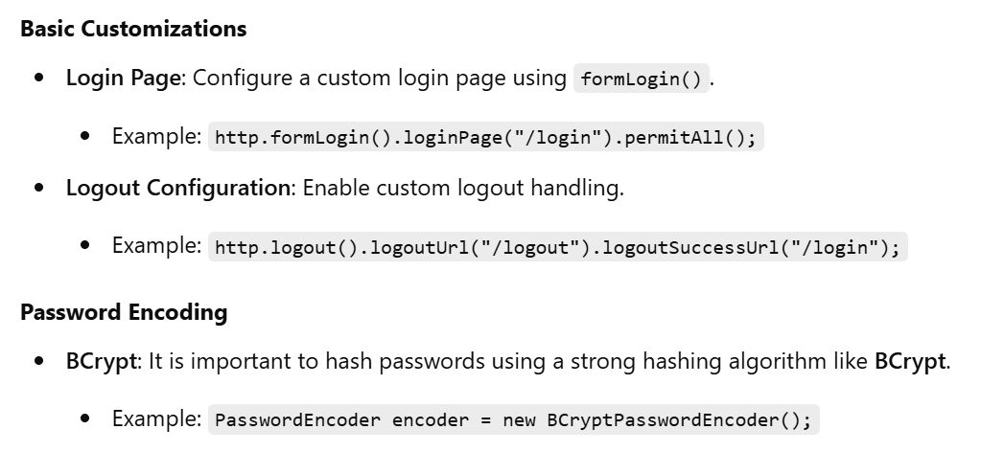
Configuring Spring Security

Slide 11
Best Practices for Spring Security
Use Strong Passwords and Hashing
Always use strong password encoding techniques like BCrypt, PBKDF2, or Argon2 to securely store passwords.
Principle of Least Privilege
Grant users the minimum level of access required for their tasks.
- Use role-based access control (RBAC) to limit user permissions and reduce the risk of unauthorized access.
Enable CSRF Protection
CSRF (Cross-Site Request Forgery) attacks can be mitigated by enabling Spring Security's built-in CSRF protection.
Regularly Update Dependencies
Session Management
Configure session management properly to prevent session fixation attacks.

Slide 12
Reference
https://docs.spring.io/spring-security/reference/
https://docs.spring.io/spring-security/reference/features/authentication/index.html
https://docs.spring.io/spring-security/reference/features/authorization/index.html
https://luv2code.com/spring-security-reference-manual

