Slide 1

Case Study Analysis
Mikayil Ahadli Data Scientist
16 April 2025
1

Slide 2

Case Study Analysis
Problem Description:
Objective: Predict annual income class (>50K or <=50K)
Dataset: US Census Income Dataset
2

Slide 3

Target and Data Quality
Data Treatment
The target is highly imbalanced — only ~6% of people earn more than 50K. I addressed this using a smart balancing technique (SMOTE) so the model can learn better.
Duplication criteria
1
If all the columns except target variable have the same values, then it is considered as duplicate
Removing duplicates
There are no missing values and no meaningless features (no columns with zero variation). However, some values contain “?” and “Not in universe”, which indicates Not Applicable or Not Available data. Will be treated as separate group in cat encoding
DQ checks
2
23% (46,716) of training data and 21% (20,936) of testing data got removed due to duplicated rows
Outliers
Significant outliers detected in income-related features like wage_per_hour and dividends_from_stocks, which may affect linear models like Logistic Regression — this was considered when interpreting model performance.
3
duplicate records were removed to avoid confusing the model.

Slide 4
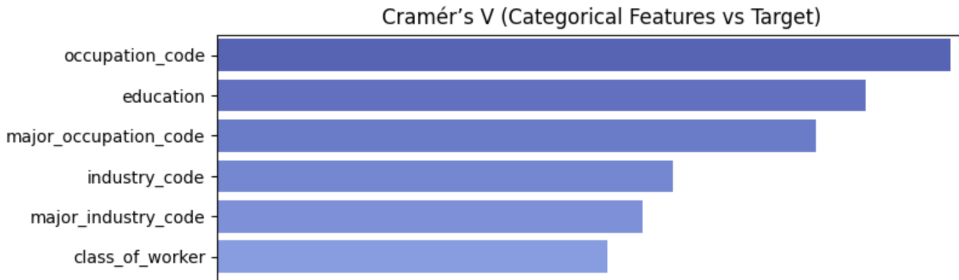
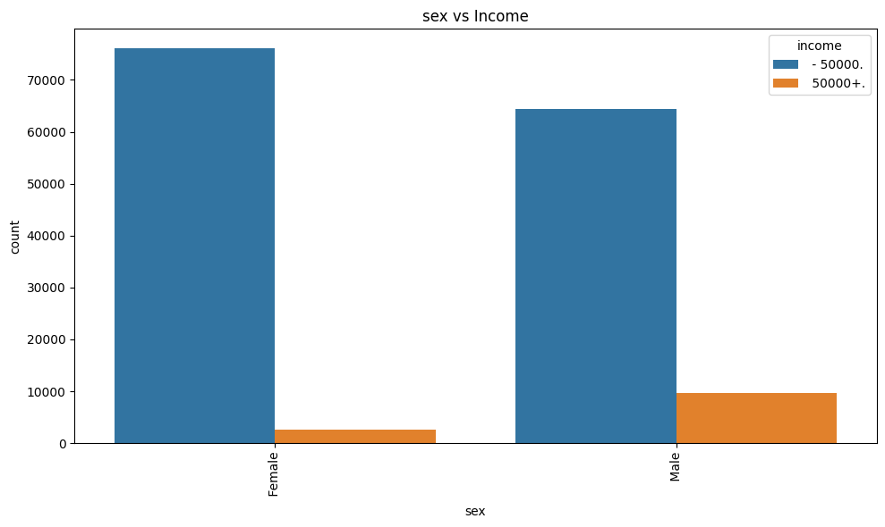
Feature Insights & Fairness Considerations
Some variables like education, occupation, and work class are strongly related to income.
It was observed that gender and race correlate with income. Males and certain racial groups are more likely to earn >50K.
Other numeric features show weak relationships individually, which means they work better in combination rather than alone.
To prioritize ethical responsibility without compromising performance, I implemented a fairness-aware model using Fairlearn. It is selected only if its F1-score is within 5% of the best-performing model, ensuring a strong balance between accuracy and fairness.
Some features, like job or country codes, have many unique values. We used compact encoding strategies to keep the model efficient.

Slide 5
Data Preparation Pipeline
Data cleaning
Cleaned the data by removing duplicate records and unnecessary columns (like instance_weight, as it was labelled as “to_ignore)
Target encoding
Mapped the income target into binary values (0 = low income, 1 = high income) to prepare for classification modelling
Variable encoding
Handled numeric and categorical variables separately using best-practice transformations:
Scaled numeric features to standardize values
Used One-Hot Encoding for simple categories (like gender, education)
Applied Frequency Encoding for complex, high-cardinality features
Exception: Some important high-cardinality features (like occupation_code) were still one-hot encoded to preserve interpretability and impact

Slide 6
Modelling Approach
Final model selection balances accuracy and fairness: fairness-aware model is chosen only if its performance is close to the best model.
5
4
Added a fairness-aware model using Fairlearn to reduce potential bias across gender and race
Tested multiple algorithms including Logistic Regression, Random Forest, and XGBoost to find the most accurate model.
1
Handled class imbalance using SMOTE (synthetic oversampling), which improves predictions for underrepresented groups (those earning >50K).
3
Used cross-validation and hyperparameter tuning to optimize each model for best F1-score — ensuring robust and generalizable results.
2

Slide 7
Model Assessment & Reporting
Evaluated model accuracy using F1-score, Precision, and Recall to understand both correctness and balance of predictions.
01
Generated a confusion matrix to visually show how well the model distinguishes between income levels.
02
Saved a final report summarizing model performance and classifier type — supports model documentation and audits.
03
Exported the trained model and key performance visualizations (confusion matrix, feature importance) for future validation or deployment.
04
Includes structured configuration files (constants.py, settings.py, README.md, requirements.txt) to ensure the solution is reproducible, transparent, and ready for handoff to decision-makers or engineering teams.
Automated the entire data science pipeline, from data preparation to model training, evaluation, and reporting — ensuring a seamless, reproducible, and production-ready process.
05
06

Slide 8
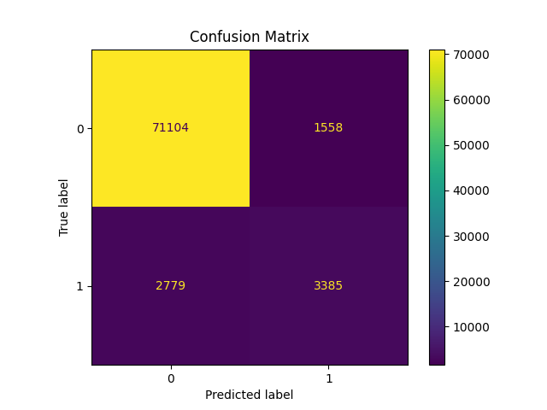
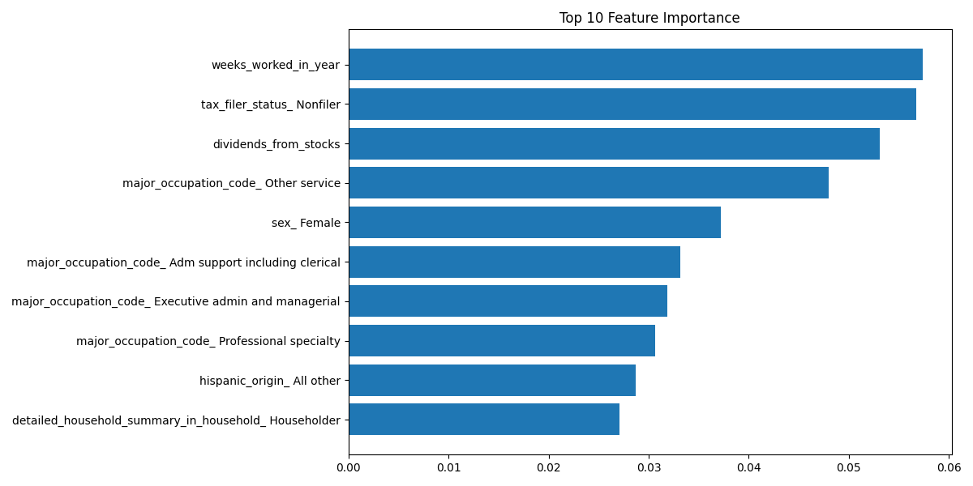
Model Result
Model Chosen: XGBoost — a powerful and widely used algorithm for classification tasks.
F1-Score (0.61): Balances both correctness and completeness — meaning the model is effective at identifying high earners without over-predicting them.
Precision (0.68): When the model predicts someone earns more than 50K, it’s correct about 68% of the time.
Recall (0.55): The model successfully identifies 55% of the actual high-income individuals.

Slide 9
Future Considerations for Model Improvement
Feature Engineering: Create new variables or transformations (e.g., log-transform skewed income fields, group rare categories) to enhance predictive power.
Feature Selection: Apply statistical or model-based selection to reduce noise and improve interpretability.
Outlier Handling for Logistic Regression: Address extreme values in numeric features that could disproportionately affect linear models.
Model Monitoring: Set up processes for performance drift detection and fairness re-evaluation post-deployment.
Add unit tests to validate critical parts of the data pipeline and catch errors early in development.

Slide 10
Thank You!
Any Questions?

