Slide 1




Department of Computer and Communication Engineering (CCE)
Course Title : Python Programming Sessional
Course Code : CCE-2406
Project Name:
CLASSMATE
Student Class Schedule Manager
1

Slide 2
TEAM MEMBERS
  Mikdad Mohammad
Id: E241006
  Mohammad Tasnimul Hasan Mahir
Id: E241001
  Golam Mostafa Naim
Id: E241034
2

Slide 3
INTRODUCTION
ClassMate is a console-based student class schedule management system developed using Python.
The application is designed to help students organize and manage their daily academic routines in a simple and efficient way.
It provides essential features such as adding new classes, viewing today’s and tomorrow’s schedules, and deleting existing class entries
The project follows a modular programming approach and uses file handling techniques with JSON to ensure persistent data storage.
ClassMate was developed as part of the Python Programming final examination, with the objective of applying core Python concepts to solve a real-world student problem
3

Slide 4
PROBLEM STATEMENT
  Students often forget daily class schedules
  Manual routine management is inefficient
  No simple offline tool for managing class routines
  Need for a lightweight and easy-to-use solution
4

Slide 5
OBJECTIVE
  Develop a console-based class schedule manager
  Apply core Python programming concepts
  Practice file handling and modular programming
  Provide an easy routine management system for students
5

Slide 6
KEY FEATURES
  Add new class to schedule
  View today’s classes
  View tomorrow’s classes
  Delete a class from schedule
  Automatic data saving
  Simple text-based menu system
6

Slide 7
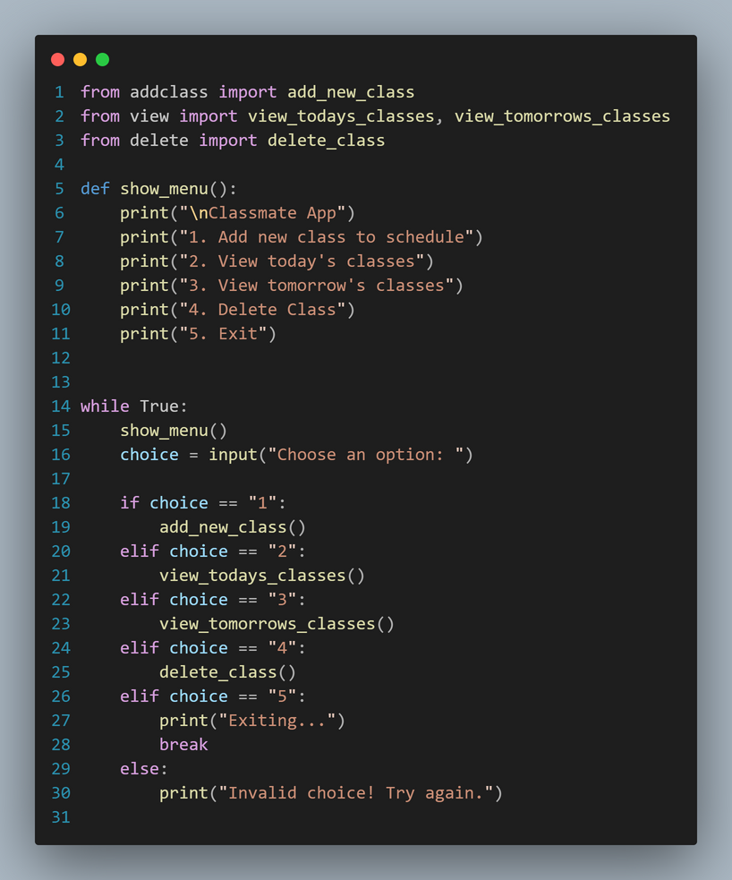
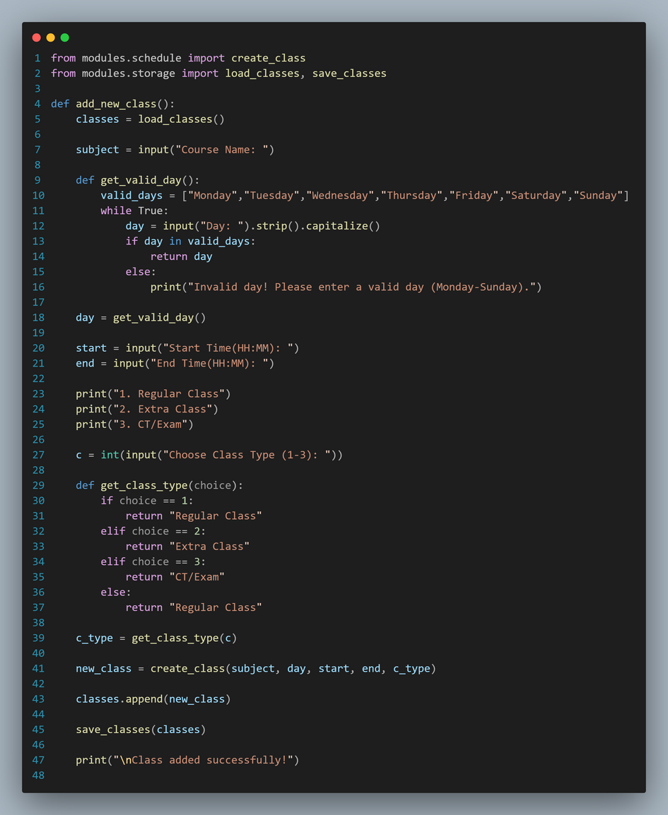
PROJECT STRUCTURE
main.py
addclass.py
7

Slide 8
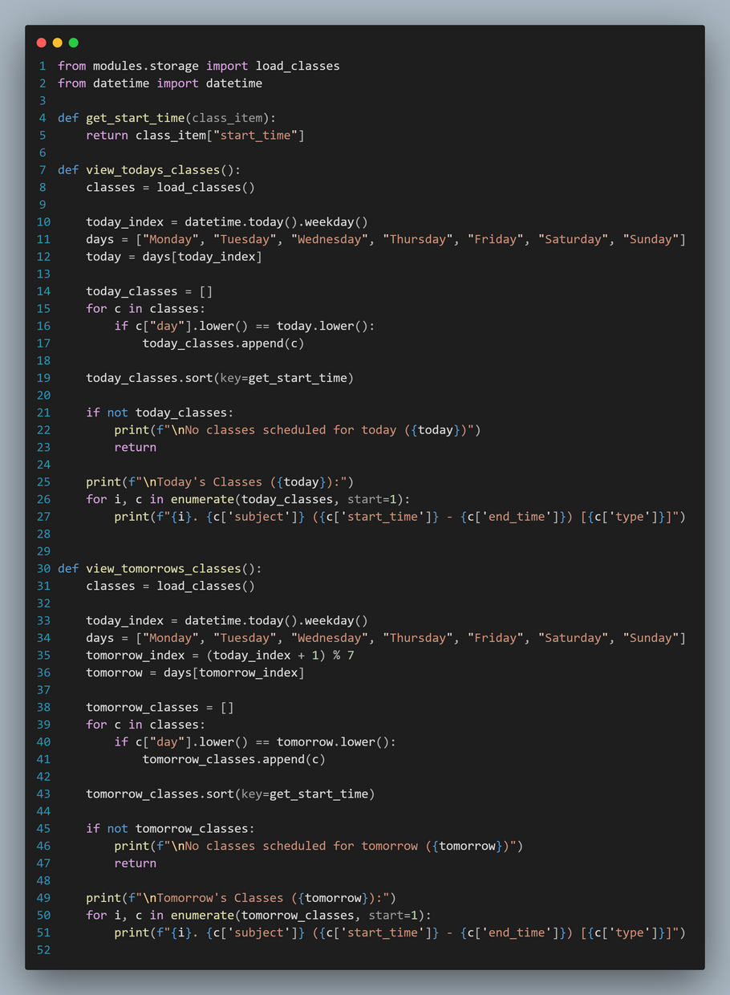
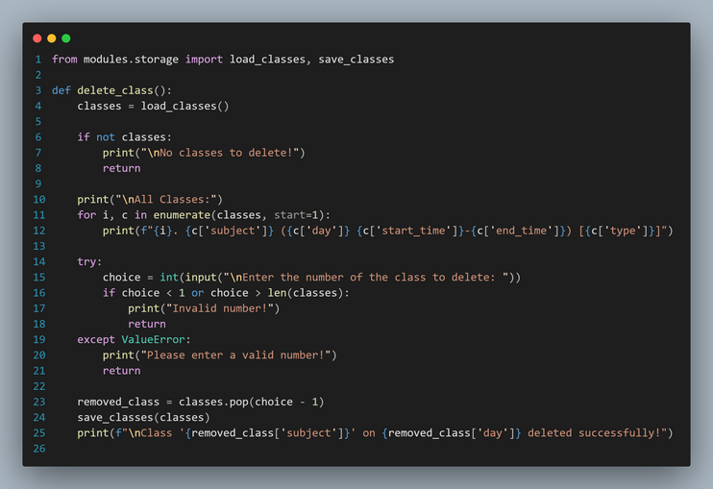
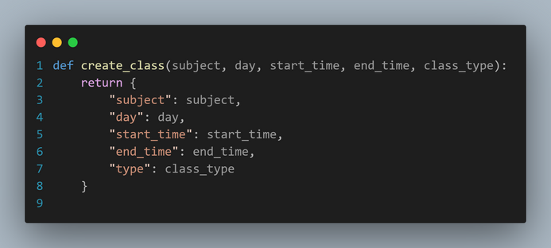
PROJECT STRUCTURE
view.py
delete.py
schedule.py
8

Slide 9
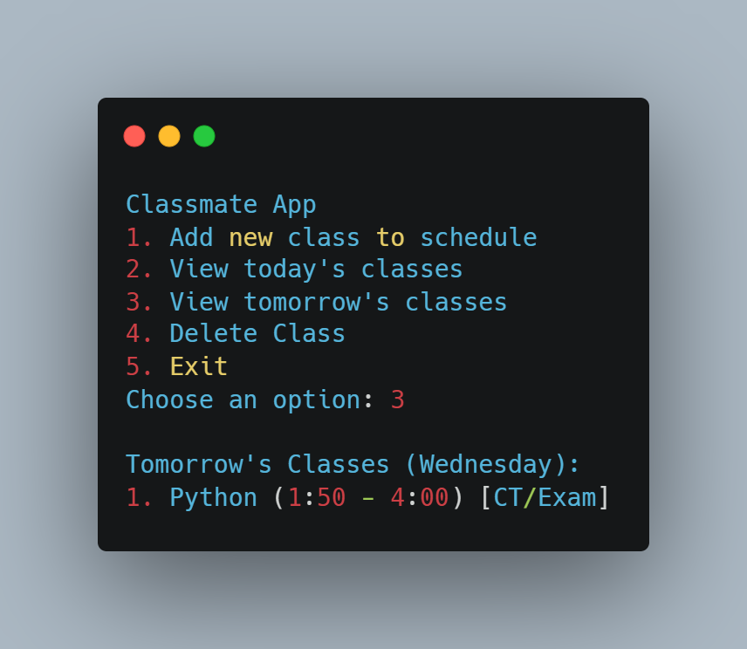
RESULT
9

Slide 10
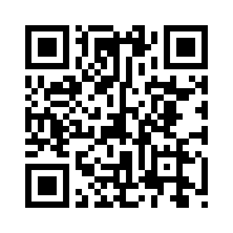

GITHUB REPOSITORY & CODESPACES
  Project source code is hosted on GitHub
  GitHub Codespaces is used as a cloud development environment
  Allows running and testing the project directly from the browser
  No local Python setup required
  Helps in easy testing and collaboration
  Public repository with full documentation
  Includes README and modular code structure
Scan to view project source code
https://github.com/Mikdad-12/Classmate
10

Slide 11
FUTURE IMPROVEMENTS
  Convert to GUI application
  Web-based version using Flask
  Android APK version
  Add notification/reminder system
  Multi-user support
11

Slide 12
CONCLUSION
ClassMate is a simple and effective Python-based console application designed to help students manage their daily class schedules efficiently.
Through this project, we successfully implemented core Python concepts such as modular programming, file handling and menu-driven logic using real-world requirements.
The application provides essential features like adding, viewing and deleting class schedules while ensuring persistent data storage using JSON.
This project fulfilled the objectives of the Python Programming course and enhanced our understanding of practical software development.
In the future, the project can be further improved by converting it into a GUI application, developing a web-based version using Flask, creating an Android APK, adding a notification or reminder system, and supporting multiple users to make it more scalable and user-friendly.
12

Slide 13
THANK YOU
For your attention
13

