Slide 1
Building-Age Transfer: Madrid → Amsterdam
Landsat spectral features · XGBoost Stage 1 → boosting-continuation Stage 2 · Team: [team name]
Abstract
Building-age classification from Landsat pixels transfers poorly between cities: a model trained on Madrid scores 0.506 macro-F1 on Amsterdam without local labels. We train an XGBoost classifier on Madrid using 60 preprocessed spectral and temporal features plus 19 engineered band ratios, differences and urban-index contrasts (macro-F1 0.639 ± 0.005, 5-fold CV). To adapt, we keep the Madrid booster and continue boosting for 50 trees on only n labelled Amsterdam pixels per class. For n = 5, 25, 50, 100 and 200, Amsterdam macro-F1 rises from 0.585 to 0.685 (25 per class: 0.647), 0.08 to 0.18 above zero-shot, with about one second of adaptation. At 25 pixels per class, continuation beat retraining XGBoost or HistGradientBoosting on pooled Madrid and Amsterdam data (0.65 vs 0.55 and 0.56).

Slide 2
Key design decisions
Stage 1 · Madrid
Stage 2 · Adapt
Evaluation
60 preprocessed features + 19 engineered (ratios, differences, urban-index contrasts)
Median imputation fitted on Madrid only
XGBoost: 300 trees, depth 8, lr 0.04
5-fold CV on 76,263 pixels
Keep the Madrid booster
Continue boosting: +50 trees on n labelled Amsterdam pixels per class
Balanced support set, seeded
Adaptation takes about 1 second
n = 5, 25, 50, 100, 200 pixels per class
Scored on all remaining Amsterdam pixels (about 26,000)
Mean ± std over random support draws
Zero-shot baseline for reference

Slide 3
Why XGBoost over the other models
Can resume boosting from the trained Madrid model, so a few Amsterdam labels refine it instead of being drowned by 76,000 Madrid pixels
Best Madrid CV: 0.639 vs 0.628 for Random Forest (and 0.615 for Extra Trees on a single validation split)
Handles correlated spectral features with no scaling; fast (about 1 s to adapt)
Retraining on pooled Madrid + Amsterdam data was clearly worse for both XGBoost and HistGradientBoosting

Slide 4
Results: Madrid and Amsterdam macro-F1
Model | Labelled pixels / class | Macro F1 (mean ± std)
Madrid (Stage 1, 5-fold CV) | – | 0.639 ± 0.005
Amsterdam zero-shot | 0 | 0.506
Amsterdam (Stage 2) | 5 | 0.585 ± 0.018
Amsterdam (Stage 2) | 25 | 0.647 ± 0.006
Amsterdam (Stage 2) | 50 | 0.652 ± 0.002
Amsterdam (Stage 2) | 100 | 0.673 ± 0.006
Amsterdam (Stage 2) | 200 | 0.685 ± 0.002
Average Amsterdam Macro F1: 0.6389 · Peak: 0.6881 (200/class) · 25-shot: 0.647
Std over 3 random support draws (2 at n = 200). To be refreshed with a 10-draw rerun.

Slide 5
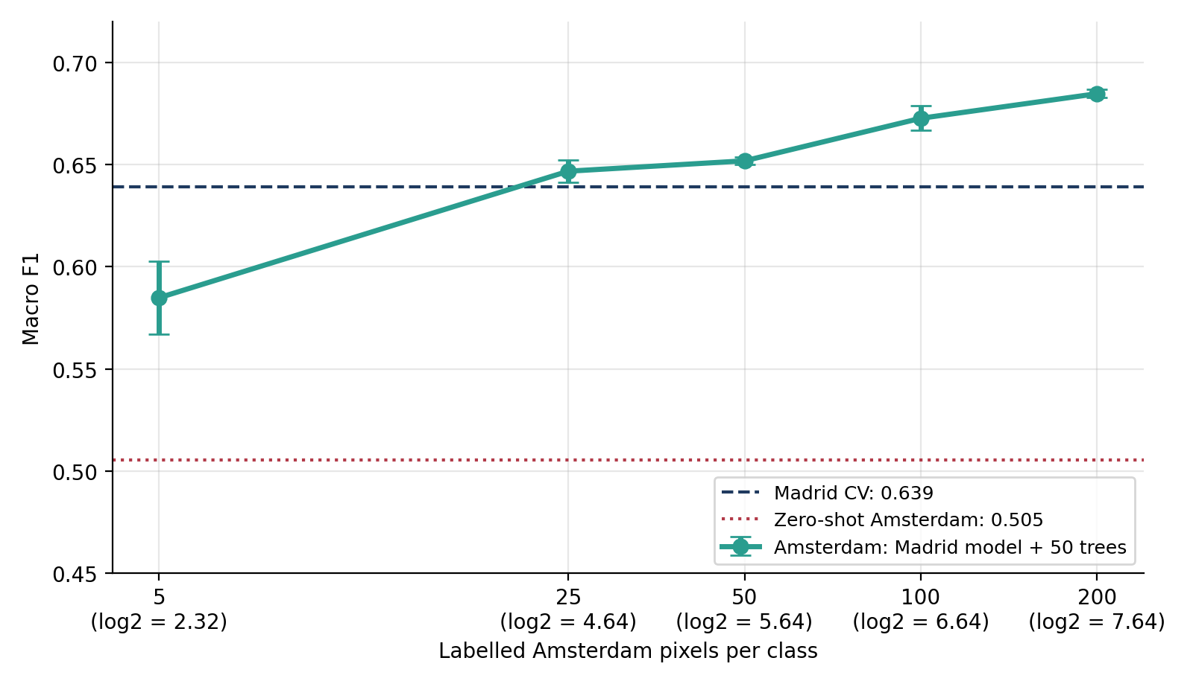
F1 vs log2(sample size), with error bars(Show more examples for better scores)

Slide 6
What worked and what did not
Worked
Did not work / limits
Boosting continuation from the Madrid model: +0.08 to +0.18 F1 over zero-shot, in about 1 second ( new trees were added on top of madrid model.
Engineered ratios, differences and urban-index contrasts: 3 of the top 5 features(The new features added worked)
Median imputation fitted on Madrid only, so no Amsterdam leakage(Amsterdam info wasn’t leaked during training the model.)
Most of the gain arrives by 25 labels per class(where most improvement was made after that gain small)
Zero-shot transfer: F1 0.506, recall only 0.18 for the 1984-2004 class
Retraining on pooled data: 0.55-0.56 at 25 per class
More than about 50 Stage 2 trees: slightly worse at 25 per class
Class 2 (1945-1984) stays weakest; random pixel splits leak spatially, so scores are optimistic

