Slide 1
COMP 558 Lecture 3 RGB Thurs. Sept. 6, 2018

Slide 2
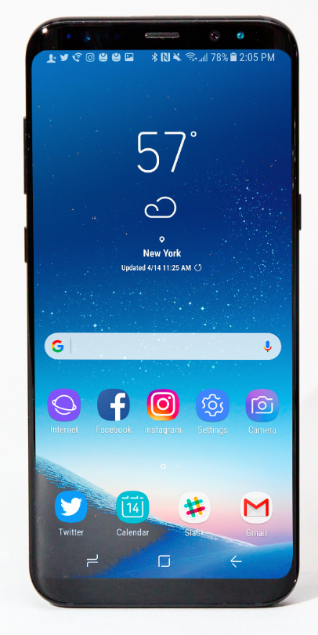
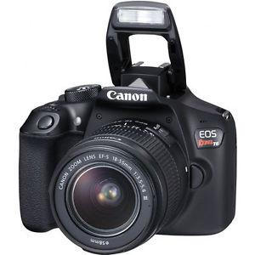
Cameras
Digital SLR (annual sales ~ 10 million units per year)
Smart phone (annual sales: over 1 billion units per year)

Slide 3
Image size
1 megapixel (one million pixels)
e.g. “720p” is 1 MP (1280 x 720 pixels, ‘p’ for progressive)
“1080p” full high definition (HD) is 2 MP (~2K x 1K pixels)
“ultra HD” is 8 MP (about 4K x 2K)

Slide 4
Pinhole Camera Model
(X, Y, Z )
3D scene point
position
(x, y)
2D image
pixel position
Here we ignore that cameras have lenses.

Slide 5
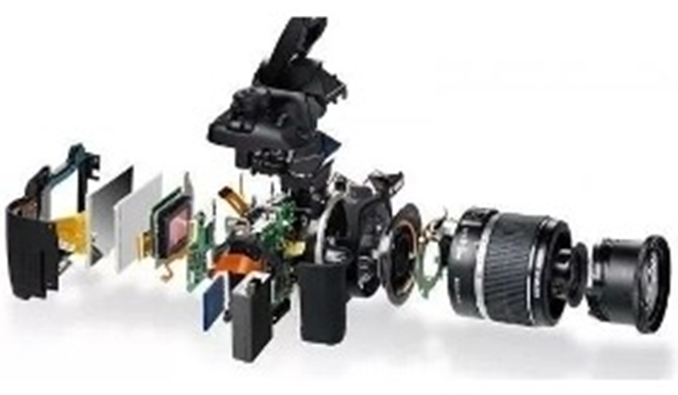
Real Digital Camera (!)

Slide 6
What is a digital image ?
Typically, 3 x 8 bits per pixel (RGB).
i.e. 3 values from 0 to 255
R channel
G channel
B channel

Slide 7
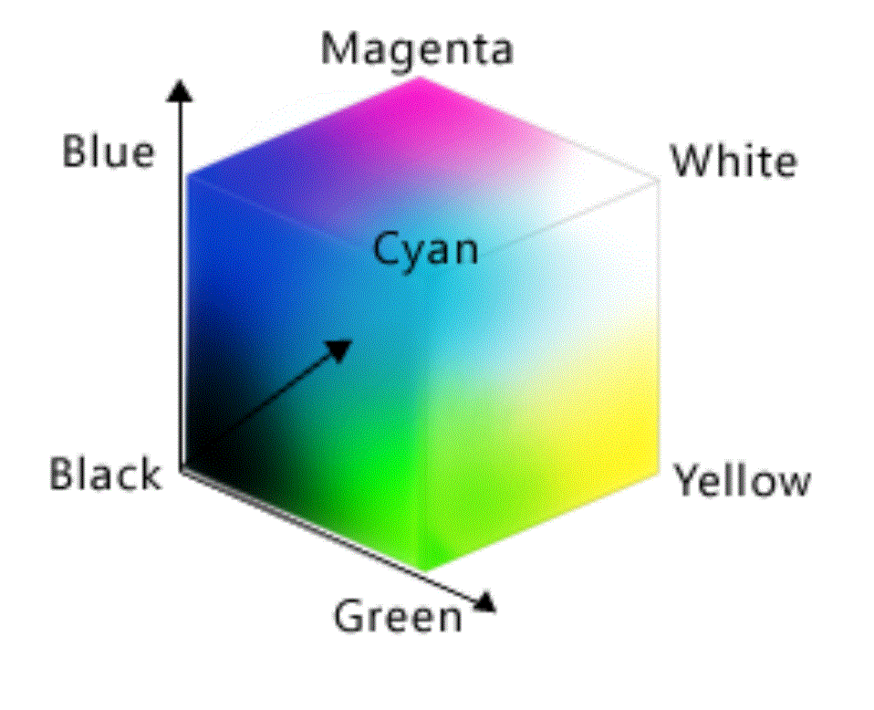
RGB values: 0 to 255 (8 bits)
(255, 0, 255)
(0, 0, 255)
(255, 255, 255)
(0, 255, 255)
Red
(255, 0, 0)
(255, 255, 0)
(0, 0, 0)
(0, 255, 0)

Slide 8
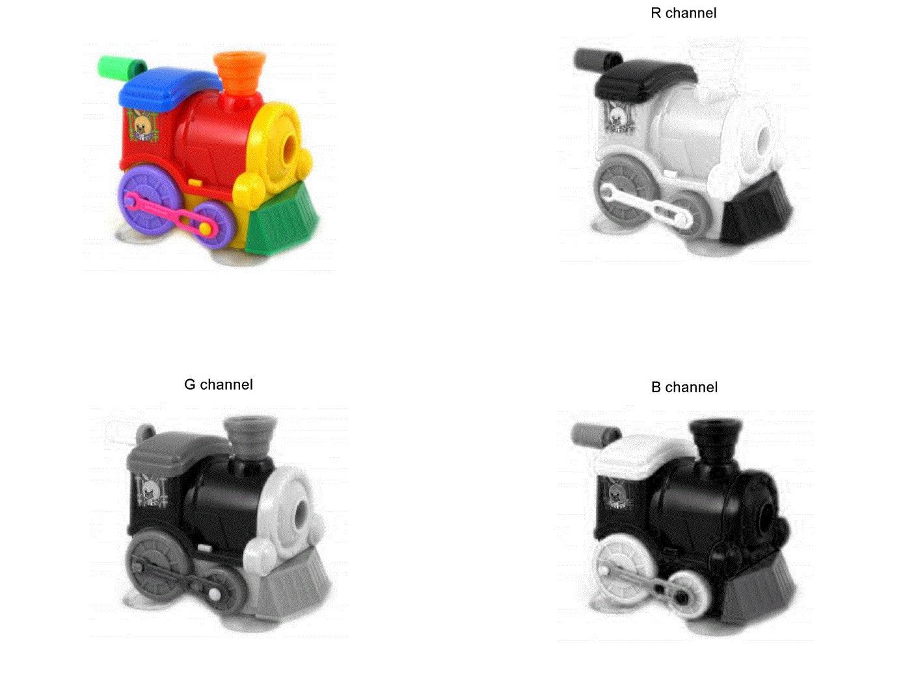
R channel
G channel
B channel

Slide 9
Why RGB ?

Slide 10
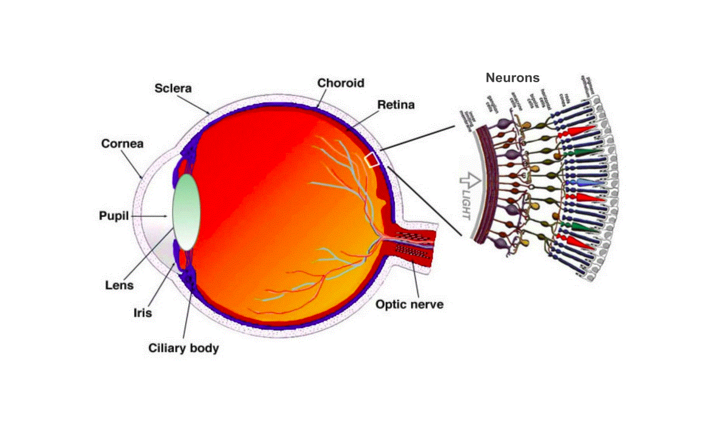
Why RGB ?
Human vision is trichromatic (Thomas Young ~1800)
The human eye has three types of color photoreceptors, called cones.
Cameras sensors are designed to mimic the spectral response of cones.

Slide 11
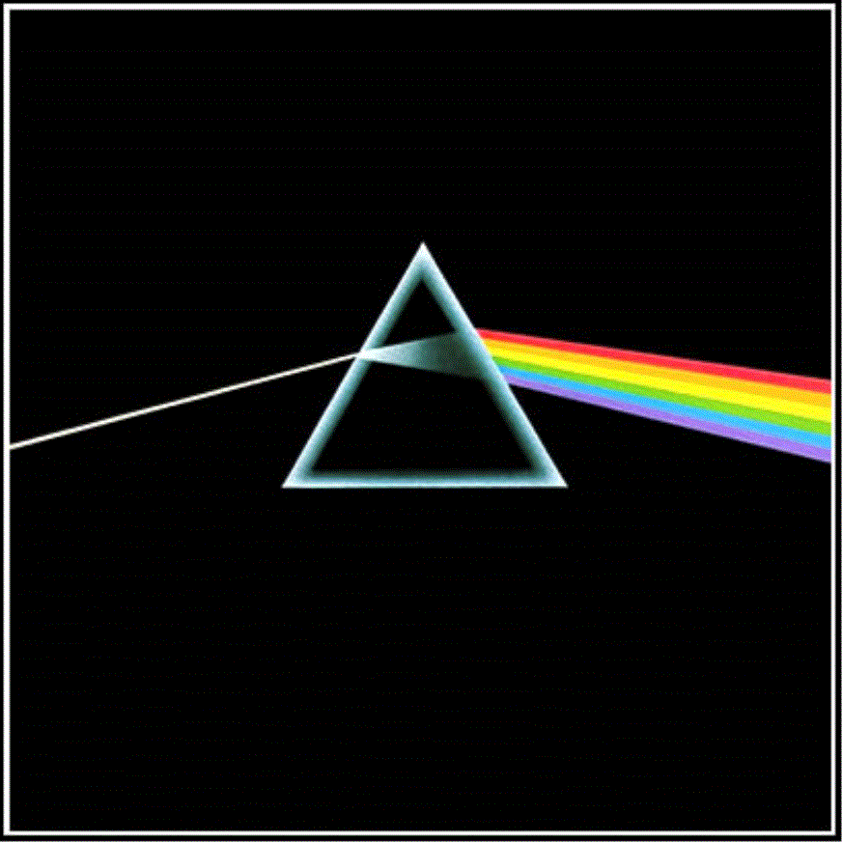
Isaac Newton’s discovery of color spectra (1666)

Slide 12
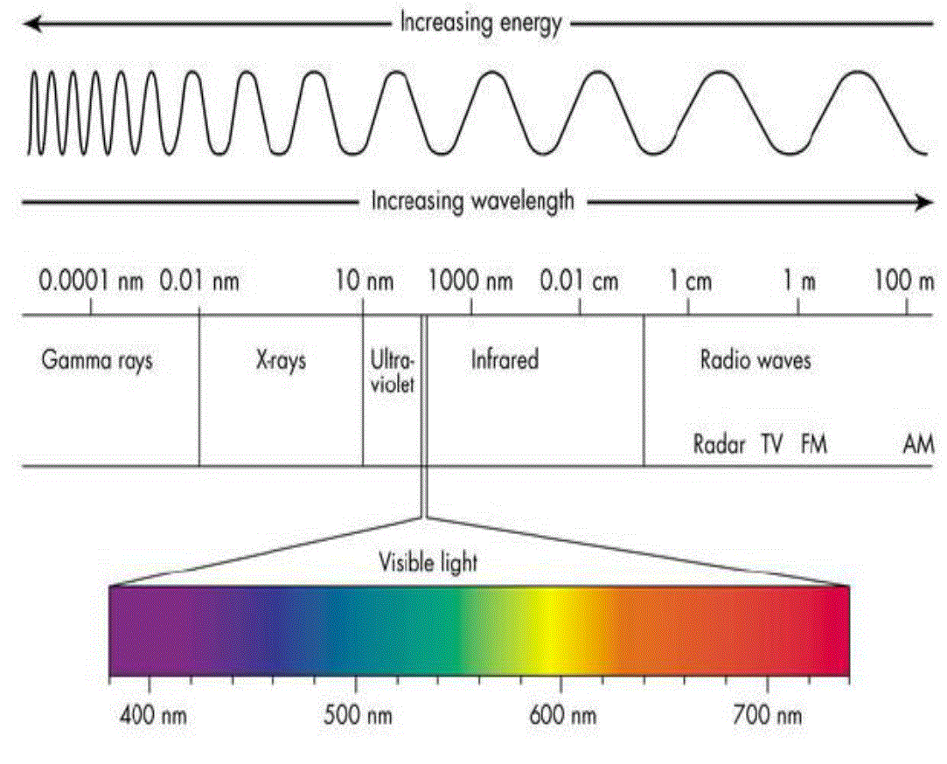
Light consists of electromagnetic waves from 400-700 nm.

Slide 13
Light Spectrum
intensity
λ
400 nm 700 nm

Slide 14
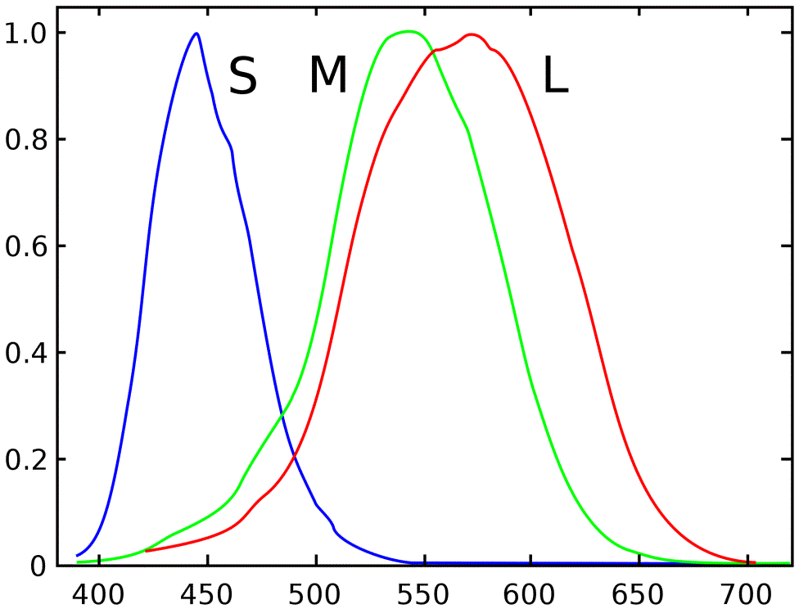
Spectral sensitivity of three types of cones in eye (RGB sensors mimic this – next slide)
R - long
G - medium
B - short
Fraction of light of wavelength λ absorbed.
(Curves are normalized to 1 for illustration purposes,.)

Slide 15
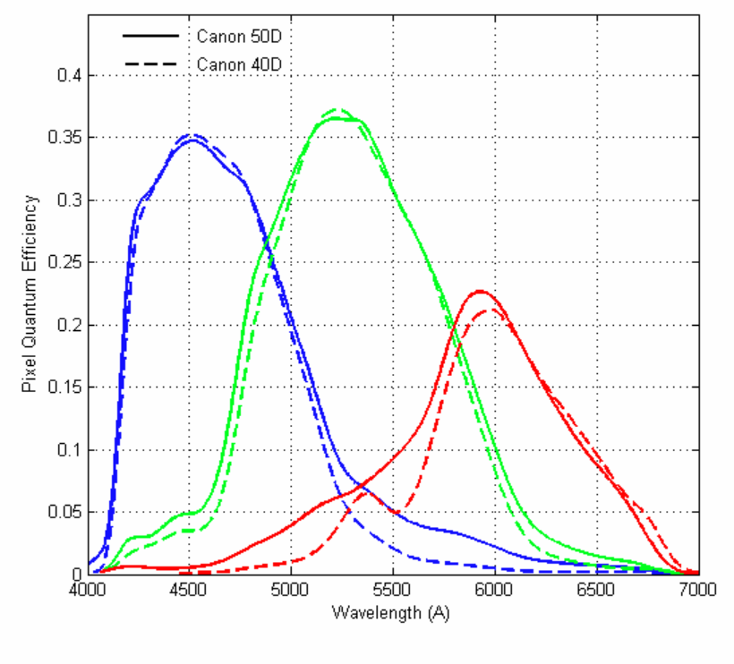
Example: RGB spectral sensitivity for Canon camera These curves will differ between cameras. Yes, this is an issue.
http://astrosurf.com/buil/50d/test.htm
http://www.gujinwei.org/research/camspec/db.html

Slide 16
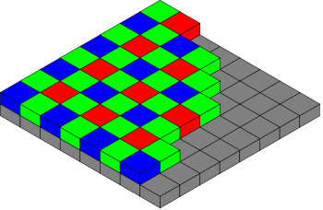
Bayer Pattern
“Color blind” sensors
(CCD vs. CMOS technology: details omitted)
Color filter array (CFA)
There are twice as many green subpixels as red & blue. The RGBG quadruples per pixel are spatially displaced.

Slide 17
Where do RGB values come from ?
For digital images, the RGB values represent measurements of light intensity.

Slide 18

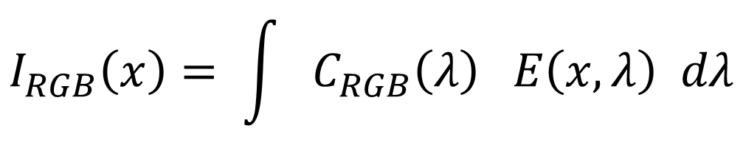

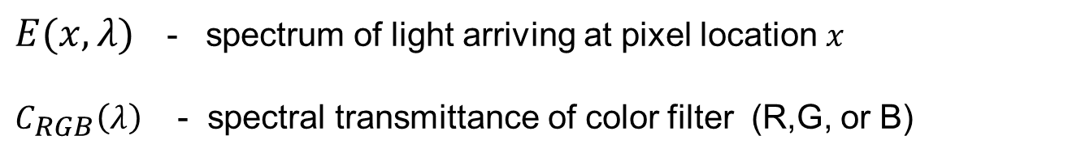




Linear Model
$E(x,λ)$ - spectrum of light arriving at pixel location $x$
$C_{RGB}\left(λ\right)$ - spectral transmittance of color filter (R,G, or B)
$$I_{RGB}\left(x\right)= \int{ C_{RGB}\left(λ\right) E\left(x,λ\right) dλ}$$
$$C_{R}\left(λ\right)$$
$$C_{G}\left(λ\right)$$
$$C_{B}\left(λ\right)$$
$$λ$$
$$λ$$
$$λ$$

Slide 19



3 x 1 3 x N N x 1
=
$$I_{RGB}\left(x\right)$$
$$C_{RGB}\left(λ\right)$$
The linear model describes how much light reaches a R,G, or B pixel.
$$E\left(x,λ\right)$$

Slide 20
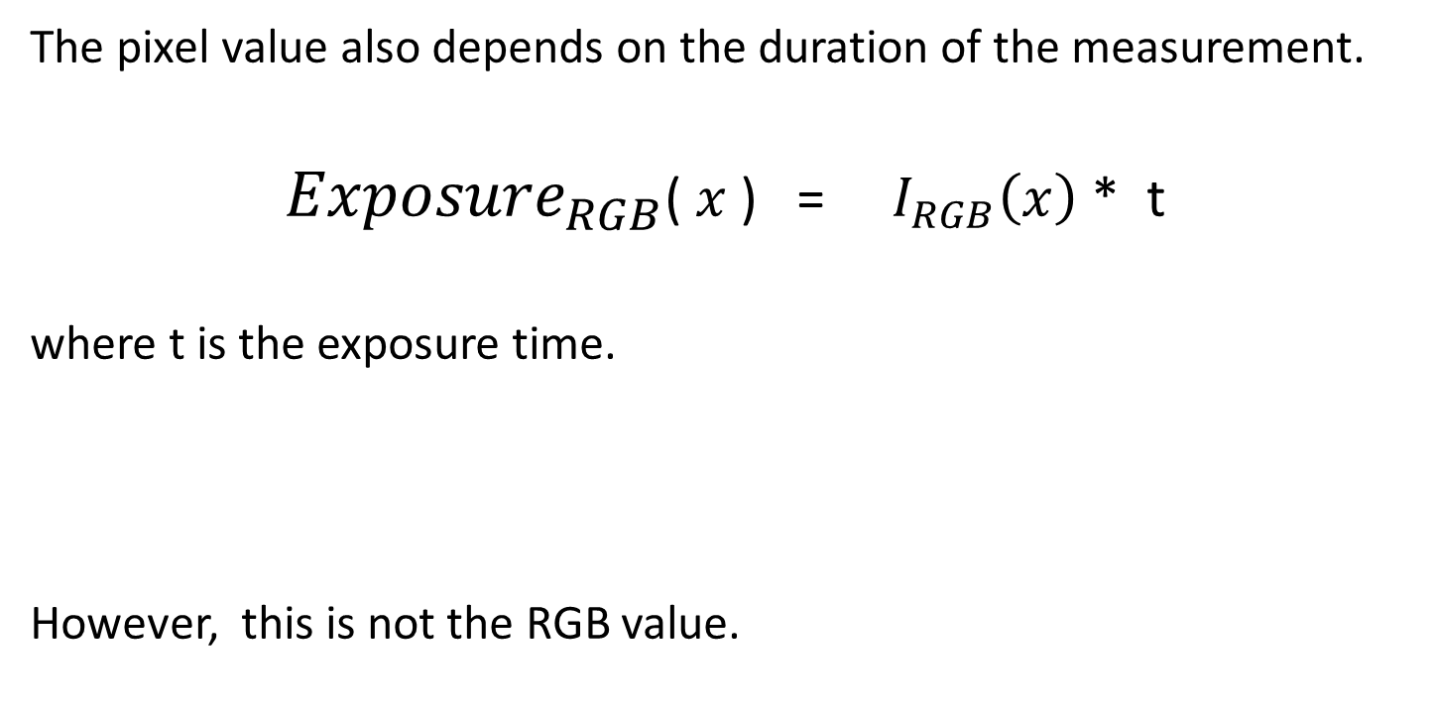
Exposure
The pixel value also depends on the duration of the measurement.
${Exposure}_{RGB}$($x$) = $I_{RGB}\left(x\right)$ * t
where t is the exposure time.
However, this is not the RGB value.

Slide 21






Analog-to-Digital conversion
The sensor measures the exposure signal at each R,G,B pixel.
(Mechanism: Photon is absorbed, releasing an electron )
This signal is then digitized : quantized and then coded in binary.
(Sometimes more than 8 bits per value at this stage.)
$${digitized}_{R}\left(x\right)$$
$${digitized}_{G}\left(x\right)$$
$${digitized}_{B}\left(x\right)$$
$${Exposure}_{R}\left(x\right)$$
$${Exposure}_{G}\left(x\right)$$
$${Exposure}_{B}\left(x\right)$$

Slide 22
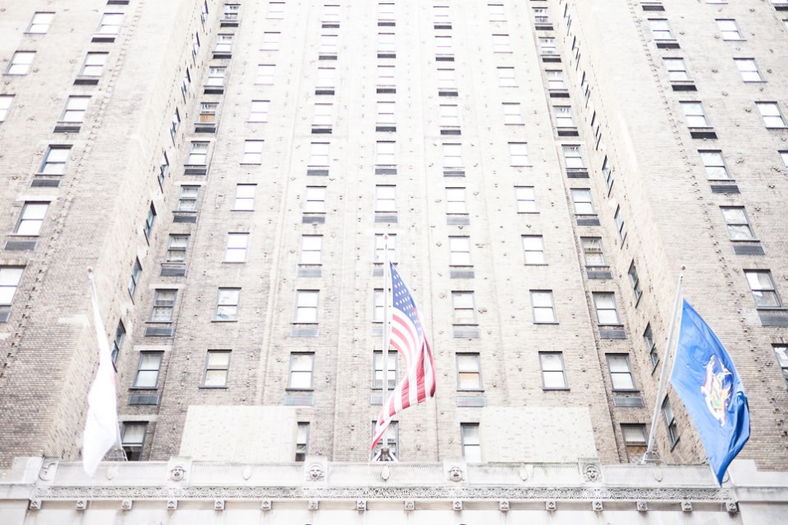
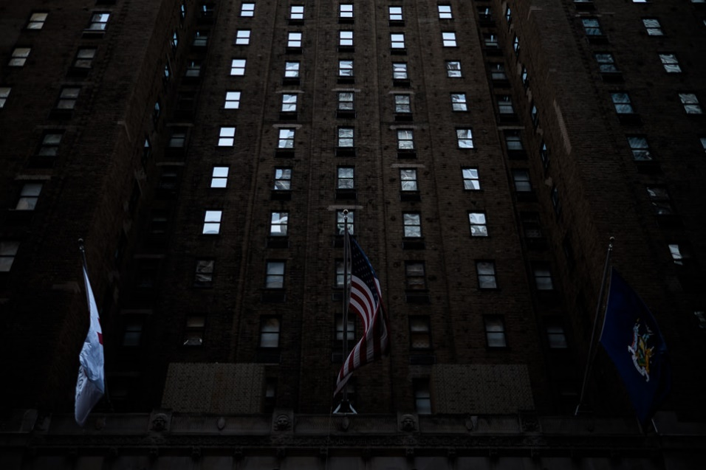
Overexposed versus Underexposed images
https://photographylife.com/underexposure-and-overexposure-in-photography

Slide 23
Analog-to-Digital conversion
The sensor measures the exposure signal at each R,G,B pixel.
This signal must be digitized : quantized and then coded in binary.
To have proper exposure, before digitization, some cameras perform:
“gain control” – adjust overall sensitivity of responses
(this happens in photoreceptors of our eyes too)
“white balance” - adjust relative sensitivity of R,G,B
(e.g. if light source has dominant color)

Slide 24






Gain control and white balancing
$${digitized}_{R}\left(x\right)$$
$${digitized}_{B}\left(x\right)$$
$${Exposure}_{R}\left(x\right)$$
$${Exposure}_{B}\left(x\right)$$
$${digitized}_{G}\left(x\right)$$
$${Exposure}_{G}\left(x\right)$$

Slide 25
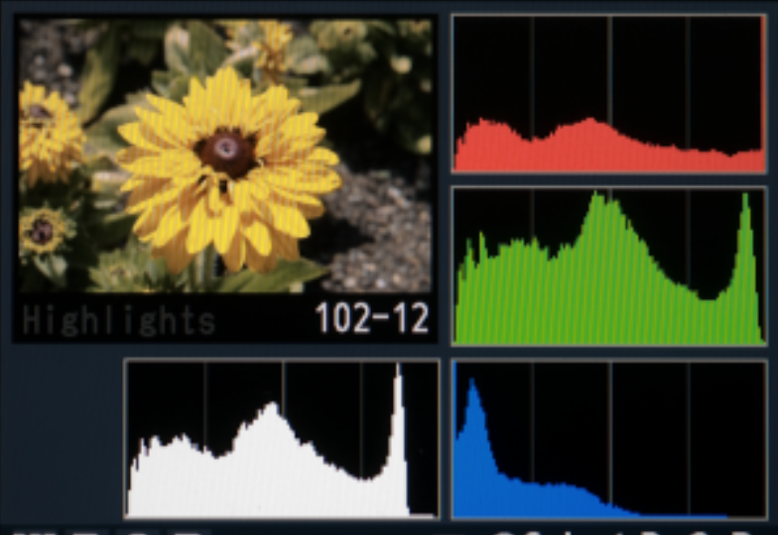
RGB Histograms
“luminance” = .3 * R + .6 * G + .1 * B

Slide 26
RAW image format
Some cameras allow you to save the captured digital values
(rather than coding using JPEG – see later).
The file format is called RAW. The details of the file format are not standard. Rather, they depend on the camera and they are proprietary.
https://en.wikipedia.org/wiki/Raw_image_format
Adobe Lightroom and Photoshop are an example of software that allows you read and manipulate RAW images, and save them in other formats such as JPG.

Slide 27
ENCODER:
Camera (+ hardware/software)
converts to a standard format
RAW
image file
(12 bits per RGB value)
JPEG, TIFF, ….
image file

Slide 28
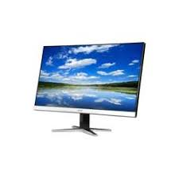
ENCODER:
Camera (+ hardware/software)
converts to a standard format
RAW
image file
(12 bits per RGB value)
JPEG, TIFF, ….
(compressed image file)
Some formats are lossless.
Some are lossy.
Details omitted.
DECODER:
hardware/software
converts from a standard format to 8 bits per RGB
(sent to display)

Slide 29
?
ENCODER:
Camera (+ hardware/software)
converts to a standard format
RAW
image file
(12 bits per RGB value)
JPEG, TIFF, ….
image file

Slide 30
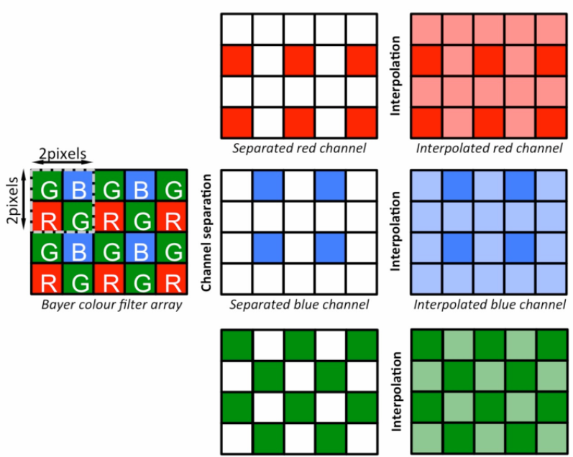
Demosaicing
(12 bits per RGB value)
Camera makers have invented lots of ways to demosaic in a smarter way than just interpolating values.

Slide 31
Then what happens ?
How are the digitized (demosaiced) RGB values at each image position transformed?

Slide 32
Recall the RGB spectral sensitivity depends on the camera.
This is a problem because the captured images will be displayed on devices that don’t know about that cameras.
Solution ?

Slide 33
Color spaces
Recall the RGB spectral sensitivity depends on the camera.
This is a problem because the captured images will be displayed on devices that don’t know about that camera.
Solution:
Transform to a standardized color space e.g.
RGB (camera specific) ⇒ “CIE XYZ” (1931)
This transformation is a 3x3 matrix multiplication, which is camera dependent.

Slide 34
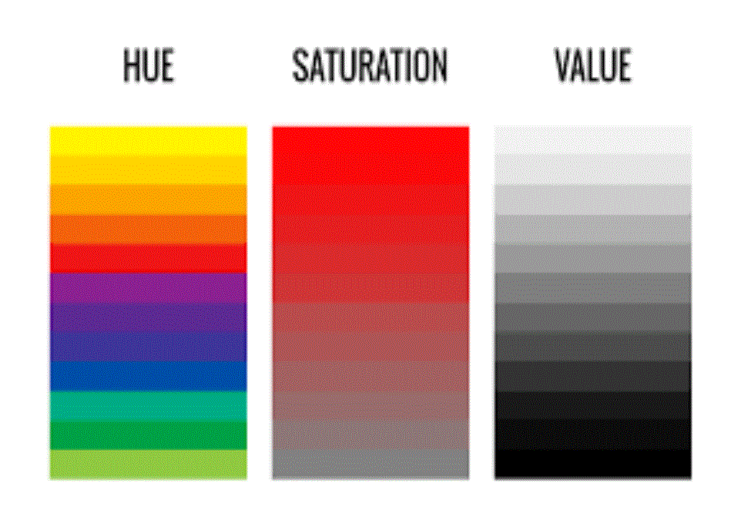
Often transforms color again to separately encode different aspects of color.
(for HSV
color space)
color name purity intensity

Slide 35
These three “perceptual dimensions” of color are non-linearly related to physical color. (Many details omitted !)
Color scientists have studied these non-linearities for decades, and we now have many powerful models and theories that are used in color industry (printing, displays, etc).
Here I give just a small taste….

Slide 36
based on
non-linearities in
human visual perception
CIE LUV
RGB ⇒ CIE XYZ ⇒ CIE LAB
3x3 matrix multiplication
HSV
… and many more

Slide 37
(for HSV
color space)
color name purity intensity

Slide 38
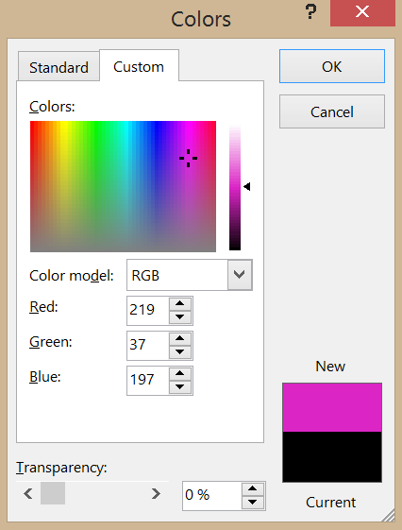
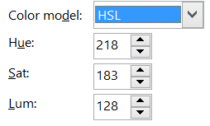
RGB vs. HSL (similar to HSV)

Slide 39
Example: Image compression standards (they encode HSV separately)
ENCODER:
(color transform,
compression)
RAW
image file
JPEG, TIFF, ….
image file
DECODER:
(uncompress)
Both be either lossless or lossy.

Slide 40
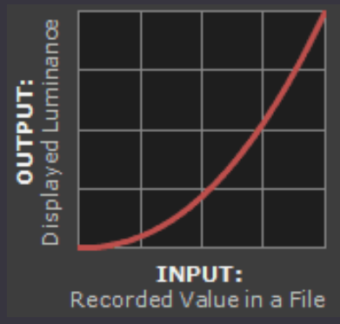

Non-linearities in the display
If you send an R, G, B value to a display, the intensity of light emitted is
$$I^{γ}$$
https://www.cambridgeincolour.com/tutorials/gamma-correction.htm

Slide 41
sRGB: image standard for internet
ENCODER:
Relatively simple non-linear transform for R,G, B values
at each pixel (inverse gamma)
RAW
image file
sRGB
DECODER
(optional – values can be sent directly to display device !)
Non-linear
(gamma)

Slide 42
Take home messages from today
RGB seems simple. But it’s not:
RGB digital images typically have been encoded with a non-linear transform.
When you manipulate RGB values in images, keep in back of your mind that they don’t represent what you think.

