Slide 1
COMP 546 Lecture 19 Sound 2: frequency analysis Tues. March 27, 2018

Slide 2
Speed of Sound
Sound travels at about 340 m/s, or 34 cm/ ms.
(This depends on temperature and other factors)

Slide 3
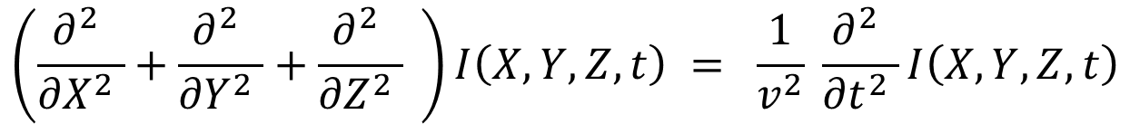
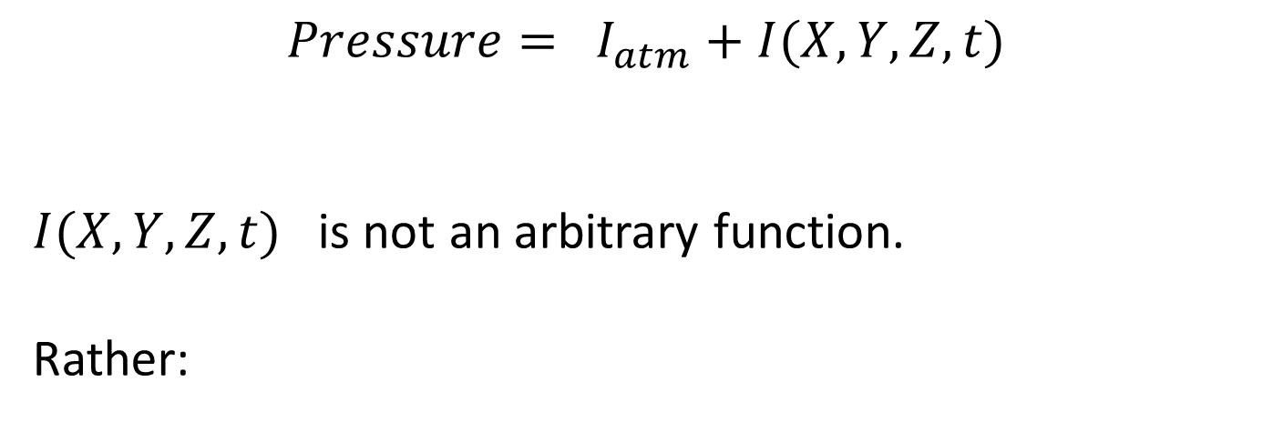
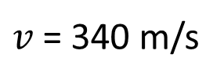
Wave equation
$$Pressure= I_{atm}+I(X,Y, Z, t)$$
$I(X,Y, Z, t)$ is not an arbitrary function.
Rather:
$$\left(\frac{∂^{2} }{{∂X}^{2} }+\frac{∂^{2} }{{∂Y}^{2} }+\frac{∂^{2} }{{∂Z}^{2} } \right)I\left(X,Y,Z,t\right) = \frac{1}{v^{2}} \frac{∂^{2} }{{∂t}^{2} }I\left(X,Y,Z,t\right)$$
$v$= 340 m/s

Slide 4

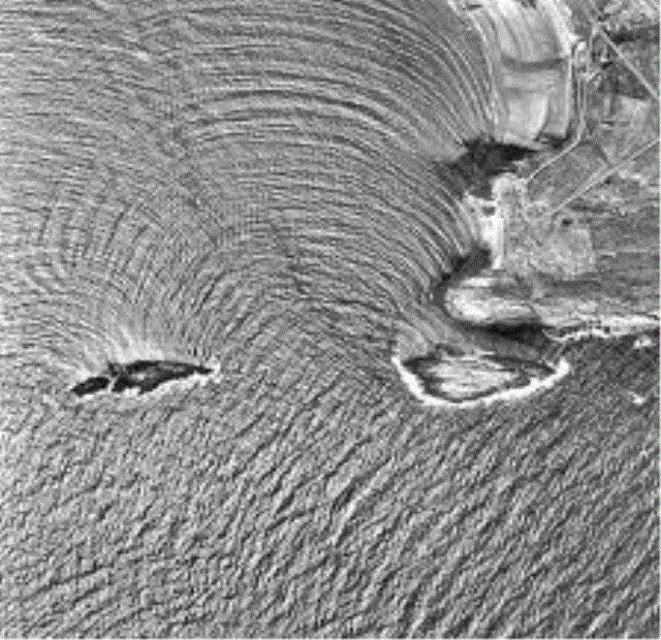
The wave equation + boundary conditions give complicated shadow and reflection effects. What happens when sound enters the ear ?
plane wave + single slit sea waves + islands

Slide 5
Musical sounds
(brief introduction)

Slide 6
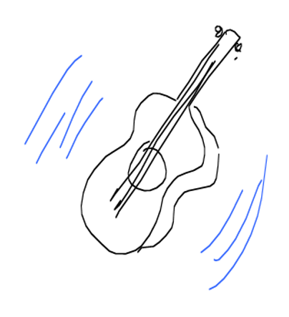
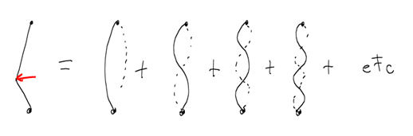
Example: guitar
Write one string displacement at t = 0 as sum of sines.
Modes are $sin⁡( \frac{π}{L} jx)$ where $L$ is the length of the string, $j$ is an integer.

Slide 7
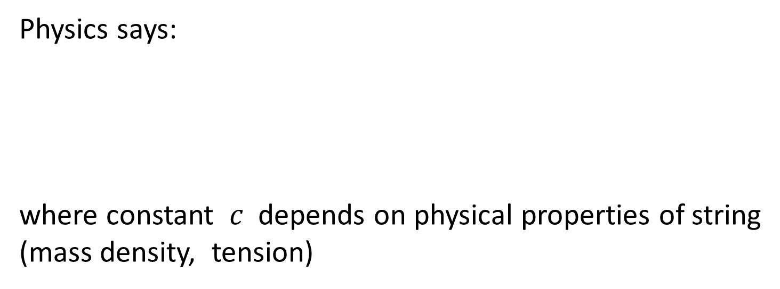


$$L$$
Physics says:
where constant $c$ depends on physical properties of string
(mass density, tension)
$$ω= \frac{c}{L}$$

Slide 8






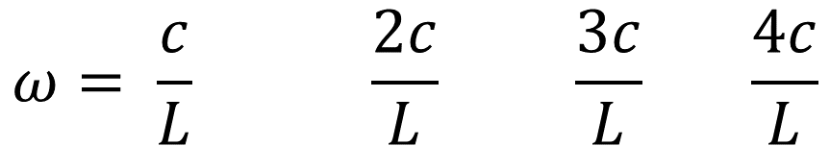


Modes of a vibrating string each have fixed points which reduce the effective length.
$$L$$
$$\frac{L}{2}$$
$$\frac{L}{3}$$
$$\frac{L}{4}$$
Physics says:
$$ω= \frac{c}{L} \frac{2c}{L} \frac{3c}{L} \frac{4c}{L}$$

Slide 9


$$ω= \frac{c}{L} \frac{2c}{L} \frac{3c}{L} \frac{4c}{L}$$
$$ω_{0}$$
“fundamental” “overtones”
(1st harmonic)
The temporal frequency $m ω_{0}$is called the $m$-th harmonic.

Slide 10
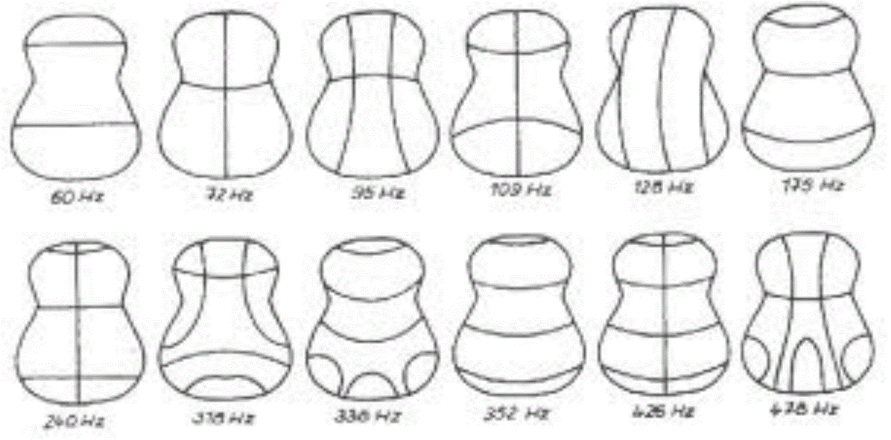
For stringed instruments, most of the sound is produced by vibrations of the instrument body (neck, front and back plates). http://www.acs.psu.edu/drussell/guitars/hummingbird.html
The lines in the sketches below are the nodal points. They don't move.
These are vibration modes, not harmonics. The guitar sound is a sum of these modes.

Slide 11
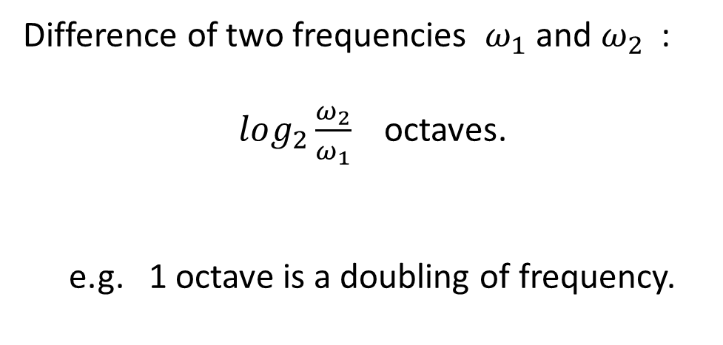
Difference of two frequencies $ω_{1}$and $ω_{2}$ :
$log_{2}\frac{ω_{2}}{ω_{1}}$ octaves.
e.g. 1 octave is a doubling of frequency.

Slide 12
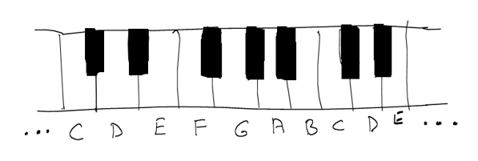
(Western) Musical Notes
Each “octave” ABCDEFGA is divided into 12 “semitones”, separated into 1/12 octave.
C-D, D-E, F-G, G-A, A-B are two semitones each
E-F, B-C are one semitone each.

Slide 13
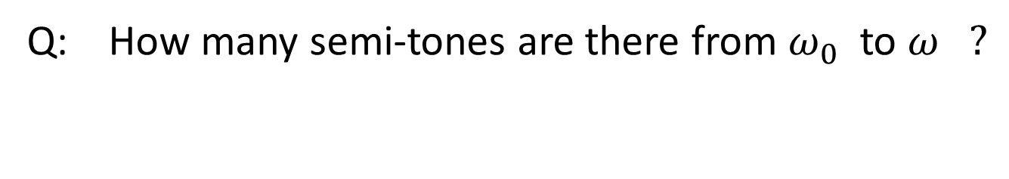
Q: How many semi-tones are there from $ω_{0}$ to $ω ?$

Slide 14
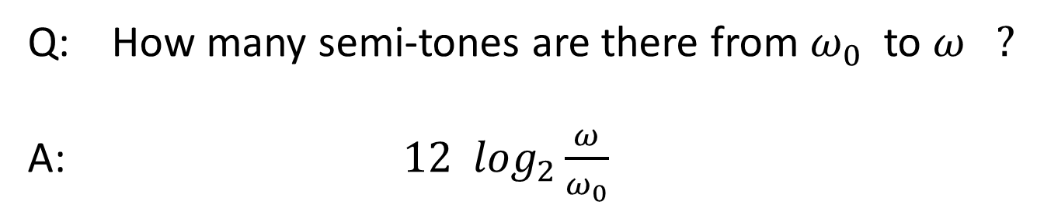


Q: How many semi-tones are there from $ω_{0}$ to $ω ?$
A: $12 \log_{2}\frac{ω}{ω_{0}}$
$$ω$$
$$ω_{0}$$
Fundamental frequency of note

Slide 15
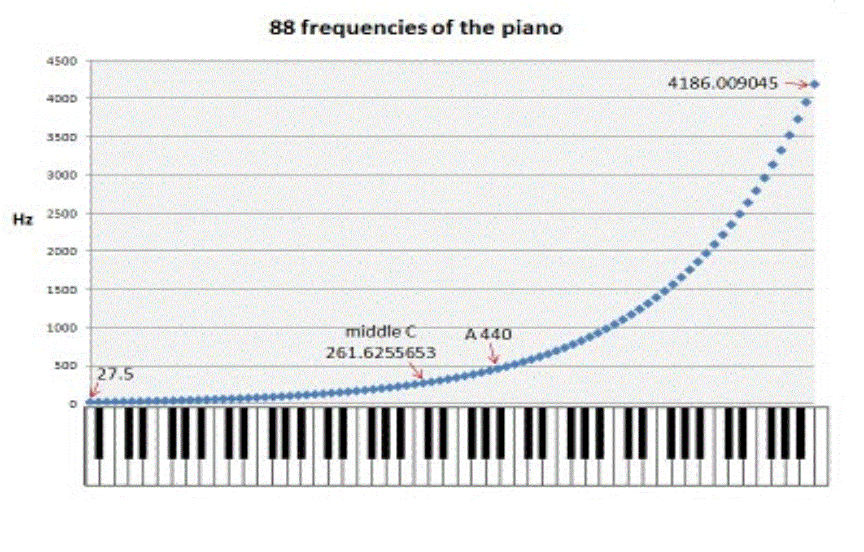
88 fundamental frequencies (Hz) on a keyboard
The fundamental frequencies of successive notes define a geometric progression.
This is different from the harmonics of a vibrating string which define an arithmetic progression.

Slide 16
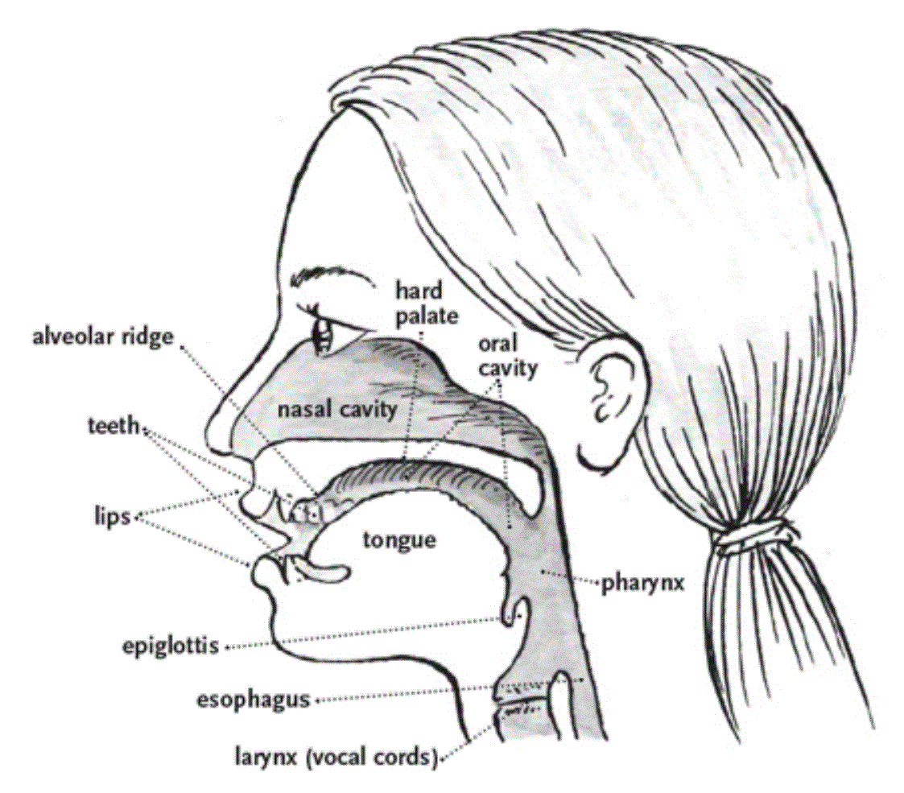
Speech Sounds

Slide 17
What determines speech sounds?
voiced vs. unvoiced
‘zzzz’ vs. ‘ssss’, ‘vvvv’ vs. ‘ffff’
articulators (jaw, tongue, lips)
‘aaaa’, ‘eeee’, ‘oooo’, …

Slide 18
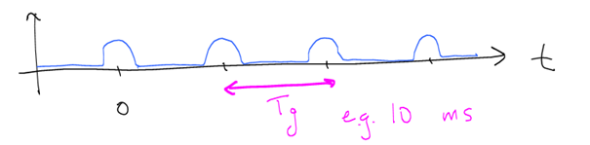
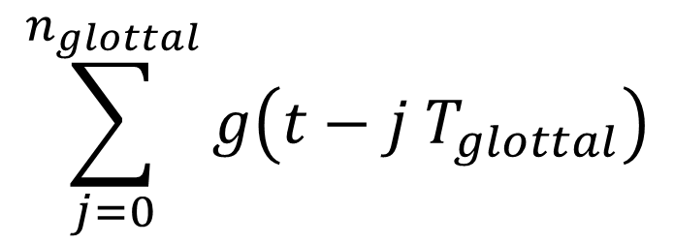

Voiced sounds are produced by “glottal pulses”.
$$T_{glottal}$$
$$\sum_{j=0}^{n_{glottal}}{g\left(t−j T_{glottal}\right)}$$

Slide 19

Recall Exercise 16 Q7.
$$g\left(t−t_{0}\right)= g\left(t\right)∗ δ(t−t_{0})$$

Slide 20
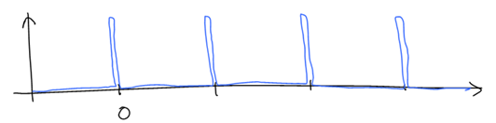
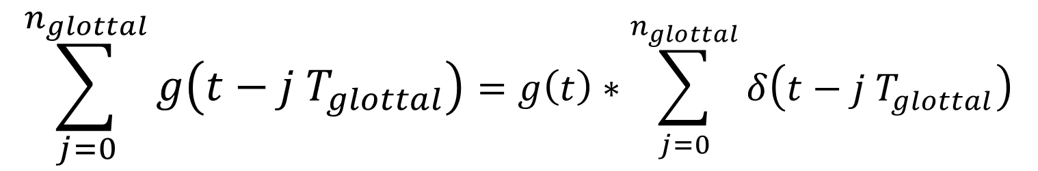
Voiced sounds are produced by “glottal pulses”.
$$T_{glottal}$$
$$\sum_{j=0}^{n_{glottal}}{g\left(t−j T_{glottal}\right)}=g\left(t\right)∗\sum_{j=0}^{n_{glottal}}{δ\left(t−j T_{glottal}\right)}$$

Slide 21
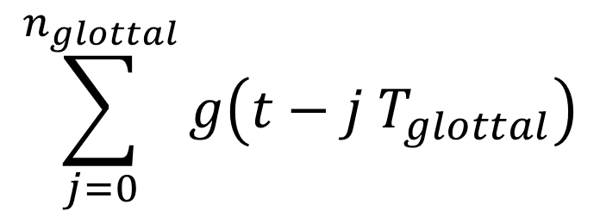

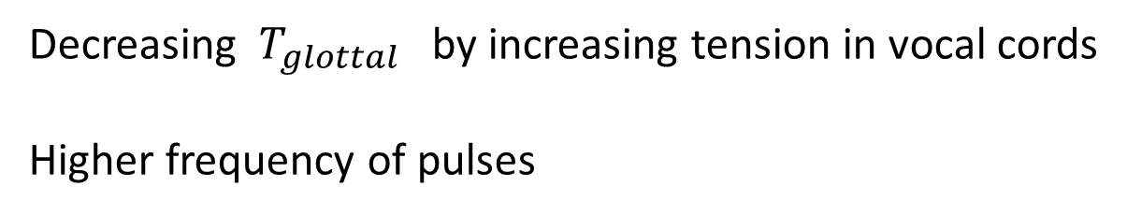

$$T_{glottal}$$
$$\sum_{j=0}^{n_{glottal}}{g\left(t−j T_{glottal}\right)}$$
Decreasing $T_{glottal}$ by increasing tension in vocal cords
Higher frequency of pulses
$$≡$$

Slide 22
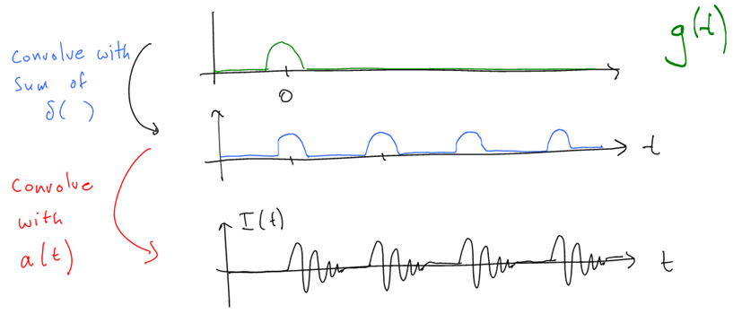
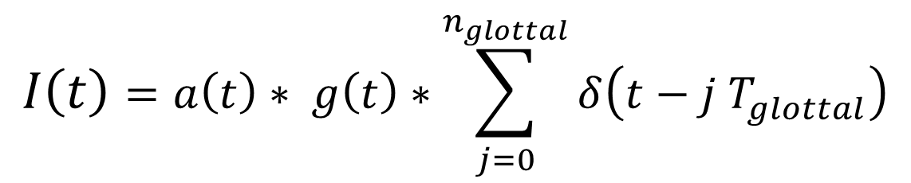
Let $a\left(t\right)$ be the impulse response function of the articulators.
$$I\left(t\right)=a\left(t\right)∗ g\left(t\right)∗\sum_{j=0}^{n_{glottal}}{δ\left(t−j T_{glottal}\right)}$$

Slide 23
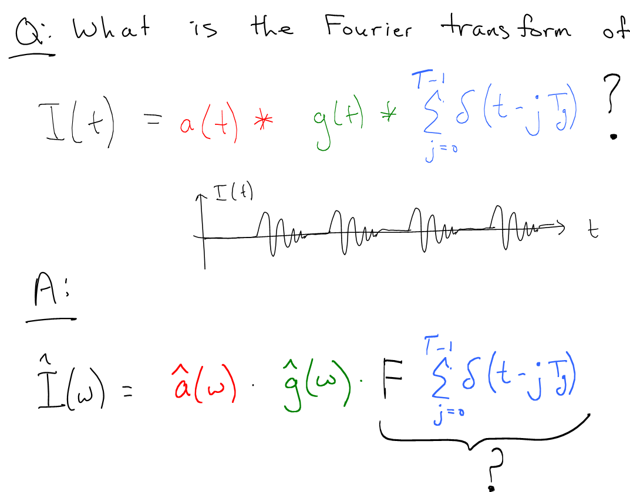

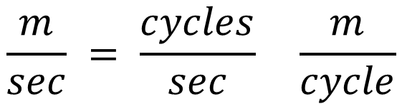
$n_{pulse}$ $−1$
$n_{pulse}$ $−1$

Slide 24
$n_{pulse}$ $−1$
$n_{pulse}$ $−1$

Slide 25
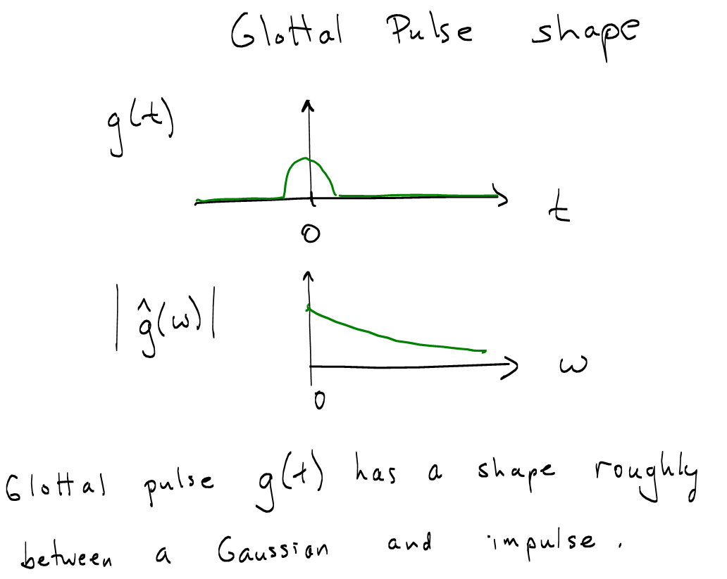

Slide 26
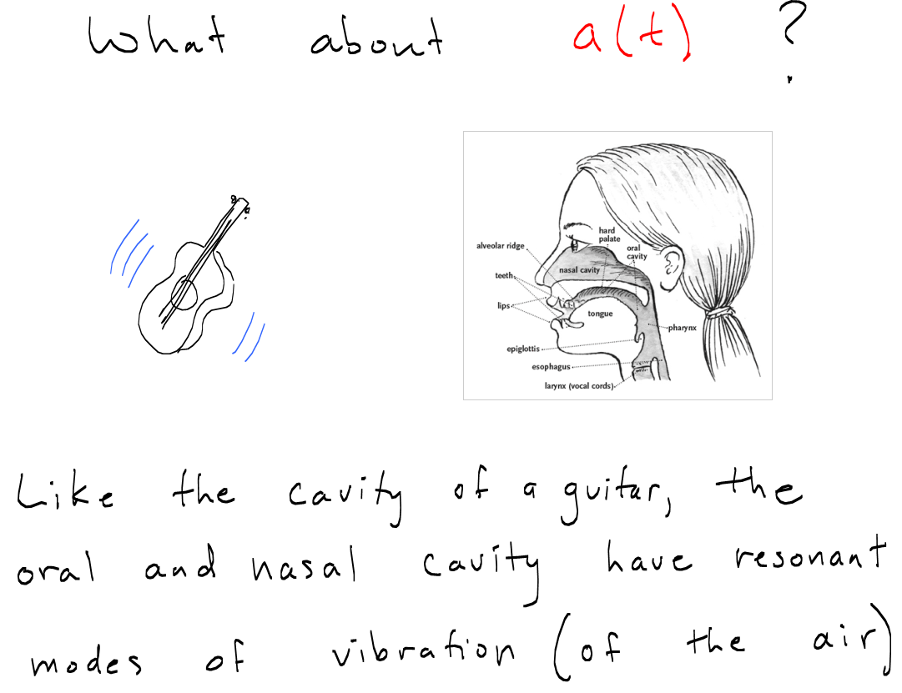

Slide 27
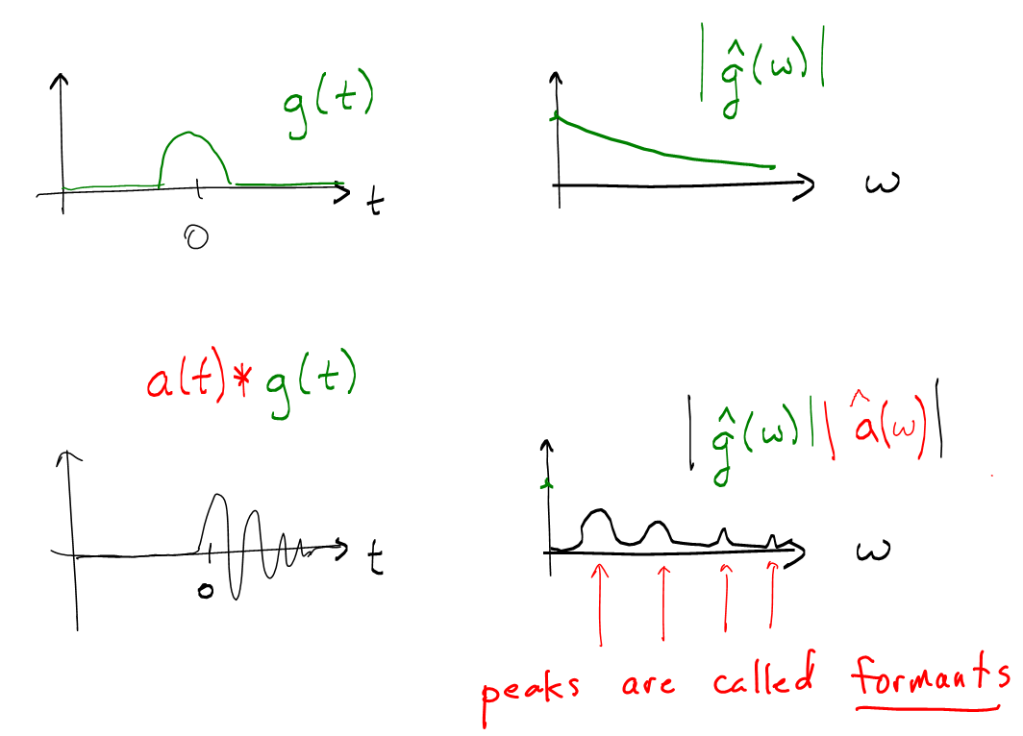

Slide 28
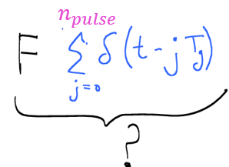
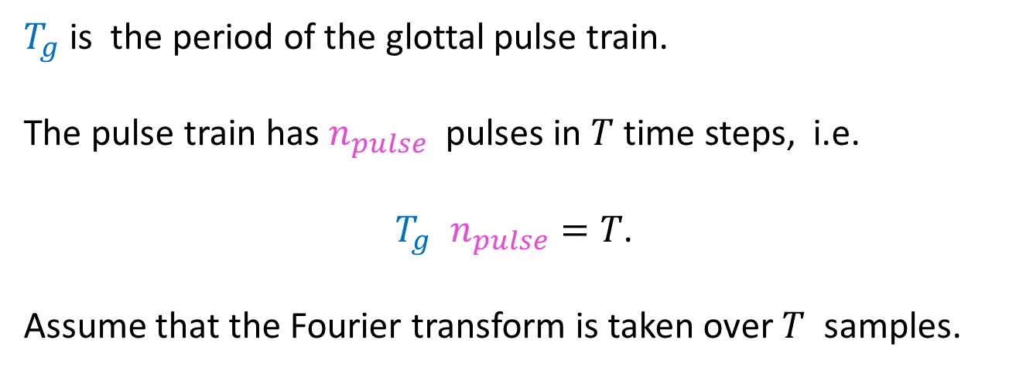
$T_{g}$is the period of the glottal pulse train.
The pulse train has $n_{pulse}$ pulses in $T$ time steps, i.e.
$T_{g}$ $n_{pulse}=T$.
Assume that the Fourier transform is taken over $T$ samples.

Slide 29
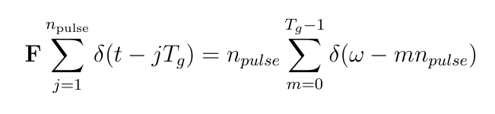
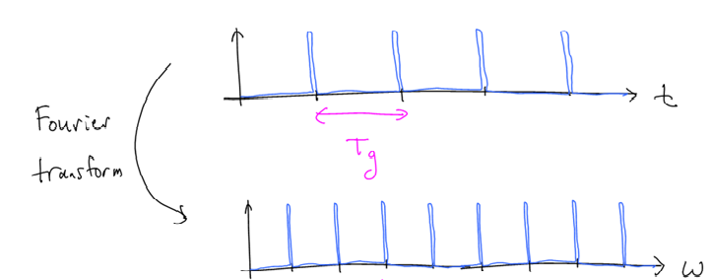
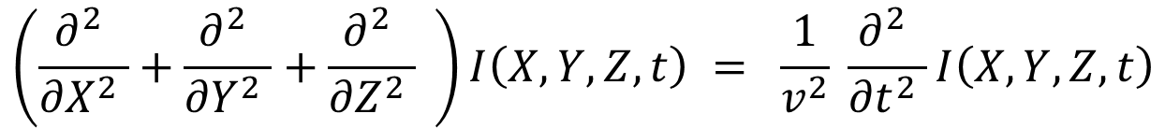
Exercise: Show
$$n_{pulse}$$

Slide 30
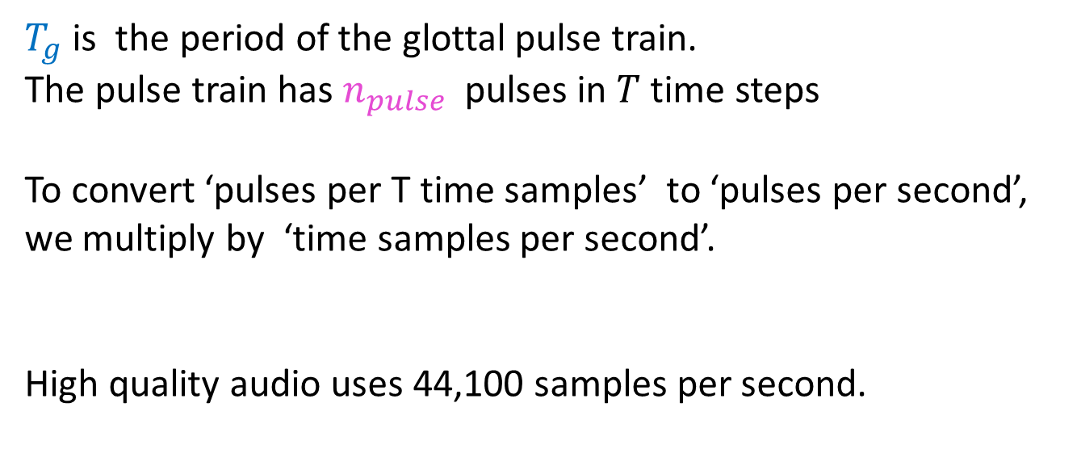
$T_{g}$is the period of the glottal pulse train.
The pulse train has $n_{pulse}$ pulses in $T$ time steps
To convert ‘pulses per T time samples’ to ‘pulses per second’, we multiply by ‘time samples per second’.
High quality audio uses 44,100 samples per second.

Slide 31
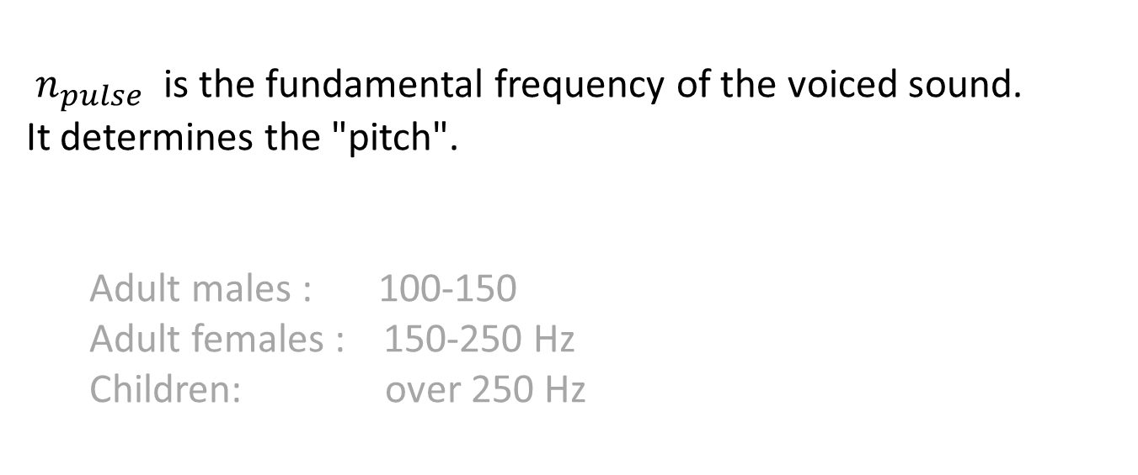
$n_{pulse}$ is the fundamental frequency of the voiced sound.
It determines the "pitch".
Adult males : 100-150
Adult females : 150-250 Hz
Children: over 250 Hz

Slide 32
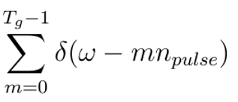
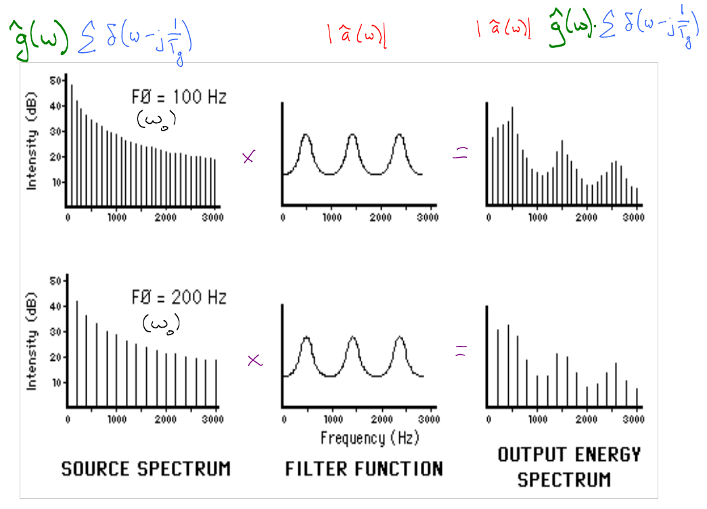

Slide 33
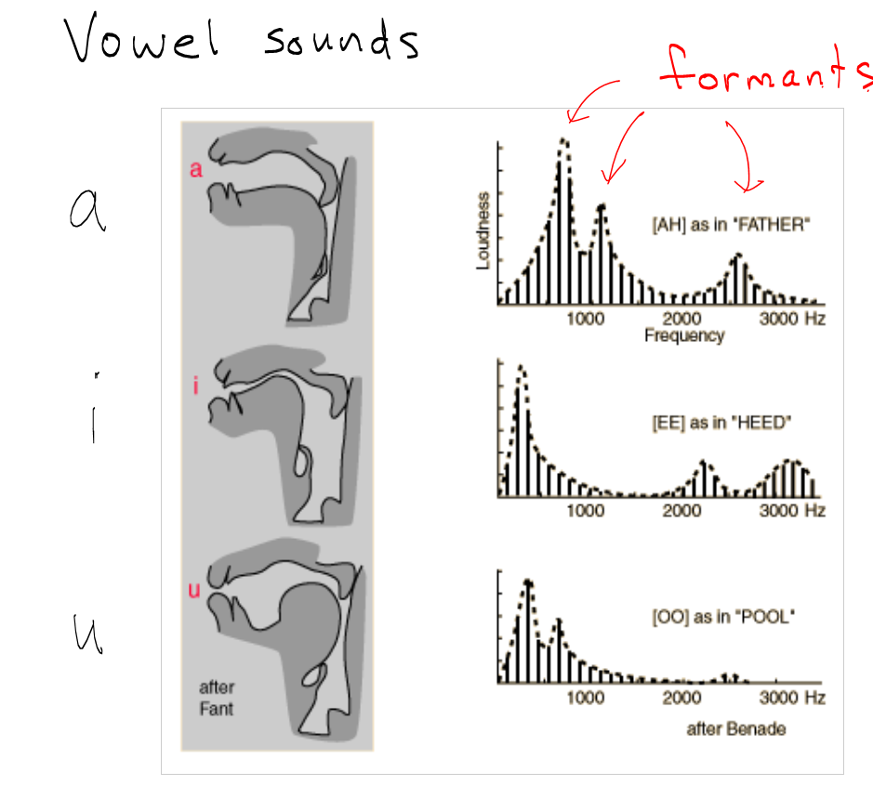

Slide 34
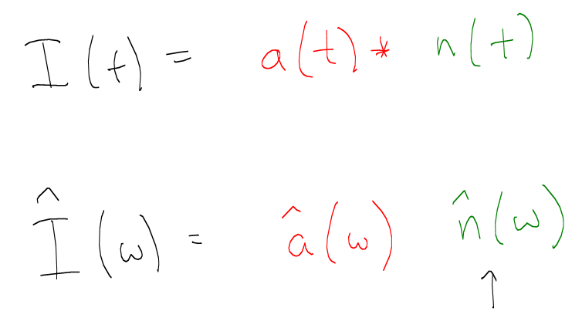
Unvoiced sounds noise instead of glottal pulses
Flat on average
( ‘white noise’)

Slide 35
Consonants
Restrict flow of air by moving tongue, lips into contact with the teeth & palate.
Fricatives
- voiced z, v, zh, th (the)
- unvoiced ?
Stops
- voiced b, d, g
- unvoiced ?
Nasals (closed mouth)
- m, n, ng

Slide 36
Consonants
Restrict flow of air by moving tongue, lips into contact with the teeth & palate.
Fricatives
- voiced z, v, zh, th (the)
- unvoiced s, f, sh, th (theta)
Stops
- voiced b, d, g
- unvoiced p, t, k
Nasals (closed mouth)
- m, n, ng

Slide 37
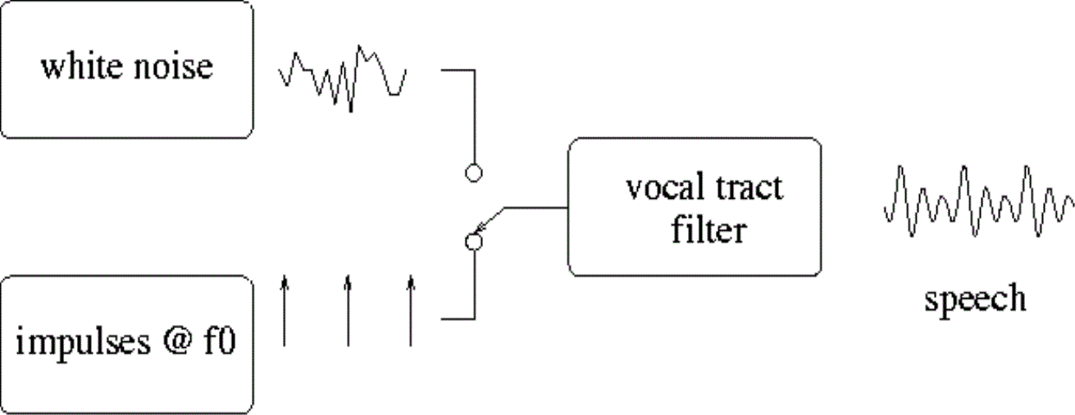
Speech production:
switch between voiced and unvoiced sounds (within words)

Slide 38
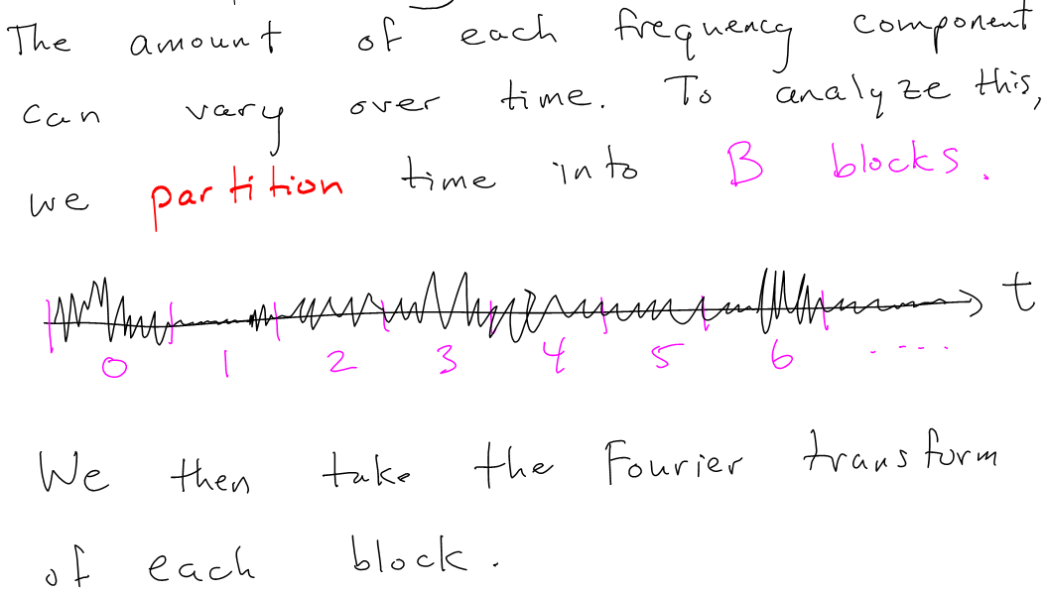
Spectrograms

Slide 39
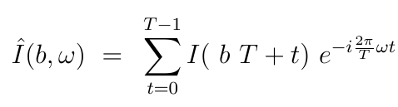
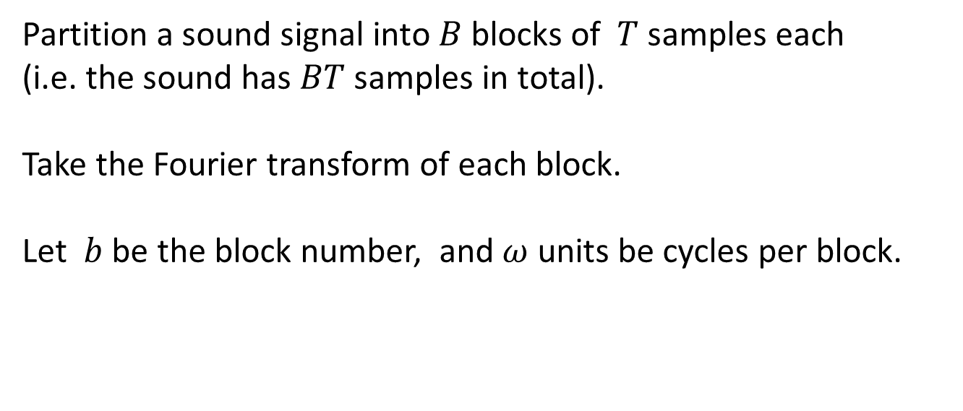
Partition a sound signal into $B$ blocks of $T$ samples each
(i.e. the sound has $BT$ samples in total).
Take the Fourier transform of each block.
Let $b$ be the block number, and $ω$ units be cycles per block.

Slide 40
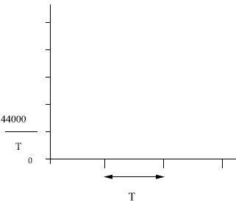

Cycles per second (Hz)
$ω_{0}$ =
Time (samples)

Slide 41
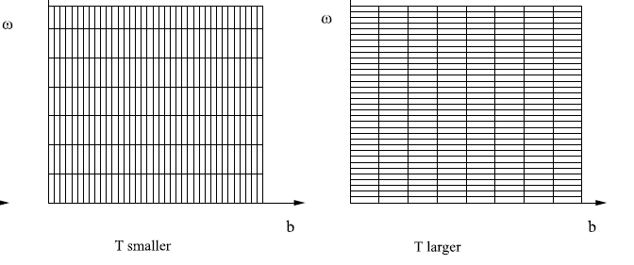


e.g. T = 512 samples (12 ms) $ω_{0}$ = 86 Hz
T = 2048 samples (48 ms) $ω_{0}$ = 21 Hz
Note that you cannot simultaneously localize the frequency and the time. This is a fundamental tradeoff. We have seen it before (recall the Gaussian).
FYI, this is essentially the Heisenberg Uncertainty principle from physics.

Slide 42
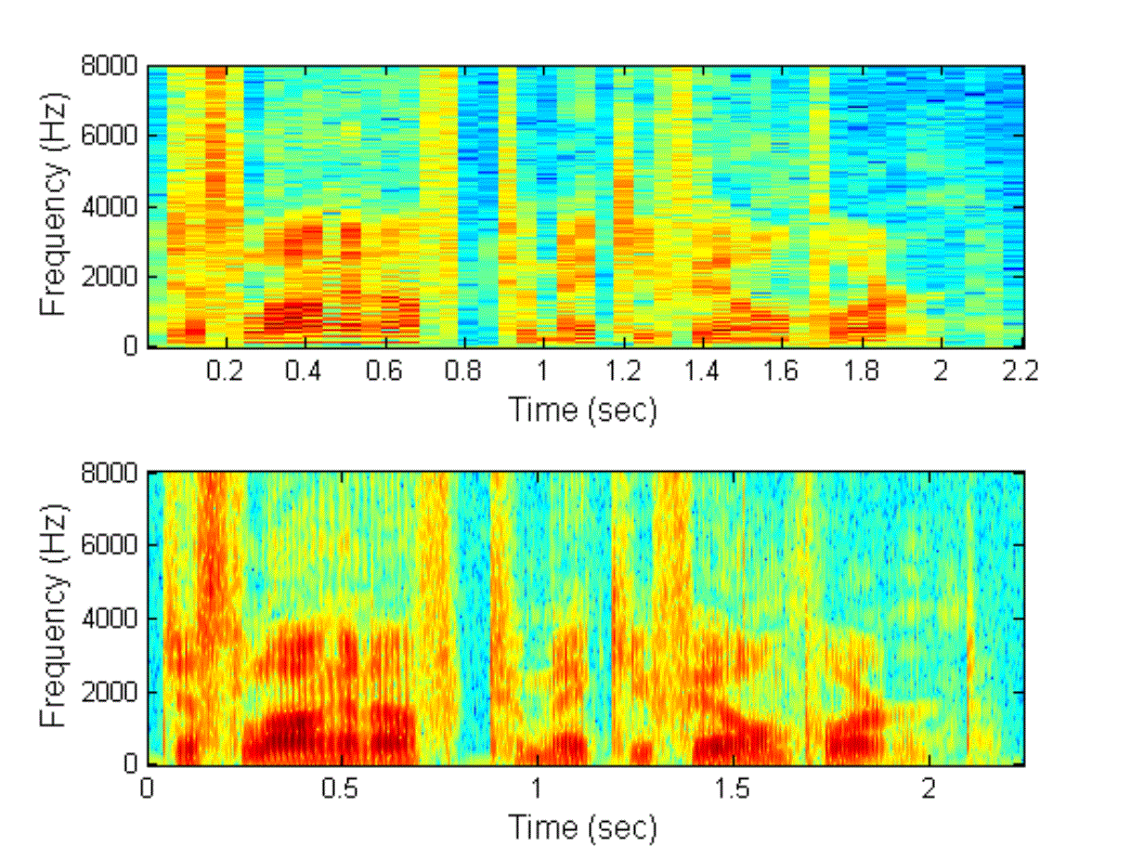
Narrowband
(good frequency resolution,
poor temporal resolution … ~50ms)
Wideband
(poor frequency resolution,
good temporal resolution)

Slide 43
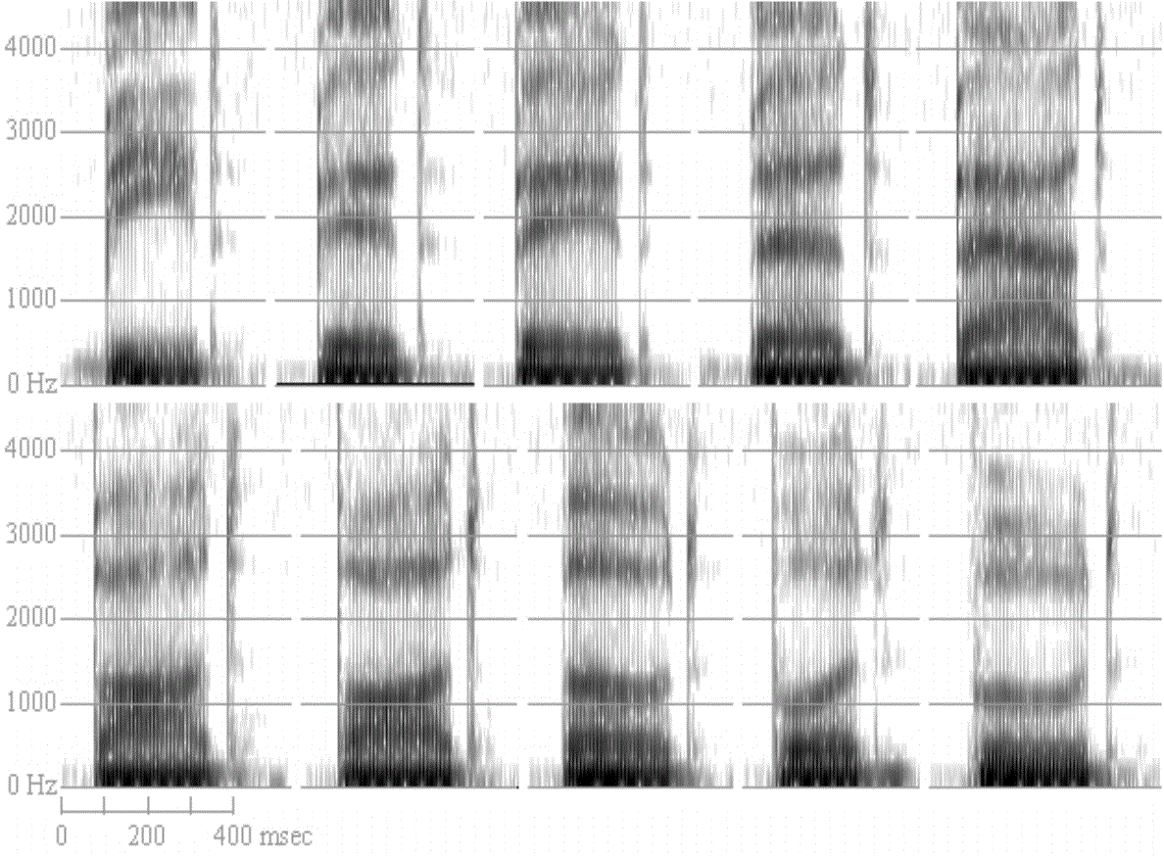
Examples: Spectrograms of 10 vowel sounds

