Slide 1
Semiconductor Data Analysis with Python
Mike Purtell

Slide 2
BIO
Principal Test Engineer for Cadence Design Systems
Semiconductor Test & Product Engineer since the 1980s
Proud member of the Silicon Valley’s silicon industry
Python user for 10 years, data analysis, and electronic instrument control
Favorite libraries are polars and plotly
Native of New York State/Albany

Slide 3
Domain - Automatic Test Equipment (ATE)
TODO: Add chart showing number of ICs produced by year
Introduce ATE Industry, technology
Big data before Big Data
Semiconductor Test Data Format (STDF) from Teradyne(1985) still widely used ATE suppliers and tool vendorsG

Slide 4
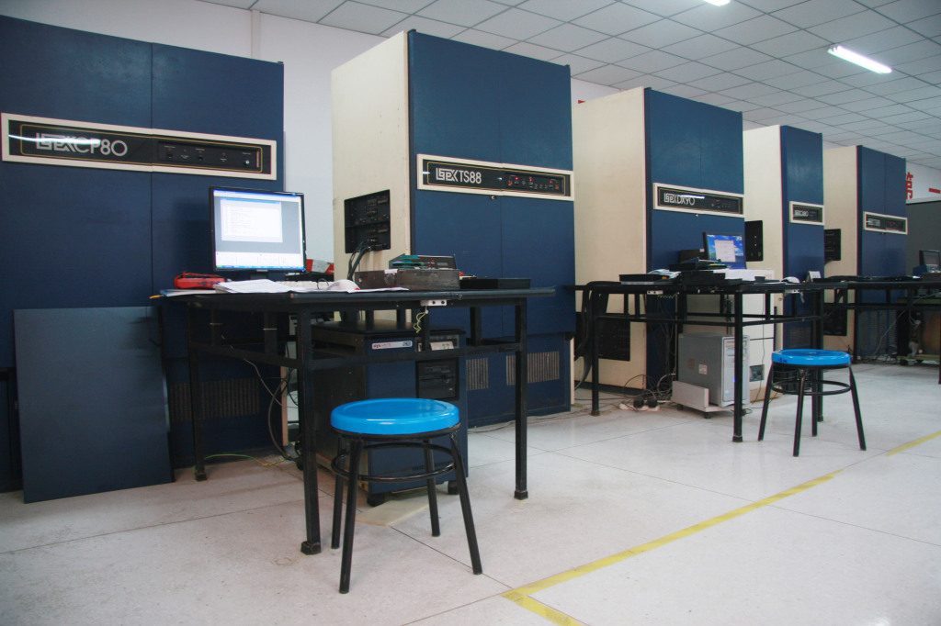
ATE - LTX 77 (1977, some in use today)
Data General Computer
Basic programming language
ALL UPPER CASE CODE
Variables limited to 2 characters
Variable names starting with I-N are integers, all others floats
Magnetic tape backups

Slide 5
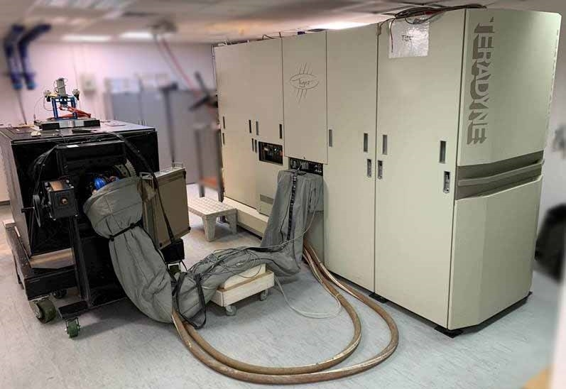
ATE - Teradyne Tiger (2000)
Sun Worksation, c-language
Prohibitive size

Slide 6
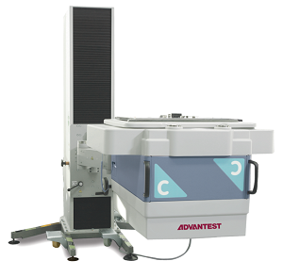
ATE Present - Advantest 93K
c++, java, Red Hat Linux
Most widely used tester

Slide 7
Managing Semiconductor Test Data
Big data before Big Data
Semiconductor Test Data Format (STDF) from Teradyne(1985) still widely used ATE suppliers and tool vendors
Inefficient by today’s standards. Columns with mixed data types and fields, 32-bit float and integers, ad hoc metadata, requires complex parsers. Only used for static analysis, not suitable for real time use.
RITdb is a powerful new data storage format that provided real-time analysis, from multiple data sources. Slow rate of adoption, industry inertia.

Slide 8
Data Analysis Experience
ATE Bundled tools
In-house tools
Commercial tools
Galaxy
JMP
SE Dana
PDF Solutions/Data Power
Free tools
Excel with VBA Scripting
Radar - R based Data Analysis Resources
Python Libraries for Data Analysis

Slide 9
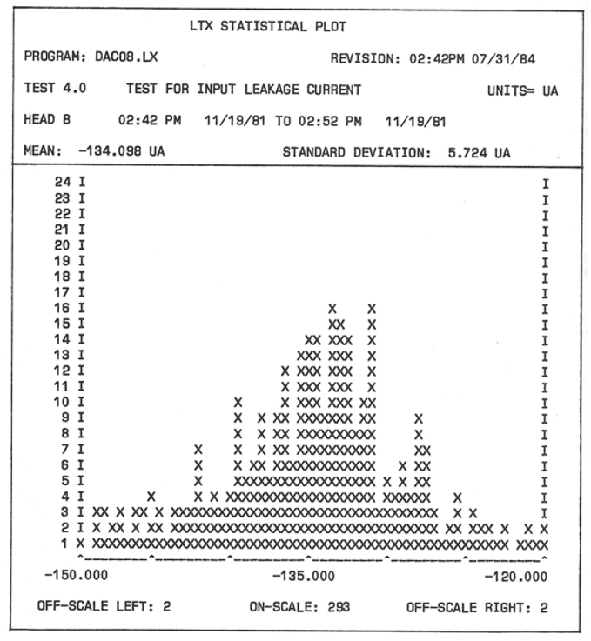
LTX Histogram (aka DPLOT)
From 1984, text-based graphics
Repeatability: measure same part N times, and focus on the spread
Yield, CPK, Outliers Analysis

Slide 10
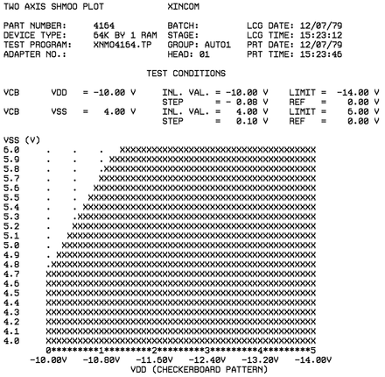

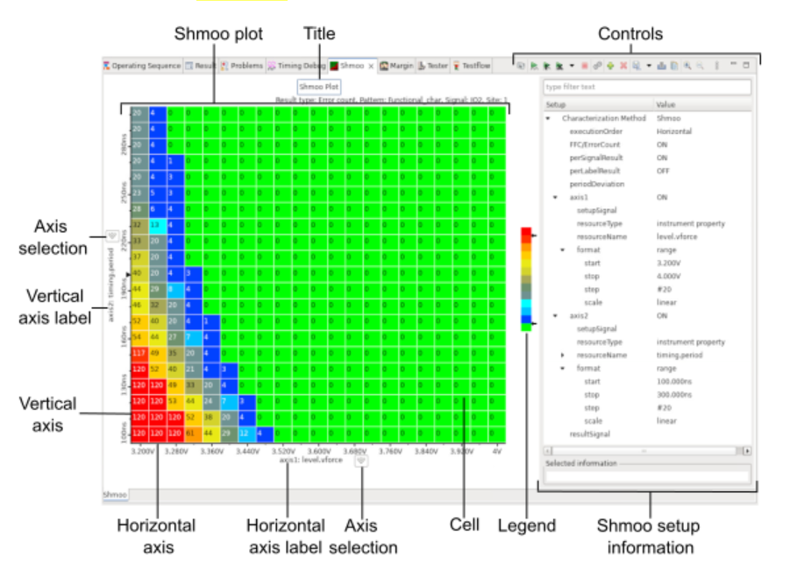
Shmoo Plot
A 1960s tool (still widely used) by Semiconductor Design & Test users
Shows operating range on X-Y grid
Inventor unknown
Andy Capp’s inspiring character had a shape similar to some observed plots
What would you call this plot if the term Shmoo had not been coined?

Slide 11
STDF Files
STDF is efficient in saving the data near real time as the test program is running, but the data structure is not efficient for reporting purposes, according to YieldHub. The data needs to be organized into a different data structure designed to be efficient for reporting. The STDF also represents a static view of the data and is useful for analysis after the tests are completed, but the data needs to be cleaned because different tool vendors and test engineers handle the collection and input of the data differently.
STDF is old and outdated. Humans are so resistant to change.

Slide 12
Python Libraries for Data Analysis
pandas, polars : DataFrame Libraries
matplotlib, seaborn : static data visualization
plotly, bokeh: interactive data visualization
numpy: array-based data structures, extensive mathematical operations
scikit-learn: Machine Learning, AI, regression
xgboost: distributed gradient boosting

Slide 13
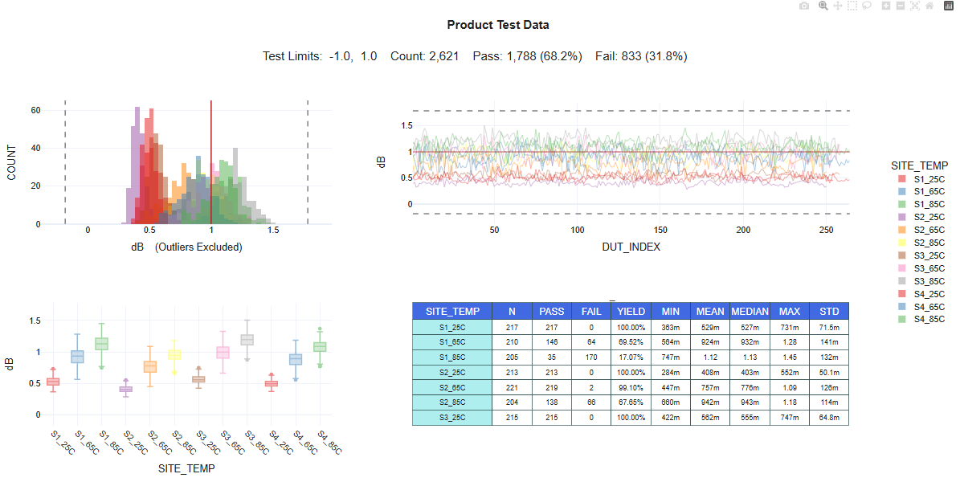
Plotly Dashboard

Slide 14
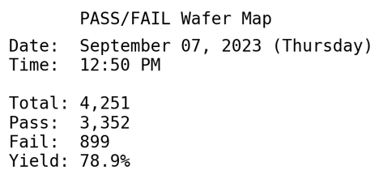
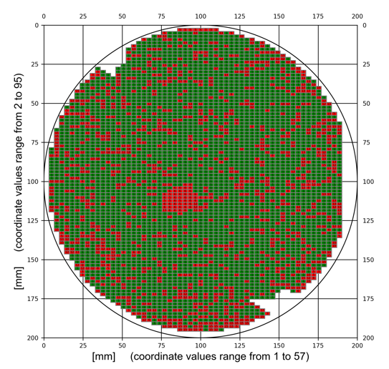
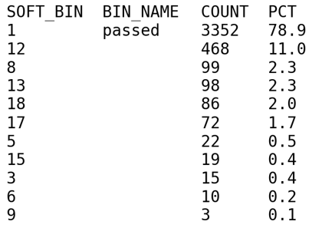
Data Viz Example: Wafer Map (matplotlib)

Slide 15
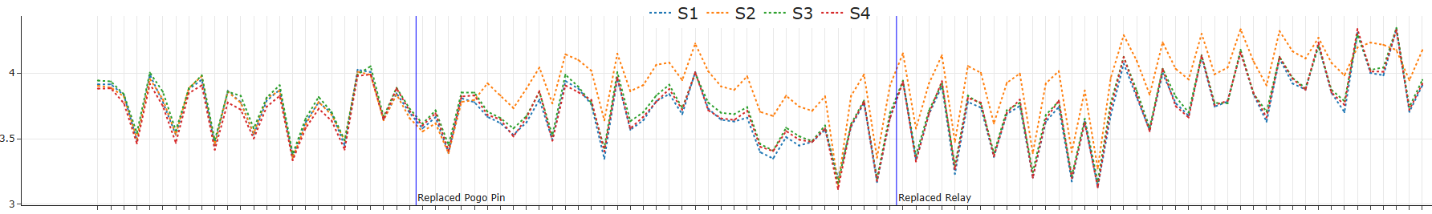
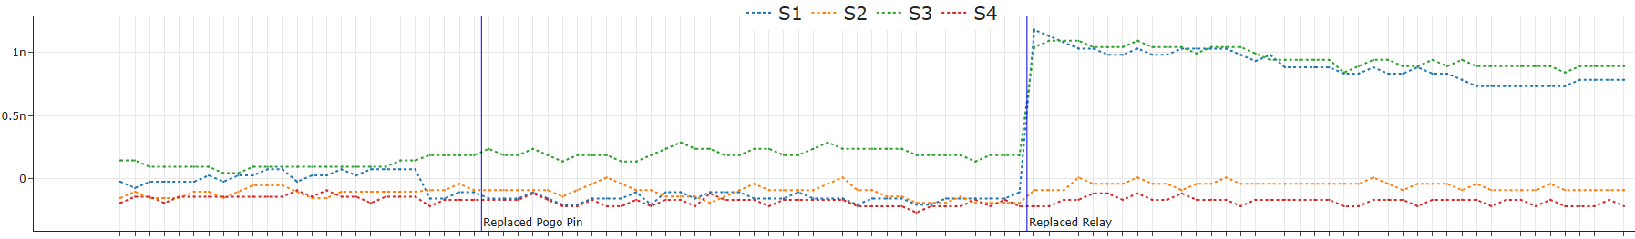
Timeline Plot (plotly)
S1, S2, S3, S4 are test sites for parallel test
These plots use data from many wafers to diagnose site-to-site drifts and gross shifts
Vertical markers added to specific maintenance events.

Slide 16
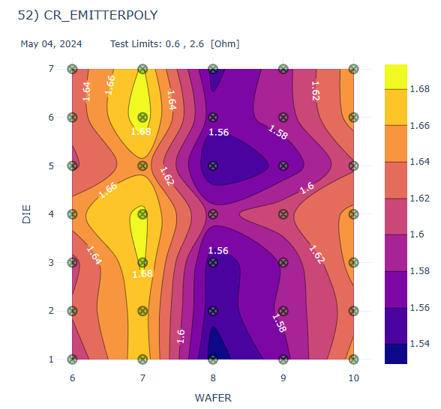
Data Viz Example: etest data/plotly

Slide 17
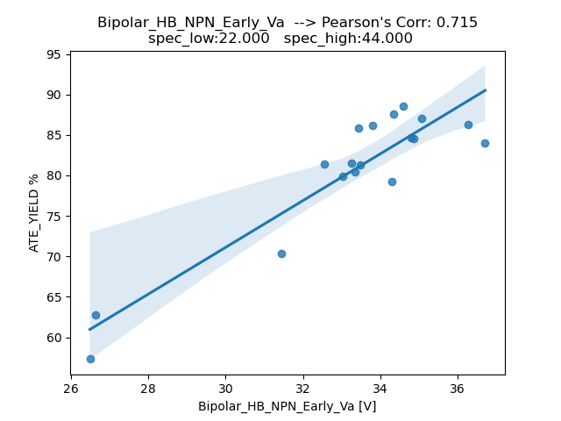
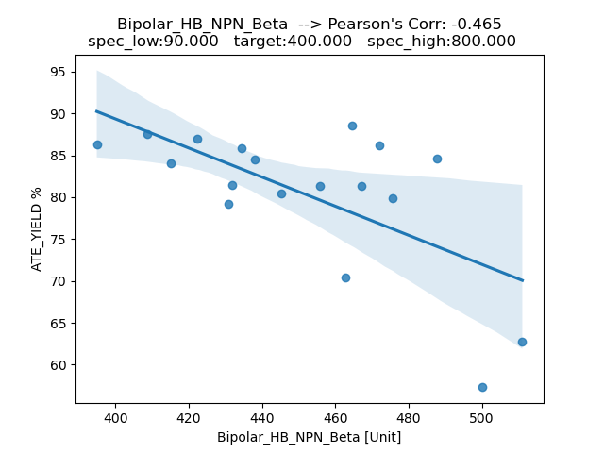
Data Viz Example: FAB Data vs. ATE Yield (seaborn)

Slide 18
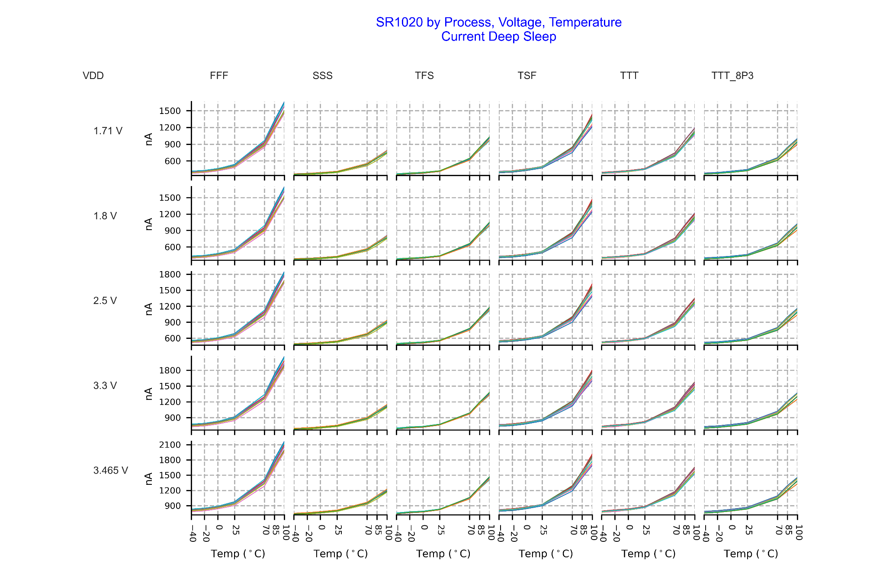
Process, Voltage, Temperature (PVT)
Inactive Current

Slide 19
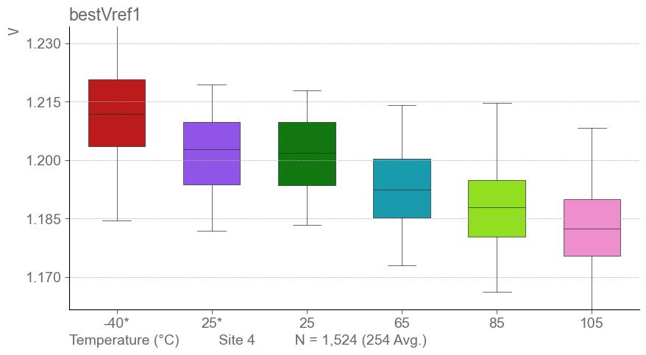
Box Plot (seaborn)

Slide 20
Future Direction, Semiconductor Test Data
RITdb is a powerful new data storage format that provided real-time analysis, from multiple data sources. Slow rate of adoption, industry inertia.
Reference: “Modernized IC Test Using SEMI RITdb Standards”, Stacy Ajouri, Mark Roos and Albert Fuchigami, December 29, 2023
Modernized IC Test Using SEMI RITdb Standards | SEMI

Slide 21
Inspiration move me brightly
Wes McKinney - “Python for Data Analysis”, inventer of pandas
Ritchie Vink – Inventer of polars
Chris Parmer, Adam Schroeder - plotly
Matt Harrison - “Effective Pandas”, “Effective Polars”, “Effective Visualizations”
Jeroen Janssens, Thijs Nieuwdorp, “Python Polars” released in April 2025
Cole Nussbaumer Knaflic, “Storytelling with Data”
BayPIGgies

Slide 22

GitHub Repo with presentation, jupyter notebook
Find me on LinkedIn by name
Bluesky: michaelpurtell@bsky.social
Plotly Community/ Figure Friday

