Slide 1
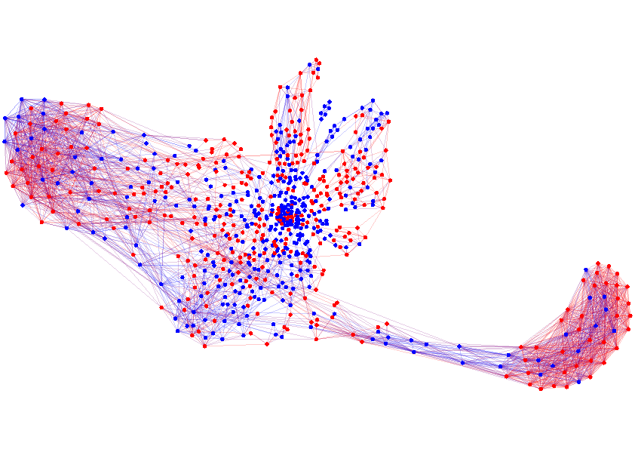

Social Network Analysis
Manuel Gomez Rodriguez Utkarsh Upadhyay Isabel Valera
MLSS-17 Tutorial

Slide 2
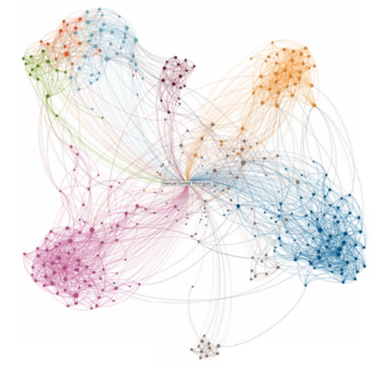
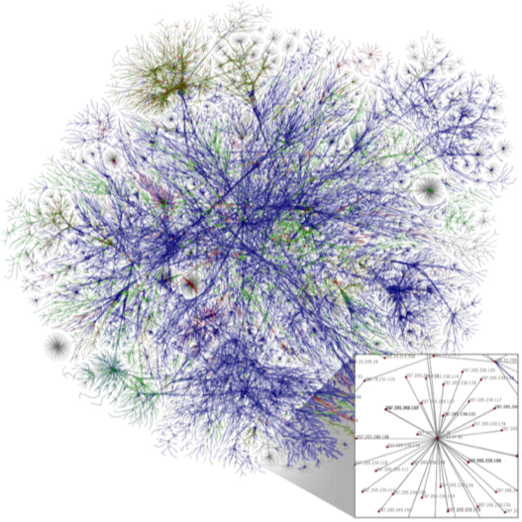
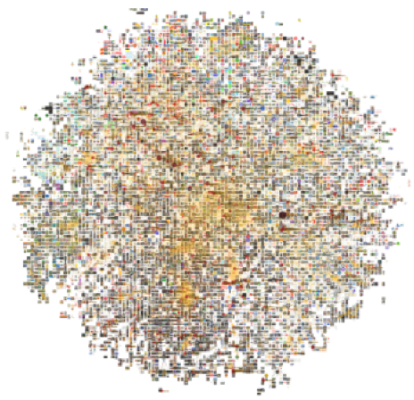
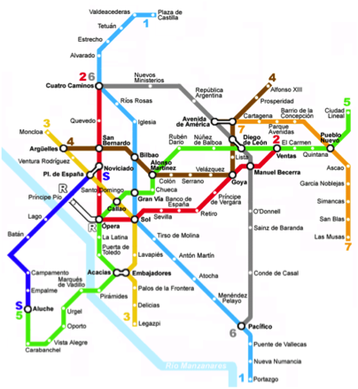
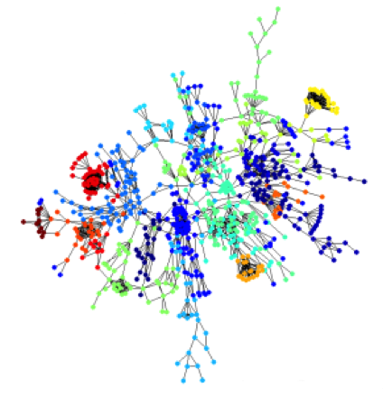
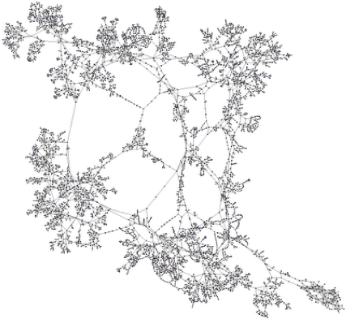
Interconnected World
Social Networks
World Wide Web
Information Networks
Transportation Networks
Protein Interactions
Internet of Things

Slide 3
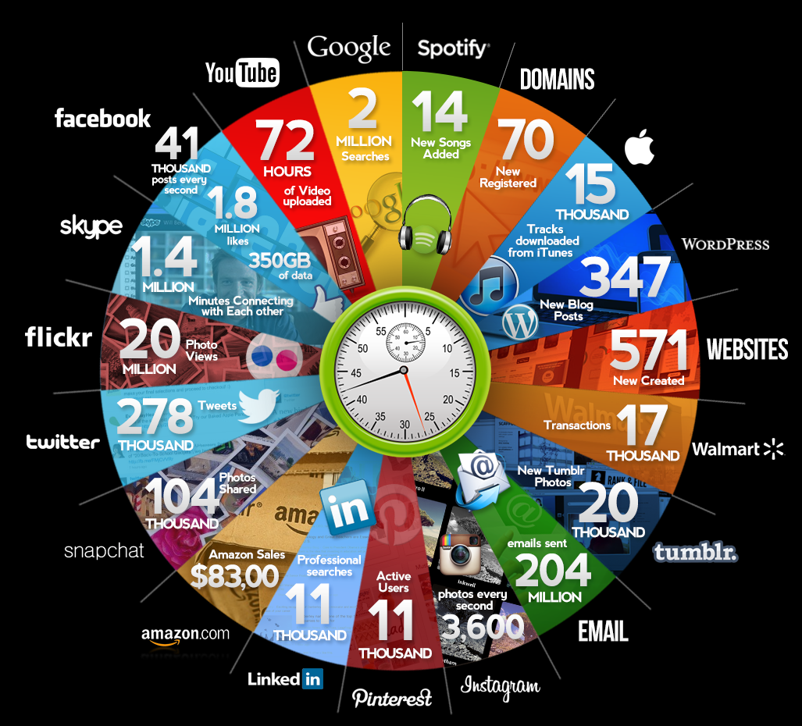
Social events over networks
Qmee, 2013

Slide 4
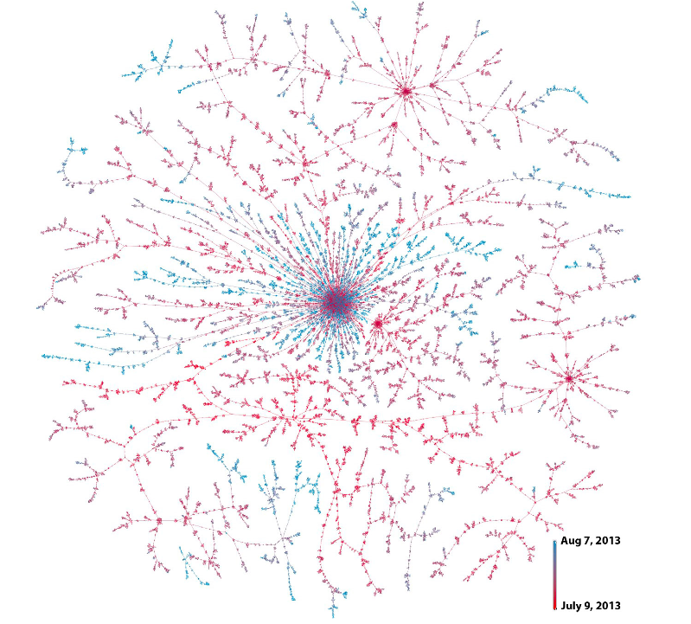





Example: Idea adoption/viral marketing
S
D
means
Christine
D follows S
Bob
3.00pm
3.25pm
Beth
3.27pm
Joe
David
4.15pm
Friggeri et al., 2014
They can have an impact in the off-line world

Slide 5
Practical Outline
Tools for Network Analysis and Visualization
Models and algorithms
Social Networks Models:
1st Part
SNAP (C++)
Forest Fire Model
Social Networks Mining:
Visualization
Properties
Manipulation
2nd Part
Gephi (GUI)
Information Propagation:
3rd Part
SNAP + Gephi
Indep. Cascade Model
Influence Maximization

Slide 6
Getting started
1. Download the handout to your personal laptop:
https://github.com/Networks-Learning/mlss-2017
2. Download Gephi to your personal laptop:
http://gephi.org/users/download/
3. Use your laptop (mac/linux) or ssh to a linux machine in mpi, download the code package (includes SNAP) & compile it:
> cd code-networks/ > make
4. You are ready to start reading the handout!

