Slide 1
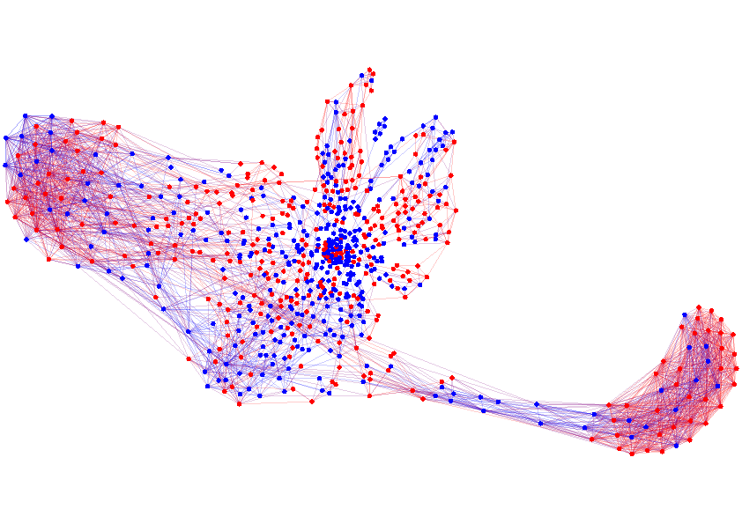

Social Network Analysis
Manuel Gomez Rodriguez Utkarsh Upadhyay Isabel Valera
MLSS-17 Tutorial

Slide 2
Networks and Graphs
Networks are everywhere:
Computer networks
Electrical networks
Social networks
Information networks
Biological networks
Traveling networks
Network mining, analysis, inference, etc… on real networks presents many challengues:
Networks are usually sparse (efficient storage/access)
Networks may be huge (10⁶ nodes/10⁹ of edges)
Networks are dynamic (updates should be efficient)

Slide 3
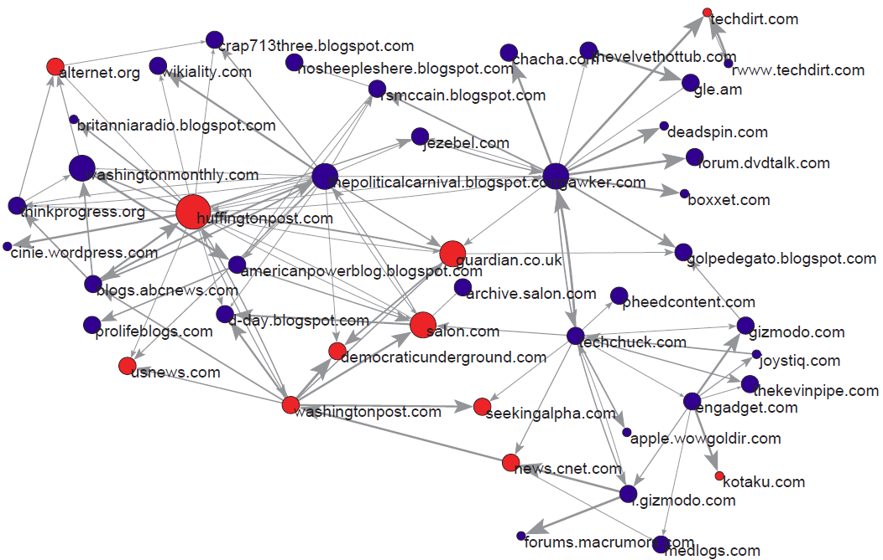
Static information network
Blogs
Mainstream media
3
3
Networks inferred with NetInf: http://snap.stanford.edu/netinf/

Slide 4

Dynamic information network
4
4
Networks inferred with InfoPath: http://snap.stanford.edu/infopath/

Slide 5










Propagation over Networks
Propagation takes place on
We can extract propagation traces from
Information Networks
Social Networks
Recommendation Networks
Epidemiology
Human Travels

Slide 6
Practical Outline
Tools for Network Analysis and Visualization
Models and algorithms
Social Networks Models:
1st Part
SNAP (C++)
Forest Fire Model
Social Networks Mining:
Visualization
Properties
Manipulation
2nd Part
Gephi (GUI)
Information Propagation:
3rd Part
SNAP + Gephi
Indep. Cascade Model
Influence Maximization

Slide 7
Getting started
1. Download the handout to your personal laptop:
https://github.com/Networks-Learning/ mlss-2017
2. Download Gephi to your personal laptop:
http://gephi.org/users/download/
3. Use your laptop (mac/linux) or ssh to a linux machine in mpi, download the code package (includes SNAP) & compile it:
> cd code-networks/ > make
4. You are ready to start reading the handout!

Slide 9
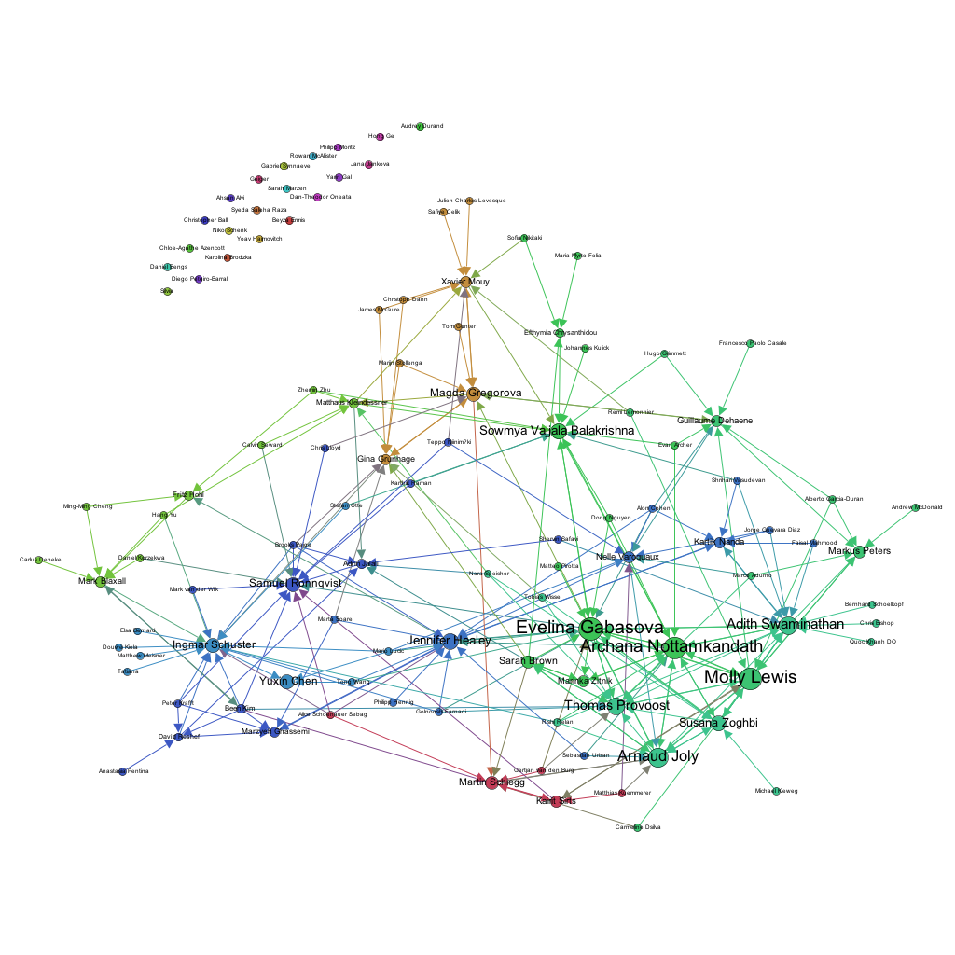

MLSS contact network (Aug 26)

