Slide 1
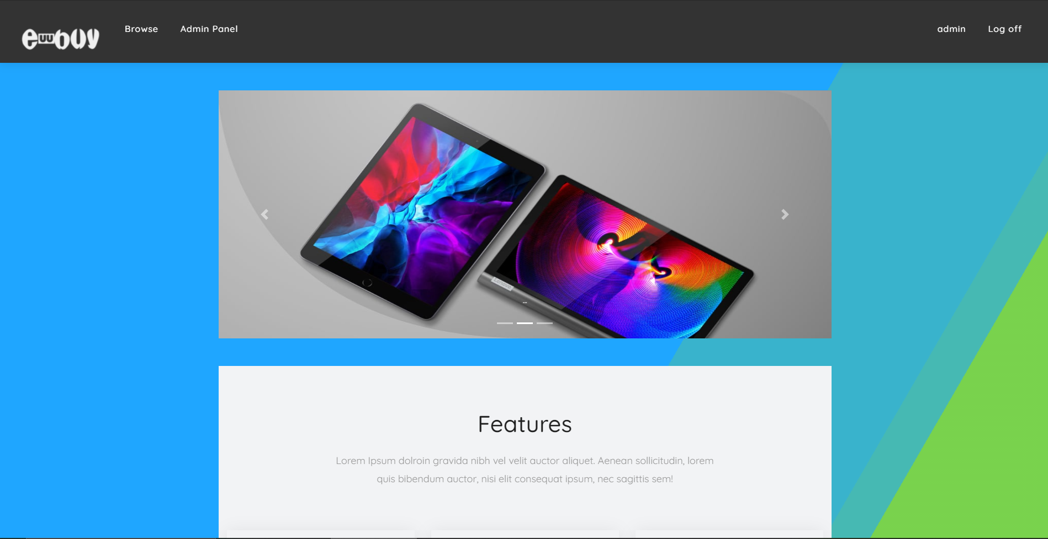
CB12 C# Full Time Group Project
Title: Ebuy
Team Coordinator: Orestis Mavroudis Database Developer: Paul Chronakis
Back-End Developer: Michalis Martasidis Front-End Developer: Apostolos Koukoulios

Slide 2
Website Description and Features
Eshop with electronic products.
Users, after registering an account and confirming their email, can search for any products they wish to buy by name, brand, and/or type, and add them to their personal cart, from which they can access a final checkout procedure of online payment using paypal, after which they are allowed a review for the product they ordered
A unique Admin account with access to admin panel with role, account, order, rating utilities.
Employee Accounts can be created by Admin, for product editing utilities.

Slide 3

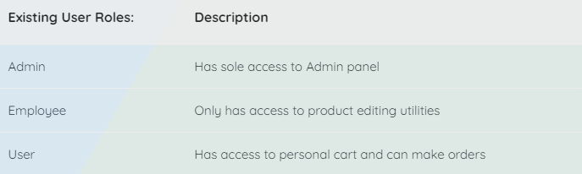

Account Register/Login
Using localdb
3 Account roles: Admin/Employee/User
Admin Panel only available to Admin account

Slide 4
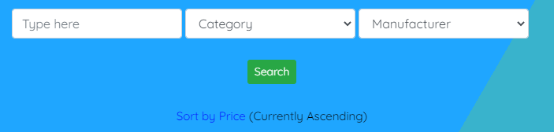
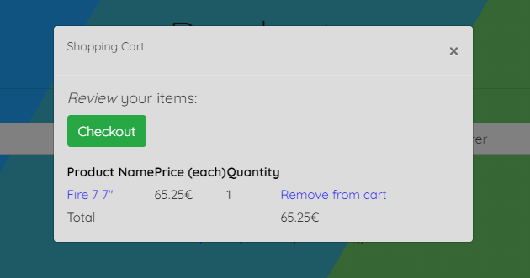

Search feature and Filter options
Real time product price updating (using SignalR)
E-Payment process with Paypal.com

Slide 5
The End

