Slide 1


A/B Testing : new design
BY THE TEAM ROCKET With Adam, Mariona, Michael & Stéphanie

Slide 2

Does the new user interface improve conversion rates?
VS
Test
Control
? % conversion
? % conversion

Slide 3
Experimental Design
01
02
Analyze data
Hypothesis
Client profiles
Digital footprint
Experiment roster
The conversion rate of the test group is better than that of the control group.
3 months
15/3 - 20/6
04
03
Evaluate results A/B testing
Experiment
Test group uses new process, control group uses the old one

Slide 4
Data Overview
3 data sets :
Client Profiles : 70 594 clients
Digital Footprints : 755 405 entries
Experiment Roster : 50 488 entries
A
Vs
B
Data cleaning process:
01
02
03
04
Merging data sets
Formatting
Null values & incorrect values
Final sample
Merging digital footprints into one dataset
Formatting data
Removing null values and correcting incorrect values from client profiles dataset
50,488 clients divided in two groups (test and control)

Slide 5
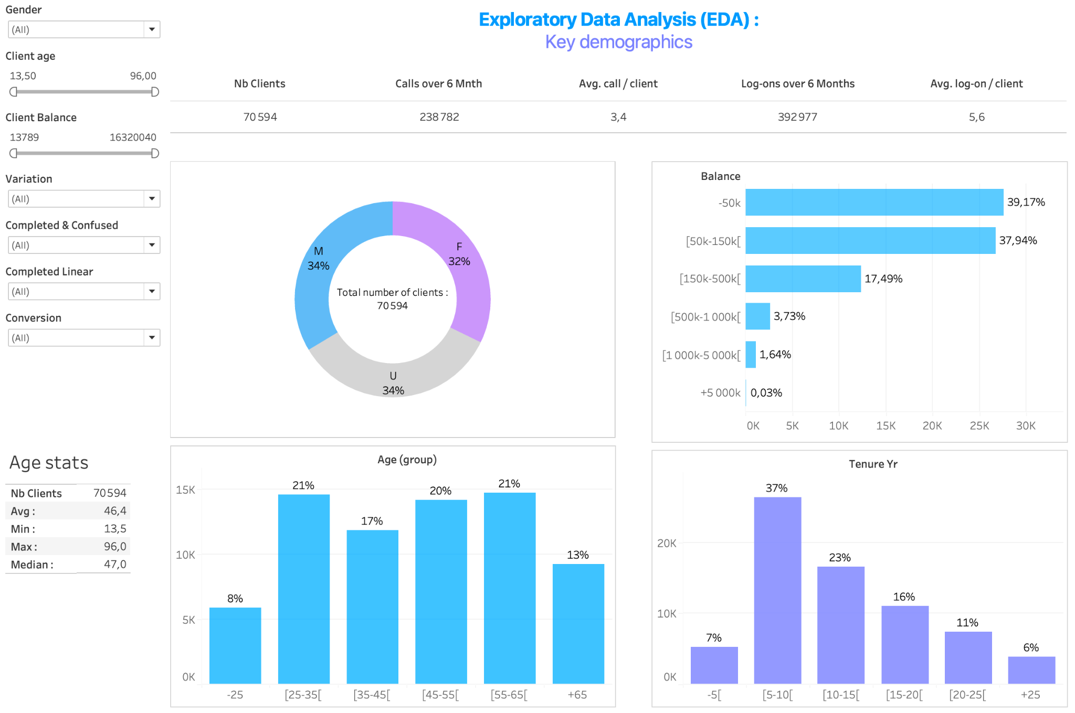

Slide 6
Key Performance Metrics : definitions
Conversion rates
S
Proportion of users that reach the “confirm” step
1
A
Error rate
2
Error : every time the user takes a step backwards
Error rate: ratio between the errors and the total number of movements
3
C
Average time
The average time a user takes from one step to another
Total average time, from start to complete

Slide 7
KPI
Conversion rate
Average Time
Error rate
Results
Control
65%
4 min 28 s
4%
The control group has lower conversion, average time per step, and error rate
Test
69%
4 min
48 s
7%
The test group has higher conversion, average time per step, and error rate

Slide 8
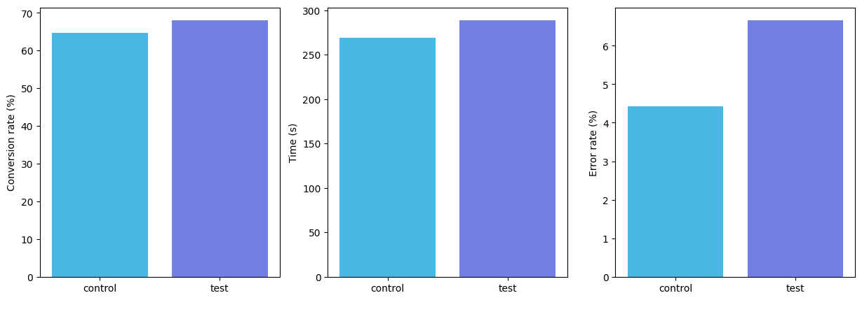
KPI
Conversion rate
Average Time
Error rate

Slide 9
Hypothesis testing
𝛂: 0.05
Conversion rate
Proportion z-test
Average time
Mann Whitney test
Error rate
Proportion z-test
H₀:
p_{test} <= p_{control}
X_{test} <= Y_{control}
p_{test} <= p_{control}
p_{test} > p_{control}
X_{test} > Y_{control}
p_{test} > p_{control}
H₁:
Stat: -8, p-value: 10⁻¹⁵
Stat: 10⁶ , p-value: 0.9
Stat: 27; p-value: 10⁻¹⁶²
Stat, P-value
Reject H₀
Cannot reject H₀
Reject H₀
Result

Slide 10
Hypothesis testing
𝛂: 0.05
Conversion rate
Proportion z-test
Average time
Mann Whitney test
Error rate
Proportion z-test
H0:
p_{test} <= 1.05 × p_{control}
X_{test} <= Y_{control}
p_{test} <= p_{control}
p_{test} > p_{control}
X_{test} > Y_{control}
p_{test} > p_{control}
H1:
Stat: 0.6 p-value: 0.3
Stat: 10⁶ , p-value: 0.9
Stat: 27; p-value: 10⁻¹⁶²
Stat, P-value
Cannot reject H₀
Cannot reject H₀
Cannot reject H₀
Result

Slide 11
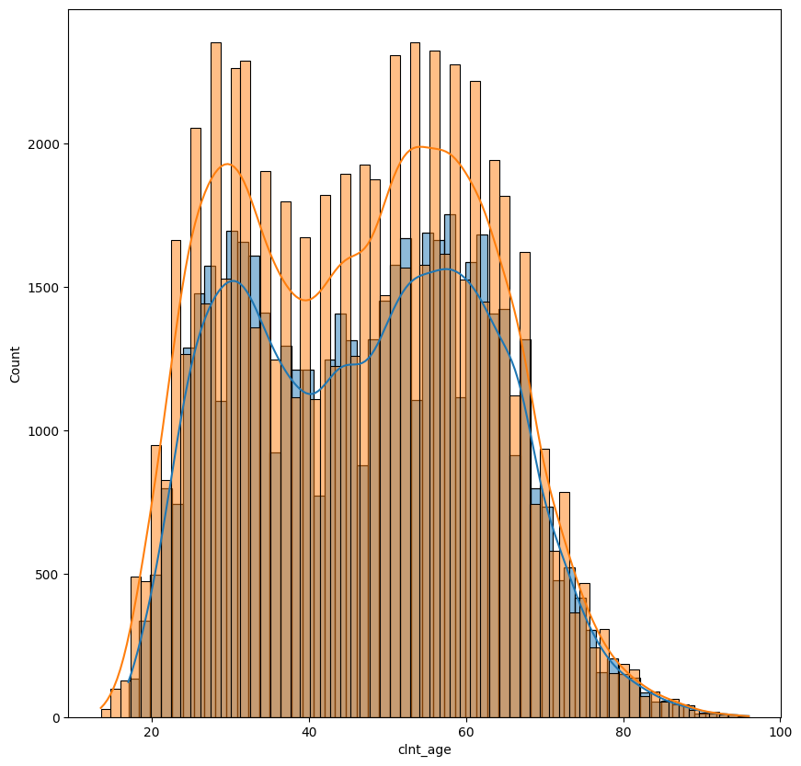
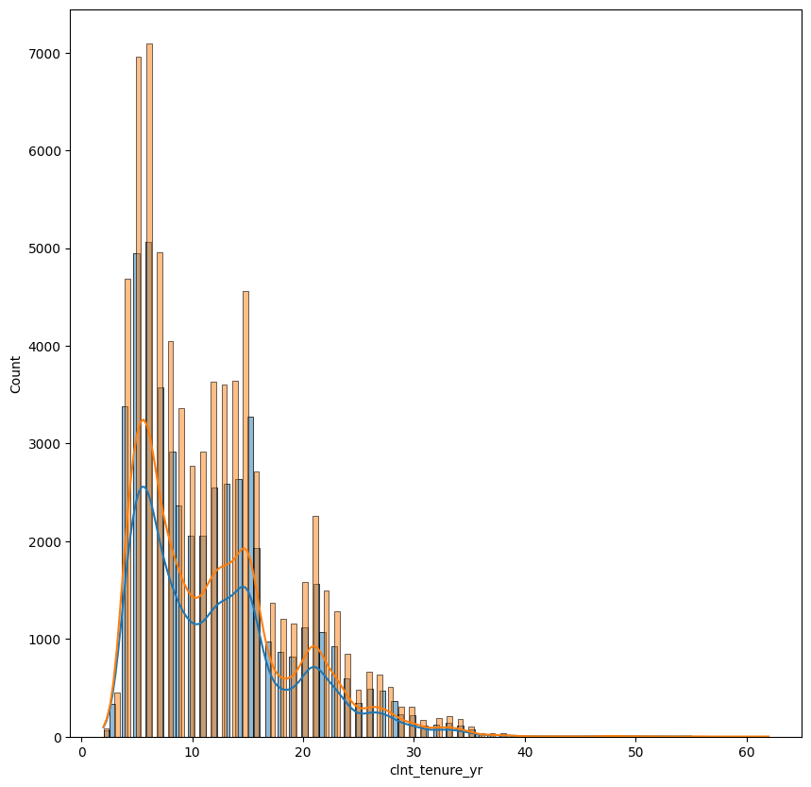
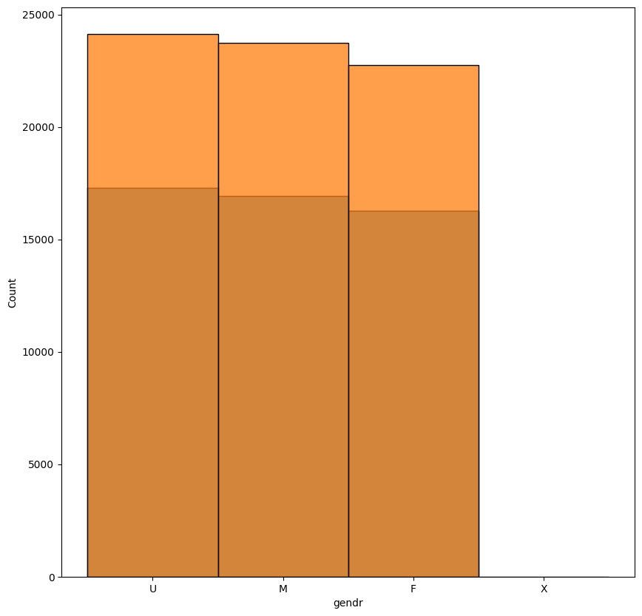
Evaluation of the experiment
01
02
03
Structure
Biases
Duration
Test ⩰ Control
Distribution
No biases in sample selection but
unusual activity in April
300k digital footprints

Slide 12
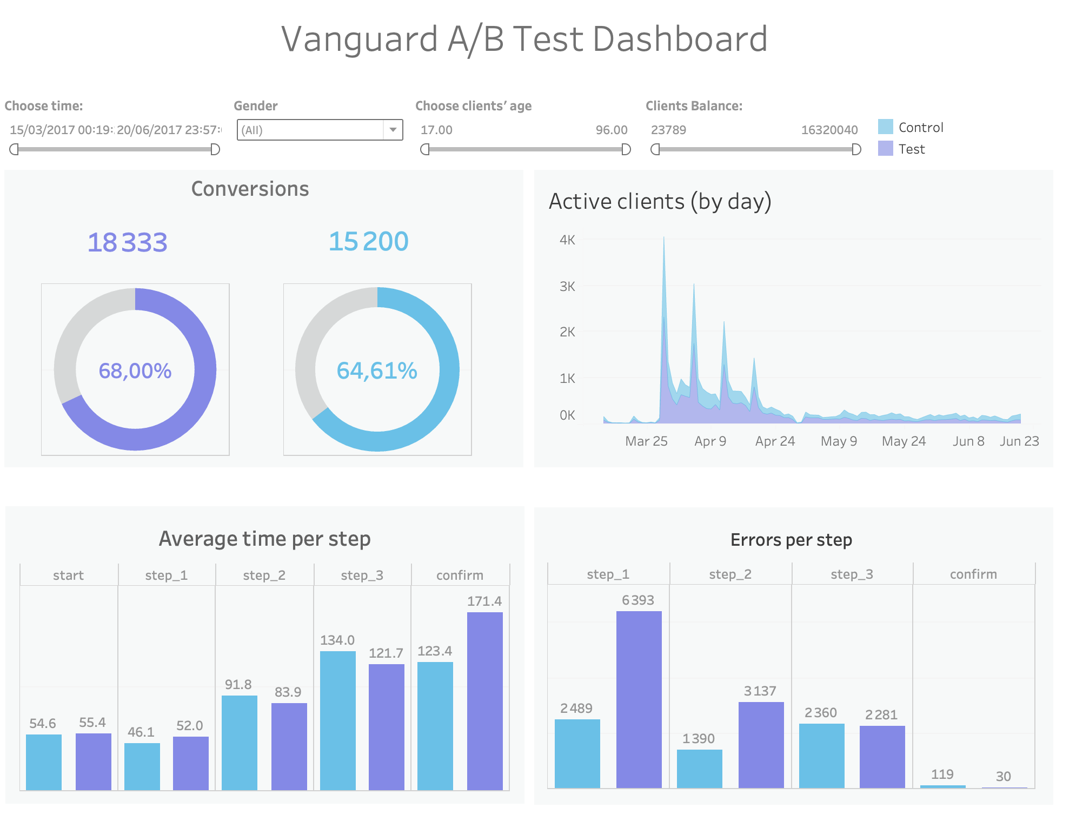
Tableau

Slide 13
Challenges & Learnings
Challenges
Effective tool to share code
Time management
Consistency in our interpretation of the project
Learnings
Take time to cool off
Sometimes it is better to avoid working at the same time
Remember: Perfect is the enemy of done!

Slide 14

Thank you very much!

