Slide 1
MOAT ACADEMY
WEB APPLICATION DEVELOPMENT TRAINING
Introduction to Cascading Style Sheet- Day1

Slide 2
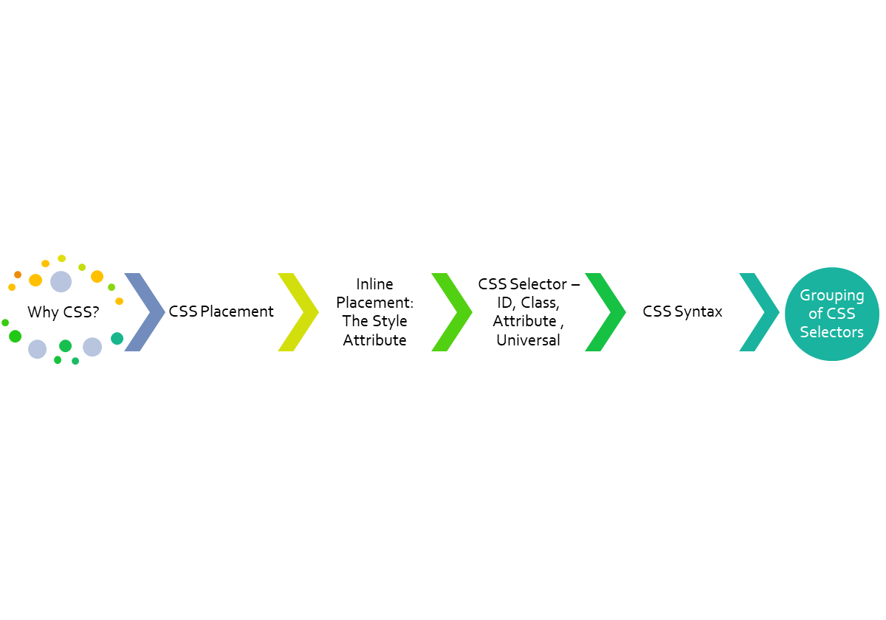
CLASS
OUTLINE

Slide 3
Introduction to CSS
CSS stands for Cascading Style Sheets
CSS is used to define styles for your web pages, including the design, layout and variations in display for different devices and screen sizes.
Created to solve the problem of HTML formatting on large websites (remember HTML formatting tags? They are limited with large websites)
CSS saves a lot of work. It can control the layout of multiple web pages all at once
Changing the default browser defaults requires the use of what are referred to as rules *
Notes:
Rule in the sense that they over rule the default behavior??

Slide 4

Why CSS?
We simply don’t want to accept the browser’s default for displaying/rendering the HTML tags
Compare default way of displaying a <p>…</p> and <a href=‘#’>Link </a>
The rule cursor: pointer and other rules can turn <p> to an <a>

Slide 5
CSS Placement
In HTML modules, you learnt different tags for placing web page contents, in CSS module, you will be learning different rules:
Where do you specify these rules?
  Inline
  Internal
  External

Slide 6
CSS Placement:
Inline Style Sheet
Here, the rules are given within the opening tag of the element by using the style attribute
An inline style may be used to apply a unique style for a single element.
An inline style loses many of the advantages of a style sheet (by mixing content with presentation).
<h1 style="color:blue; margin:30px;">
This is a heading.
</h1>
QUIZ: Create up to 3 links on your page. Using Inline CSS, write a rule that makes all the links become red color

Slide 7
CSS Placement:
Internal Style Sheet
Internal stylesheet may be used if each of the webpages have a unique style.
Using an internal stylesheet , you simply place your CSS inside a <style> element contained within the HTML head section.
<head>
<style type=‘text/css’>
/* css rules here */
</style>
</head>

Slide 8
CSS Comments
Comments are used to explain the code, and may help when you edit the source code at a later date.
Comments are ignored by browsers.
A CSS comment starts with /* and ends with */
Comments can also span across multiple lines:
<head>
<style type=‘text/css’>
/* css comment here */
</style>
</head>

Slide 9
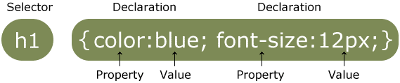
CSS Syntax
Web browsers apply CSS rules to a document to affect how they are displayed.
A CSS rule-set consists of a selector and a declaration block
The selector points to the HTML element you want to style.
The declaration block contains one or more declarations separated by semicolons.

Slide 10
CSS Syntax:
CSS Declaration
Each declaration includes a CSS property name and a value, separated by a colon.
Property could be “Let all the elements on this webpage have background color of red”
A CSS declaration always ends with a semicolon, and declaration blocks are surrounded by curly braces.

Slide 11
CSS Syntax:
CSS Selectors
The selector represents the means through which CSS tells the browser which element to apply the CSS rule(s) to:
Selectors may be: Tags, Id, Class, attribute, universal selector

Slide 12
CSS Selectors: Tag
When using the tag selector, we specify the name of the HTML tag we desire to apply the rule(s) to and ALL such tags within the page obey the rule(s)
Syntax:
tagname { rule: value; rule: value;}
Example:
h4{color: blue; font-size:24px;}

Slide 13
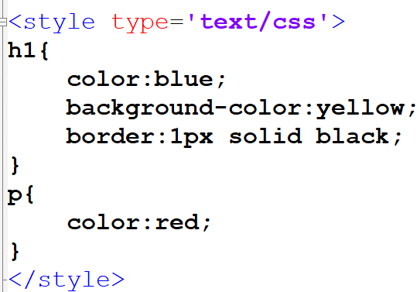
CSS Selectors: Tag
There are 4 rules in the CSS directed at 2 tags:
The first declaration starts with an h1 selector, which means that it will apply its property :values (rules) to all the <h1> elements on the page. It contains three properties and their values.(3 rules)
The first rule sets the text color to blue.
The second sets the background color to yellow.
The third one puts a border around the header that is 1 pixel wide, solid and colored black.
The second declaration starts with a p selector, which means that it will apply its property values to ALL the <p> elements on the page. It contains one rule which sets the text color to red.

Slide 14
Attribute selectors
This matches elements based on their attributes and attribute values.
Their generic syntax consists of square brackets ([]) containing an attribute name followed by an optional condition to match against the value of the attribute.
[attr] : This selector will select all elements with the attribute attr, whatever its value.
[attr=’val’] : This selector will select all elements with the attribute attr, but only if its value is val.
Syntax:
[attr]{property:value;}
Example:
[src]{width:400px}

Slide 15
EXERCISE
Given the following elements on a HTML page:
<input type='text’ size=‘40’ name=‘user’>
<input type='password’ size=‘40’ name=‘pwd’>
<input type='button' value=‘Sign Up’>
Write a CSS rule that gives all input elements of type password a red border
Assign a rule to the sign up button without affecting others
Notes:
[type=’password’]{
border:1px solid red
}

Slide 16
The Id Selector
This uses the id attribute of an HTML element to select a specific element.
The id of an element should be unique within a page, so the id selector is used to select one unique element!
To select an element with a specific id, write a hash (#) character, followed by the id of the element.
<span> This is my favorite color</span>
<span id=‘test’>I really love this one </span>
Syntax:
#idname {property:value;}
Example:
#test{color:orange}
Notes:
#test{color:blue; font-weight:bold;}

Slide 17
CSS Class Selector
The class attribute can be given to an HTML tag
A group of element can have the same class attribute value, we say they belong to the same class.
The class selector selects elements with a specific class attribute and helps you apply the same rule to a group of element at once!
To select elements with a specific class, write a period (.) character, followed by the name of the class.
Syntax:
.classname{property:value;}
Example:
.test2 {text-align: center; color: red;}

Slide 18
Universal Selector
The universal selector, represented with the asterisk character is used for selecting all elements.
It also has the capability to select elements that are inside another element.
It is useful when trying to reset any default property. Example:
*{
margin:0px; padding:0px
}
The above will remove the initial margin and padding that may be set by any browser. The developer can then specify the desired amount of padding/margin
QUIZ: using the universal selector, apply a red border to all the elements on the page

Slide 19
Exercise – 12 mins
On your page, create:
  4 p tags under the heading tag 'Profile'
  1 image tag (img)
  2 Lists
  3 span ...
  1 iframe with pdf content
Style as follows:
The image and the iframe are to have the same width and height
The first list and the p tags should be color blue and should have black border.
The heading tag and all the span should have yellow background

Slide 20
GROUPINGS AND MORE
Specific element
Element within another
Grouping of Tags

Slide 21
Specific class Element
Helps you specify specific HTML elements that should be affected by a class.
In the example below, only <p> elements with class="center" will be center-aligned:
p.center {
text-align: center;
color: red;
}
Note that there is no space between the p tag and the class (.center)

Slide 22
The DOM and “Cascading” Idea
The Document Object Model (DOM) – a representation of the document in the computer memory.
When a browser displays a document, it combines the document's content with its style information and displays the contents of the DOM
A DOM has a tree-like structure. Each element, attribute and piece of text in the markup language becomes a DOM node in the tree structure.
The nodes are defined by their relationship to other DOM nodes. Some elements are parents of child nodes, and child nodes have siblings.

Slide 23
The DOM and “Cascading” Idea
<head>
  <title></title>
  <meta>
  <meta>
</head>
<body>
  <h1>Welcome</h1>
  <p><a href=‘#’>This is an example of:</a></p>
  <ul>
      <li>Cascading</li>
      <li>is my Style</li>
      <li>Sheets</li>
  </ul>
</body>
The next slide shows the above DOM structure,
Notes:
A tree-like structure containing each of the tags and their contents

Slide 24
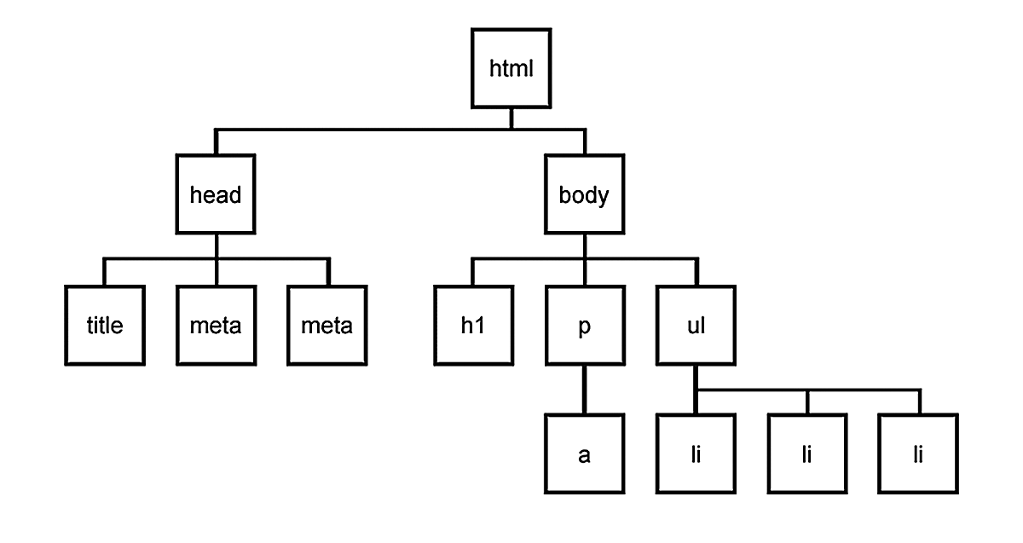
The DOM and “Cascading” Idea
The implication of the DOM is that certain styles can be applied to the child(ren) via the parent. A color set on <ul> will affect all the <li>.
*Setting color for <a> tag has to be done on the <a> tag itself.

Slide 25
The DOM and “Cascading” Idea
<head>
  <title></title>
  <meta>
</head>
<body>
  <ul>
      <li>Cascading</li>
      <li>is my <span>Style</span></li>
      <li>Sheets</li>
  </ul>
</body>
QUIZ: how will you represent the above in a DOM?,Can you style the span using the DOM structure?
SOLUTION: See the notes
Notes:
ul li span{color:red}
A tree-like structure containing each of the tags and their contents
Note the space

Slide 26
Specific class Element : Targeting an element through the parent
Hint- you are giving a total description of the tag, naturally you want to pause as you describe… see the pause as space
The <a> tag, inside <li> inside <ul> tag. Stating this will ensure that only the specific <a> tag mentioned will be affected by the rule
ul li a{
text-align: center;
color: red;
}

Slide 27
Grouping Selectors
You can minimize your codes by grouping elements that have similar definitions
Consider:
h1, h2 and p tags that are center-aligned, text color of red and font size of 12px, rather than specifying the same rules for each of the elements, you can group them.
To group selectors, separate each selector with a comma.
h1,h2,p{
text-align:center;
color:red;
font-size:12px;
}
Notes:
Formular: you are saying “h1 and h2 and p should obey these rules”

Slide 28
Exercise
Change the color of all <p> and <h1> elements, to "red". Group the selectors to minimize code.
Try out different styles with the anchor tag

Slide 29
Specificity: The trick
When two or more selectors target the same element and conflict with each other, the CSS cascade uses a system of specificity to determine which selector takes priority.
In general, the more specific a selector is, the higher its weight in the cascade. The selector that has the largest sample space (possibility of appearing many more time) will be the weakest while the selector with the least sample space is the strongest.
See notes :
Notes:
For example:
There can be many elements of the same tags on the page and fewer members of a class, but there can only be 1 element with a particular id on the page.
Supposing an announcement was made in a school on the type of uniform that should be worn to the school, targeting the announcement to different tag selector can be likened to:
- universal: all students should wear red *{ border:2px solid red;}
- tag : all male students should wear blue h1{ border:2px solid blue;}
- class : all 200L students should wear yellow .myclass{border:2px solid yellow;}
- attribute: all students using eyeglasses should wear orange [src]{border:2px solid orange;}
In the above class and attribute each represents a form of grouping and they have the same weight, so the rule that comes last will be obeyed.
- id: the student with registration number 'abcd' should wear black #abcd{border:2px solid black'}
However, the inline style attribute has the most weight that takes priority over any of the above.

Slide 30
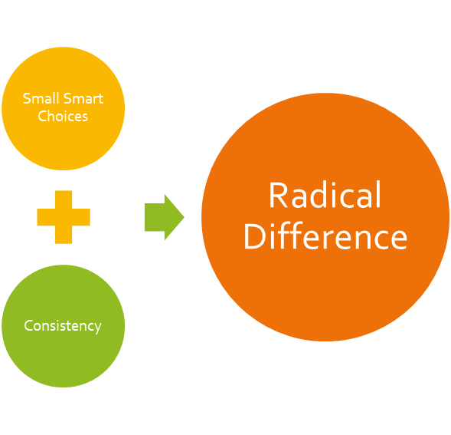
KEEP CODING!
Imagine and create…

