Slide 1
Crime by city
a statistical comparison of crime data and population information to argue for or against their correlations

Slide 2
When a man is denied the right to live the life he believes in, he has no choice but to become an outlaw.
- Nelson Mandela

Slide 3
information used for comparison
Violent Crime
Graduation Rates
Poverty Rates
Income

Slide 4
Locations used for comparison
Chicago
Los Angeles
New York
Tampa
Washington, DC
United States used for comparison data

Slide 5
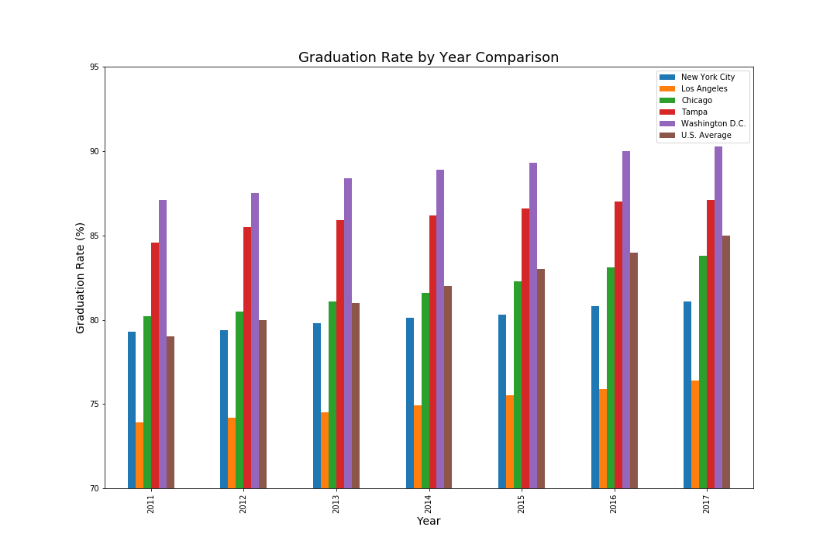
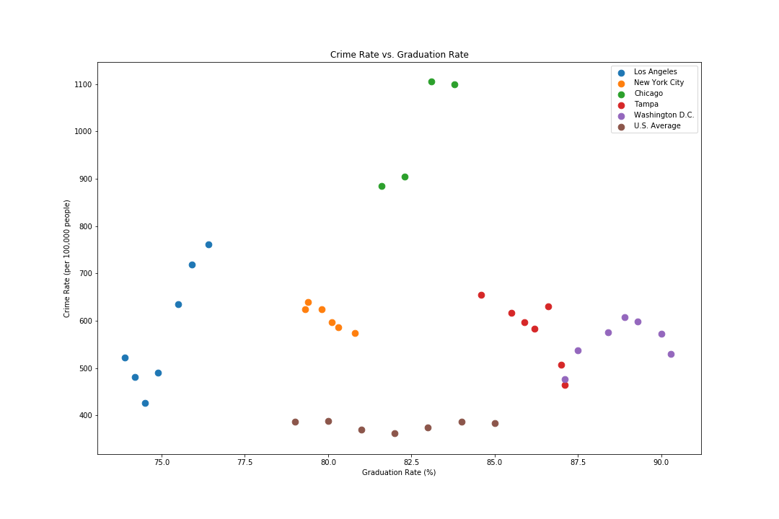
Violent crime vs. graduation rates
Bar Graph
Scatter Plot

Slide 6
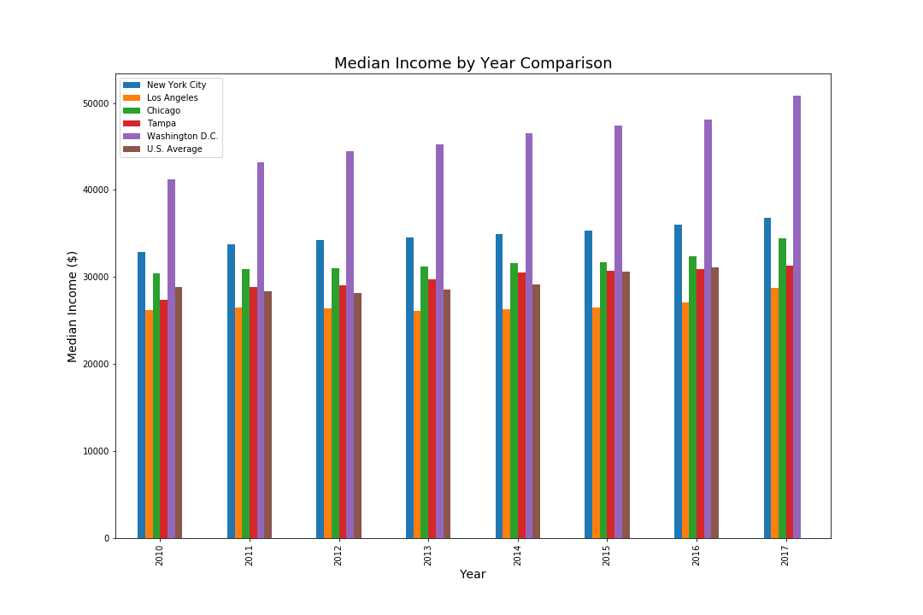
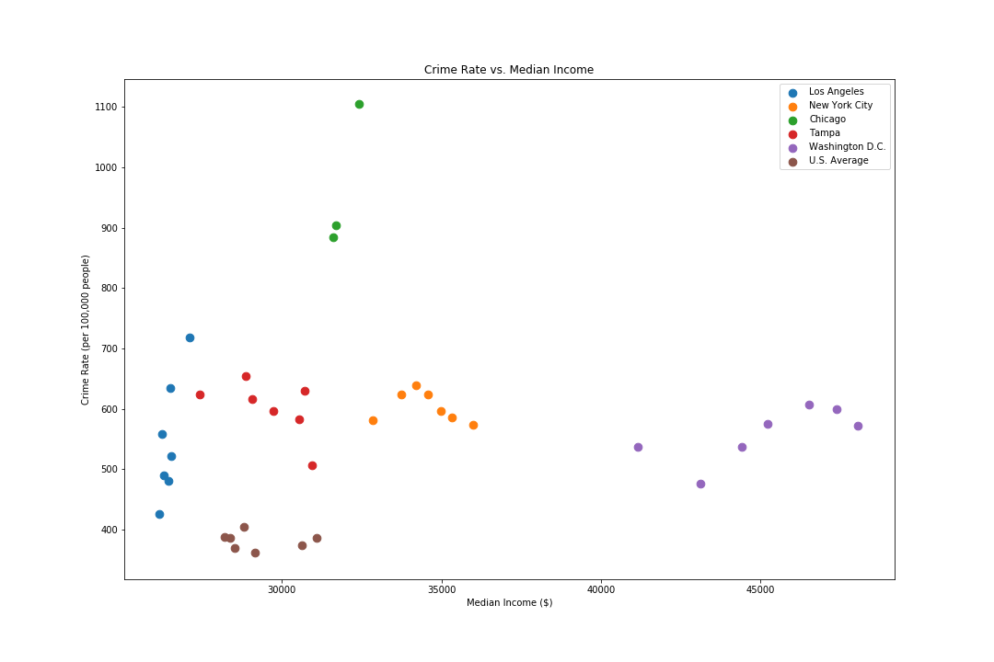
Violent crime vs. income
Bar Graph
Scatter Plot

Slide 7
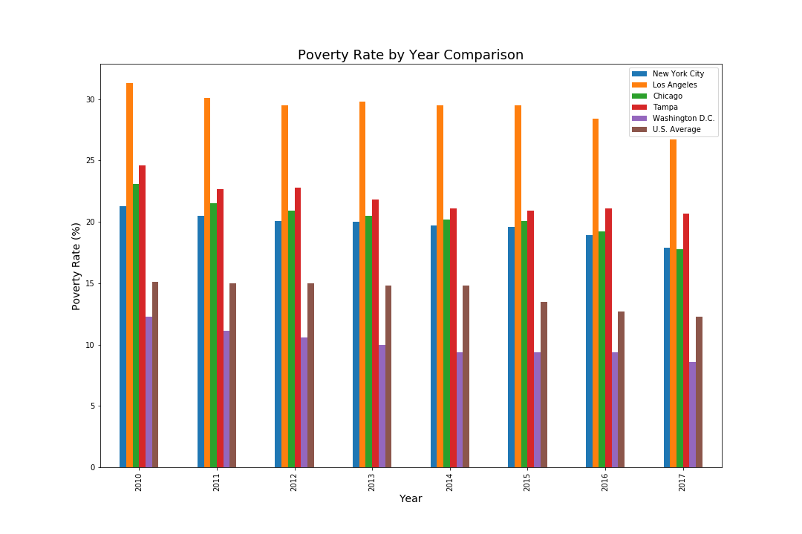
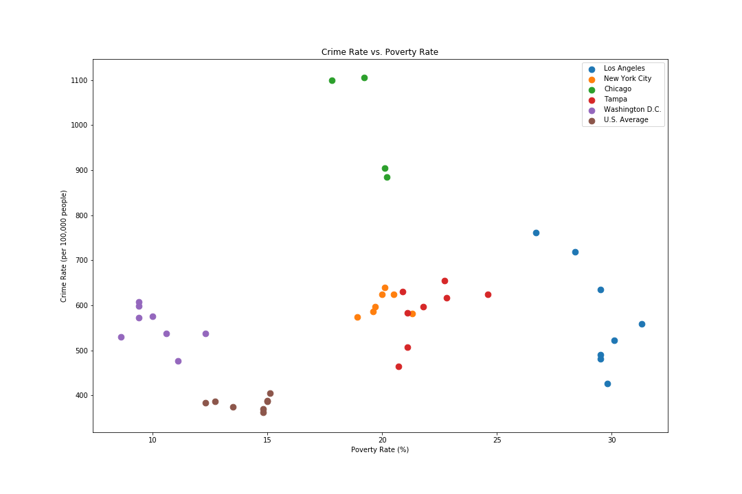
Violent crime vs. poverty rate
Bar Graph
Scatter Plot

Slide 8
Graduation rates vs. income
Bar Graph
Scatter Plot

