Slide 1
Crime by city
a statistical comparison of crime data and population information to argue for or against their correlations

Slide 2
When a man is denied the right to live the life he believes in, he has no choice but to become an outlaw.
- Nelson Mandela

Slide 3
information used for comparison
Violent Crime
Graduation Rates
Poverty Rates
Income

Slide 4
Locations used for comparison
Chicago
Los Angeles
New York
Tampa
Washington, DC
United States used for comparison data

Slide 5
Our Hypothesis and Null Hypothesis
Our hypothesis: Rates of violent crime can be correlated with income, poverty rates and/or graduation rates in our cities. If a city’s violent crime rate is high, this will also mean the income is lower, poverty rates higher and graduation rates lower than the national average.
Our null hypothesis is as follows: Violent crime is not statistically related to an increase or decrease in factors like graduation rates, income, or poverty rate.

Slide 6
discoverables
1. It is often assumed that violent crime is associated with a lack of education, causing perpetrators to venture outside of normal social and legal constructs and inflict harm on others. Is there a direct correlation between violent crime rate and high school graduation rate over the span of so many years?
2. There has also been a school of thought that perhaps offenders commit violent crimes because jobs and access to income are limited or altogether out of reach. Does higher income yield lower violent crime?
3. Now surely we all have heard that the higher the poverty rate, the higher the crime rate. How accurate is the hearsay? Is high poverty in a city associated with high violent crime rate? If the poverty level decreases, can we prove that violent crime rate does as well?
4. Well, clearly, crime stands on its own and perpetrators are not swayed by any of the aforementioned factors. Can we find consolation in a correlation between graduation rates and household median income despite the consistency of violent crime in the observed areas?

Slide 7
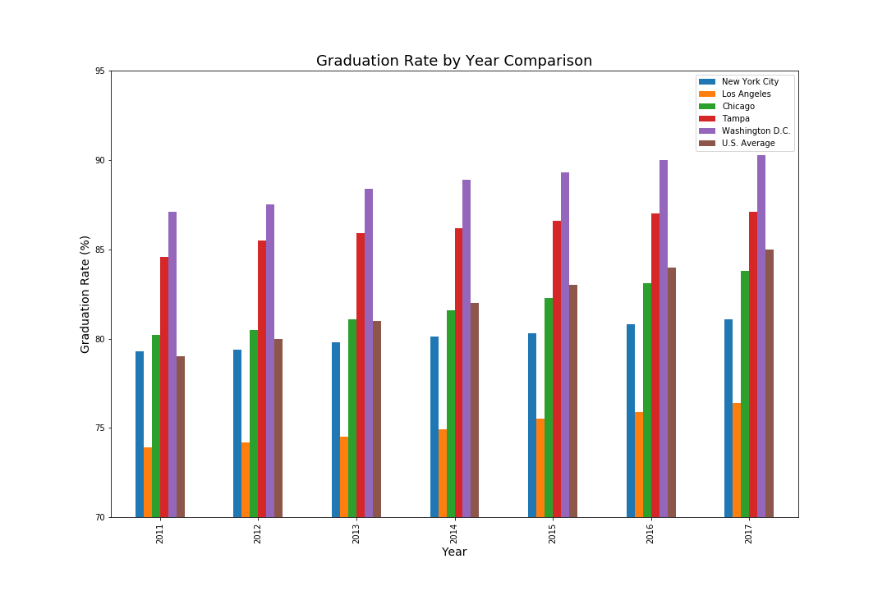
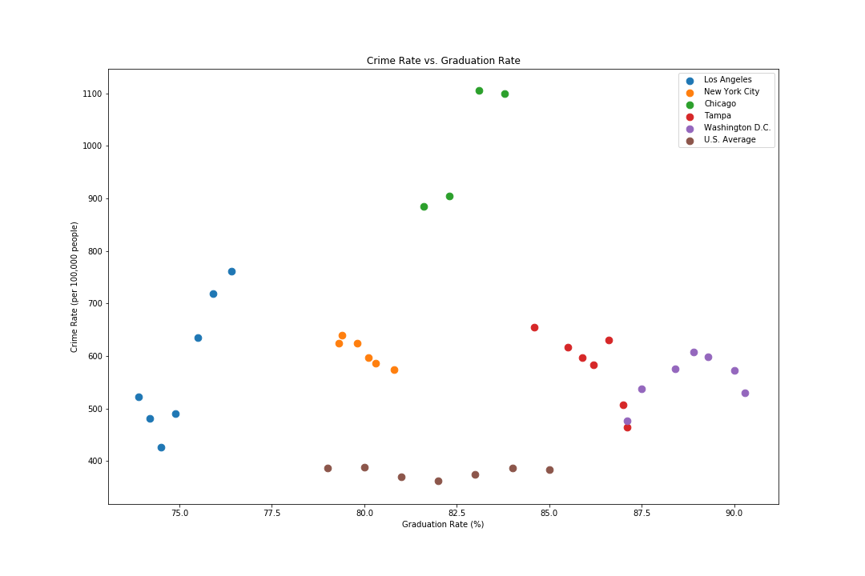
Violent crime vs. graduation rates
Bar Graph
Scatter Plot

Slide 8
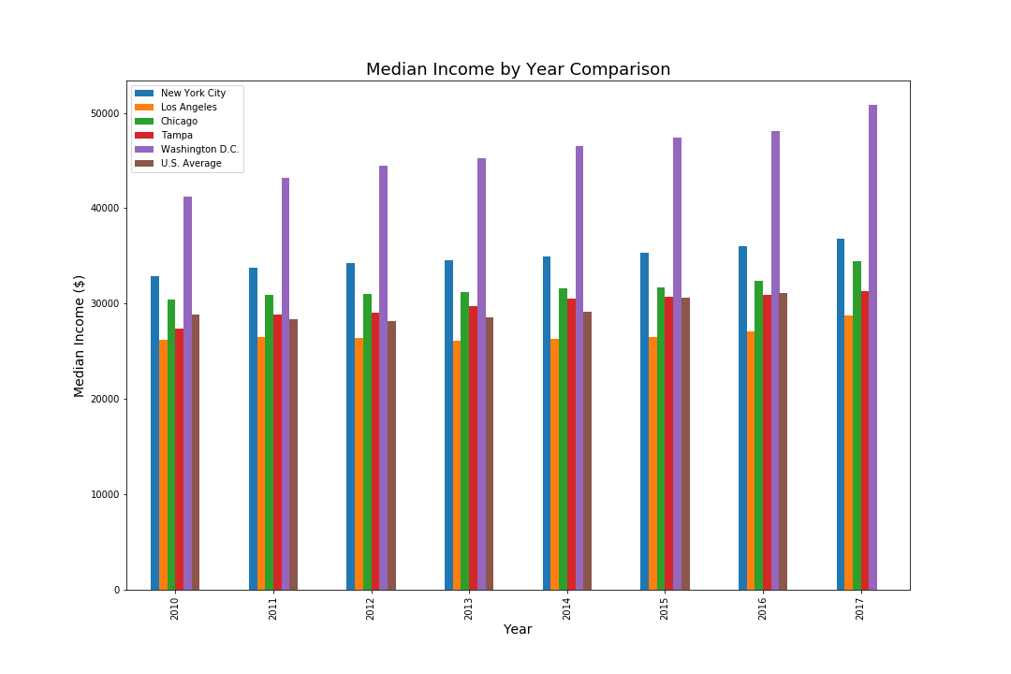
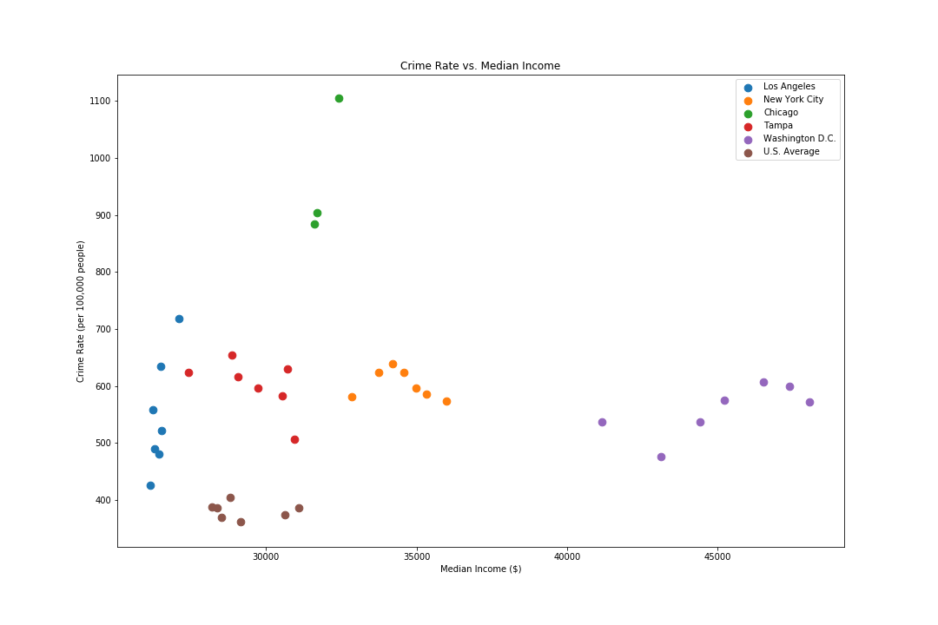
Violent crime vs. income
Bar Graph
Scatter Plot

Slide 9
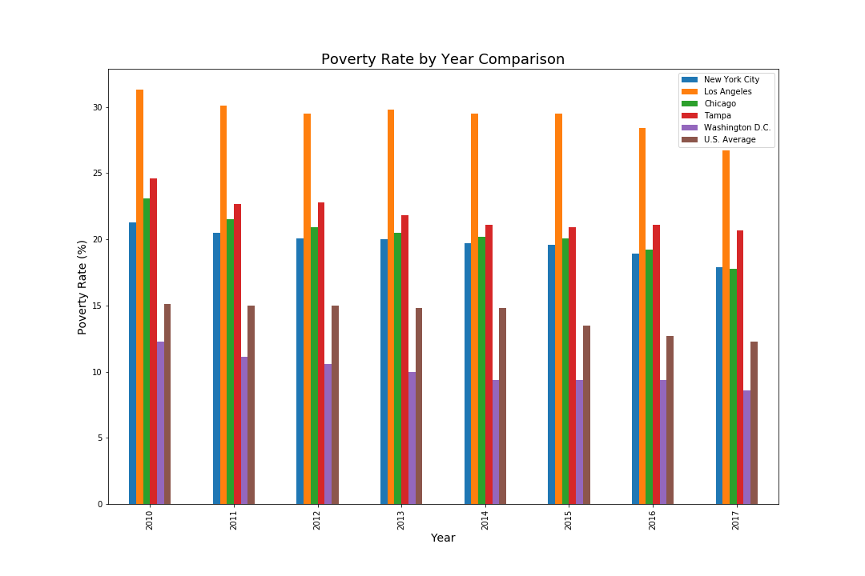
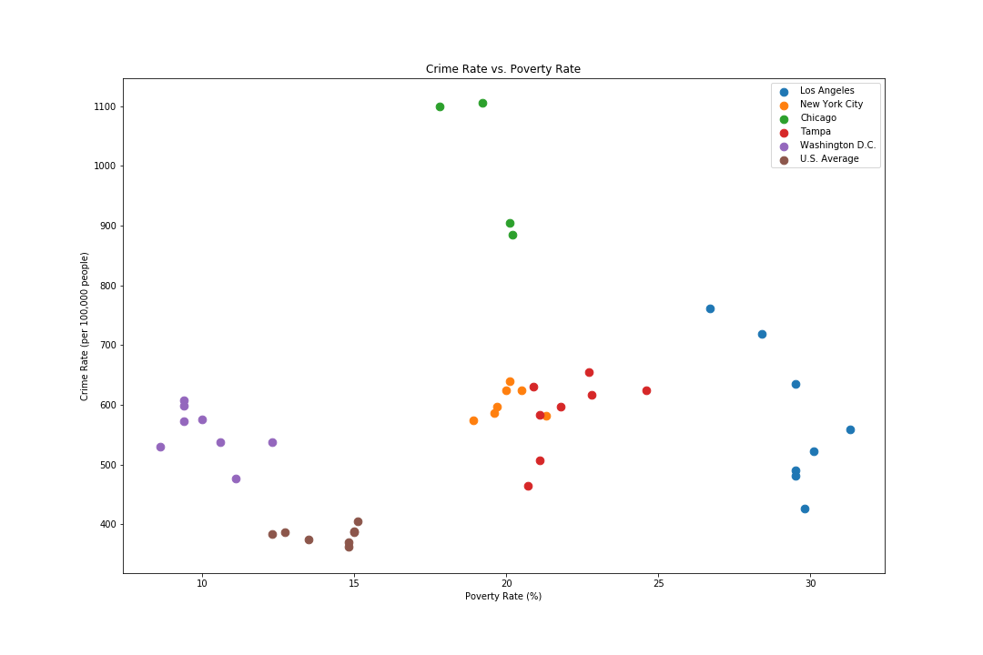
Violent crime vs. poverty rate
Bar Graph
Scatter Plot

Slide 10
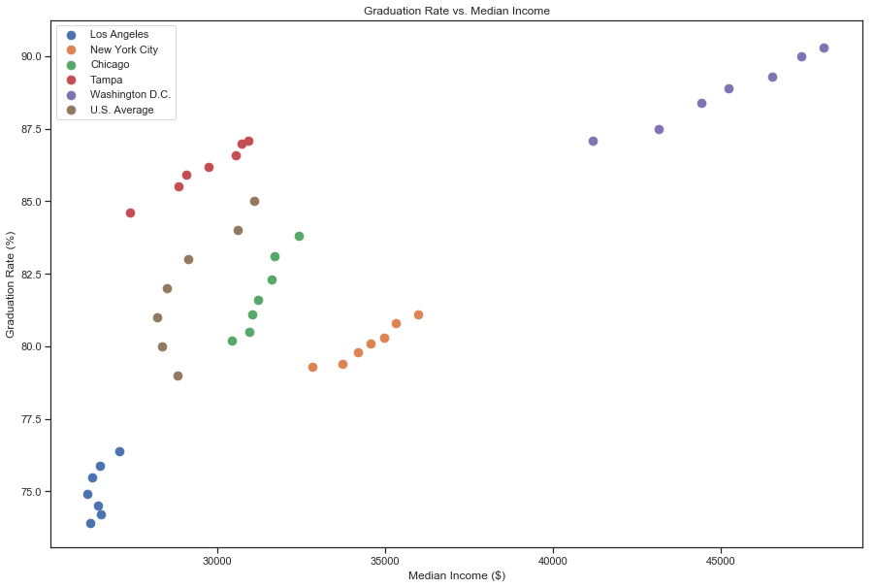
Graduation rates vs. income
Scatter Plot

Slide 11
Results by comparison
Though high school graduation rates proved to have increased across the board, violent crime rate remained inconsistent and without pattern.
Though the level of poverty decreased rather significantly within the Five Cities, violent crime rate remained inconsistent and without pattern.
Though the working class earned greater income, the violent crime rate remained inconsistent and without pattern.
It is crystal clear that as the city’s high school graduation rate increased, so did the city’s median income.

Slide 12
Our conclusion
According to the data, there is no generalized relationship between violent crime rate and the societal factors examined.
The city variable has the strongest relationship of the other independent variables, according to the ANCOVA. Crime rate largely depends on the city and can not be compared from one city to the next.
Unfortunately, graduation rate, median income, and poverty rate do not play large factors in the violent crime rate.

