Slide 1
Crime by city
a statistical comparison of crime data and population information to argue for or against their correlations

Slide 2
When a man is denied the right to live the life he believes in, he has no choice but to become an outlaw.
- Nelson Mandela

Slide 3
information used for comparison
Violent Crime
Graduation Rates
Poverty Rates
Income

Slide 4
Locations used for comparison
Chicago
Los Angeles
New York
Tampa
Washington, DC
United States used for comparison data

Slide 5
Our Hypothesis and Null Hypothesis
If a city’s violent crime rate increases, there will be an inevitable drastic and economically devastating crash in population growth, graduation rate, and median income and a heart-wrenching increase in the city’s overall poverty level, widening the chasm that keeps us all from experiencing the utopian world peace that is so desperately desired.
However, if the violent crime rates plummet, then surely there is hope for us all! We will compare all results for each factor against violent crime rates with the national averages.
Our null hypothesis is as follows: Violent crime is not statistically related to an increase or decrease in factors like graduation rates, income, or poverty rate.

Slide 6
discoverables
1. It is often assumed that violent crime is associated with a lack of education, causing perpetrators to venture outside of normal social and legal constructs and inflict harm on others. Is there a direct correlation between violent crime rate and high school graduation rate over the span of so many years?
2. There has also been a school of thought that perhaps offenders commit violent crimes because jobs and access to income are limited or altogether out of reach. Does higher income yield lower violent crime?
3. Now surely we all have heard that the higher the poverty rate, the higher the crime rate. How accurate is the hearsay? Is high poverty in a city associated with high violent crime rate? If the poverty level decreases, can we prove that violent crime rate does as well?
4. Well, clearly, crime stands on its own and perpetrators are not swayed by any of the aforementioned factors. Can we find consolation in a correlation between graduation rates and household median income despite the consistency of violent crime in the observed areas?

Slide 7
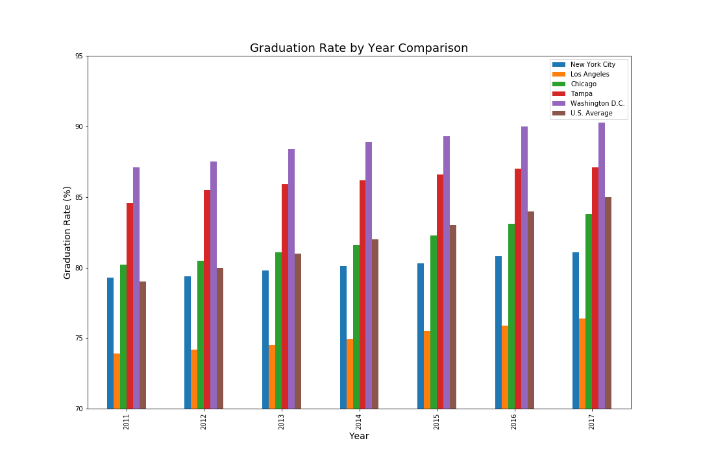
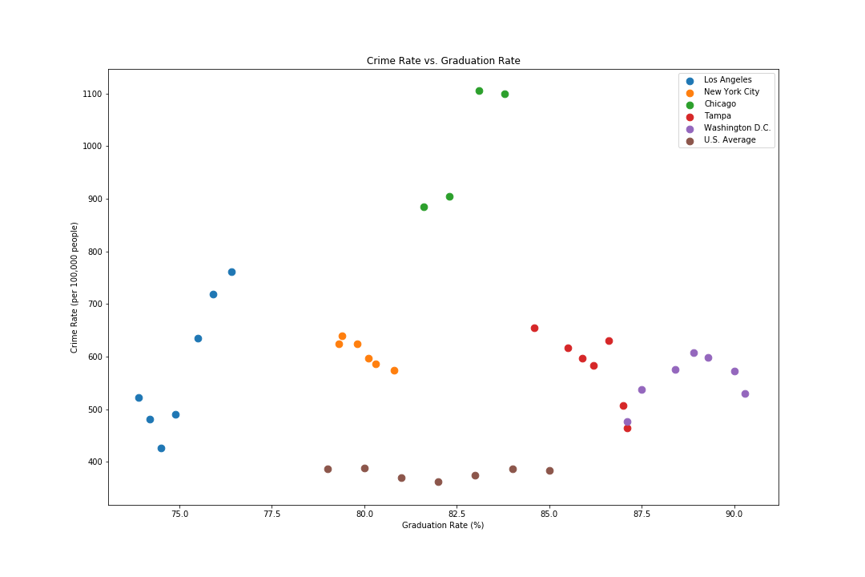
Violent crime vs. graduation rates
Bar Graph
Scatter Plot

Slide 8
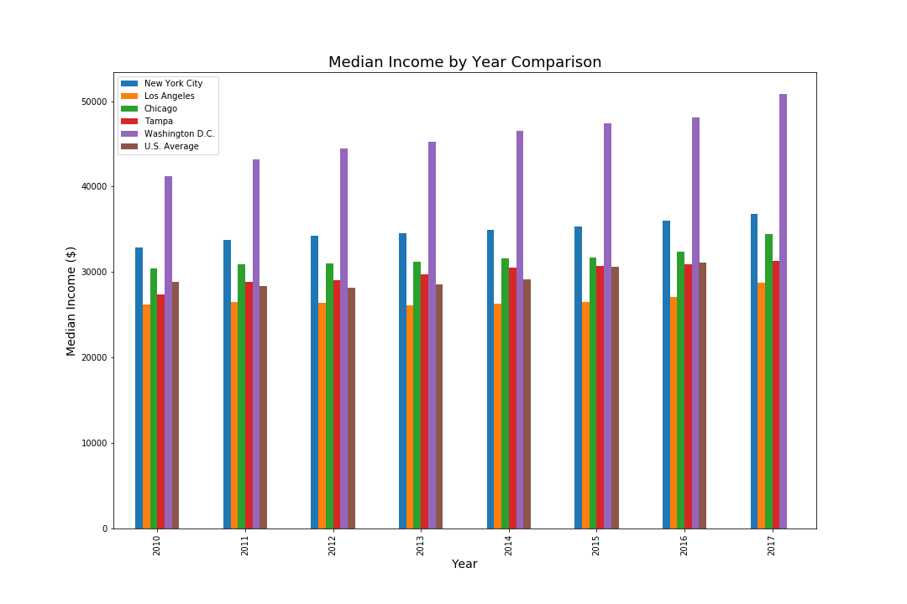
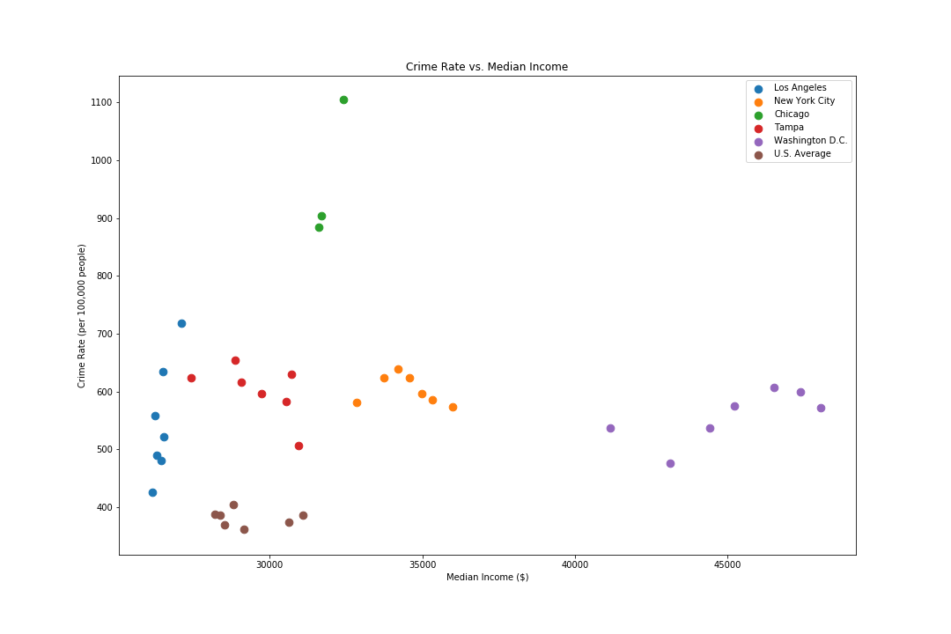
Violent crime vs. income
Bar Graph
Scatter Plot

Slide 9
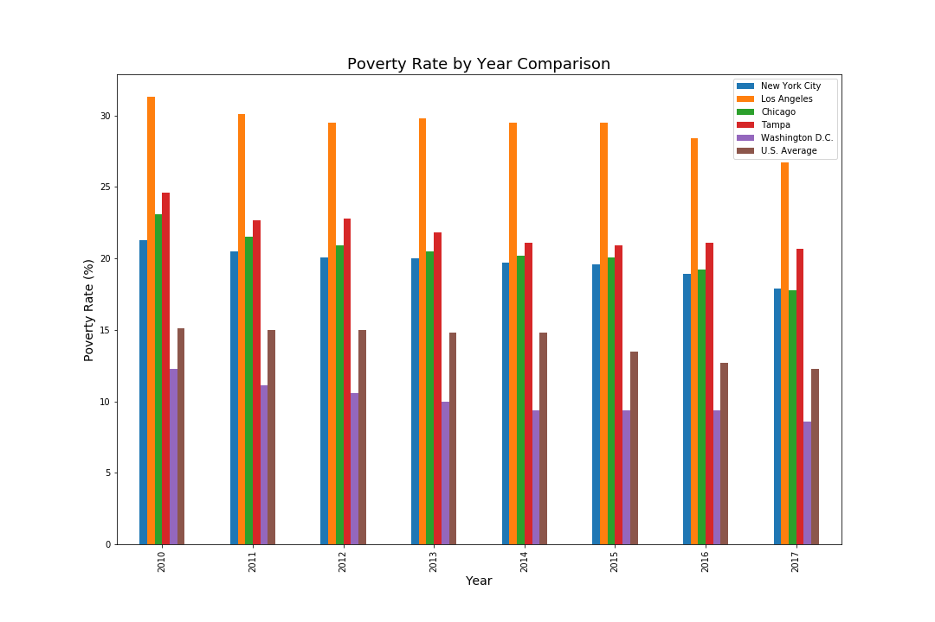
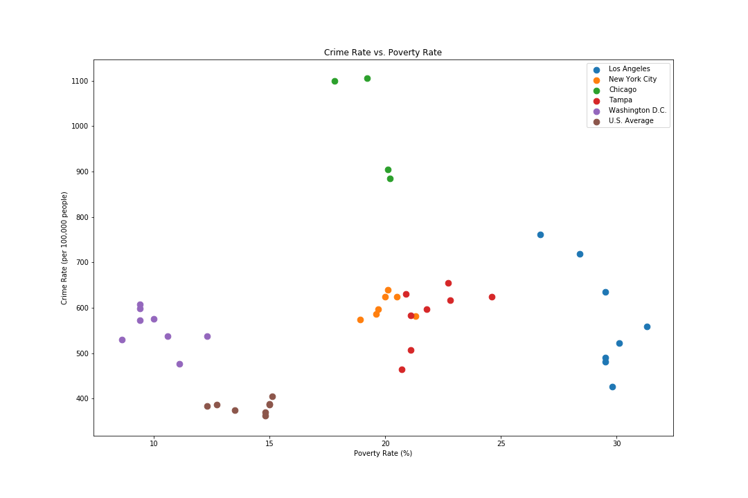
Violent crime vs. poverty rate
Bar Graph
Scatter Plot

Slide 10
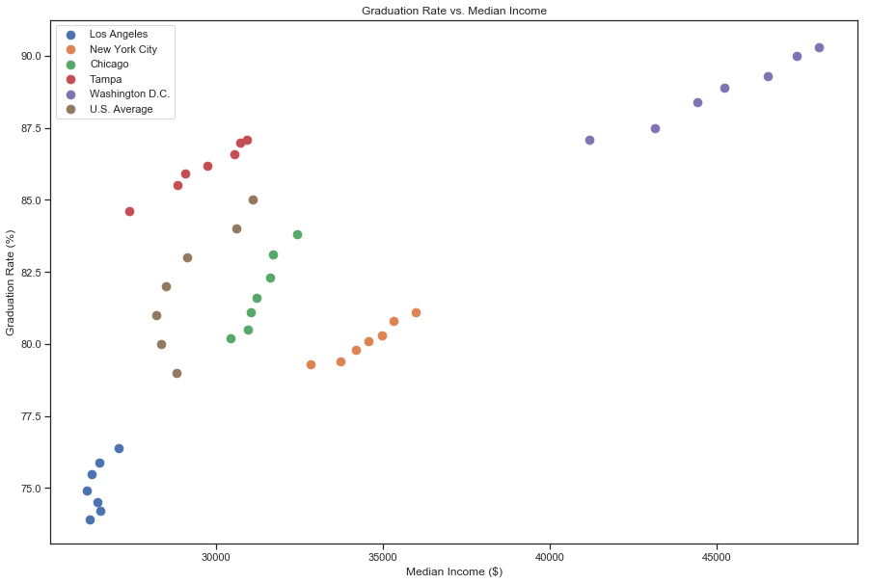
Graduation rates vs. income
Scatter Plot

Slide 11
Results by comparison

