Slide 1
Social factors as a predictor of crime improvement
Mike Anderson, mark Athanason, Kelly brown, heather bell, Thomas stokes

Slide 2
When a man is denied the right to live the life he believes in, he has no choice but to become an outlaw.
- Nelson Mandela

Slide 3
Objective
Assess if the longitudinal average trends in social indicators, including:
Graduation Rates
Poverty
Income
Correlate in the expected manner with the incidence of violent crime.
Data acquired from:
www.opendatanetwork.com

Slide 4
ANCOVA Analysis
Average rate
Education
Income
Poverty
Violent crime
Year

Slide 5
Questions based on assumption
1. It is often assumed that violent crime is associated with a lack of education, causing perpetrators to venture outside of normal social and legal constructs and inflict harm on others. Is there a direct longitudinal correlation between violent crime rate and high school graduation rate?
2. There has also been a school of thought that perhaps offenders commit violent crimes because jobs and access to income are limited or altogether out of reach. Does higher income yield lower violent crime?
3. Now surely, we all have heard that the higher the poverty rate, the higher the crime rate. How accurate is the hearsay? Is high poverty in a city associated with high violent crime rate? If the poverty level decreases, can we show that violent crime rate does as well?
4. Can we find other expected correlations, such as graduation rates and household median income despite the consistency of violent crime in the observed areas?

Slide 6
Our hypothesis: Rates of violent crime will correlate negatively with income, poverty rates and/or graduation rates per city. If a city’s violent crime rate is high, this will correlate with decreased average income and graduation rates while the average amount individuals beneath the poverty line rates will be increased.

Slide 7
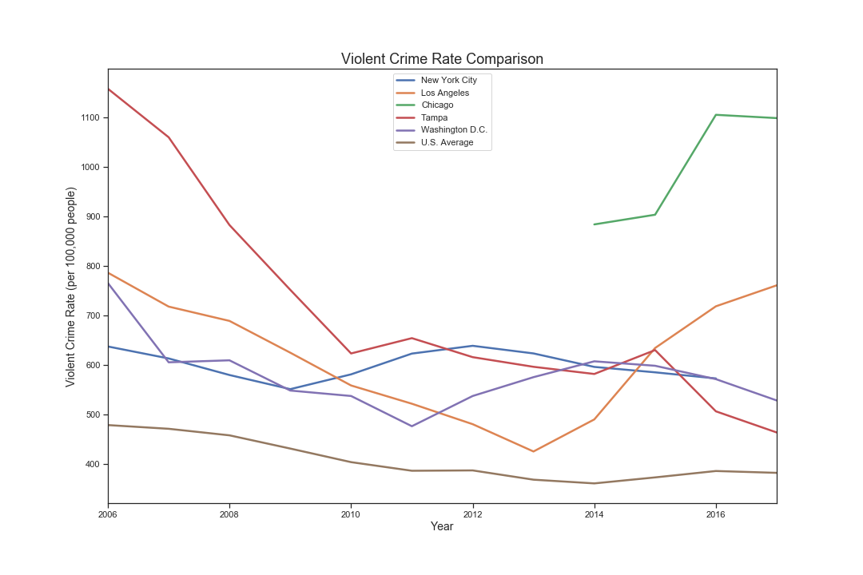
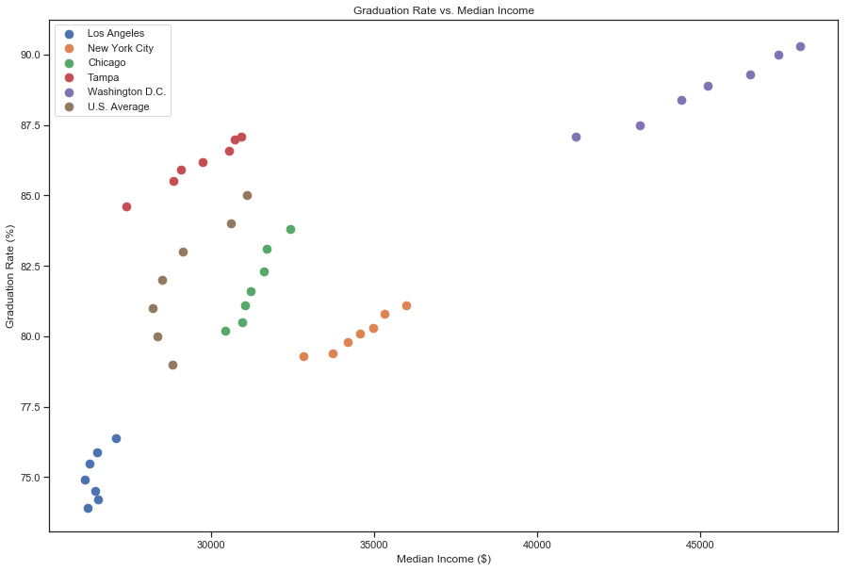
Average violent crime 2010 - 2017

Slide 8
Locations used for comparison
Chicago
Los Angeles
New York
Tampa
Washington, DC
National averages for overall comparision

Slide 9
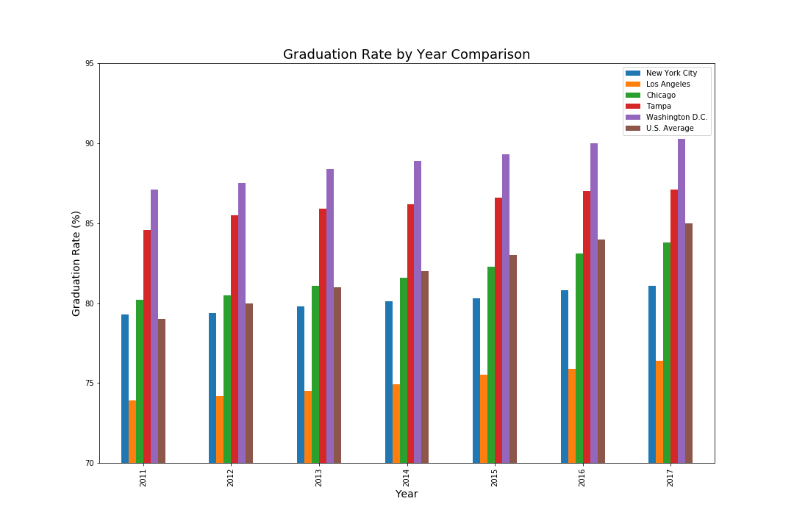
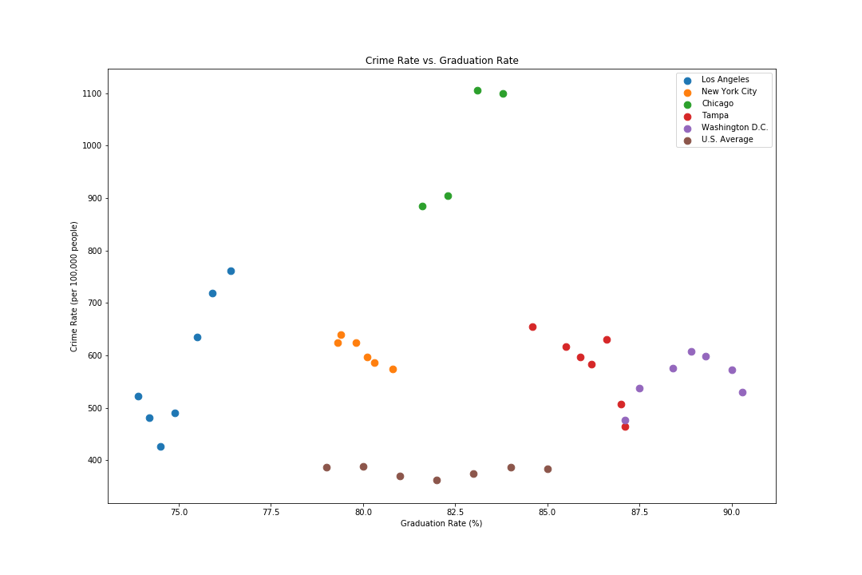
Violent crime vs. graduation rates
ANCOVA | F | P-value
Graduation Rate | 0.019 | 0.891804

Slide 10
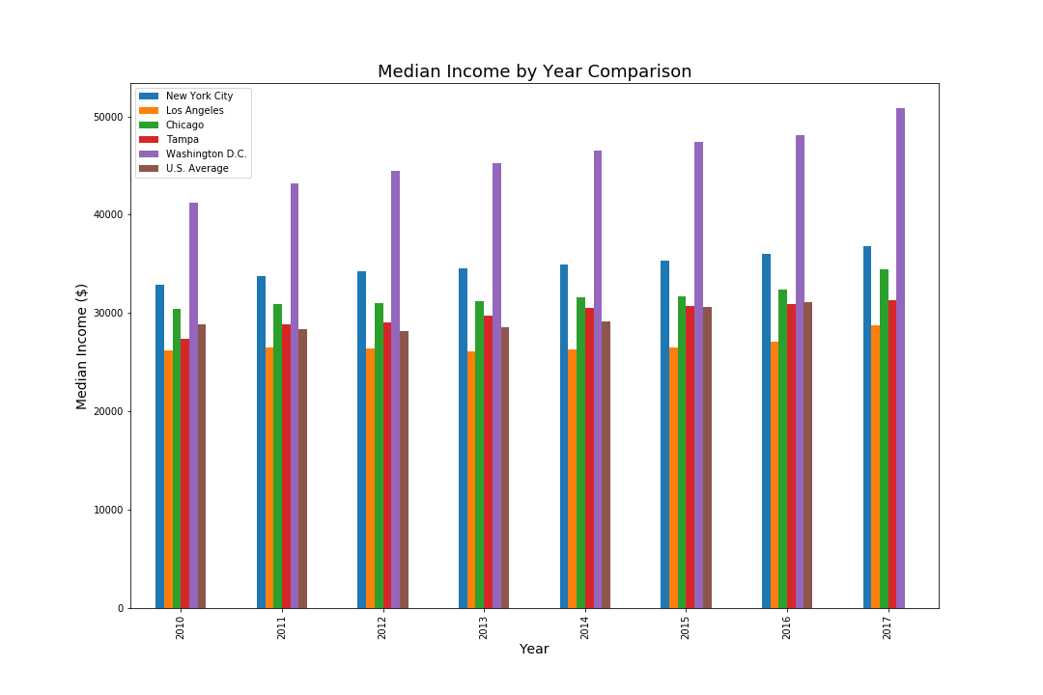
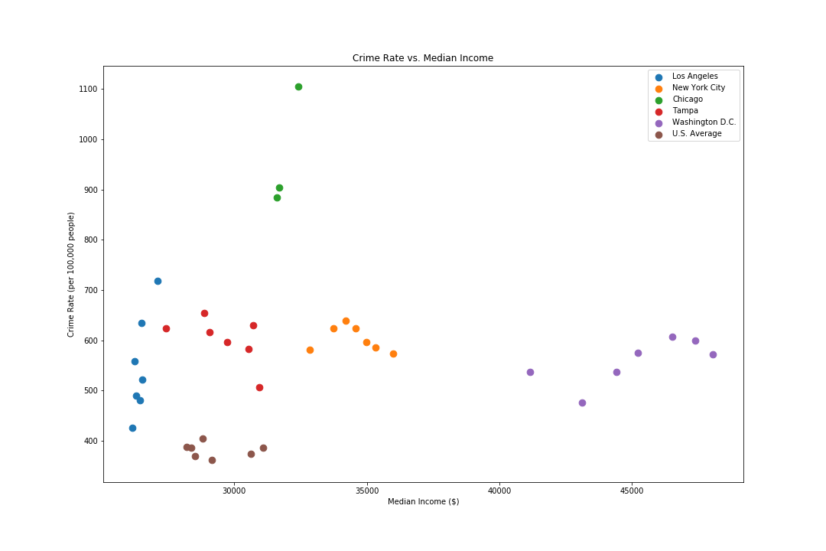
Violent crime vs. income
ANCOVA | F | P-value
Median income | 4.166 | 0.053428

Slide 11
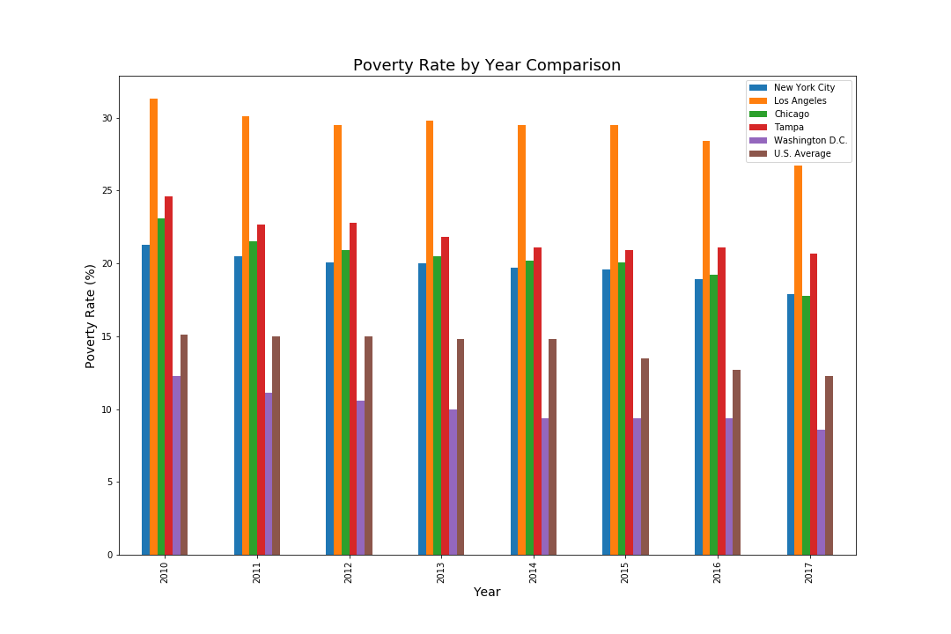
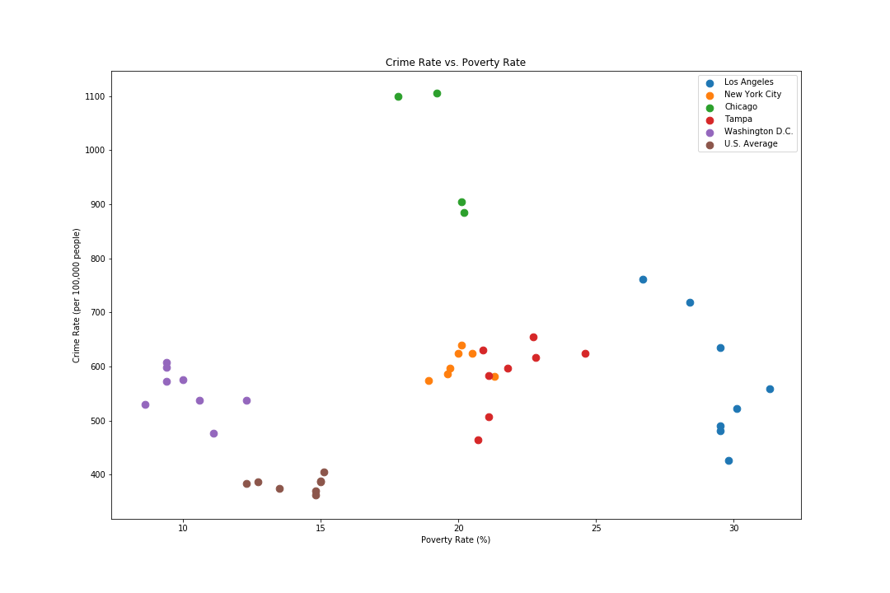
Violent crime vs. poverty rate
ANCOVA | F | P-value
Poverty rate | 2.098 | 0.161599

Slide 12
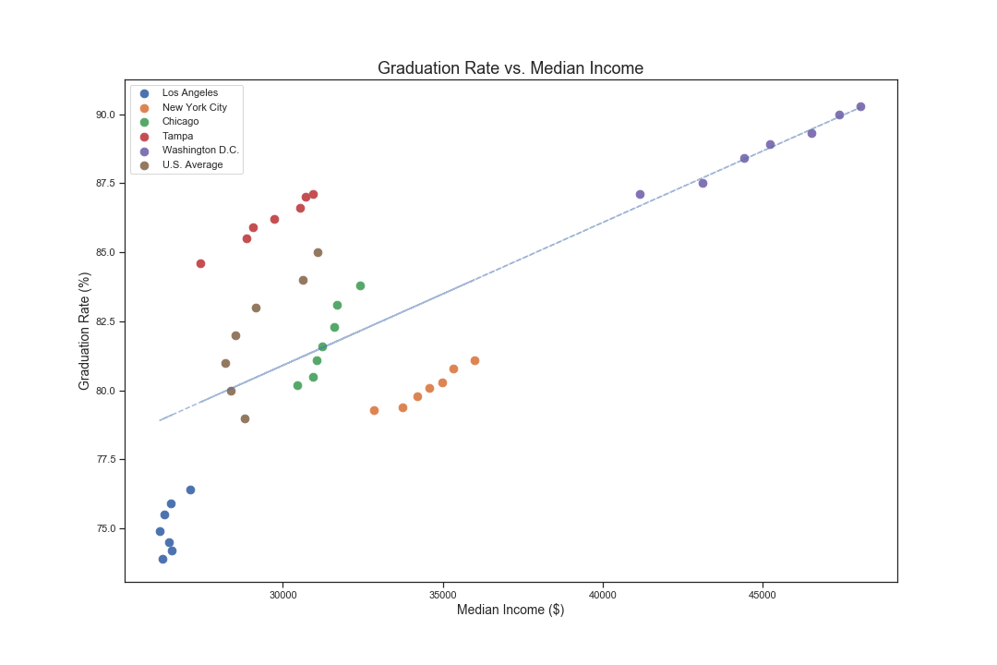
Graduation rates vs. income
Person’s correlation | R-value | P-value
Graduation rate vs. Median income | 0.705 | 1.8178 x 10⁻⁷

Slide 13
Results by comparison
Though high school graduation rates proved to have increased across the board, violent crime rate remained inconsistent and without pattern.
Though the level of poverty decreased rather significantly within the five Cities, violent crime rate remained inconsistent and without pattern.
Though the working class earned greater income, the violent crime rate remained inconsistent and without pattern.
The city’s high school graduation rate increased, so did the city’s median income.

Slide 14
Our conclusion
According to the data, there is no generalized relationship between violent crime rate and the societal factors examined.
The city variable has the strongest relationship of the other independent variables, according to the ANCOVA (F = 7.994, P = 0.00039). Crime rate largely depends on the city and can not be compared from one city to the next.
Unfortunately, graduation rate, median income, and poverty rate do not play large factors in the violent crime rate.

Slide 15
Improved study

Slide 16
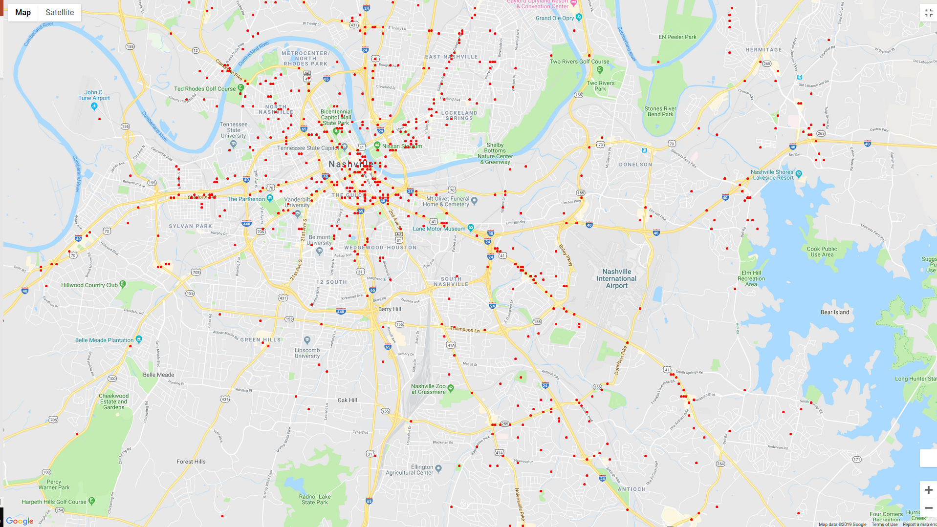
Calls made to the police (2019 data)
*1000 entries

Slide 17
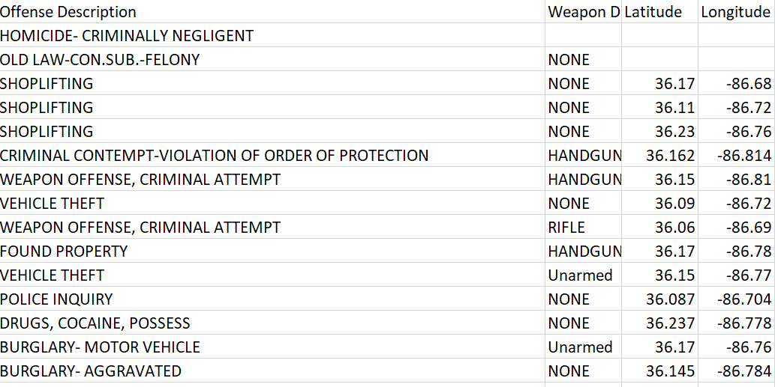
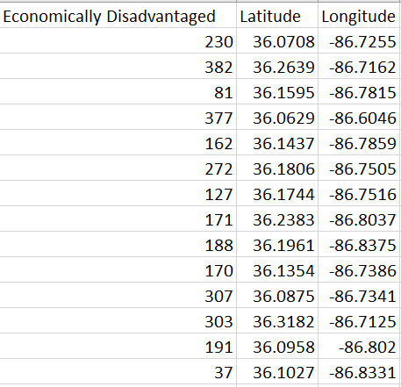
Closer look and interpretation of data…
Nashville crime data
Nashville school data

Slide 18
Calls made to the police (2019 data)
“Worse” schools
“Worse” schools
“Better” schools
“Worse” schools
“Better” schools

