Slide 1
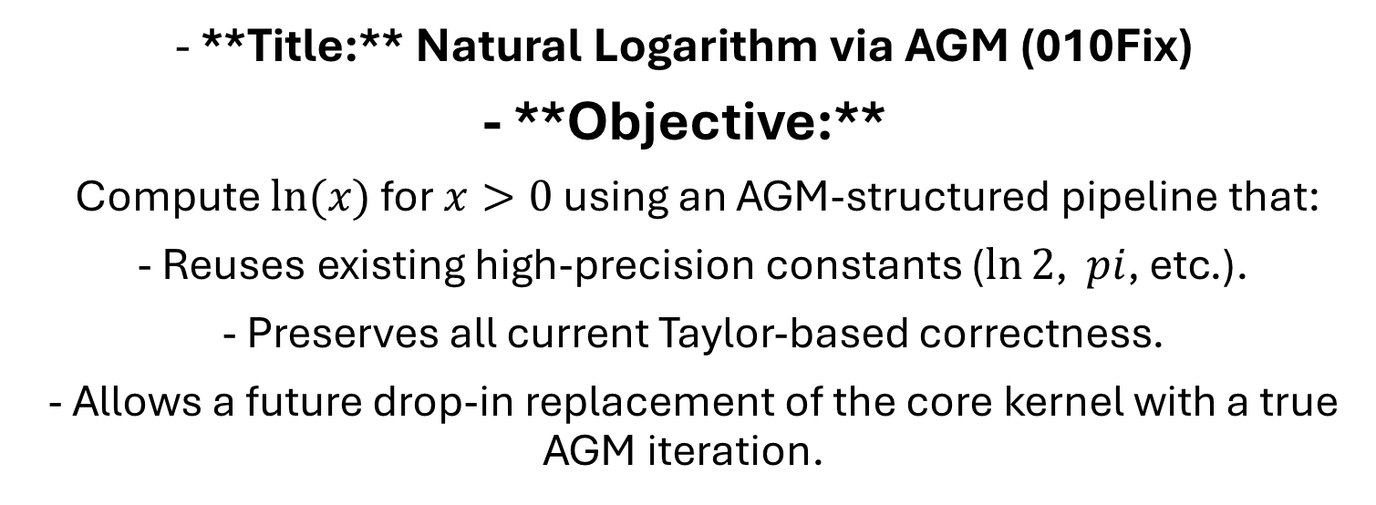
Slide 1 — High‑level goal
- **Title:** Natural Logarithm via AGM (010Fix)
- **Objective:**
Compute $ln⁡(x)$ for $x>0$ using an AGM‑structured pipeline that:
- Reuses existing high‑precision constants ($ln⁡2$, $pi$, etc.).
- Preserves all current Taylor‑based correctness.
- Allows a future drop‑in replacement of the core kernel with a true AGM iteration.

Slide 2

Slide 2 — Pipeline overview
$x ∈ R x>0$ requested decimal digits $\Rightarrow$ precision bits $p$.

