Slide 1
Python - Big Data Analysis
by team El Numero Uno

Slide 2
What is python?
Multi-purpose (Web, GUI, Scripting, etc.)
Object Oriented
Interpreted
Strongly typed and Dynamically typed
Focus on readability and productivity

Slide 3
Why python?
Designed to be easy to learn and master
Clean, clear syntax
Very few keywords
Highly portable
Runs almost anywhere
Uses machine independent byte-codes
Extensible
Designed to be extensible using C/C++, allowing access to many external libraries

Slide 4
More of the Features
Everything is an object
Interactive Shell
Strongly typed and Dynamically typed
Variables do not need declaration
But not a type-less language
Uses white-space to delimit blocks

Slide 5
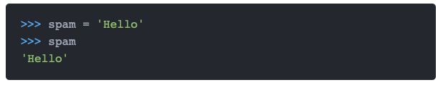

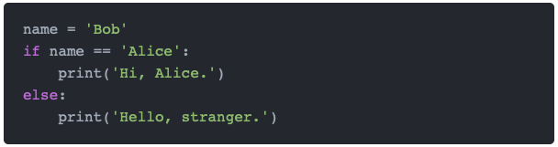
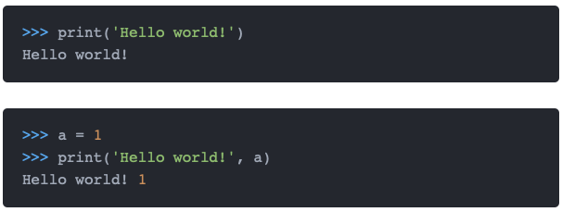
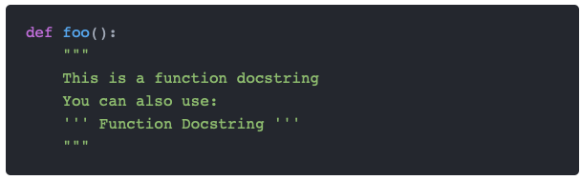
Syntax is simple
More on pythoncheatsheet.org

Slide 6
Python and Big Data

Slide 7
5 Reasons why you Should Choose
Python for Big Data
It’s a bag of powerful scientific packages
Python big data combination is backed by its robust library packages which fulfill analytical and data science needs and makes it a popular choice in big data applications.
Some of its popular libraries which make Python and big data useful together are:
Pandas
Pandas is a library which helps in data analysis. Besides that, it provides the required data structure and operations for data manipulation on time series and numerical tables.
NumPy
NumPy is the fundamental package of Python which makes possible scientific computing. It provides the support for linear algebra, random number crunching, Fourier transforms. Also, it supports multi-dimensional arrays, matrices with its extensive library of high-level mathematical functions.

Slide 8
Compatible with Hadoop
As Python big data is compatible, similarly Hadoop and big data are synonymous with each other. Hence, Python has been made inherently compatible with Hadoop to work with big data. Python consists of Pydoop package which helps in accessing HDFS API and also writing Hadoop MapReduce programming. Besides that Pydoop enables MapReduce programming to solve complex big data problems with minimal effort.
Easy to Learn
Python is easy to learn as it abstracts many things with its features. As a result, user needs to code fewer lines of code. Besides that it has scripting feature as well. Python is coupled with user-friendly features like code readability, simple syntax, auto identification and association of data types and easy implementation.
Scalability
Scalability matters a lot when you are dealing with massive data. Unlike other data science languages like R, MatLab or Stata, Python is much faster. Though there was initial complain about its speed, however, with Anaconda its speed performance has enhanced a lot. This makes Python and big data compatible with each other with a greater scale of flexibility.
Large Community Support
Big data analysis often deals with complex problems which need community support for solutions. Python as a language has a large and active community which helps data scientist and programmer with expert support on coding related issues.This is another reason for its popularity.

Slide 9
Pandas
That's what are we going to use

Slide 10
Loading and Saving Data with Pandas
When you want to use Pandas for data analysis, you’ll usually use it in one of three different ways:
Convert a Python’s list, dictionary or Numpy array to a Pandas data frame
use pd.DataFrame() method
Open a local file using Pandas, usually a CSV file, but could also be a delimited text file (like TSV), Excel, etc
use pd.read_[filetypename](), example pd.read_csv()

Slide 11
Viewing and Inspecting Data
Basic Methods
df.head(n) - get the first n rows
df.tail(n) - get the last n rows
df.shape() - get the number of rows and columns
df.info() - get the index, datatype and memory information
df.describe() - get summary statistics for numerical columns

Slide 12
Get statistics on the entire data frame or a series (a column etc):
df.mean() - Returns the mean of all columns
df.corr() - Returns the correlation between columns in a data frame
df.count() - Returns the number of non-null values in each data frame column
df.max() - Returns the highest value in each column
df.min() - Returns the lowest value in each column
df.median() - Returns the median of each column
df.std() - Returns the standard deviation of each column

Slide 13
Selection of Data
One of the things that is so much easier in Pandas is selecting the data you want in comparison to selecting a value from a list or a dictionary.
You can select a column (df[col]) and return column with label col as Series or a few columns (df[[col1, col2]]) and returns columns as a new DataFrame.
You can select by position (s.iloc[0]), or by index (s.loc['index_one']) .
In order to select the first row you can use df.iloc[0,:] and in order to select the first element of the first column you would run df.iloc[0,0]

Slide 14
Filter, Sort and Groupby
You can use different conditions to filter columns.
For example, df[df[year] > 1984] would give you only the column year is greater than 1984.
You can use & (and) or | (or) to add different conditions to your filtering. This is also called boolean filtering.
It is possible to sort values in a certain column
in an ascending order using df.sort_values(col1)
in a descending order using df.sort_values(col2,ascending=False)
Furthermore, it’s possible to sort values by col1 in ascending order then col2 in descending order by using df.sort_values([col1,col2],ascending=[True,False])

Slide 15
Setup

Slide 16
Go to https://www.python.org/downloads/ and download the latest version of Python
Go to https://pip.pypa.io/en/stable/installing/ and install Pip
Run the following commands to install required libraries
pip install pandas
pip install matplotlib
pip install plotly
pip install numpy
Create a new directory for the next project
Run the following command in terminal in that directory
svn checkout https://github.com/MikeBahs/ResearchProject/trunk/data

